Slide 2



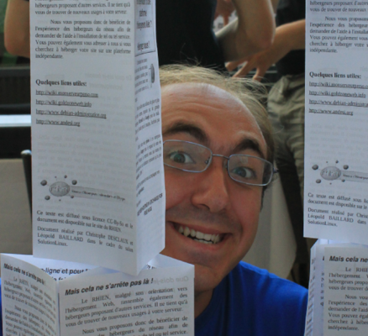

ZONE-extractor
Feeds
reading
Feeds
Annotated news
BDD
RDF
ZONE-watcher
topics
SPARQL
RSS Feed
XML
http://openclipart.org/detail/12273/gears-by-felipecaparelli-12273
http://drawingbynumbers.org/data-design-basics/note-3-opening-open-data
http://openclipart.org/detail/23513/cartoon-tyrannosaurus-rex-by-studiofibonacci
Notes:
Expliciter enormément que les 2
parties fonctionnent une apres l'autre
Asynchrone
On annote

Slide 3






ZONE-extractor
Annotation
Annotators
Annotations
News
Annotated
news
Feeds
reading
RDF
database
Feeds
Annotated news
ZONE-watcher
SPARQL
request
Needs
procesing
RDF
filters
SPARQL Request
generation
User
needs
Transformation
Vers RDF
RSS Feed
Notes:
Expliciter enormément que les 2
parties fonctionnent une apres l'autre
Asynchrone
On annote

