Slide 1
ChadaTech Agile Presentation
Daniel Escobedo

Slide 2
Introduction
ChadaTech is a company that specializes in custom software design and development.
The company has been using the waterfall development methodology.
Recently, ChadaTech has considered shifting to an agile methodology, such as Scrum.
This presentation will compare and contrast the waterfall and agile development approaches.
It will also discuss the factors that ChadaTech should consider when choosing a development methodology.

Slide 3
Waterfall Development Methodology
Waterfall is a sequential development methodology.
The project is divided into a series of phases, and each phase must be completed before the next phase can begin.
This approach is often used for large, complex projects.
However, it can be inflexible and slow to adapt to changes.

Slide 4
Agile Development Methodology
Agile is an iterative development methodology.
The project is broken down into smaller, more manageable increments.
Each increment is developed and tested in a short sprint.
This approach is often used for more complex projects.
It is also more flexible and adaptable to change.

Slide 5
“…the agile movement in software is part of a larger movement towards more humane and dynamic workplaces in the 21st century.”
“
”
Rowan Bunning

Slide 6
Scrum Framework
Scrum is an agile framework that is often used for software development.
It is based on the following principles:
Iterative development: The project is broken down into smaller, more manageable increments.
Continuous improvement: The team continuously reviews and improves its processes.
Self-organizing teams: The team is responsible for its own planning and execution.
Transparency: The team shares information with stakeholders throughout the development process.
Inspection: The team regularly inspects its work to identify and correct problems.
Adaptation: The team adapts its processes as needed to meet the needs of the project.

Slide 7
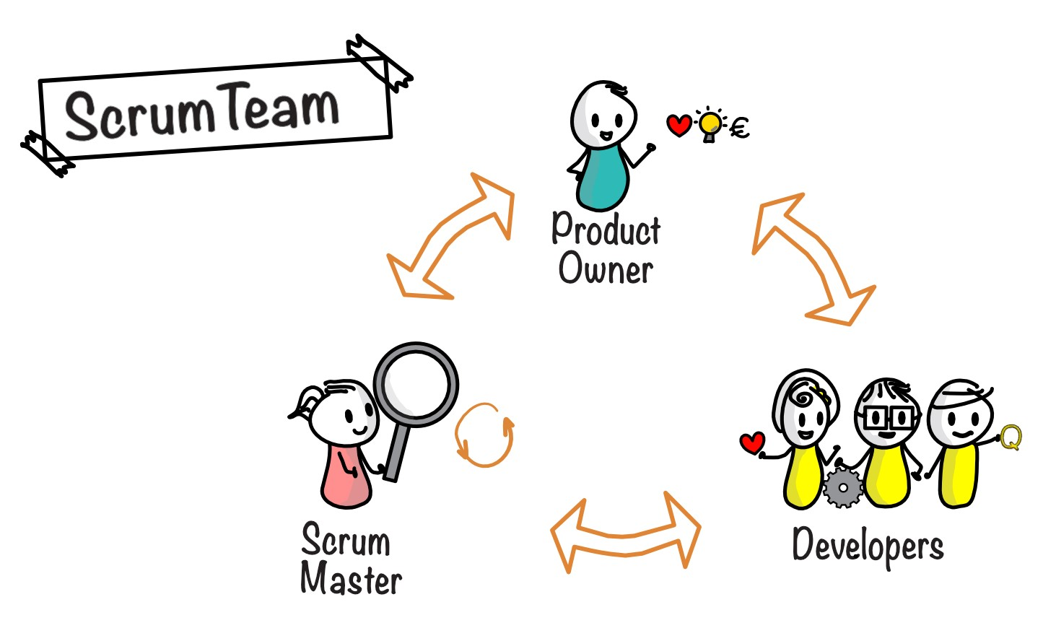



Roles in a Scrum Team
Product Owner
The product owner is responsible for the product vision and ensuring that the team delivers the right product.
Scrum Master
The scrum master is responsible for facilitating the scrum process and removing obstacles to the team's progress.
Development Team
The development team is responsible for developing the product increments.

Slide 8
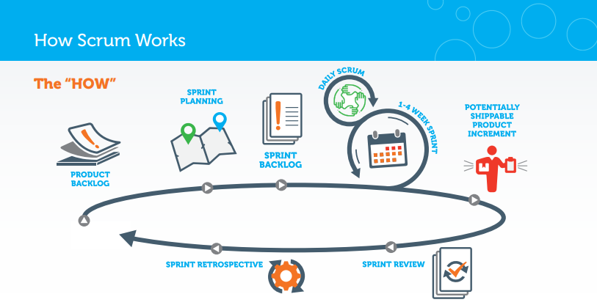

Slide 9
SDLC Phases in an Agile Approach
Planning: The team plans the next sprint and identifies the work that needs to be done.
Sprint: The team works on the sprint backlog and delivers the product increment at the end of the sprint.
Review: The team reviews the product increment with stakeholders and gets feedback.
Retrospective: The team reflects on the sprint and identifies areas for improvement.

Slide 10
Waterfall vs. Agile
Waterfall | Agile
Sequential development | Iterative development
Large, complex projects | Both Smaller and Larger, more complex projects
Inflexible | Flexible
Slow to adapt to change | Quick to adapt to change

Slide 11
Factors to Consider When Choosing a Development Methodology
The size and complexity of the project
The budget and timeline
The team's experience and skills
The needs of the stakeholders
The company's culture

Slide 12
Conclusion
Both waterfall and agile have their own strengths and weaknesses.
ChadaTech should carefully consider the factors listed on the previous slide when choosing a development methodology.
Agile may be a good choice for ChadaTech, as it is flexible and adaptable to change.

Slide 13
Thank you
Daniel Escobedo
ChadaTech
CS-250

Slide 14
References
Actors, A. (2020, June 30). 10 quotes related to the agile methodology to get you inspired. Medium. https://medium.com/agileactors/10-quotes-related-to-the-agile-methodology-to-get-you-inspired-d4999f3b348a
Putting agile and Scrum to work - scrum alliance. (n.d.). https://www.scrumalliance.org/ScrumRedesignDEVSite/media/ScrumAllianceMedia/WhitePaper_English_2019.pdf
Billie Keita. (2022, October 19). Mastering scrum? here’s everything you need to know. Invensis Learning Blog. https://www.invensislearning.com/blog/agile-scrum-methodology/

