Slide 1



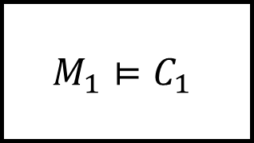

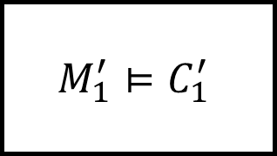

$$x$$
$$M_{1}⊨C_{1}$$
$$y,z$$
$$w_{1},w_{2}$$
$$x$$
$$M_{1}^{′}⊨C_{1}^{′}$$
$$y$$

Slide 2

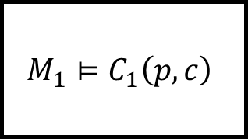

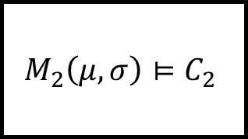
$$w\sim Gaussian \left({0,2}^{2}\right)$$
$$M_{1}⊨C_{1}\left(p,c\right)$$
$$u$$
$$w\sim Gaussian \left({μ,σ}^{2}\right)$$
$$M_{2}\left(μ,σ\right)⊨C_{2}$$

Slide 3

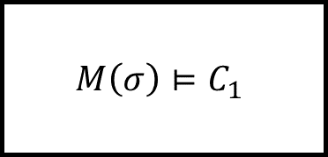
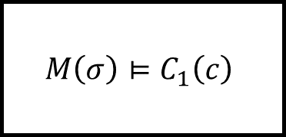
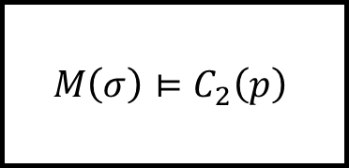
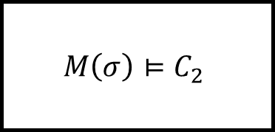


$$w\sim Gaussian \left({0,σ}^{2}\right)$$
$$u$$
$$M\left(σ\right)⊨C_{1}$$
$$M\left(σ\right)⊨C_{2}\left(p\right)$$
$$w\sim Gaussian \left({0,σ}^{2}\right)$$
$$M\left(σ\right)⊨C_{1}\left(c\right)$$
$$M\left(σ\right)⊨C_{2}$$

Slide 4





















$$a_{e} [m/s^{2}]$$
$$a_{l} [m/s^{2}]$$
$$v_{r}$$
$$K_{P}$$
$$v_{e} [m/s]$$
$$v_{r} [m/s]$$
$$v_{l} [m/s]$$
$$+$$
$$+$$
$$+$$
$$a_{e}$$
$$d [m]$$
$$\hat{d}=d+n_{d}$$
$$K_{I}$$
$$−$$
$$d_{target}$$
$$x_{e} [m]$$
$$x_{l} [m]$$
$$v_{e}$$
$$τ$$
$$d_{safe}$$
Ego Vehicle
Leading Vehicle
$$+$$
$$+$$

Slide 5



















$$w\sim Gaussian\left(0,Q\right)$$
$$w\sim Gaussian\left(0,Q\right)$$
Plant
$$x_{k+1}=Ax_{k}+Bu_{k}+w_{k}$$
Plant
$$x_{k+1}=Ax_{k}+Bu_{k}+w_{k}$$
$$u$$
$$x$$
$$u$$
$$x$$
Controller
$$u_{k}=Dz_{k}+E$$
Sensor
$$z_{k}=Cx_{k}+v_{k}$$
Controller
$$u_{k}=Dz_{k}+E$$
Sensor
$$z_{k}=Cx_{k}$$
$$z$$
$$z$$
$$v\sim Gaussian\left(0,R\right)$$
Plant
$$x_{k+1}=Ax_{k}+Bu_{k}$$
$$u$$
$$x$$
Controller
$$u_{k}=Dz_{k}+E$$
Sensor
$$z_{k}=Cx_{k}+v_{k}$$
$$z$$
$$v\sim Gaussian\left(0,R\right)$$

Slide 6







$$w\sim Gaussian\left(0,Q\right)$$
Plant
$$x_{k+1}=Ax_{k}+Bu_{k}+w_{k}$$
Plant
$$x_{k+1}=Ax_{k}+Bu_{k}$$
$$u$$
$$x$$
$$u$$
$$x$$
Controller
$$u_{k}=g^{′}\left(x_{k}\right)$$
Controller
$$u_{k}=g\left(x_{k}\right)$$

Slide 7










Multi-Sensor Perception System
Sensor $1$, $M_{1}$
Data Fusion,
$$M_{N+2}$$
$$z_{1}$$
$$⋯$$
$$x$$
Sensor $N$, $M_{N}$
$$\hat{x}$$
$$z_{2}$$
Sensor $N+1$, $M_{N+1}\left(σ\right)$
$$z_{3}$$
Partially-specified Sensor

