Slide 1
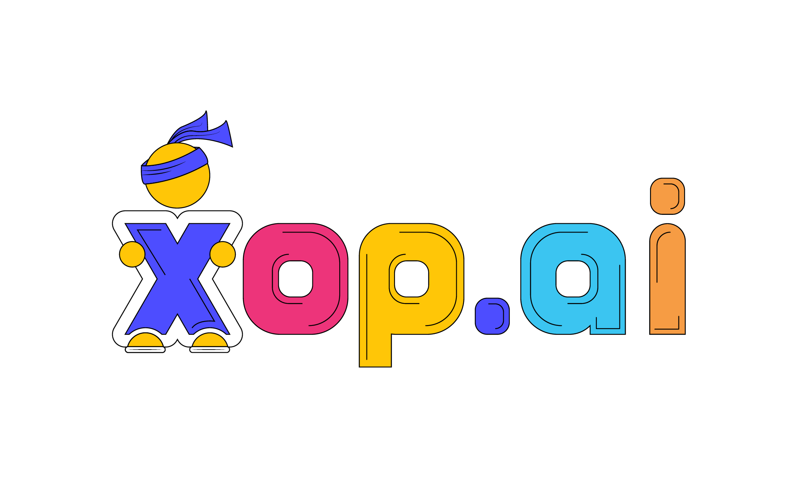
End Uses, Engineers & Management
Your Clients & Staff
Engineers / Technicians
Leadership
AI Scoring
Analytics gathered on each ticket / interaction
Escalations
Multimodal AI for Telephony
Teams Chatbot
MSP branded Teams Chatbot PSA integrated
Ticket Alerts
MSP branded Teams Chatbot PSA integrated
Triage
MSP branded Teams Chatbot PSA integrated
AI Voice
Overflow / After-Hours PSA integrated
Admin Assist
Ticket classification, time entries, replies
Enterprise Search
Historical tickets, client doc,, SharePoint
Engineer Health
Productivity, Coaching, Skills Eval & Check-In’s
Client Health
CBR / QBR / contract renewal prep
Hands Free Mode
Captures phone & chat updates ticket.
Client Environment
Tech stack, frequently requested items
Group Scheduler
AI infused scheduling assistant
< Revenue Leakage
Identifies tickets & requests that lack client entitlement
Enterprise Search
Train chatbots on their data

