Slide 1







Slide 2



Detector
Mesh grating
Lens

Slide 3
Detector
Mesh grating
Lens

Slide 4


Detector
Mesh grating
Lens

Slide 5
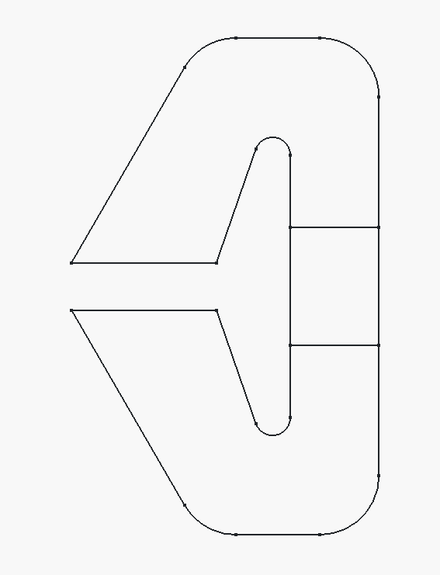

Poolschoen
Luchtspleet
Magneet

Slide 6








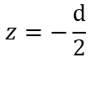

Slide 7








Polepiece
Nd-magneet
Gap (lucht)
Polepiece

Slide 8








Slide 10
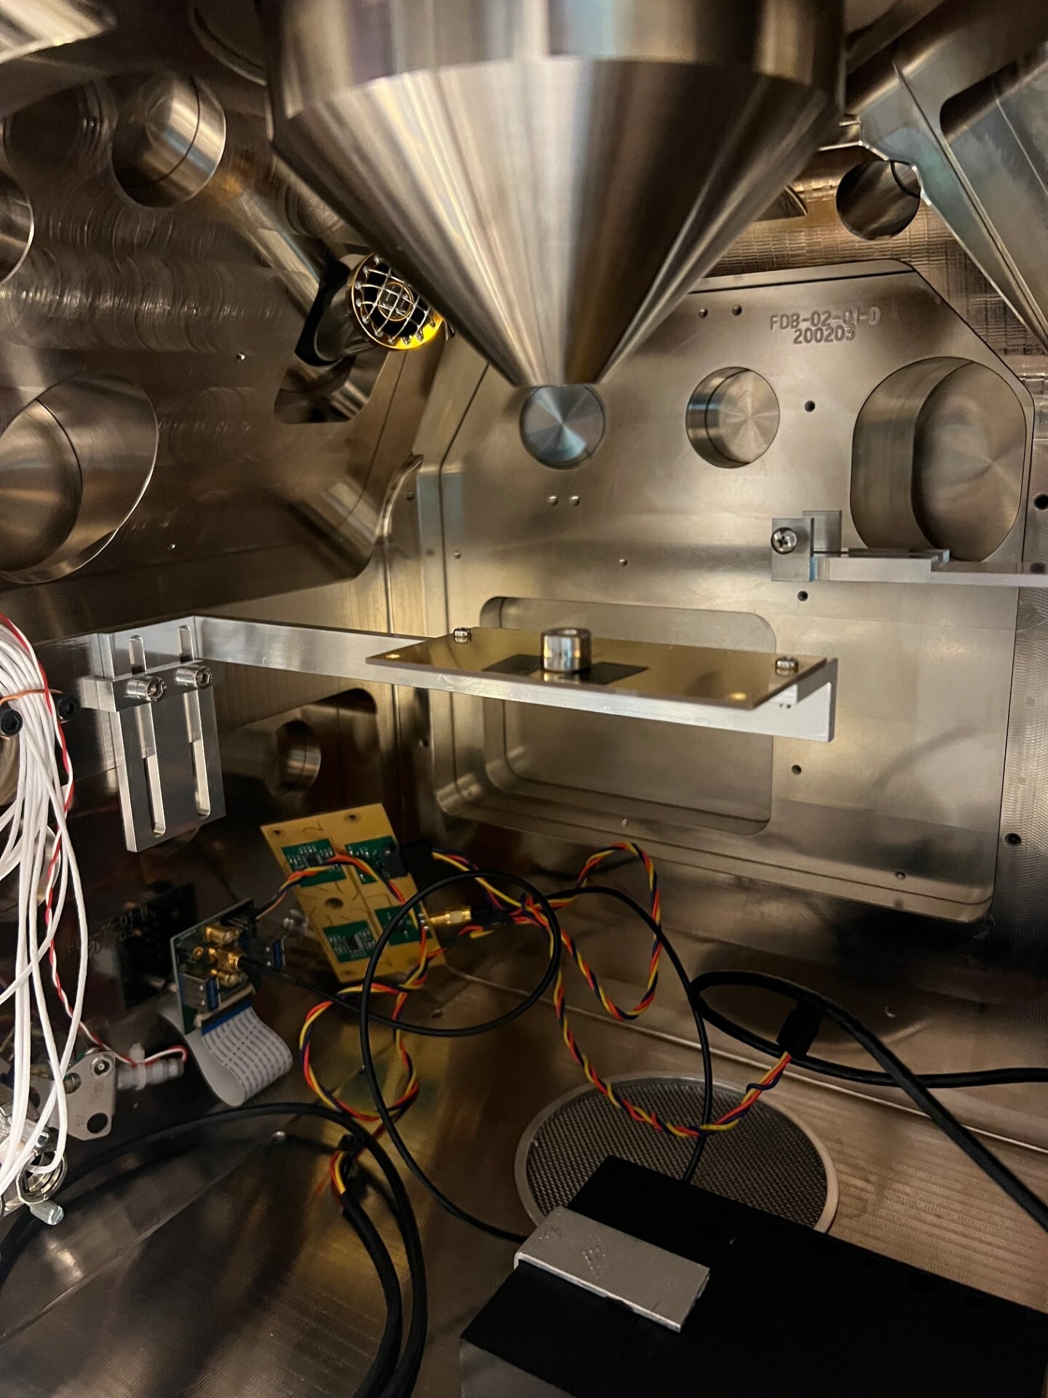
Elektronenbron
Lensplatform
Elektronendetector

