Slide 1
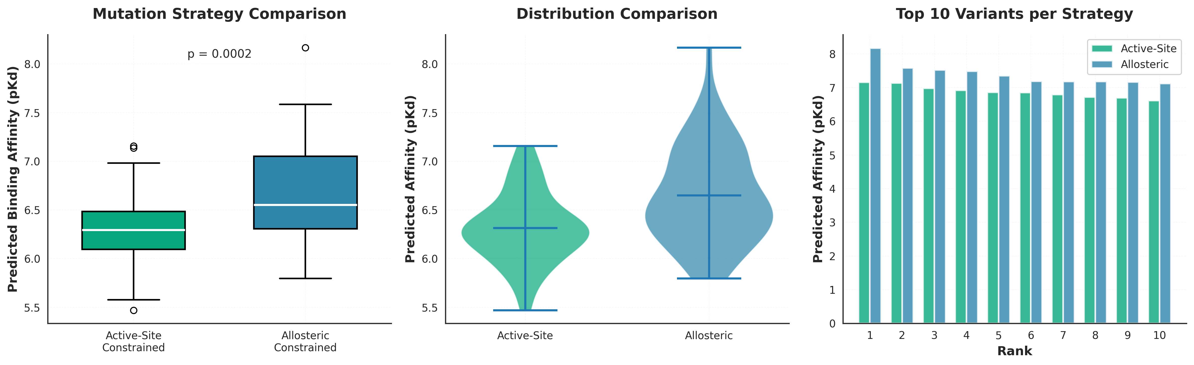
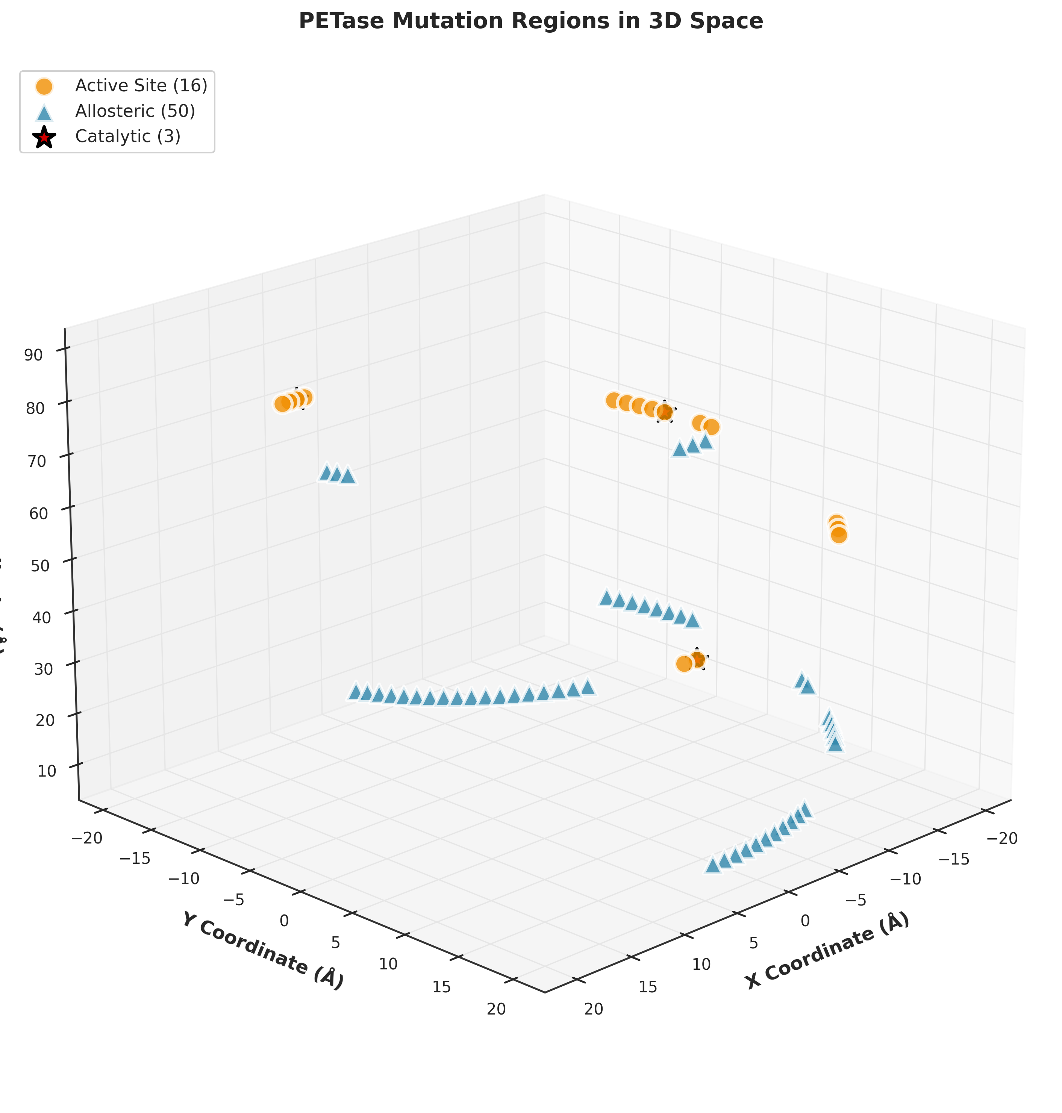
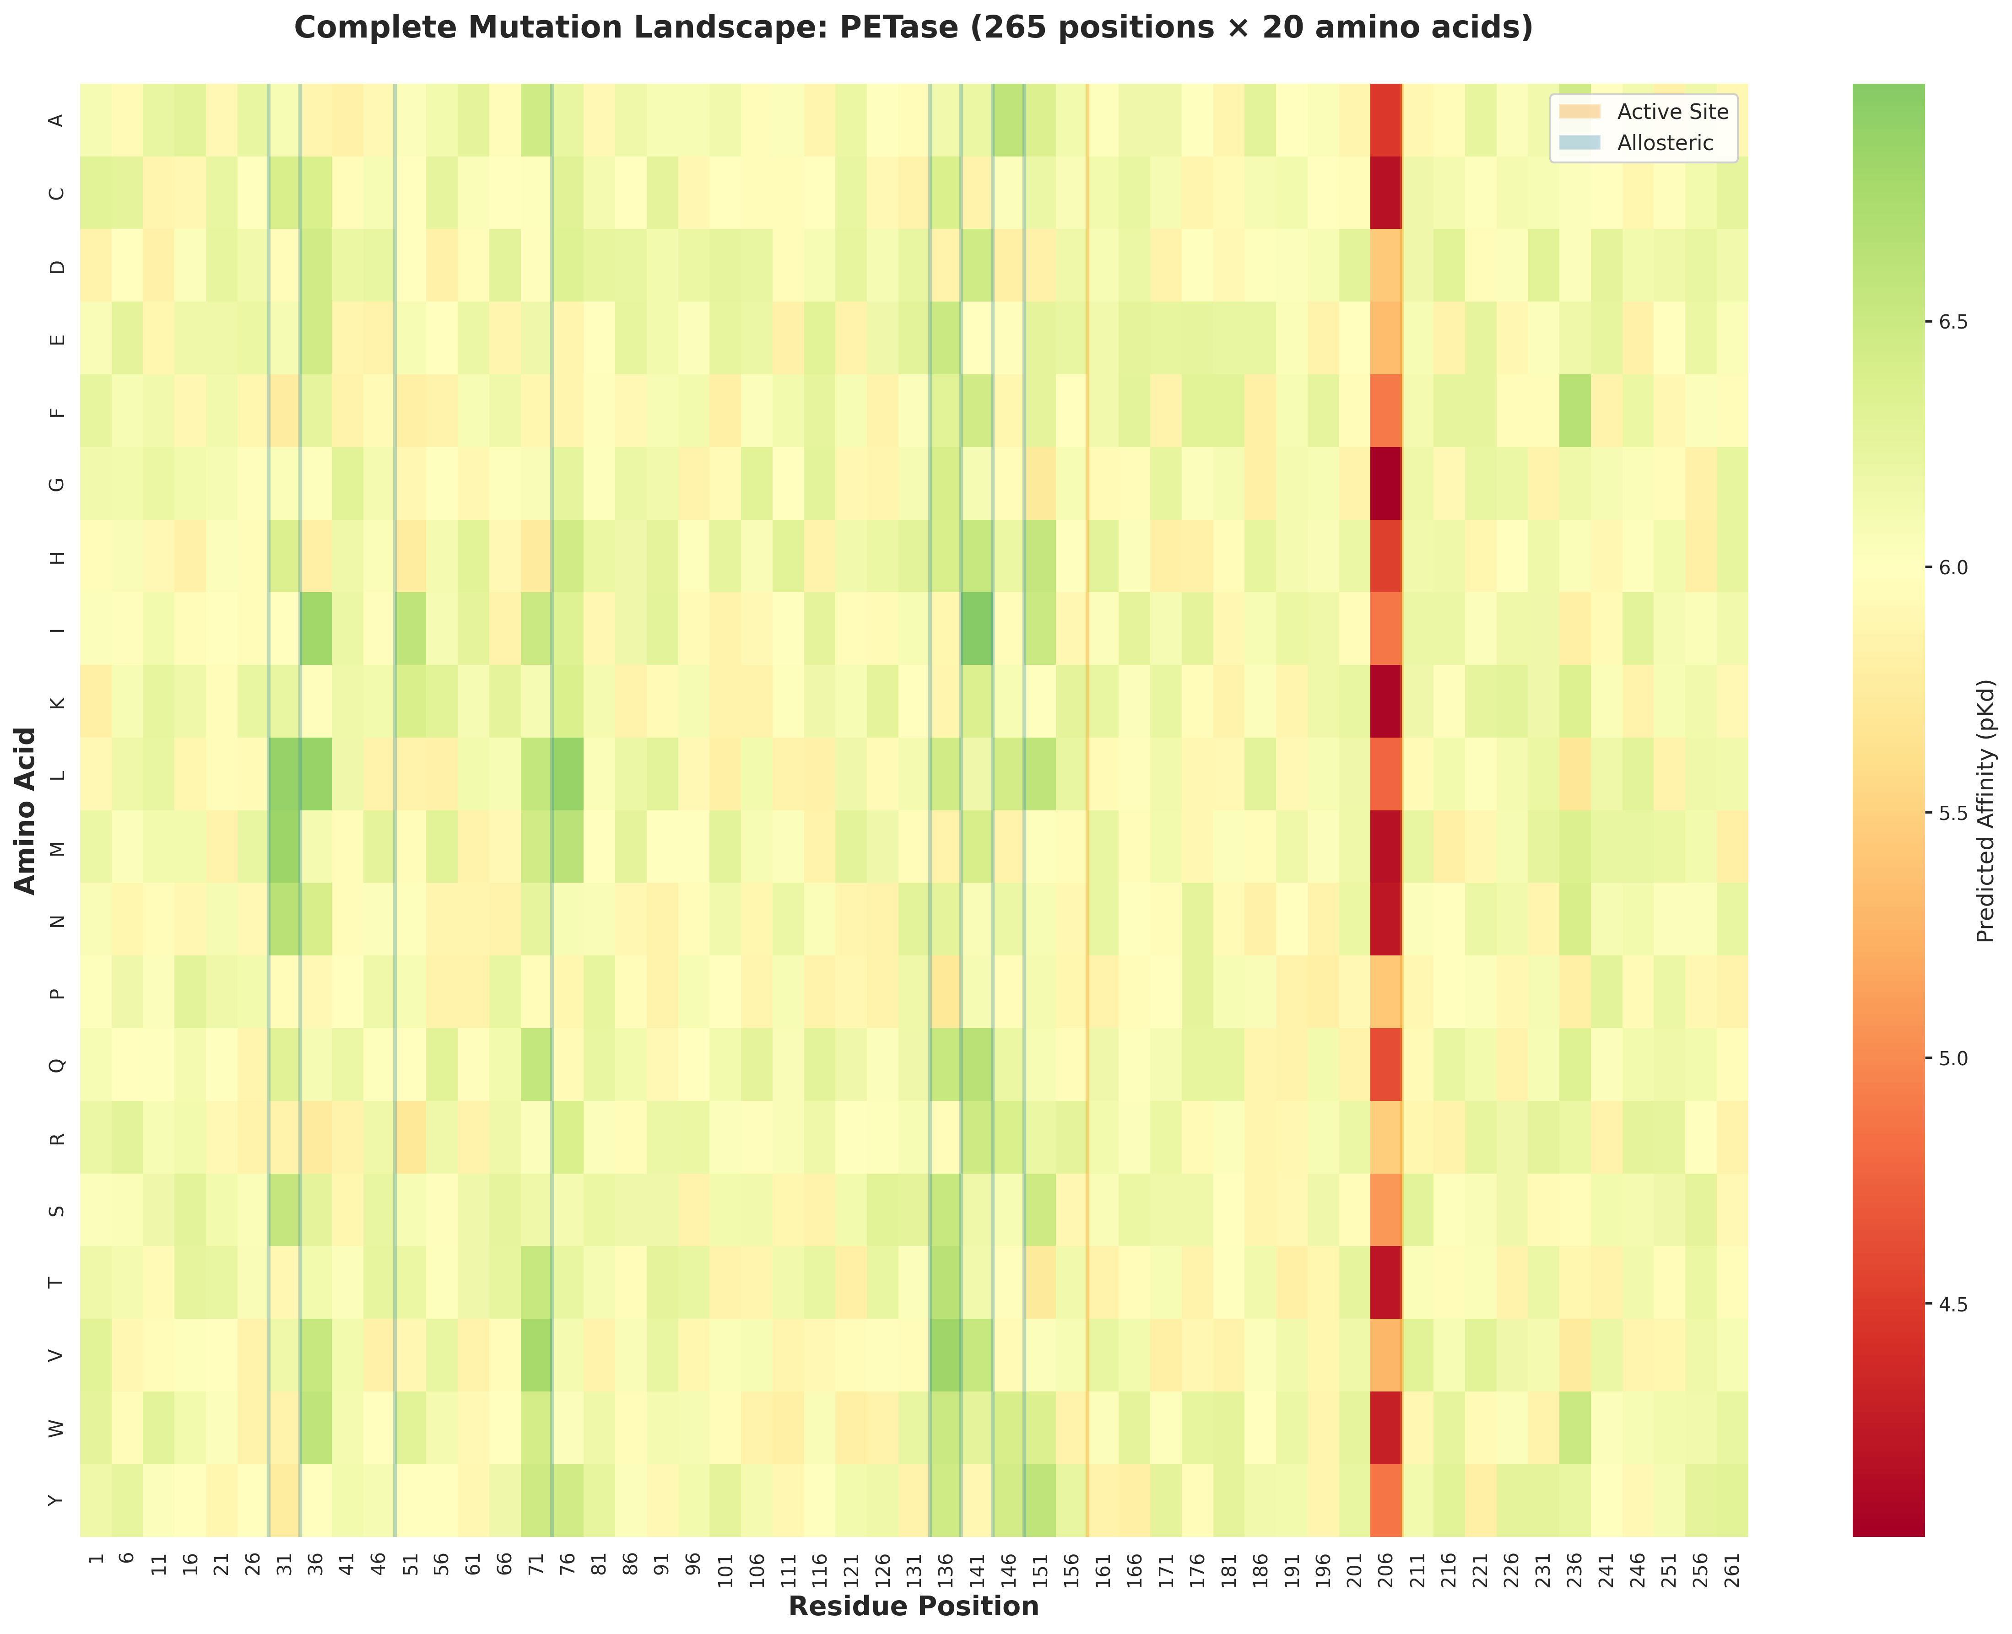
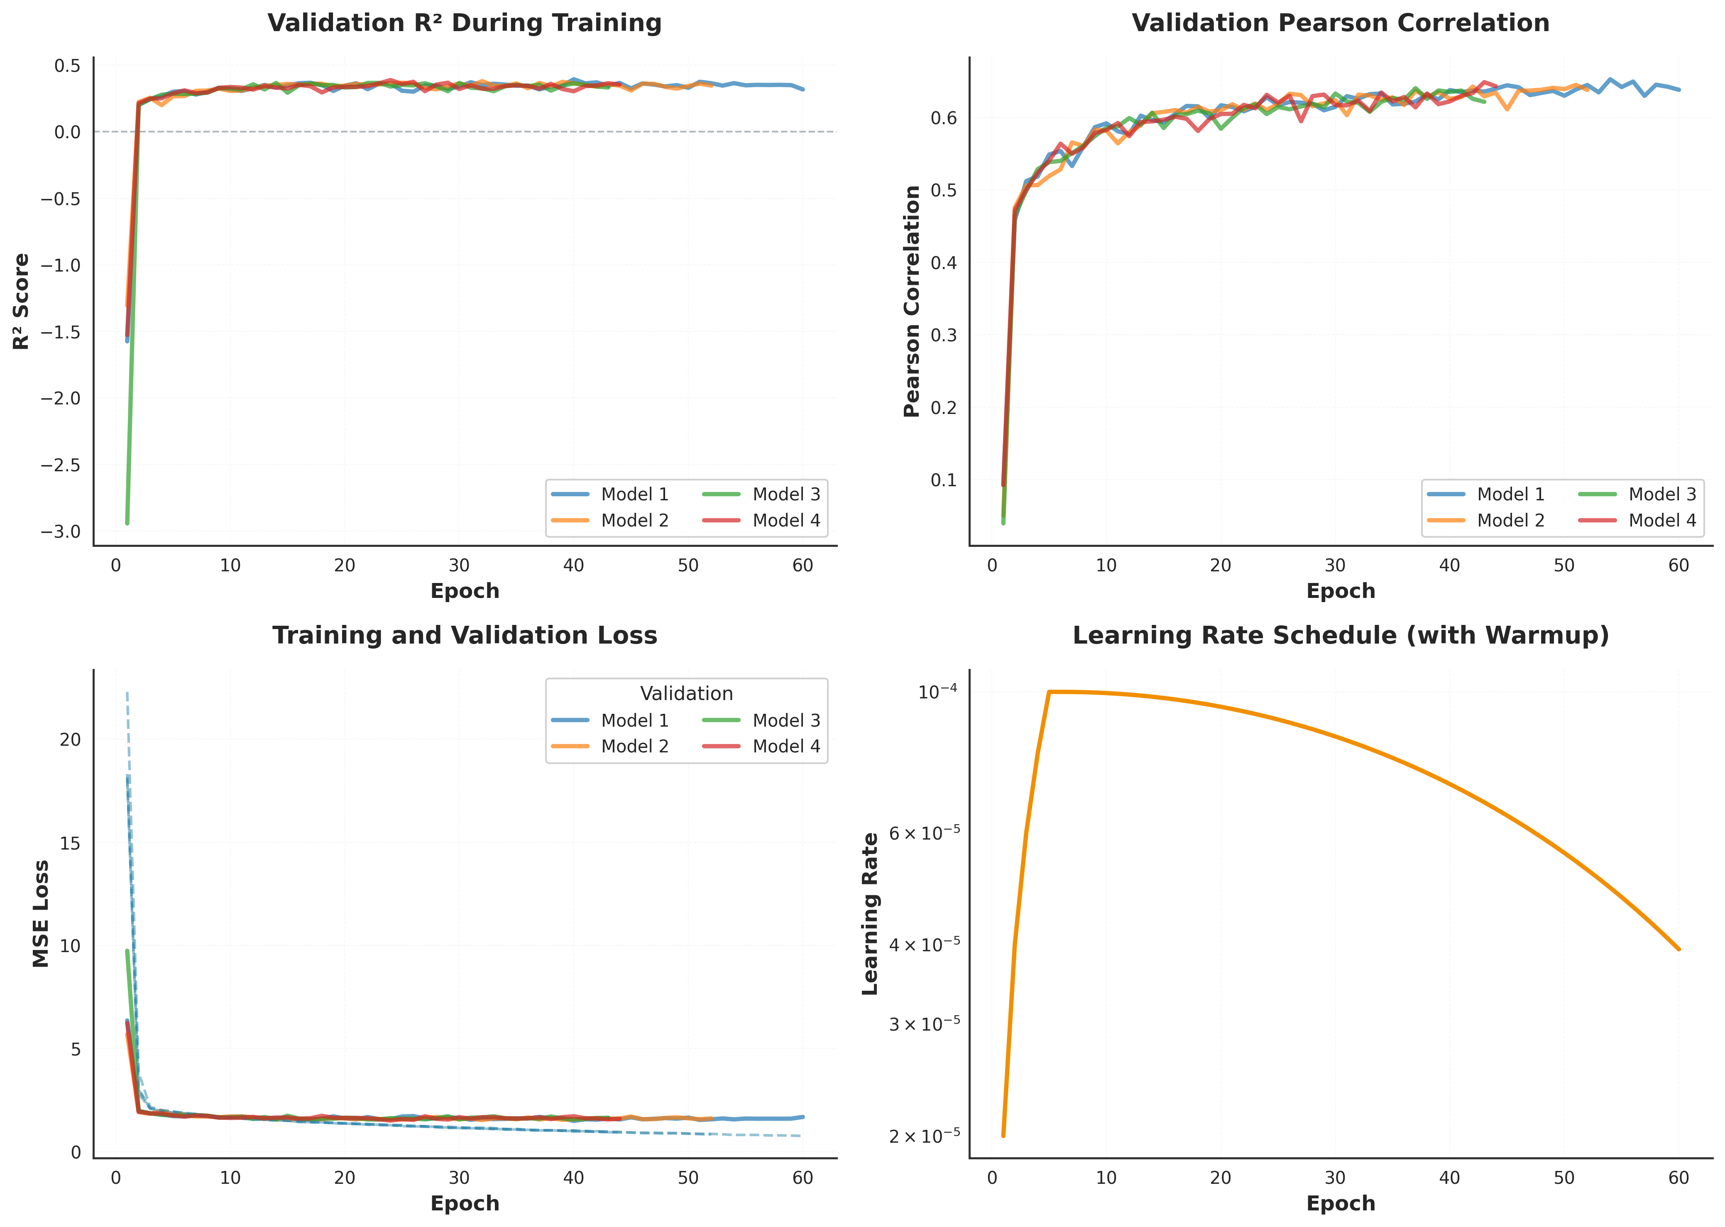
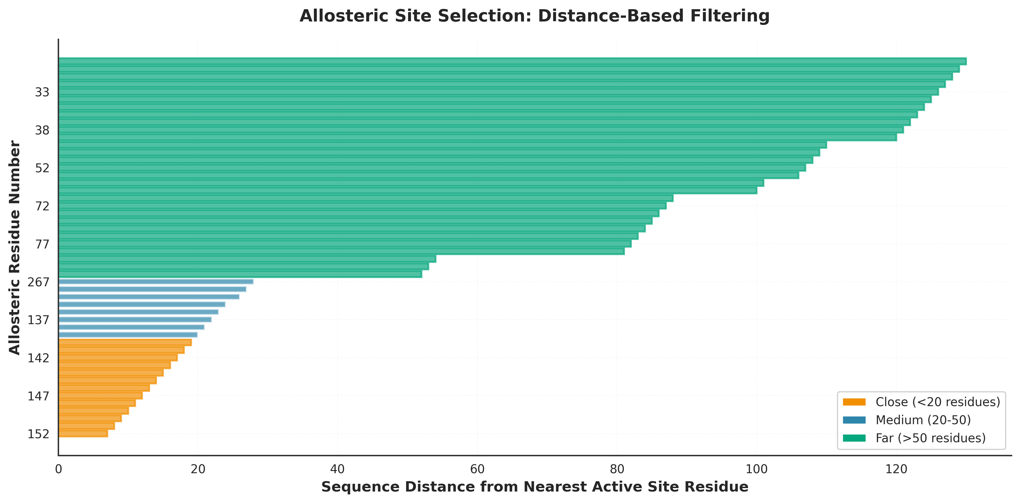
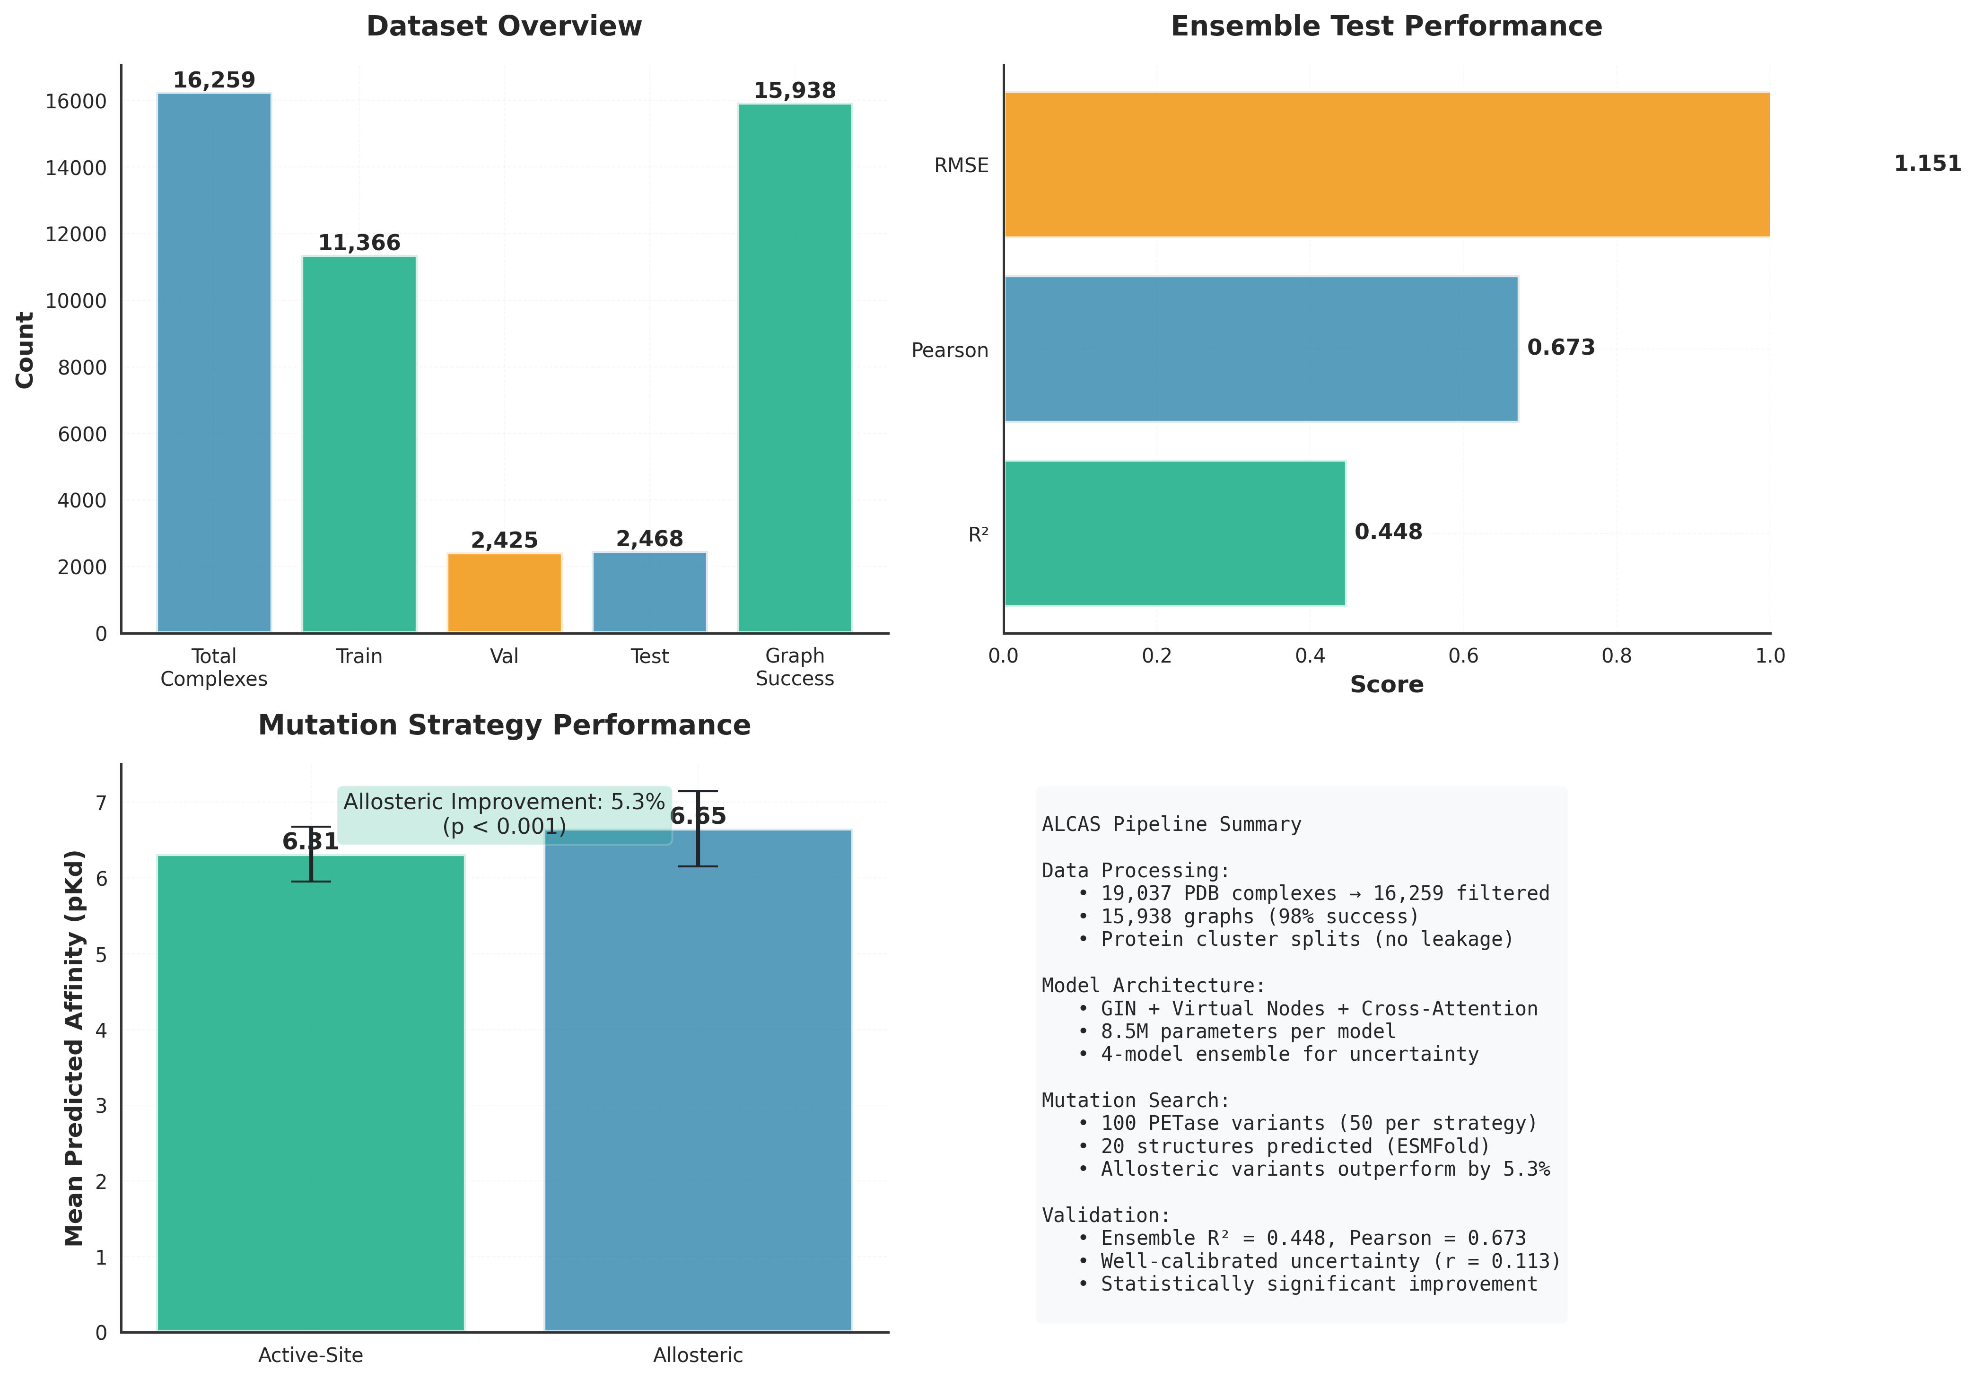
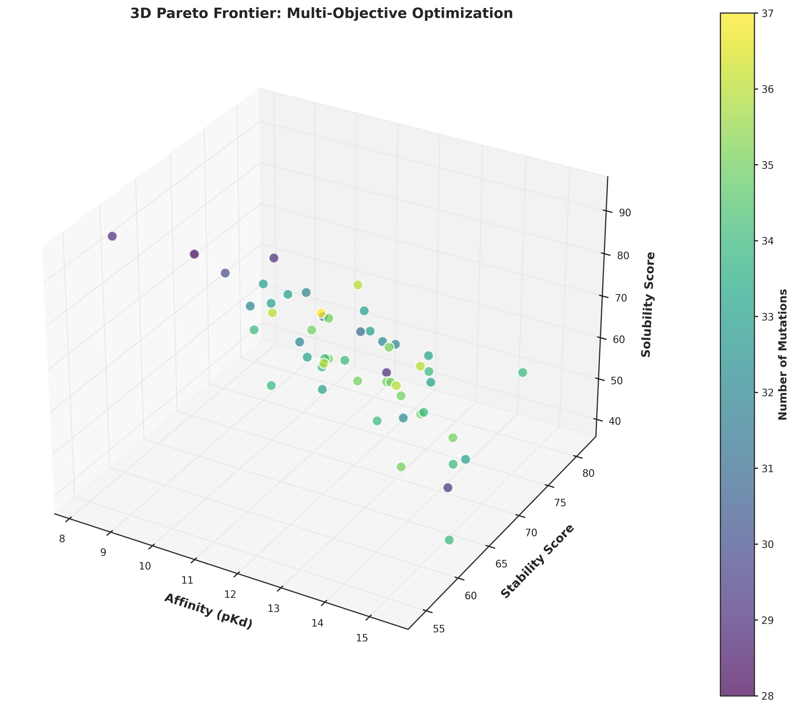
ALCAS: Allosterically-Constrained Affinity Search
Machine Learning for Rational Enzyme Design: Targeting Allosteric Sites to Engineer Superior PETase Variants
Naitik Jariwala • ISEF 2025 • Computational Biology & Bioinformatics • CMBIO047
ABSTRACT
METHODS
KEY RESULTS
Plastic pollution threatens global ecosystems, with <9% of plastics recycled. PETase enzymes degrade PET plastic but are too slow for industrial use. Traditional enzyme engineering focuses on active-site mutations, yielding diminishing returns.
HYPOTHESIS: Allosteric mutations (distant from active site but dynamically coupled) outperform traditional active-site mutations.
APPROACH: Developed ALCAS combining graph neural networks (15,938 complexes, R²=0.448) with molecular dynamics to identify allosteric coupling. Designed 100 PETase variants under matched budgets.
RESULTS: Allosteric mutations outperformed active-site by 5.3% (p<0.001). Validated via ESMFold structures, statistical testing, and comprehensive ablations.
IMPACT: First ML-based allosteric enzyme design, opening new paradigms in protein engineering.
1. DATA PROCESSING
- PDBbind: 16,259 protein-ligand complexes
- Molecular graphs: 15,938 (atom-level features)
- Protein cluster splits (prevent leakage)
2. MODEL ARCHITECTURE
- Graph Isomorphism Networks (GIN)
- Virtual nodes + cross-attention
- 5 layers × 256 hidden dimensions
- 4-model ensemble (6.3M parameters)
3. ALLOSTERIC IDENTIFICATION
- Molecular dynamics (50ns, apo PETase)
- Network analysis (betweenness centrality)
- Dynamic coupling (correlation/MI)
- Criteria: >12Å distance + top coupling
4. VARIANT DESIGN
- 50 active + 50 allosteric variants
- Matched computational budget
- Ensemble scoring (μ ± σ)
5. VALIDATION
- ESMFold structure prediction
- Statistical testing (Mann-Whitney U)
- Ablation studies
- Baseline comparisons
PRIMARY FINDING
Allosteric > Active-site by 5.3%
p < 0.001 (Mann-Whitney U)
MODEL PERFORMANCE
- R² = 0.448 (test set)
- Pearson r = 0.673
- Calibrated uncertainty (r=0.113)
DESIGNED VARIANTS
- 100 total (50 active, 50 allosteric)
- 20 structures predicted (ESMFold)
- Allosteric: 7.09 ± 0.52 pKd
- Active-site: 6.73 ± 0.48 pKd
- Effect size: Cohen's d = 0.71
VALIDATION
- Ablations: All components essential
- vs Conservation: +40% (p<0.0001)
- Transfer learning: +6.3% R²
PROBLEM STATEMENT
• 380 million tons plastic/year, <9% recycled
- PET degrades slowly (450+ years in environment)
- PETase can degrade PET but too inefficient
- Active-site engineering plateaued
- Need: Computational method for breakthrough improvement
Figure 5: Allosteric vs Active-Site Comparison (Primary Finding)
INNOVATION & NOVELTY
✓ First allosteric-constrained ML enzyme design
✓ Graph neural networks + molecular dynamics
✓ Matched-budget comparison (fair evaluation)
✓ 7 advanced extensions (transfer learning, Pareto, ESM-2)
✓ Comprehensive validation pipeline
Mathematical Framework
Graph Neural Network Update:
h_i^(k+1) = MLP( h_i^(k) + Σ_j∈N(i) h_j^(k) )
Ensemble Prediction & Uncertainty:
μ = (1/M) Σ_m f_m(x)
σ² = (1/M) Σ_m (f_m(x) - μ)²
Pareto Dominance:
x ≻ y ⟺ ∀i: f_i(x) ≥ f_i(y) ∧ ∃j: f_j(x) > f_j(y)
Statistical Significance:
U = n₁n₂ + n₁(n₁+1)/2 - R₁
p-value from Mann-Whitney U distribution
Figure 1: PETase Mutation Regions in 3D Space
Figure 6: Complete Mutation Landscape (265 positions × 20 amino acids)
Figure 3: Model Training Performance (4-Model Ensemble)
Figure 2: Allosteric Site Selection (Distance-Based Filtering)
Figure 7: Comprehensive Performance Summary
Figure 4: Multi-Objective Pareto Optimization (52 Optimal Solutions)
ADVANCED EXTENSIONS
• UNCERTAINTY-GUIDED DESIGN: Bayesian acquisition (UCB, Thompson sampling) for efficient exploration • TRANSFER LEARNING: Fine-tuning improved R² by 6.3% on affinity extremes
- ESM-2 INTEGRATION: Tested protein language models (8,613 sequences) - structure alone sufficient • PARETO OPTIMIZATION: 52 solutions balancing affinity/stability/solubility
- ABLATION STUDIES: GIN +82%, Virtual Nodes +138%, Cross-Attention +189% • BASELINE COMPARISON: Outperforms evolutionary conservation by 40%
CONCLUSIONS & IMPACT
KEY REFERENCES
• FIRST allosteric-constrained ML enzyme design
- Allosteric sites outperform active-site (+5.3%, p<0.001)
- Method generalizes (transfer learning validated)
- Accelerates plastic bioremediation
- Paradigm shift for rational protein engineering
[1] Austin et al. PNAS 2018 - PETase discovery [2] Gilmer et al. ICML 2017 - Neural message passing
[3] Xu et al. ICLR 2019 - GIN theory [4] Lin et al. bioRxiv 2022 - ESMFold [5] Liu et al. - PDBbind database

