Slide 1



OWIN & KATANA
By: Ahmed Marzouk

Slide 2
Agenda
A Brief History
What is OWIN and Why?
What is KATANA?
OWIN Specifications
OWIN/KATANA Goals
KATANA Implementation
Demo

Slide 3
A Brief History
History of ASP
1996 – ASP (Active Server Pages)
2002 – ASP.NET Web Forms
2008 – ASP.NET MVC
2010 – ASP.NET Web Pages
2012 – ASP.NET WebAPI, SignalR
2014 – ASP.NET vNext
2015 – vNext > ASP.NET 5
2016 ASP.NET 5 > ASP.NET Core 1.0

Slide 4
Why OWIN?
ASP.NET net result was a mature, feature-rich runtime and developer programming model.
Challenges raised by the historical model
Different features in one big DLL: System.Web.dll assembly (for example, the core HTTP objects with the Web forms framework).
ASP.NET was included as a part of the larger .NET Framework, which meant that the time between releases was on the order of years.
System.Web.dll itself was coupled in a few different ways to a specific Web hosting option: Internet Information Services (IIS).

Slide 5
Why OWIN?
Two evolutionary steps: ASP.NET MVC and ASP.NET Web API
Web applications were increasingly being developed as a series of small, focused components rather than large frameworks.
ASP.NET MVC was released as an independent download. This gave the engineering team the flexibility to deliver updates much more frequently than had been previously possible.
ASP.NET WebAPI Another major shift in Web application development due to the shift from dynamic, server-generated to static initial markup using AJAX
Nugget so frequently updates
No dependencies on System. Web so can hosted outside IIS

Slide 6
Why OWIN?
So Why OWIN?
What was needed was a single hosting abstraction that would enable a developer to compose an application from a variety of different components and frameworks, and then run that application on a supporting host.
Why not hosting on IIS only?
Use small, lightweight web server
Avoid IIS performance overhead
IIS might not be available…

Slide 7
What is OWIN?
stands for: The Open Web Interface for .NET
Inspired by Rack in the Ruby community
It creates an abstraction between Web servers and framework components
It’s an open standard
Authored by 2 MS guys: Benjamin Vanderveen and Louis Dejardin

Slide 8
What is KATANA?
Katana is « just » Microsoft implementation of OWIN rules!
So OWIN itself does not have any tools, libraries or anything else. It is just a specification.
Whereas both the OWIN specification and Owin.dll are community owned and community run open source efforts, the Katana project represents the set of OWIN components that, while still open source, are built and released by Microsoft.
These components include both infrastructure components, such as hosts and servers, as well as functional components, such as authentication components and bindings to frameworks such as SignalR and ASP.NET Web API.

Slide 9
OWIN/KATANA Goals
OWIN Goals:
creates an abstraction between Web servers and framework components
KATANA Goals:
Portable Components
Modular Components
Lightweight Components

Slide 10
OWIN Specifications
Specifications on: http://owin.org
Specifications main parts:
Definition of Software Actors
Request execution
Application Delegate
Environment
Request data, Response data, Other data
Application Startup
URI and Paths
Error Handling
Versioning

Slide 11
Check Open source KATANA packages
https://katanaproject.codeplex.com

Slide 12
OWIN Specifications
Definition of Software Actors:
Host:
The process that hosts the other parts( IIS , Windows service, Console application)
It is responsible for starting every thing up.
Server:
Responsible for binding to a TCP port, constructing the environment dictionary
and processing requests through an OWIN pipeline.
In IIS: Host == Server
Middleware:
Is just a piece of code that the request passes on the way to and from the application
They can be used to inspect & modify both the incoming requests & outgoing responses.

Slide 13
OWIN Specifications
Definition of Software Actors – Cont. :
Pipeline of middlewares:
As the server passes the request to the app using AppFunc, it send it through a pipeline of middlewares.
Application:
Is the part that responsible for generating the actual response.
Technically, no difference between application and middleware except the fact that the application short circuit the pipeline by generating a response but the middleware alter the pass the request or response.
Web Framework:
Not part of actors but it’s a set of middleware that plug into the pipeline and expose their own set of APIs for developers to interact with.

Slide 14
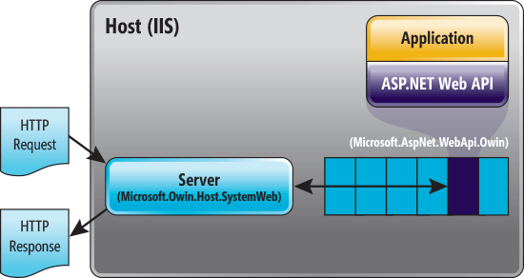
OWIN Specifications
Definition of Software Actors – Cont. :
Application
Middleware
Server
Host

Slide 15

OWIN Specifications
Application Delegate (AppFunc):
The primary interface in OWIN is called the application delegate or AppFunc.
An application delegate takes the IDictionary<string, object> environment and returns a Task when it has finished processing.
The application MUST eventually complete the returned Task, or throw an exception.
Returning Task tell server to non block any process waiting request to finish.

Slide 16
Check MVC template with individual user account.

Slide 17
Simplest OWIN Middleware with IIS

Slide 18
OWIN Specifications
Environment:
The Environment dictionary stores information about the request, the response, and any relevant server state.
Server is responsible for initiating it, but the application is responsible for response data and response body.
The environment dictionary MUST be non-null, mutable and MUST contain the keys listed as required in the specifications.

Slide 19
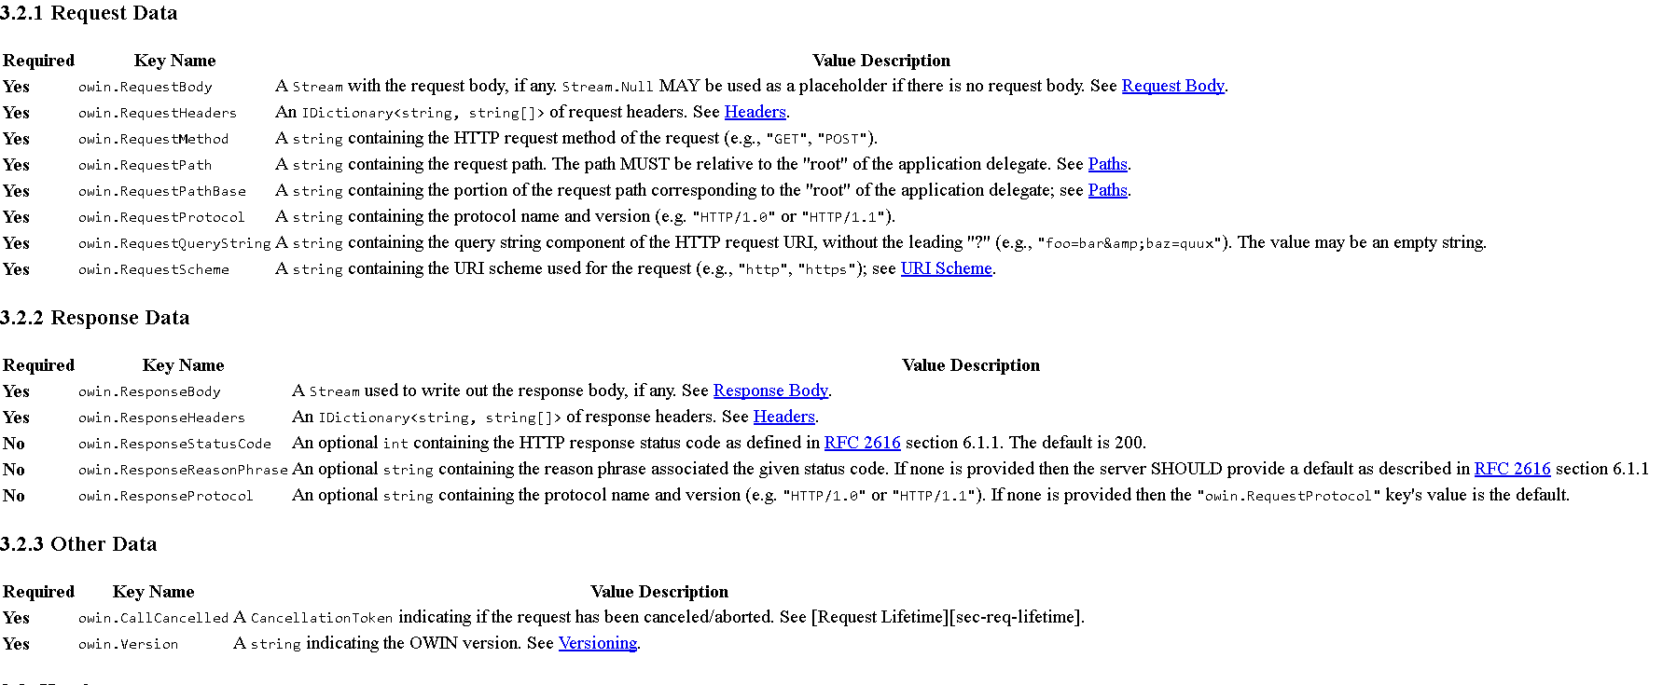
OWIN Specifications

Slide 20
OWIN Specifications
Application Startup:
When the host process starts there are a number of steps it goes through to set up the application:
The host creates a Properties IDictionary<string, object> and populates any startup data or capabilities provided by the host.
The host selects which server will be used and provides it with the Properties collection so it can similarly announce any capabilities.
The host locates the application setup code and invokes it with the Properties collection.
The application reads and/or sets configuration in the Properties collection, constructs the desired request processing pipeline, and returns the resulting application delegate.
The host invokes the server startup code with the given application delegate and the Properties dictionary. The server finishes configuring itself, starts accepting requests, and invokes the application delegate to process those requests.

Slide 21
OWIN Specifications
The Flow after startup:
Client send Http request.
Server take separate it into pieces, and put them in an corresponding Environment dictionary items.
Server passes Environment Dictionary to the first middleware in the pipeline using AppFunc.
After middleware done it’s processing send it to the next one and etc.
Application generate a response and send the dictionary back to the last middleware in the pipeline till the first one.
When the dictionary arrive to the first middleware in the pipeline and this middleware finished processing, response will be send then connection will be close.
Note: Application sets any response headers that it has to set before writing the response stream and send it to the client.

Slide 22
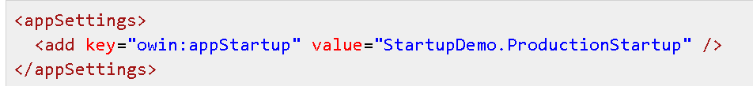
KATANA Implementation
KATANA Startup class detection:
App.config or Web.config:
OwinStartup Attribute:
Put Startup class in the main project namespace.

Slide 23

KATANA Implementation
KATANA Startup class detection – Cont.
Note: There are another way (explicit way) when there are a project that have entry point
t like console application:

Slide 24
KATANA Implementation
IAppBuilder
Include some methods that allow me to configure application behavior.
With adding more KATANA components IAppBuilder will have additional extension methods that do specific functionalities related to the new components.

Slide 25
Simplest self-host app using OWIN

Slide 26
app.Run()
app.Use()
app.UseWelcomePage()

Slide 27
Low-level middleware

Slide 28
Middlewares pipeline
Request / Response

Slide 29
Self-hosted WebAPI

Slide 30
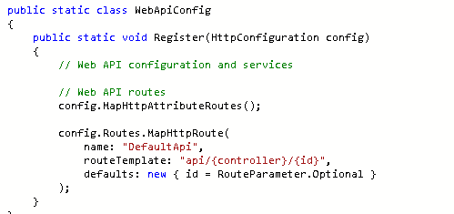
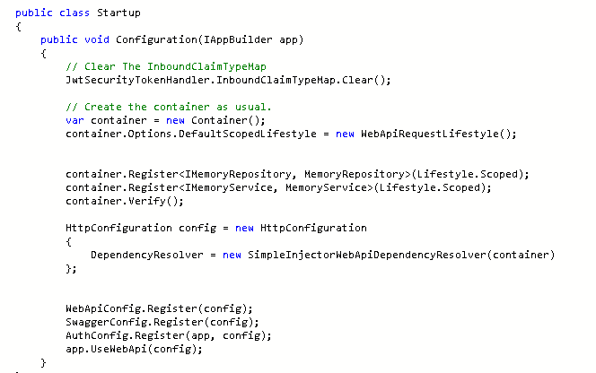
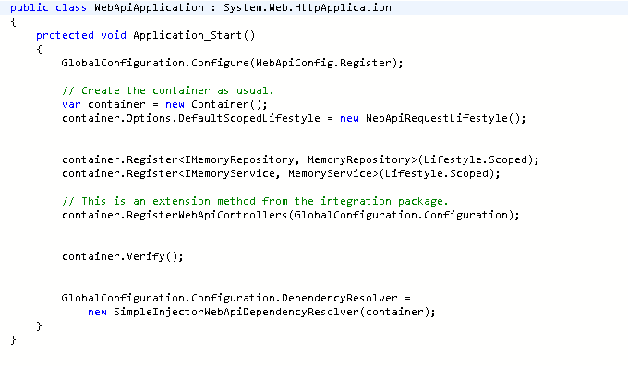
Migrating from Global.ascx to Startup class

Slide 31
MVC side by side with OWIN pipeline

Slide 32
Migrating from self-hosted WebApi to IIS
From IIS to Self-hosted WebAPI
Debugging middleware with options

Slide 33


Thank You
Notes:
When add image, you must sent it to back! Right Click on Image -> Send to Back -> Send Back

