Slide 2
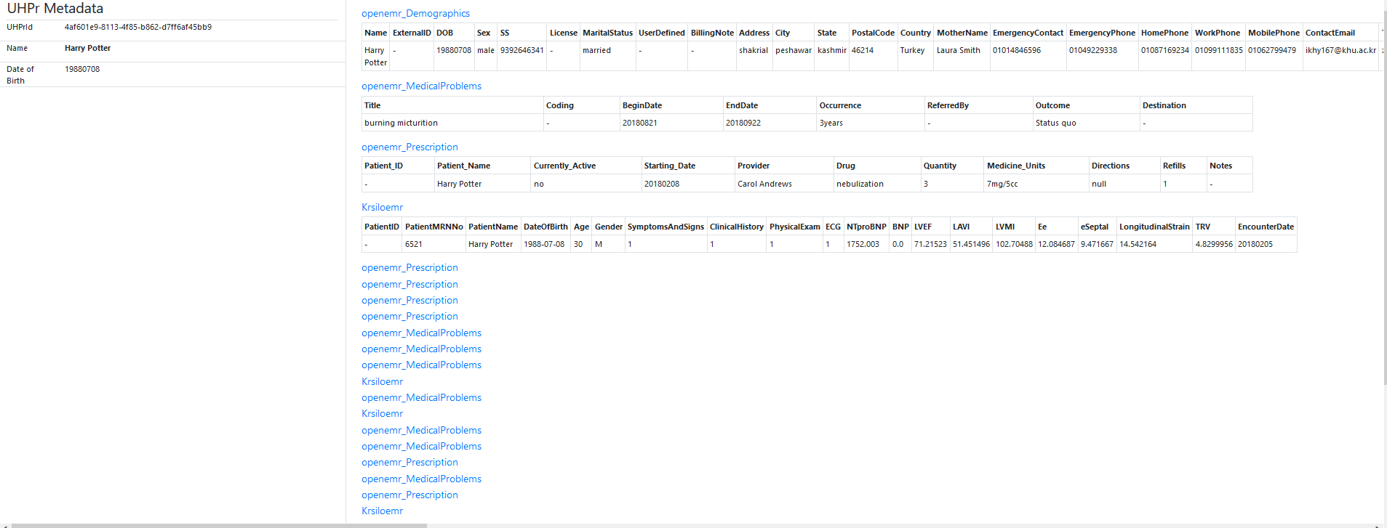

Slide 3






Comprehensive Medical History
EHR A
Ubiquitous Health Platform
k1
v1
k2
v2
Medical documents
.
EHR A
EHR B
k3
v3
Map
Patient
Medical Expert
Patient Medical Profile
EHR B

Slide 4
Describe
Plan
Discover
Preserve
BigData Storage
Acquire
Prepare
Analyze
Assure
Big Data Curation Lifecycle

Slide 5
Comprehensive Medical History
k1
v1
k2
v2
Medical documents
.
EHR A
EHR B
Patient
k3
v3
Map
Medical Expert
Patient Medical Profile
EHR A
Semantic Transformation
UHP
EHR B
EHR X
Epidemiology
Public Health
Precision Medicine
Better Medicine Choices
Incorporate environment, behavioral, and genetic factors
….

Slide 6
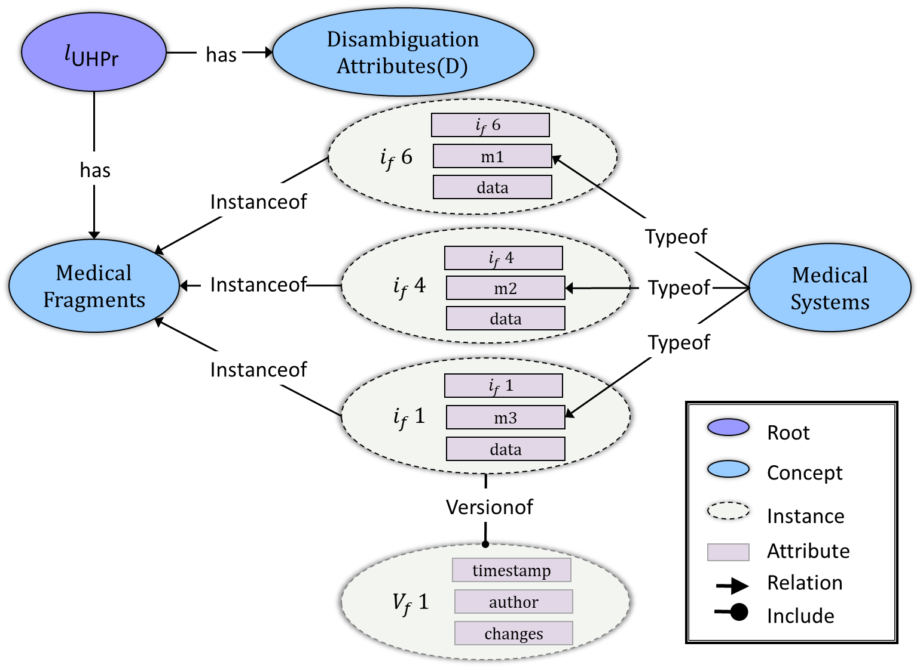

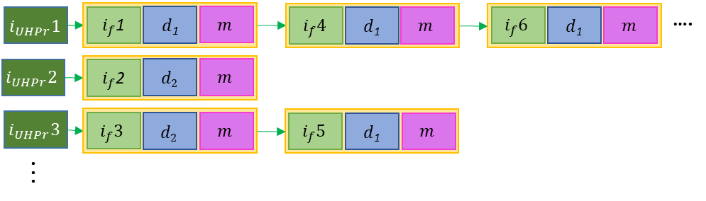



Comprehensive Medical Profile
k1
v1
Semantic Linking
UHPr Model Form
k2
v2
Medical documents
.
EHR A
EHR B
Patient
Medical Expert
k3
v3
Map
Linked format
Semantic Integration
EHR A
UHP
EHR B
EHR X
Integrated format
Mapping Management
Mapping Conflict Resolution
Drizzle Input Adapter
Data Serialization Service
UHPr Storage Form
Mapping Evolution
Location Management
UHPr Maps
Identifier ($i_{m}$)
Medical Data Archive
Type ($τ$)
Raw Data
Ontology Store
Version ($v_{m}$)
L-Store

Slide 7















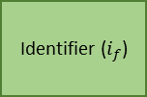




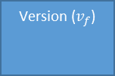









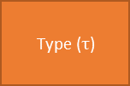

Identifier ($i_{m}$)
{$τ$1, $τ$2, $τ$3,..}
Type ($τ$)
Raw Data
Version ($v_{m}$)
$$i_{UHPr}1$$
$i_{f}$1
$i_{f}$4
$i_{f}$5
….
$$i_{UHPr}2$$
$i_{f}$2
L-Store
Medical Fragment
$$i_{UHPr}3$$
$i_{f}$3
$i_{f}$6
.
.
.
Identifier ($i_{f}$)
Medical Data Archive
$i_{f}$1
$i_{f}$4
$i_{f}$5
$i_{f}$2
$i_{f}$3
$i_{f}$6
Type ($τ$)
$τ$1
$$τ2$$
$τ$1
$τ$1
$$τ2$$
$$τ2$$
Raw Data
Raw Data
Raw Data
Raw Data
Raw Data
Raw Data
Raw Data
$v_{f}$1
$v_{f}$1
$v_{f}$1
$v_{f}$1
$v_{f}$1
$v_{f}$1
Medical Data Archive
.
.
.
Version ($v_{f}$)
.
.
.
$i_{f}$1
$i_{f}$6
$τ$1
$$τ2$$
Raw Data
Raw Data
$$v_{f}2$$
$$v_{f}2$$
UHPr Storage Form ($i_{UHPr}1$)
($i_{UHPr}$2)
($i_{UHPr}3$)

Slide 8



P$Id1$
$i_{f}$1
$i_{f}$4
$i_{f}$5
….
$$\text{P}\text{I}d2$$
$i_{f}$2
L-Store
$$\text{P}\text{I}d3$$
$i_{f}$3
$i_{f}$6
.
.
.
$i_{f}$1
$i_{f}$4
$i_{f}$5
$i_{f}$2
$i_{f}$3
$i_{f}$6
$τ$1
$$τ2$$
$τ$1
$τ$1
$$τ2$$
$$τ2$$
Raw Data
Raw Data
Raw Data
Raw Data
Raw Data
Raw Data
$v_{f}$1
$v_{f}$1
$v_{f}$1
$v_{f}$1
$v_{f}$1
$v_{f}$1
Medical Data Archive
.
.
.
.
.
.
$i_{f}$1
$i_{f}$6
$τ$1
$$τ2$$
Raw Data
Raw Data
$$v_{f}2$$
$$v_{f}2$$
UHPr Storage Form (Pid1)
(PId2)
(Pid3)

Slide 9







$$i_{UHPr}1$$
$i_{m}$ 1
$i_{m}$ 4
$i_{m}$ 5
….
$$i_{UHPr}2$$
$i_{m}$ 2
$$i_{UHPr}3$$
$i_{m}$ 3
$i_{m}$ 6
.
.
.

Slide 10
OpenEMR Reports
Demographics
Krsiloemr_tblPatient
PatientID
PatientMRNNo
PatientName
DateOfBirth
Age
Gender
SymptomsAndSigns
ClinicalHistory
PhysicalExam
ECG
NTproBNP
BNP
LVEF
LAVI
LVMI
Ee
eSeptal
LongitudinalStrain
TRV
EncounterDate
openemr_MedicalProblems
Title
Coding
BeginDate
EndDate
Occurrence
ReferredBy
Outcome
Destination
Name
ExternalID
DOB
Sex
SS
License
MaritalStatus
UserDefined
BillingNote
Address
City
State
PostalCode
Country
MotherName
EmergencyContact
EmergencyPhone
HomePhone
WorkPhone
MobilePhone
ContactEmail
TrustedEmail
Provider
Referring_Provider
Pharmacy
HIPPANoticeReceived
AllowVoiceMessage
LeaveMessageWith
AllowMailMessage
AllowSMS
AllowEmail
AllowImmunizationRegistryUse
AllowImmunizationInfoSharing
AllowHeartInformationExchange
AllowPatientPortal
CareTeam
CMSPortalLogin
ImmunizationRegistryStatus
ImmunizationRegistryStatusEffectiveDate
PublicityCode
PublicityCodeEffectiveDate
ProtectionIndicator
ProtectionIndicatorEffectiveDate
Language
Race
Ethnicity
FamilySize
FinancialReviewDate
Homeless
MonthlyIncome
Interpreter
MigrantSeasonal
VFC
Religion
DateDecreased
ReasonDecreased
openemr_Prescriptions
PatientId
PatientName
Add
EndDate
Occurrence
ReferredBy
Outcome
Destination

Slide 11
tblPatient
PatientID
PatientMRNNo
PatientName
DateOfBirth
Age
Gender
SymptomsAndSigns
ClinicalHistory
PhysicalExam
ECG
NTproBNP
BNP
LVEF
LAVI
LVMI
Ee
eSeptal
LongitudinalStrain
TRV
EncounterDate
OpenEMR Reports
Demographics
openemr_MedicalProblems
Title
Coding
BeginDate
EndDate
Occurrence
ReferredBy
Outcome
Destination
Name
ExternalID
DOB
Sex
SS
License
MaritalStatus
UserDefined
BillingNote
Address
City
State
PostalCode
Country
MotherName
EmergencyContact
EmergencyPhone
HomePhone
WorkPhone
MobilePhone
ContactEmail
TrustedEmail
Provider
Referring_Provider
Pharmacy
HIPPANoticeReceived
AllowVoiceMessage
LeaveMessageWith
AllowMailMessage
AllowSMS
AllowEmail
AllowImmunizationRegistryUse
AllowImmunizationInfoSharing
AllowHeartInformationExchange
AllowPatientPortal
CareTeam
CMSPortalLogin
ImmunizationRegistryStatus
ImmunizationRegistryStatusEffectiveDate
PublicityCode
PublicityCodeEffectiveDate
ProtectionIndicator
ProtectionIndicatorEffectiveDate
Language
Race
Ethnicity
FamilySize
FinancialReviewDate
Homeless
MonthlyIncome
Interpreter
MigrantSeasonal
VFC
Religion
DateDecreased
ReasonDecreased
AdmissionsCorePopulatedTable
PatientID
AdmissionID
AdmissionStartDate
AdmissionEndDate
PatientCorePopulatedTable
PatientID
PatientGender
PatientDateOfBirth
PatientRace
PatientMaritalStatus
PatientLanguage
PatientPopulationPercentageBelowPoverty
PatientName
LabsCorePopulatedTable
PatientID
AdmissionID
LabName
LabValue
LabUnits
LabDateTime
Krsiloemr
openemr_Prescriptions
PatientId
PatientName
Add
EndDate
Occurrence
ReferredBy
Outcome
Destination
AdmissionsDiagnosesCorePopulatedTable
PatientID
AdmissionID
PrimaryDiagnosisCode
PrimaryDiagnosisDescription
EMRBOTS.org

Slide 12
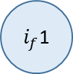
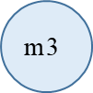

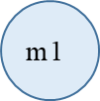


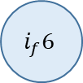

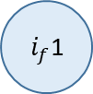
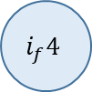

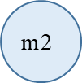
Fragment
Identifier ($i_{m}$)
Type ($τ$)
Raw Data
ι_{UHPr}
Version ($v_{m}$)
M_{i}={m1,m2,m3}
Medical Fragments
d
$$i_{f}6$$
$$\text{m}\text{3}$$
$$i_{f}4$$
$i_{f}$1
$v_{f}$1
$$\text{m}\text{1}$$
$$\text{m}\text{2}$$
$i_{f}$1
$$v_{f}2$$
$i_{f}$1

Slide 13
$$l_{\text{UHPr}}$$
Disambiguation Attributes(D)
has
$$i_{f }6$$
$$i_{f }6$$
has
m1
Instanceof
data
$$i_{f }4$$
Typeof
Medical Fragments
$$i_{f }4$$
Medical Systems
Instanceof
m2
Typeof
data
Typeof
Instanceof
$$i_{f }1$$
$$i_{f }1$$
m3
Root
data
Concept
Versionof
Instance
$$V_{f }1$$
Attribute
timestamp
Relation
author
Include
changes

Slide 14
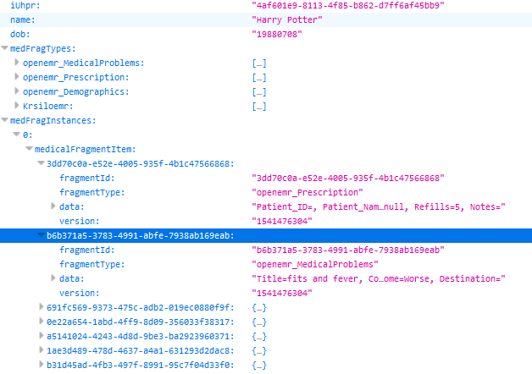
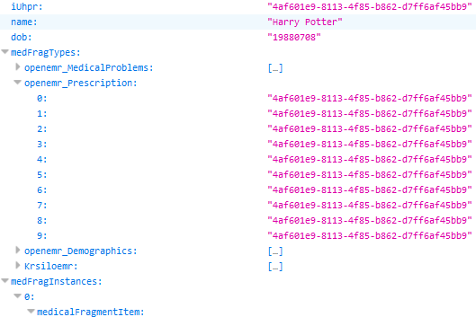

Slide 15
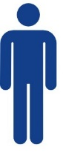
OpenEMR Reports
1. Demographics
2. Medical Problems
3. Prescription
UHPr Storage and processing
OpenEMR
Name: Harry Potter
Date of Birth: 1988-07-08
KRSiloEMR
UHP Semantic Retrieve
OpenEMR
Hospital A
UHP Semantic Retrieve
Medical Fragments
KRSiloEMR
Hospital B
KRSiloEMR

Slide 16
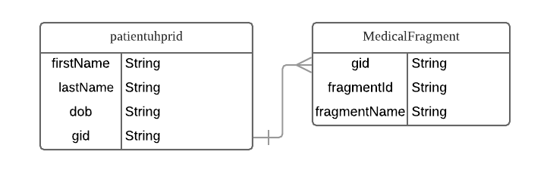

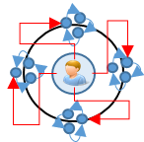
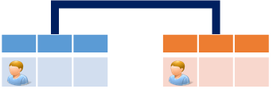
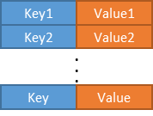




UHP Hadoop deployment is composed of, 1 master and 2 slave nodes, with 1.8TB HDFS size, 20MB block size, Block Replication of 3, and 64GB ram on the master, while 32GB on the slaves.
OpenEMR
8,202,040 Medical Fragments
L-Store
Krsiloemr
EHR A
390,101 patient records
Hospital A
12 pts.
40 pts
HDFS
UHPr Storage Form
Identifier ($i_{m}$)
Semantic Query Interface
Type ($τ$)
Doc
EHR B
Doc
Doc
Hospital B
Raw Data
Patient
Version ($v_{m}$)
UHP
Hospital
C
EHR X
EMRBOTS
100,000 pts.

Slide 17
Iteration 0
Iteration 2
Iteration 3
Iteration 4
Iteration 5
Iteration 6
New Patients(P): 80,000
Iteration 1
P: 100
MR: 2,000
P: 10,000
P: 40,000
P: 80,000
P: 80,000
P: 1
New Medical Records(MR): 2,400,000
MR: 200,000
MR: 800,000
MR: 2,400,000
MR: 2,400,000
MR: 40

Slide 22
OpenEMR
Medical Fragments
KRSiloEMR

Slide 23
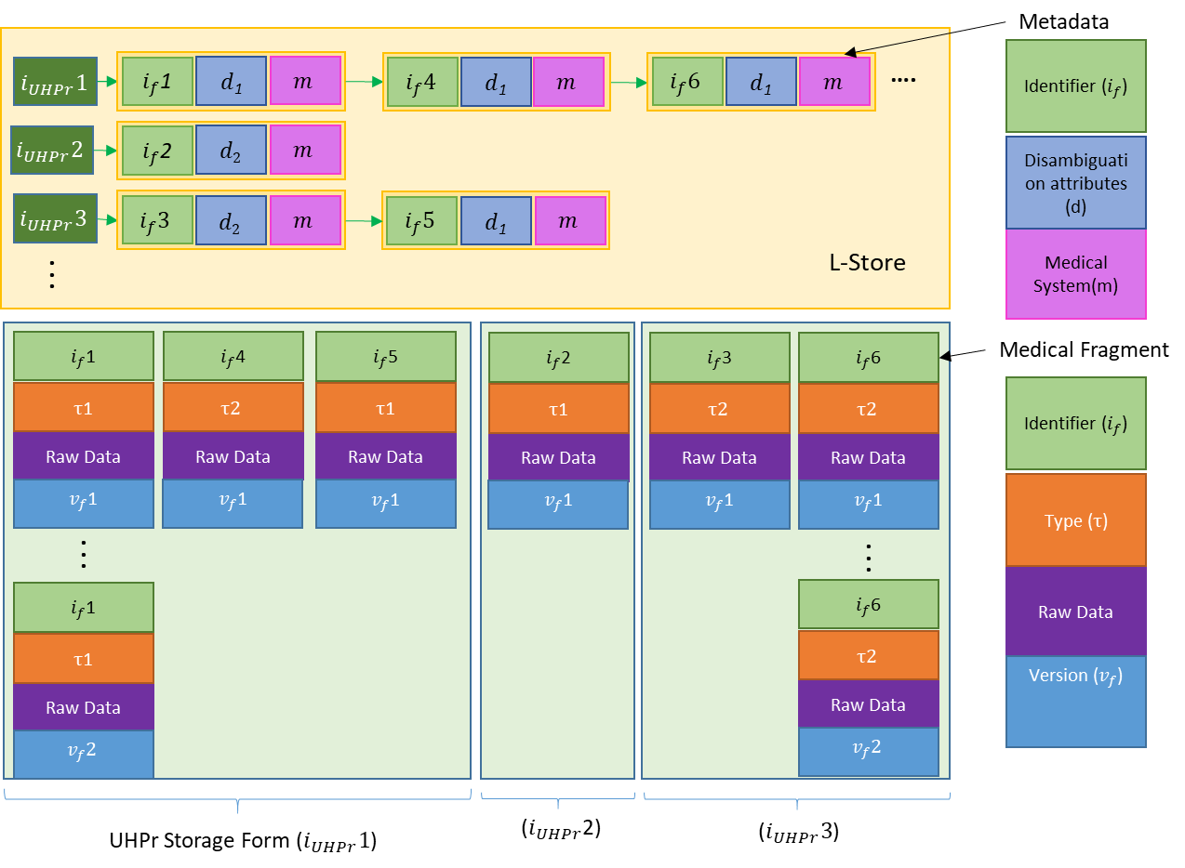
(a) UHPr Storage Form
(b) UHPr Model Form

Slide 24





















Metadata
$$i_{UHPr}1$$
$i_{f}$1
$d$₁
$$m$$
$$i_{f}4$$
$d$₁
$$m$$
$$i_{f}6$$
$d$₁
$$m$$
Identifier ($i_{f}$)
….
$$i_{UHPr}2$$
$i_{f}$2
$$d2$$
$$m$$
Disambiguation attributes (d)
$$i_{UHPr}3$$
$$i_{f}3$$
$$d2$$
$$m$$
$$i_{f}5$$
$d$₁
$$m$$
L-Store
Medical System(m)
.
.
.
$i_{f}$1
$i_{f}$4
$i_{f}$5
$i_{f}$2
$i_{f}$3
$i_{f}$6
Medical Fragment
$τ$1
$$τ2$$
$τ$1
$τ$1
$$τ2$$
$$τ2$$
Identifier ($i_{f}$)
Raw Data
Raw Data
Raw Data
Raw Data
Raw Data
Raw Data
$v_{f}$1
$v_{f}$1
$v_{f}$1
$v_{f}$1
$v_{f}$1
$v_{f}$1
Type ($τ$)
.
.
.
.
.
.
$i_{f}$1
$i_{f}$6
Raw Data
$τ$1
$$τ2$$
Version ($v_{f}$)
Raw Data
Raw Data
$$v_{f}2$$
$$v_{f}2$$
UHPr Storage Form ($i_{UHPr}1$)
($i_{UHPr}$2)
($i_{UHPr}3$)

Slide 25



Map Generator
Medical Fragment Schema
1
Case Insensitive Search
…
Yes
No
2
Longest Subsequence Matching
(Attribute + Attribute)
Concurrent Suffix Trees
Offline
3
Split Attribute to Words
Online
4
Regular Expression
Update Words by UMLS CUI
Medical Fragment Records
5
Compare CUI
(word + word)
Identifier ($i_{f}$)
Type ($τ$)
Longest Subsequence Matching
(word + word)
6
UHPr Map
Raw Data
7
Version ($v_{f}$)
Check relatedness from ConceptNet
(word + word)

