Slide 1



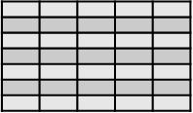






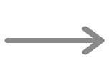



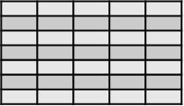


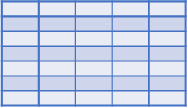




EMR Data
Sources
Schema
Acquisition
Semantic Enriched Sentences Generation
Schema Map Generation
EMR₁
Semantic Enriched Sentences
att₁
att₂
.
.
.
att_{n}
EMR₂
Similarity
Matching
att₁
0 0 0 1 0 0 0 0 0 0 0 0 0 0
att₂
Context vectors₁
.
.
.
att_{n}
0 0 0 0 0 0 0 0 0 0 1 0 0 0
EMR₃
Context vectors₂
att₁
0 0 0 0 0 0 1 0 0 0 0 0 0 0
att₂
Context vectors_{n}
.
.
.
att_{n}
Embedded Vectors Generations
EMR₄
att₁
att₂
.
.
.
att_{n}
EMR_{n}
Terminological
Standard Dictionaries
(UMLS , SNOMED-CT or LONICS)
att₁
From attribute to sentence
att₂
A Consolidated and Interoperable Data
.
.
.
att_{n}

