Slide 1
HW13-2 手把手教學
負責助教：姜成翰
聯絡方式： ntu-ml-2020spring-ta@googlegroups.com

Slide 2
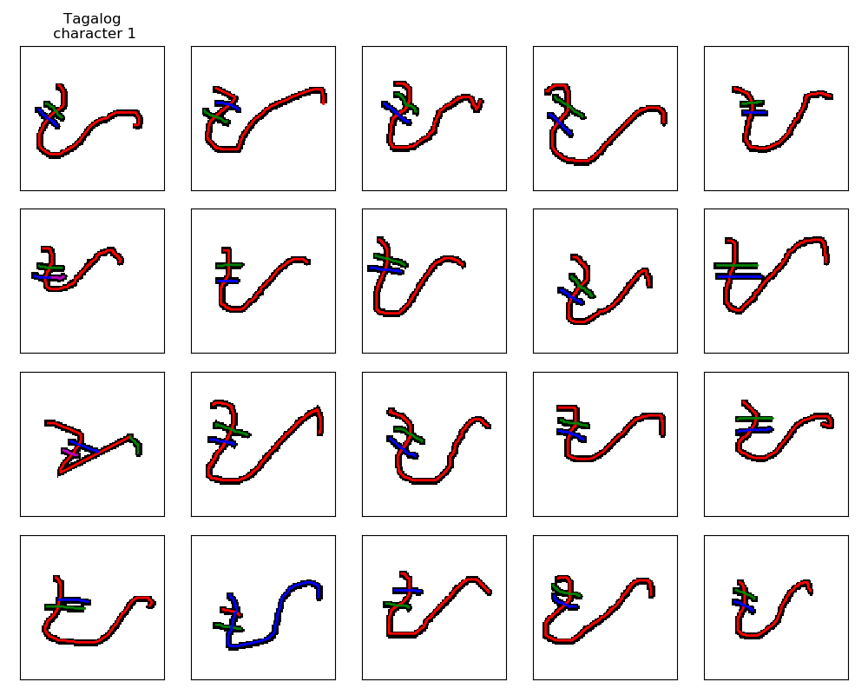
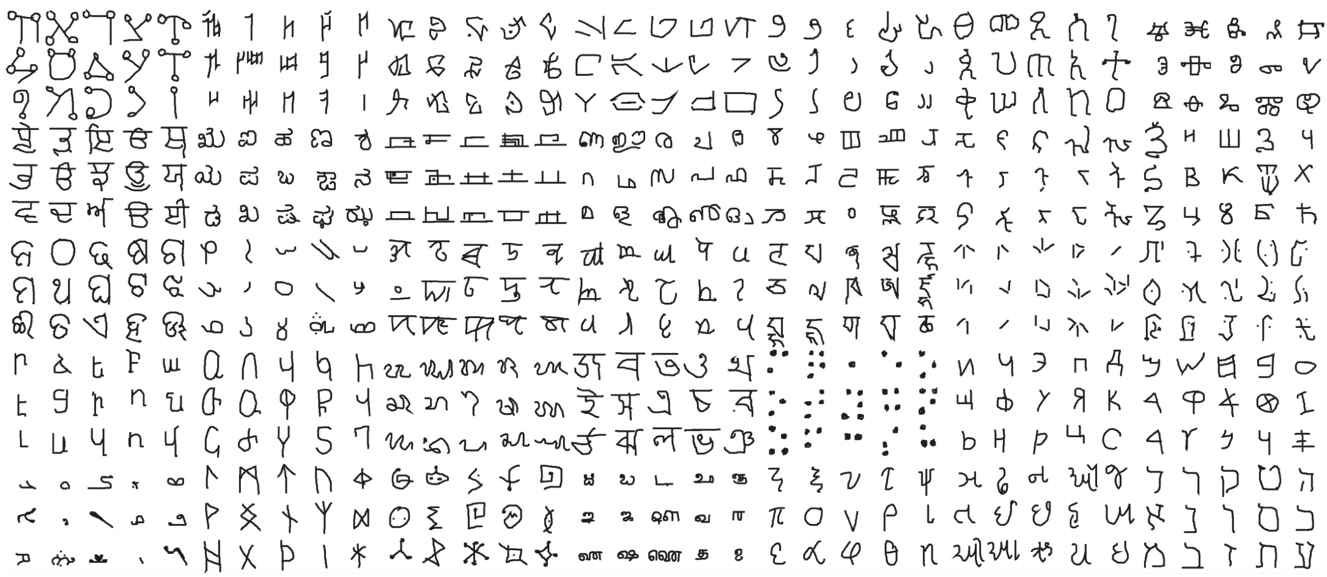
Omniglot
https://github.com/brendenlake/omniglot
1623 characters
Each has 20 examples
Notes:
https://github.com/google-research/meta-dataset
https://arxiv.org/abs/1902.03477
https://science.sciencemag.org/content/350/6266/1332

Slide 3
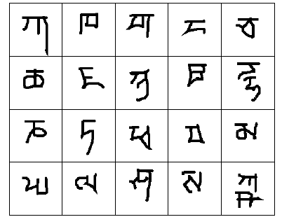
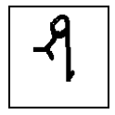
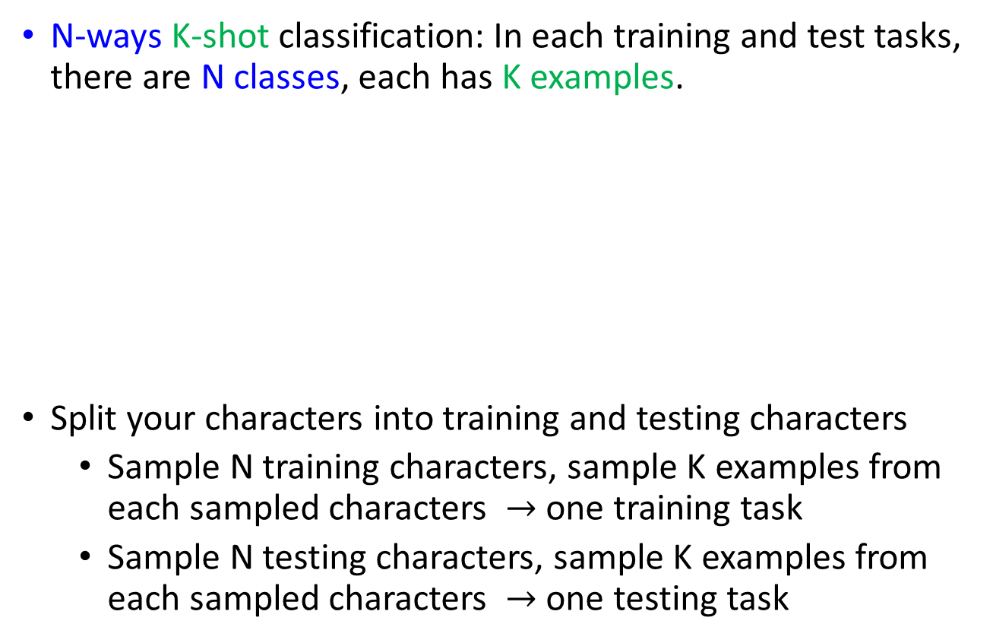
Omniglot – Few-shot Classification
Demo of Reptile:
https://openai.com/blog/reptile/
N-ways K-shot classification: In each training and test tasks, there are N classes, each has K examples.
Split your characters into training and testing characters
Sample N training characters, sample K examples from each sampled characters $→$ one training task
Sample N testing characters, sample K examples from each sampled characters $→$ one testing task
20 ways
1 shot
Testing set
(Query set)
Each character represents a class
Training set
(Support set)

Slide 4
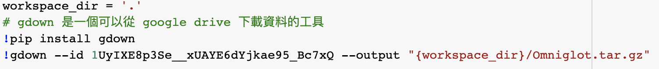
Step1: 下載資料

Slide 5

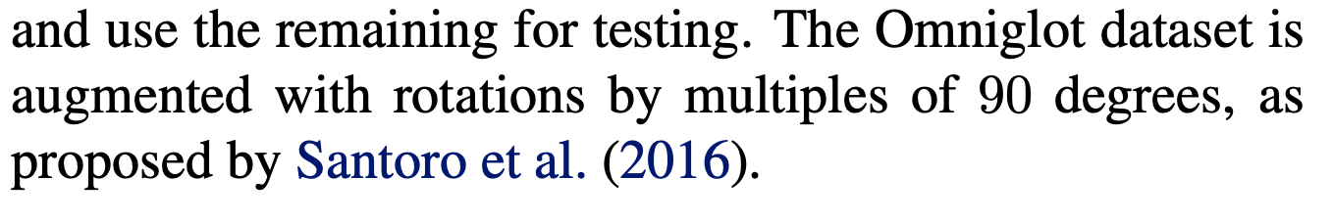
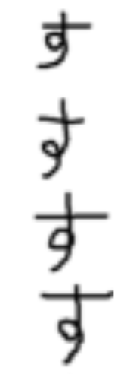
關於 Data Augmentation
這 4 個 す是不同的 class (不同的 character)
https://arxiv.org/pdf/1703.03400.pdf

Slide 6
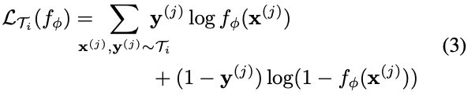
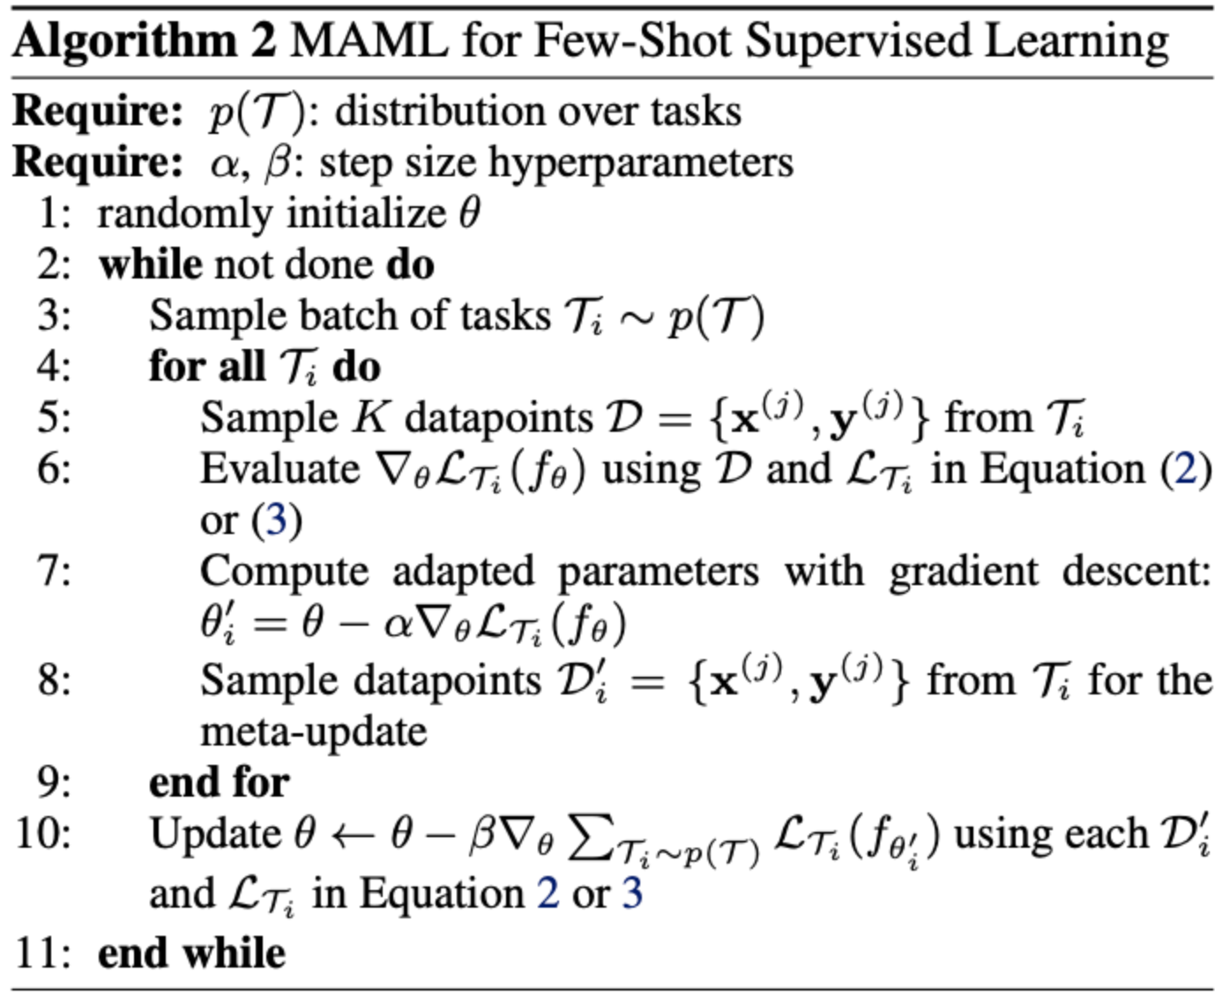
Step2: 建立模型
模型
演算法
Step 1 已經做好這件事了
Step 3 會定義
Outer loop
Inner loop

Slide 7
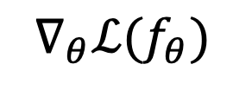


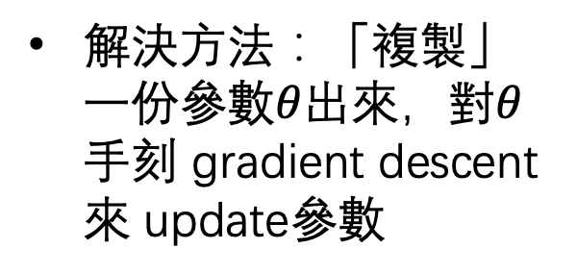


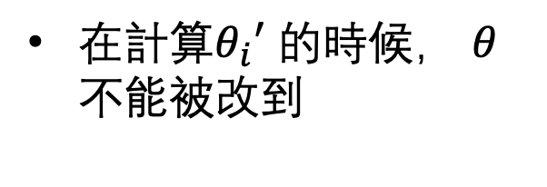

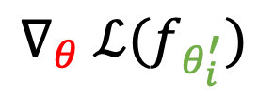
MAML – 老師上課講的
Sample a training task m
$$θ_{i}′$$
在計算$θ_{i}′$ 的時候， $θ$ 不能被改到
$$∇_{θ}ℒ(f_{θ})$$
$$∇_{θ} ℒ(f_{θ_{i}^{′}})$$
$$θ$$
$$θ$$
解決方法：「複製」一份參數$θ$出來，對$θ$手刻 gradient descent 來 update參數
Sample a training task n
$$θ$$
$$θ_{i}′$$

Slide 8
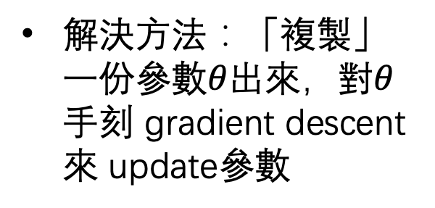

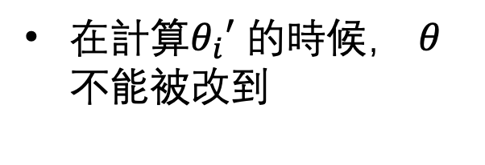
MAML – Real Implementation
Sample a batch of training tasks
$$θ_{i}′$$
在計算$θ_{i}′$ 的時候， $θ$ 不能被改到
$$∇_{θ}ℒ(f_{θ})$$
$$∇_{θ} ℒ(f_{θ_{i}^{′}})$$
$$θ$$
$$θ$$
解決方法：「複製」一份參數$θ$出來，對$θ$手刻 gradient descent 來 update參數
Sample a batch of training tasks n
$$θ$$
$$θ_{i}′$$

Slide 9




A meta-batch
In meta-learning, a training data is a task
Task 1
$$ℒ(f_{θ_{1}^{′}})$$
Task 2
$$ℒ(f_{θ_{2}^{′}})$$
Meta-batch size = 4
Task 3
$$ℒ(f_{θ_{3}^{′}})$$
Task 4
$$ℒ(f_{θ_{4}^{′}})$$
$$∇_{θ}MEAN[ℒ\left(f_{θ_{1}^{′}}\right)+ℒ\left(f_{θ_{2}^{′}}\right)+ℒ\left(f_{θ_{3}^{′}}\right)+ℒ\left(f_{θ_{4}^{′}}\right)]$$

Slide 10
An Epoch
Task 1
Task 2
…
Task 3
Task 4
Meta-batch #1
Meta-batch #2
Meta-batch #2
One Epoch

Slide 11
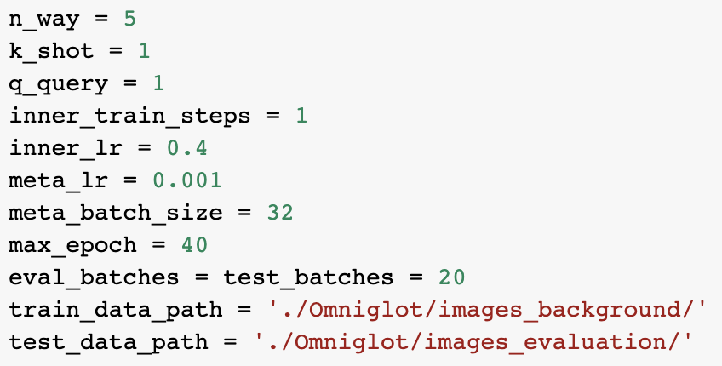
Step3: 開始訓練
Hyperparameters

