Slide 1
Deep Learning Computation
Risman Adnan
Telkom University

Slide 2
Outline
DL Frameworks
Tensorflow vs PyTorch
PyTorch DL Tutorial
Tensorflow DL Tutorial
Homeworks

Slide 3
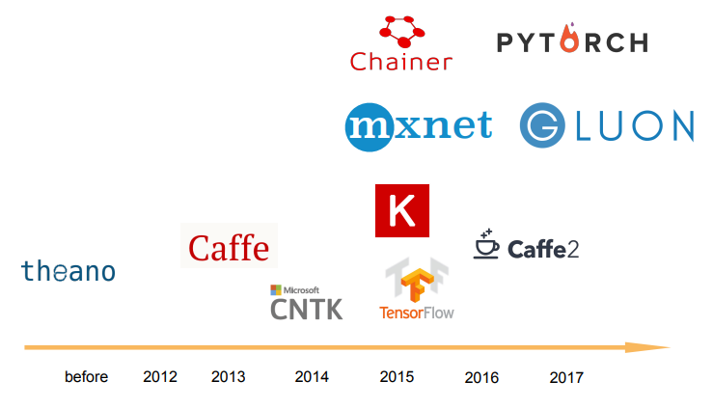
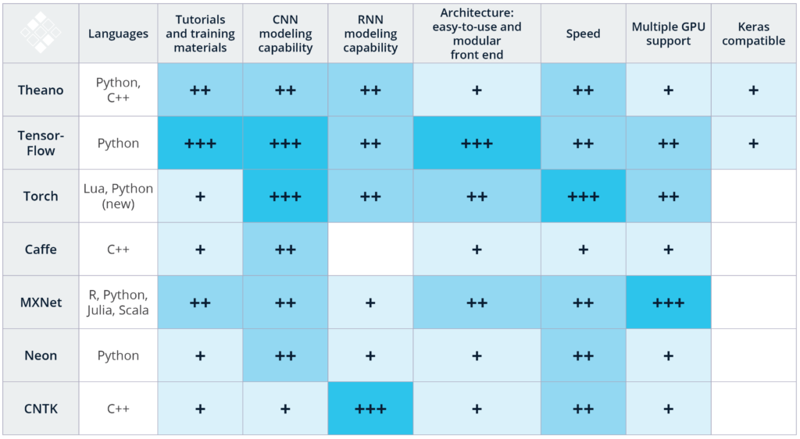
DL Frameworks

Slide 4
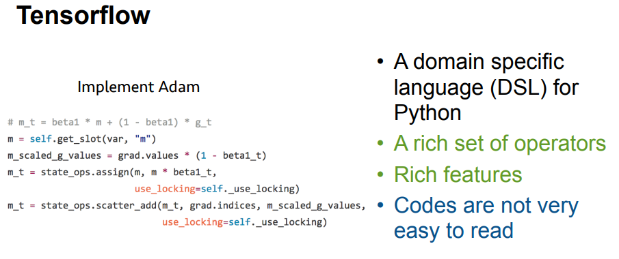
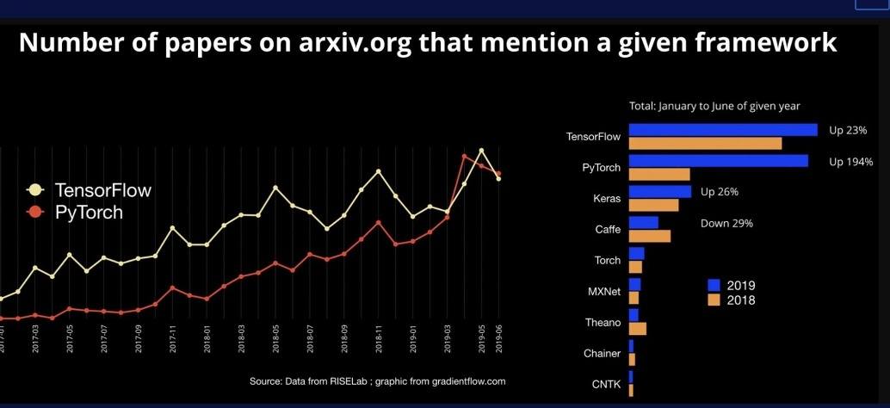
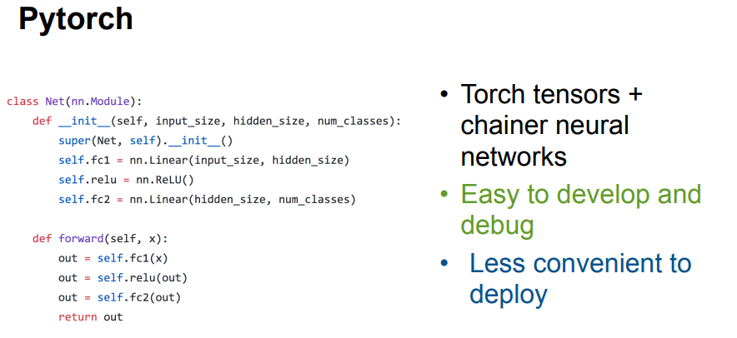
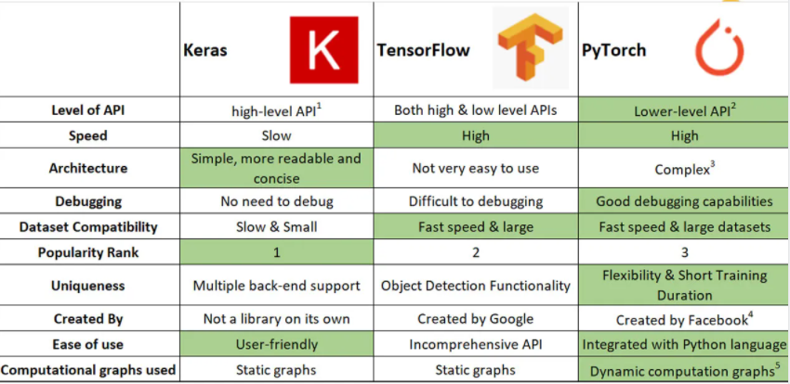
Tensorflow vs PyTorch

Slide 5
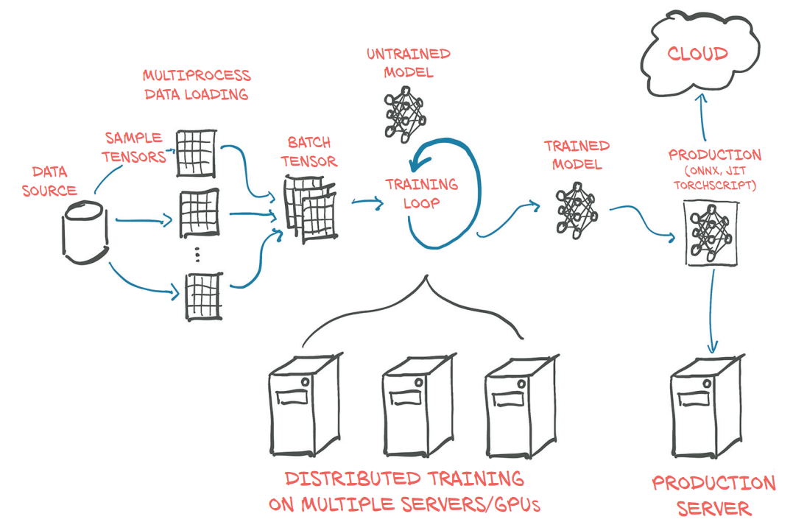
Development Lifecycle
Free eBooks
https://pytorch.org/assets/deep-learning/Deep-Learning-with-PyTorch.pdf

Slide 6
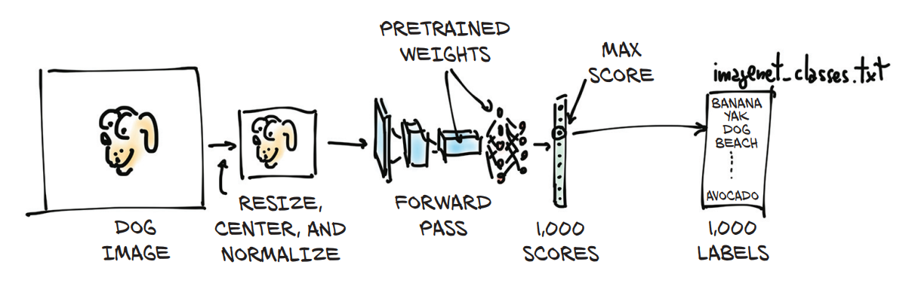
Development Lifecycle
https://pytorch.org/assets/deep-learning/Deep-Learning-with-PyTorch.pdf

Slide 7
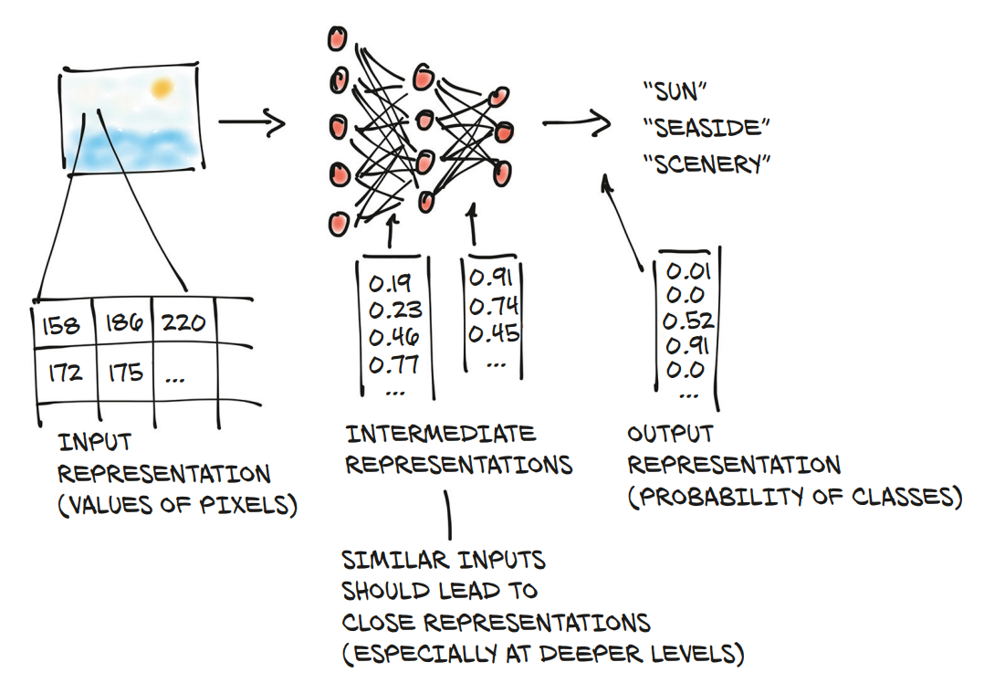
Its About Tensor Processing
https://pytorch.org/assets/deep-learning/Deep-Learning-with-PyTorch.pdf

Slide 8
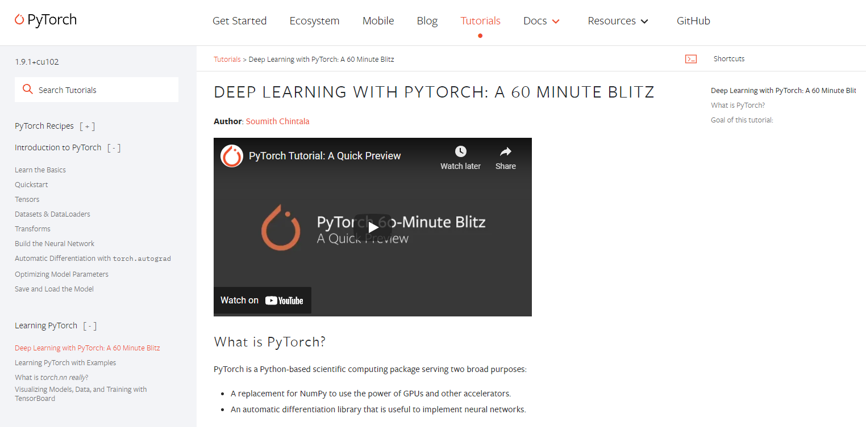

Slide 9
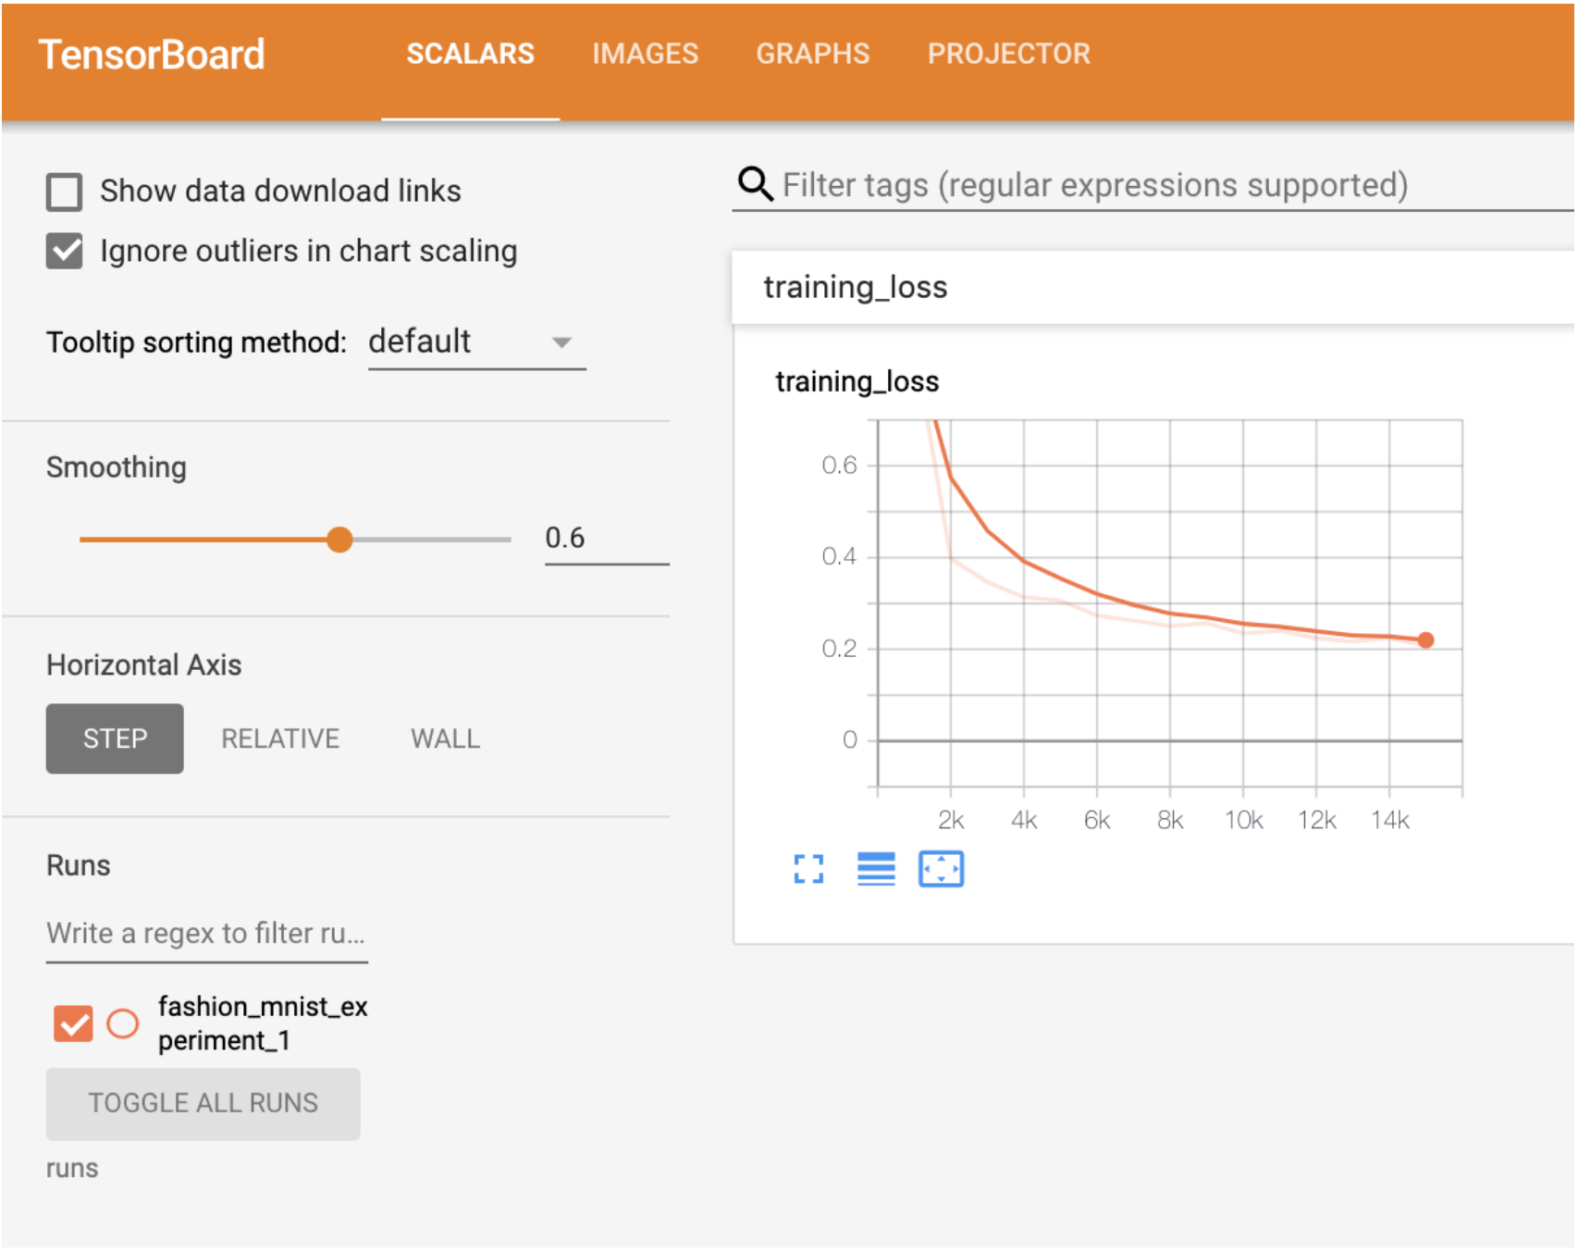
Home Work
PyTorch Tutorial
How to Visualize Training with TensorBoard

