Slide 1
Automatic Assessment of Text Readability
Hypothesis: Text predictability is a measure of its readability

Slide 2



Why is it important?
Authors can improve quality of writing
Produce better search results
Organizations can ensure writing standards

Slide 3
Early Formula-Based Methods
Words per sentence
# ‘unfamiliar’ words
Syllables per word
Letters per word
Easy to measure by hand

Slide 4
Supervised learning based methods
Features
Sentence length
Frequency of words
Discourse relations
Parse tree depth
Number of noun phrases
...
Ground truth
Texts classified by grade level
Pairs of phrases ranked by humans

Slide 5
Features => Deep learning
Ground truth => Our central hypothesis
“Predictability (or perplexity) of a text, as determined by a modern language model, is a good measure of its readability”

Slide 6
The Algorithm
Train language models on various corpora
Each corpus represents a target reader’s linguistic background
Compute perplexity on given text as the measure of readability
Outputs:
Minimum perplexity among all models
Perplexity of model trained on target reader’s corpus (eg. medical text for a doctor)

Slide 7
Why is this important?
Feature engineering requires effort, separate for each language
Ground truth is often unavailable and expensive to create. If it isn’t needed, we can:
  Produce scores for various languages
  Produce domain specific scores
Current methods don’t generalize to all kinds of text
Entropy is a canonical measure

Slide 8
Experiments
Baselines
We compare our approach to six formula-based metrics and one ML based scheme..
We use unigram models provided by Kevyn Collins-Thompson Jamie Callan as well as those produced from our own dataset in our evaluations.

Slide 9
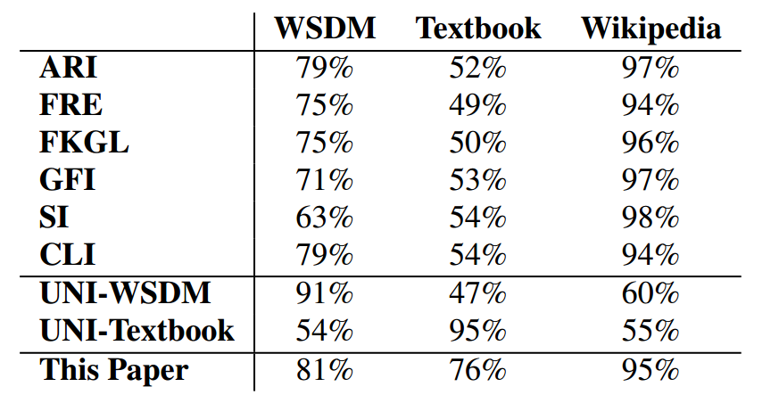
WSDM Dataset | 12,728 pairwise comparison annotated by 624 human readers | To check how our method appropriates human readers
NCERT Dataset | Mathematics books from grades 6-12, 1000 passages each of 50-100 words | To evaluate performance on short and large passages.
Simple vs. Standard Wikipedia | Articles from simple wikipedia and corresponding standard wikipedia | To evaluate on the same topic with different levels of difficulty
Accuracy of prediction of pairwise readability for various schemes

Slide 10
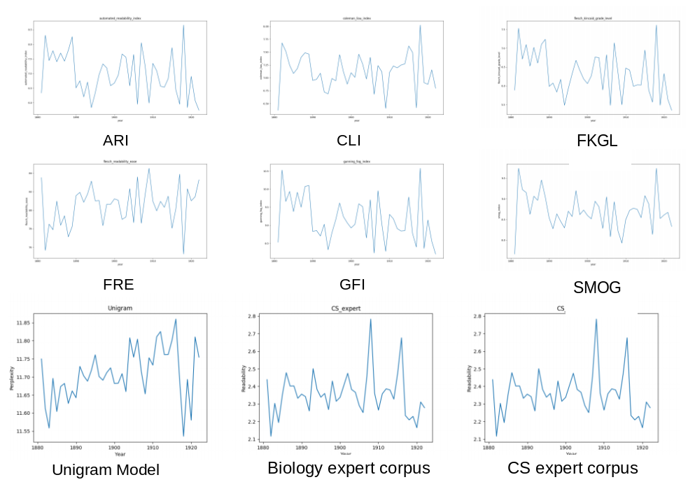
2. Short Term Language Change
Readability seen as a function of time, for novels published between 1881 and 1922 in the Oxford “Corpus of English Novels”

Slide 11
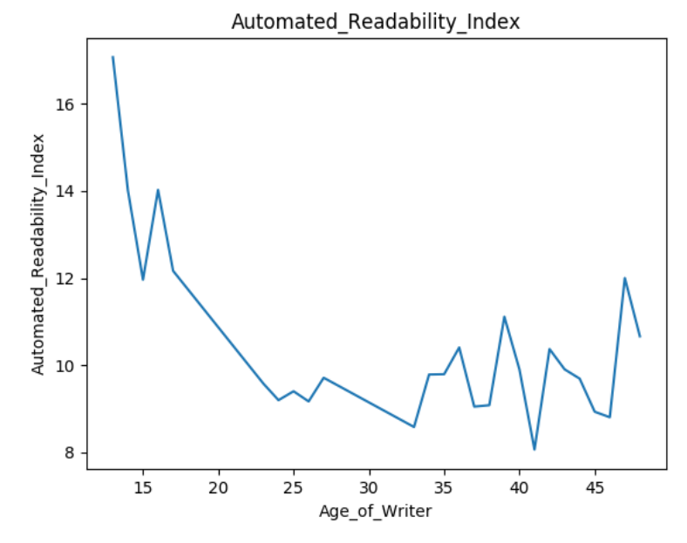
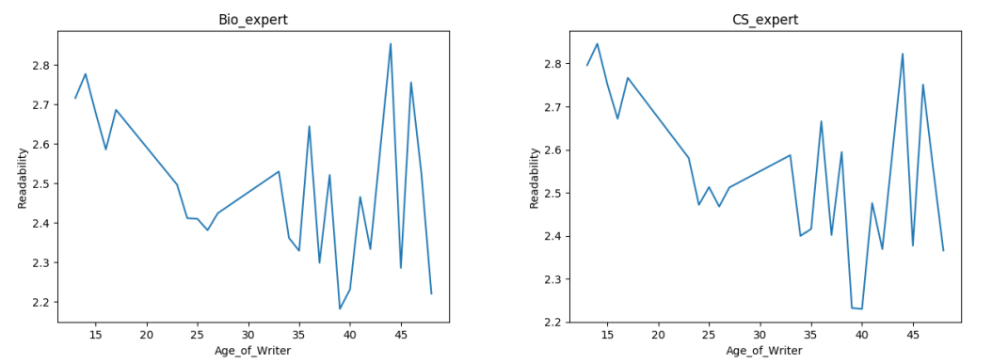
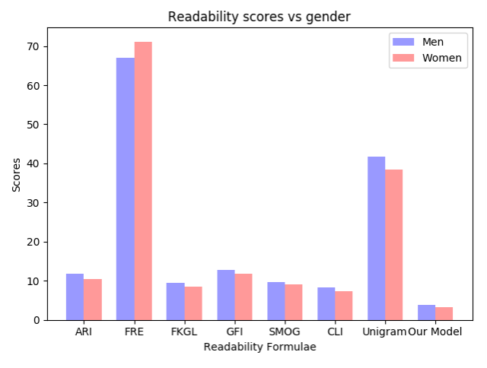
3. Effect of author’s age on blog readability
To analyze the readability of written text as a function of the author’s age and gender.
Staitical Formula
Biology expert Corpus
CS expert Corpus

