Slide 1
Ordinary Differential Equations
afridiimran94@yahoo.com

Slide 2
CHAPTER 1
Introduction to Differential Equations
1.1 Definitions and Terminology
1.2 Initial-Value Problems
1.3 Differential Equation as
Mathematical Models

Slide 3
1.1 Definitions and Terminology
DEFINITION: differential equation
An equation containing the derivative of one or more dependent variables, with respect to one or more independent variables is said to be a differential equation (DE).
(Definition 1.1, page 6).

Slide 4
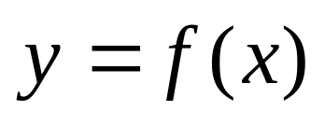
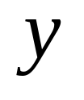
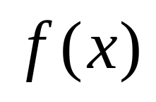
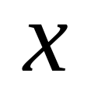
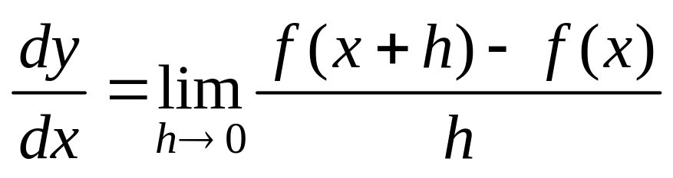
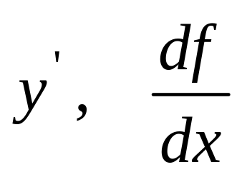
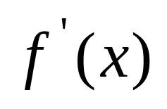
1.1 Definitions and Terminology
Recall Calculus
Definition of a Derivative
If , the derivative of or
With respect to is defined as
The derivative is also denoted by or

Slide 5
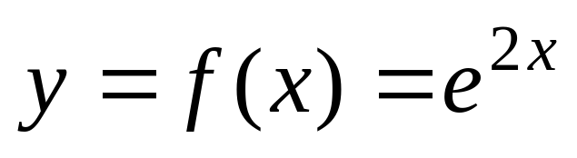
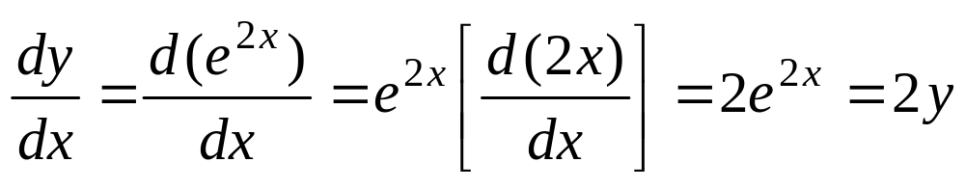
1.1 Definitions and Terminology
Recall the Exponential function
➔dependent variable: y
➔independent variable: x

Slide 6
1.1 Definitions and Terminology
Differential Equation:
Equations that involve dependent variables and
their derivatives with respect to the independent
variables.
Differential Equations are classified by
type, order and linearity.

Slide 7
1.1 Definitions and Terminology
Differential Equations are classified by
type, order and linearity.
TYPE
There are two main types of differential equation: “ordinary” and “partial”.

Slide 8
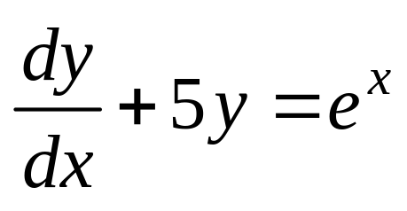
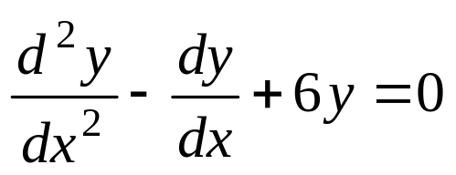
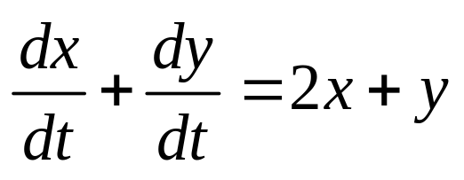
1.1 Definitions and Terminology
Ordinary differential equation (ODE)
Differential equations that involve only
ONE independent variable are called
ordinary differential equations.
Examples:
, , and
➔only ordinary (or total ) derivatives

Slide 9
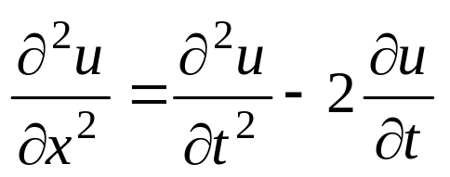
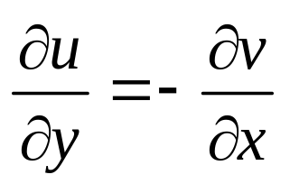
1.1 Definitions and Terminology
Partial differential equation (PDE)
Differential equations that involve
two or more independent variables are called
partial differential equations.
Examples:
and
➔only partial derivatives

Slide 10
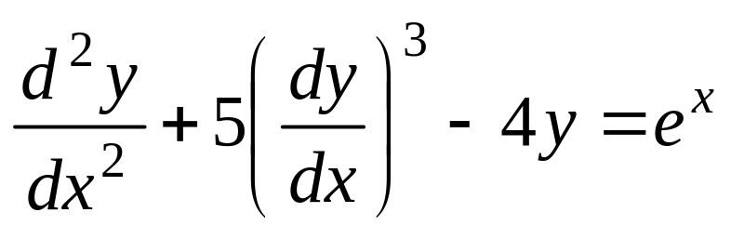
1.1 Definitions and Terminology
ORDER
The order of a differential equation is the order of the highest derivative found in the DE.
second order first order

Slide 11
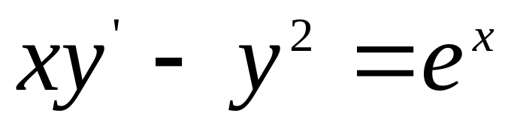
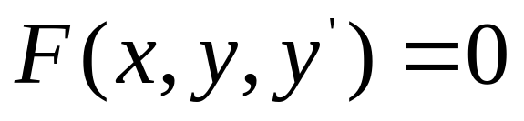
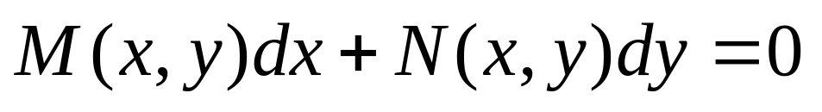
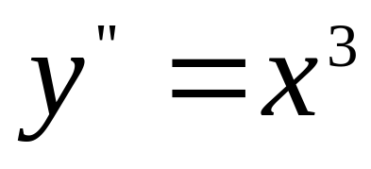
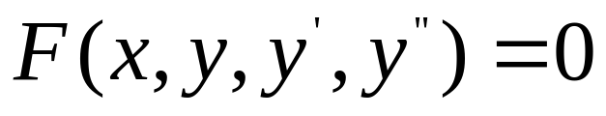
1.1 Definitions and Terminology
➔first order
Written in differential form:
➔second order

Slide 12
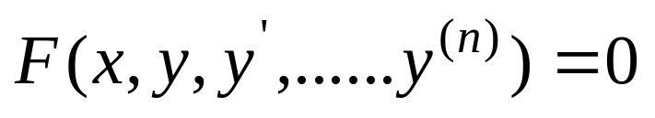
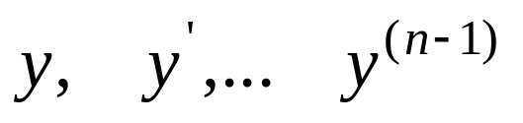
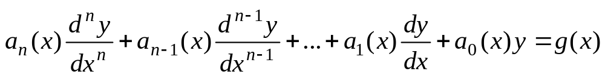
1.1 Definitions and Terminology
LINEAR or NONLINEAR
An n-th order differential equation is said to be linear if the function
is linear in the variables
➔
➔there are no multiplications among dependent variables and their derivatives. All coefficients are functions of independent variables.
A nonlinear ODE is one that is not linear, i.e. does not have the above form.

Slide 13
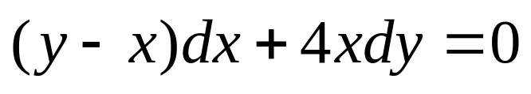
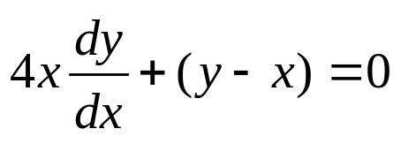
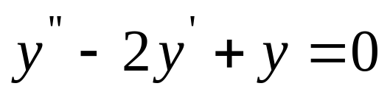
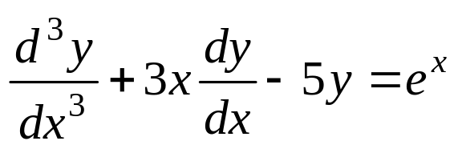
1.1 Definitions and Terminology
LINEAR or NONLINEAR
or
➔linear first-order ordinary differential equation
➔linear second-order ordinary differential equation
➔ linear third-order ordinary differential equation

Slide 14
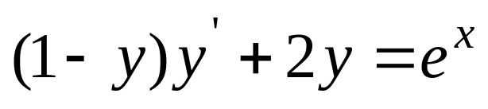
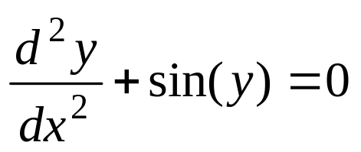
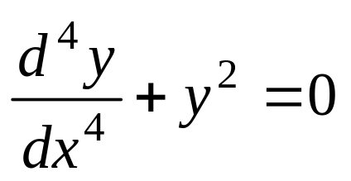
1.1 Definitions and Terminology
LINEAR or NONLINEAR
coefficient depends on y
➔nonlinear first-order ordinary differential equation
nonlinear function of y
➔nonlinear second-order ordinary differential equation
power not 1
➔ nonlinear fourth-order ordinary differential equation

Slide 15
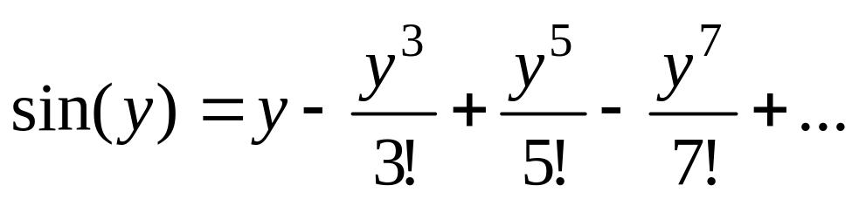
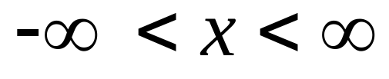
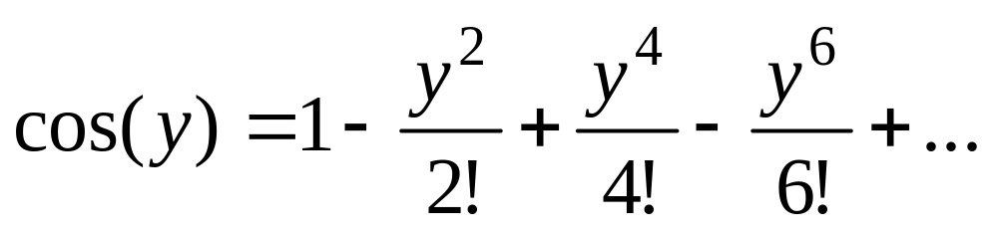
1.1 Definitions and Terminology
LINEAR or NONLINEAR
NOTE:

Slide 16
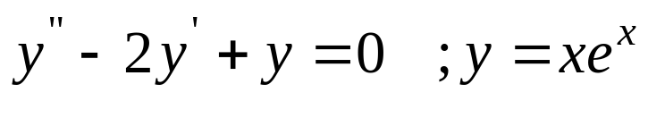
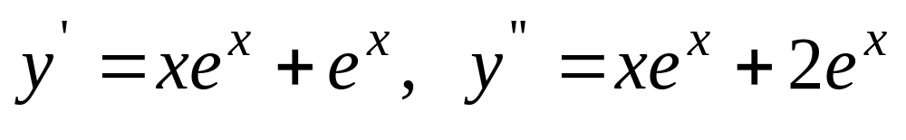
1.1 Definitions and Terminology
Verification of a solution by substitution
Example:
➔
➔left hand side:
right-hand side: 0
The DE possesses the constant y=0 ➔trivial solution

Slide 17
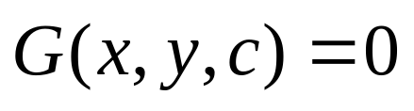
1.1 Definitions and Terminology
DEFINITION: families of solutions
A solution containing an arbitrary constant (parameter) represents a set of
solutions to an ODE called a one-parameter family of solutions.
A solution to an n−th order ODE is a n-parameter family of solutions .
Since the parameter can be assigned an infinite number of values, an ODE can have an infinite number of solutions.

Slide 18
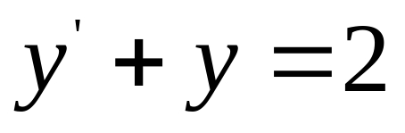
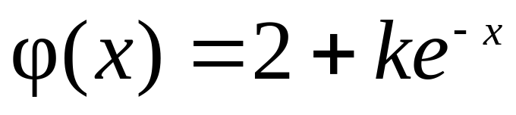
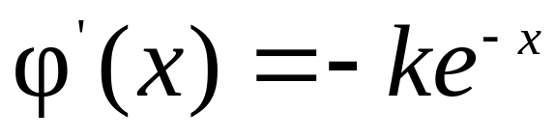
1.1 Definitions and Terminology
Verification of a solution by substitution
Example:
➔

Slide 19
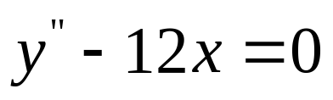
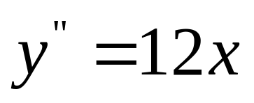
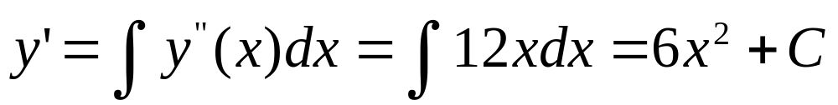

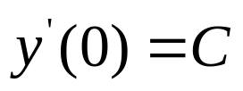
Second-Order Differential Equation
Consider the simple, linear second-order equation
➔ ,
➔
To determine C and K, we need two initial conditions, one specify a point lying on the solution curve and the other its slope at that point, e.g. ,
WHY ???

Slide 20
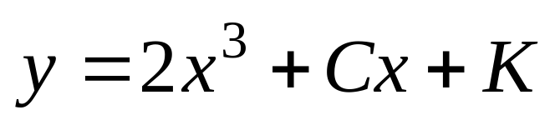
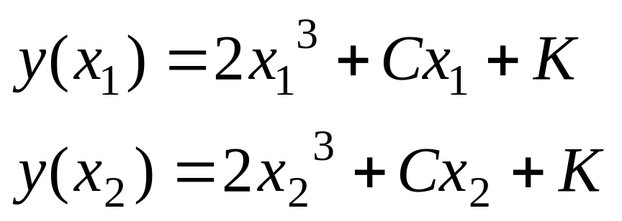
Second-Order Differential Equation
IF only try x=x_{1,} and x=x₂
➔
It cannot determine C and K,

Slide 21
1.1 Definitions and Terminology
Solutions
General Solution: Solutions obtained from integrating the differential equations are called general solutions. The general solution of a nth order ordinary differential equation contains n arbitrary constants resulting from integrating n times.
Particular Solution: Particular solutions are the solutions obtained by assigning specific values to the arbitrary constants in the general solutions.
Singular Solutions: Solutions that can not be expressed by the general solutions are called singular solutions.

