Slide 1

National Institute of Technology, Karnataka
Analysis of Co-Authorship network using Scopus databases
Presented by-
Gavali Deshabhakt Naganath
Mohammad Ahsan
Mayur Anil Shimpi
Course Instructor: Dr. Pushparaj Shetty
Subject: Big Data Analytics
Specialization: CDS
Date: 14/04/2021

Slide 2
Downloading Database
Scopus
Keyword – Artificial intelligence
Document type – Article
Subject area – Engineering
Query:
TITLE-ABS-KEY(Artificial Intelligence) AND ( LIMIT-TO ( DOCTYPE,"ar" ) OR LIMIT-TO ( DOCTYPE,"ENGI" ) OR LIMIT-TO ( DOCTYPE,"Artificial Intelligence" ) )

Slide 3
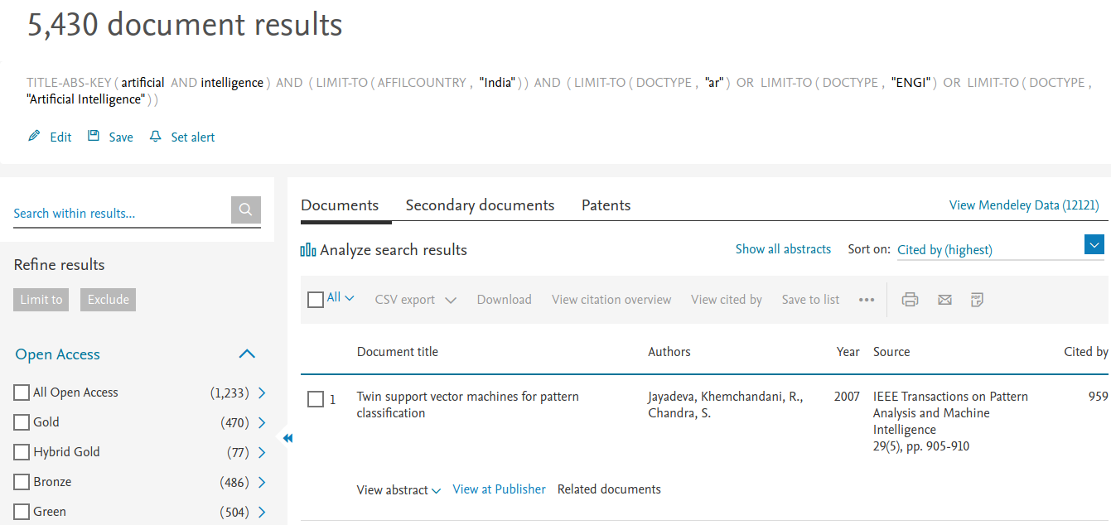
Downloading India’s Database
TITLE-ABS-KEY(Artificial Intelligence) AND ( LIMIT-TO ( AFFILCOUNTRY,"India" ) ) AND ( LIMIT-TO ( DOCTYPE,"ar" ) OR LIMIT-TO ( DOCTYPE,"ENGI" ) OR LIMIT-TO ( DOCTYPE,"Artificial Intelligence" ) )

Slide 4
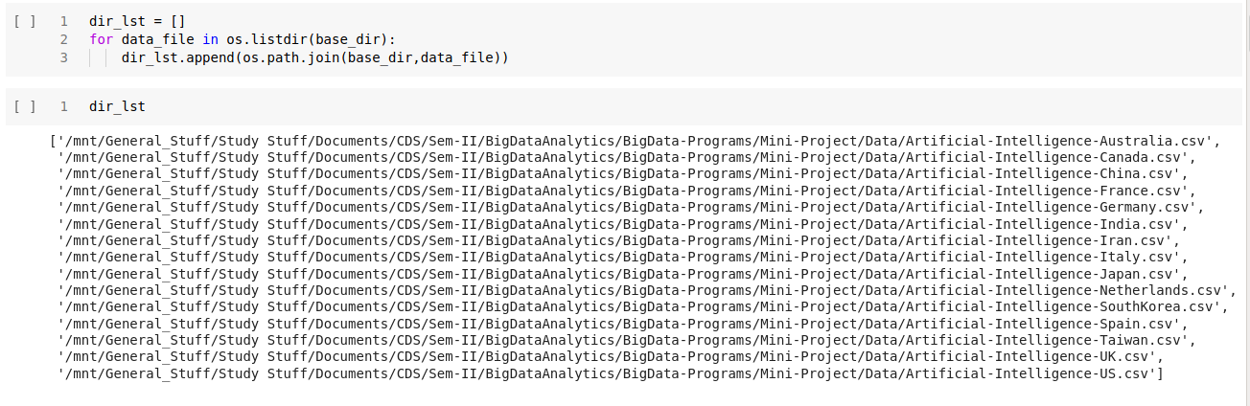
Setting path of Data directory

Slide 5
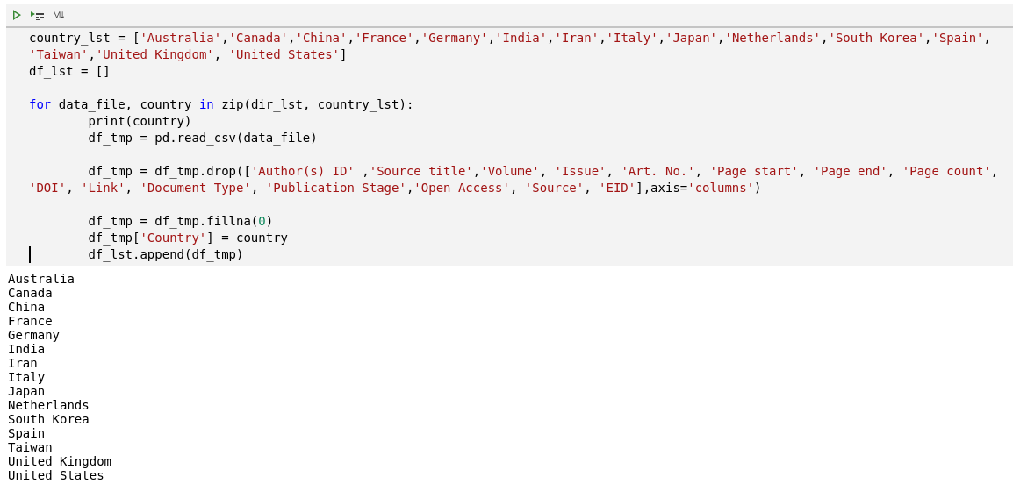
Importing and preprocessing country-wise database

Slide 6
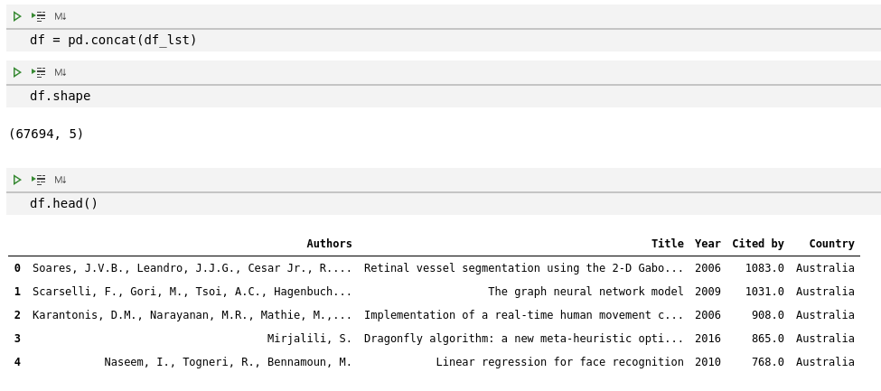
Forming Main Dataframe

Slide 7
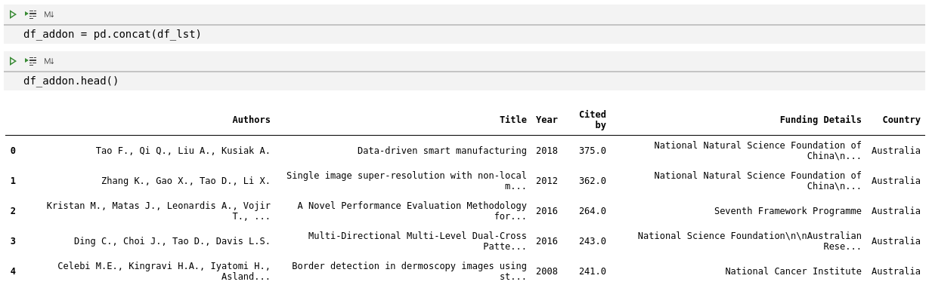
Applying same data pipeline to Database with sponsorship column

Slide 8
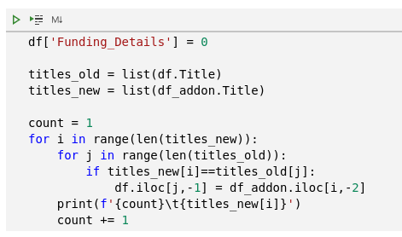
Updating Funding details of Main Dataframe - df

Slide 9
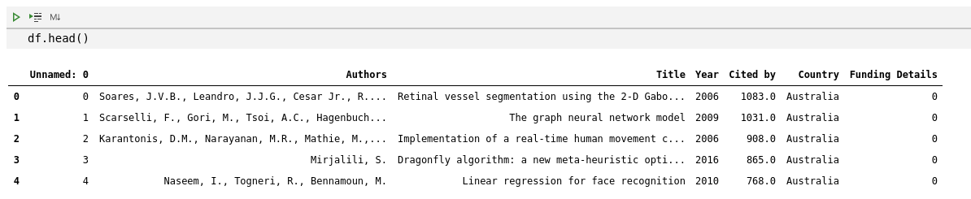

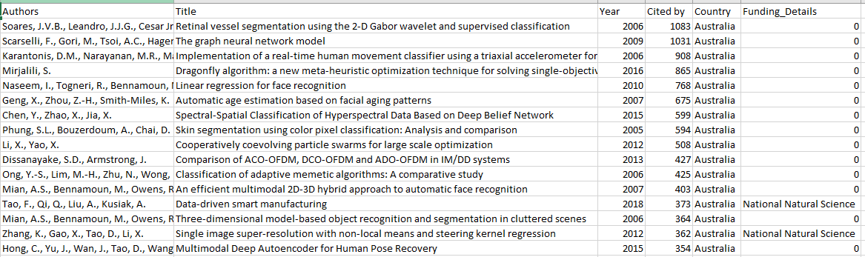
Saving Database to csv File

Slide 10
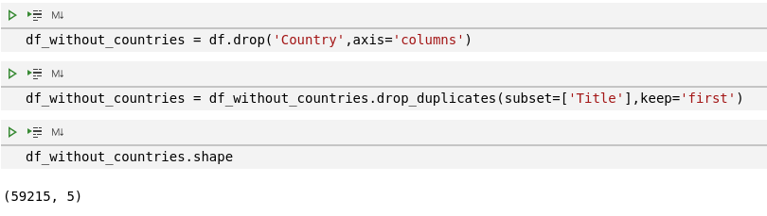
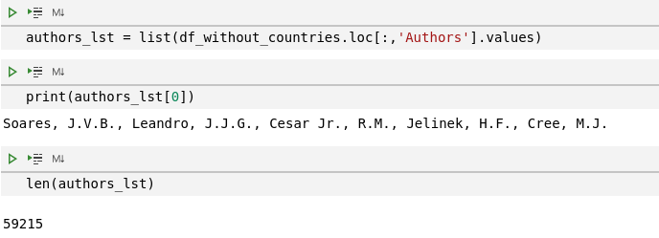
Generating Files necessary for further Analysis

Slide 11
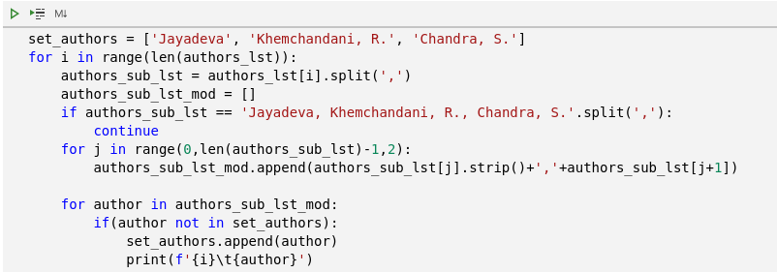

Separating Author Names

Slide 12

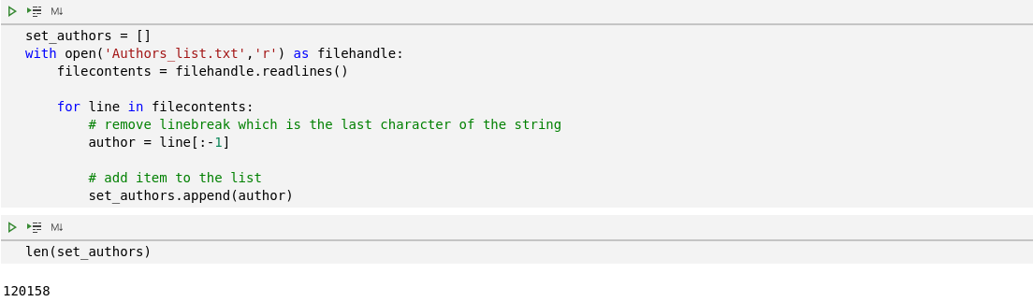
Storing Author Names to Text File
Reading Author Names from Text File

Slide 13
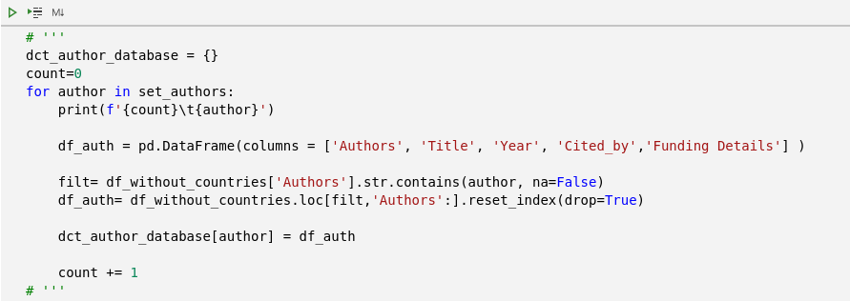
Creating Author: Database Dictionary

Slide 14
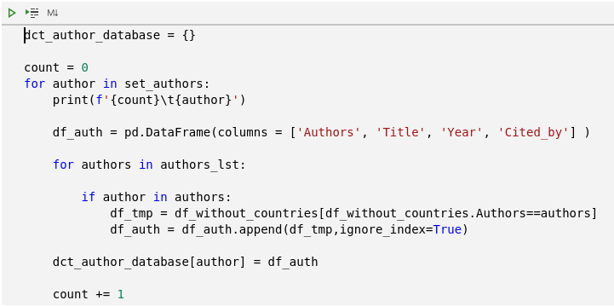
Alternative code

Slide 15

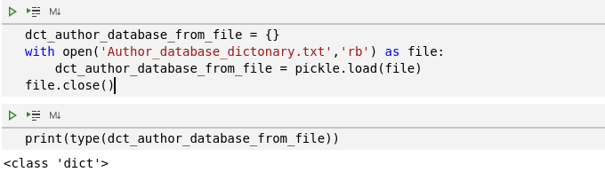
Storing dictionary to text file
Reading dictionary from text file

Slide 16
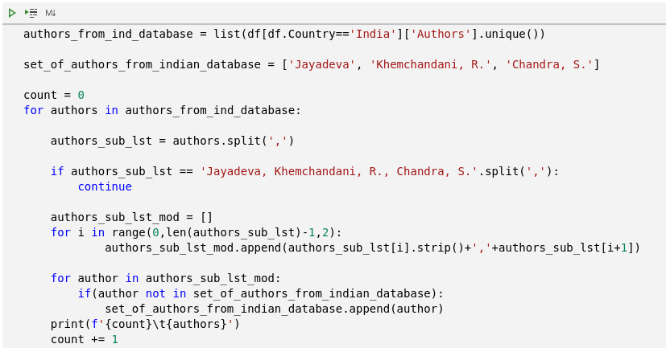
Separating Indian Authors Names

Slide 17
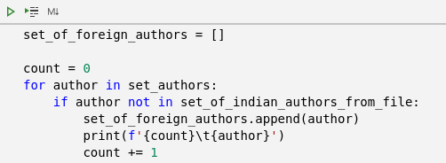
Separating Foreign Authors Names

Slide 18
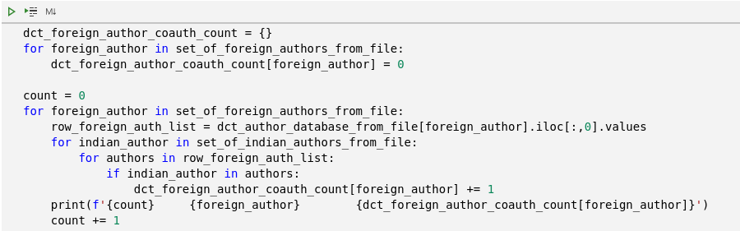
Generating Author :Publication count with Indian authors Dictionary

