Slide 1
Clustering
Find homogeneous subgroups within the data
Data points in each cluster are as similar as possible
Similarity measures are such as Euclidean-based distance or correlation-
based distance

Slide 2
K-Means Clustering
K-Means algorithm is an iterative algorithm
It partitions the dataset into K pre-defined distinct clusters where each data point belongs to only one group
It assigns data points to a cluster such that the sum of the squared distance between the data points and the cluster’s centroid is at the minimum

Slide 3
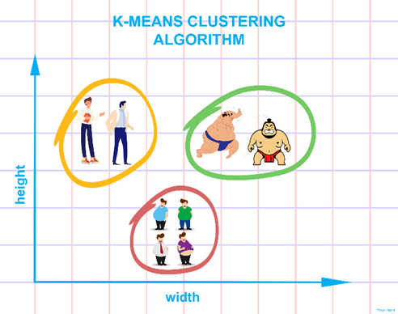

Slide 4
K-Means Algorithm
1. Choose k initial means µ1, . . . , µk uniformly at random from the set X.
2. For each point x ∈ X, find the closest mean µi and add x to a set Si
3. For i = 1, . . . , k, set µ_{i} to be the centroid of the points in Si
4. Repeat steps 2 and 3 until the means have converged.

Slide 5
K-Means via MapReduce
Two Phases of K-Means
1]Map will Assign Observations to Closest cluster Center
2]Reduce will revise cluster centers as mean of assigned observations

Slide 6
K-Means via MapReduce Algorithm
1. Choose k initial means µ1, . . ., µk uniformly at random from the set X.
2. Apply the MapReduce given by k-meansMap and k-meansReduce to X.
3. Compute the new means µ1, . . ., µk from the results of the MapReduce.
4. Broadcast the new means to each machine on the cluster.
5. Repeat steps 2 through 4 until the means have converged.

Slide 7

Classification step as Map
Classify: Assign observations to closest cluster center
1] map([μ$1$, μ₂………. μ_{k}],X_{i}]
2]Z_{i}← argmin ||μ_{i}-X_{i}||₂²
^{i}
3]emit(Zi,Xi)

Slide 8
Recenter Step as Reduce
Recenter: Revise cluster centers as Mean of Assigned observations
1]reduce (Zi, X in cluster i:[X1,X3……….])
sum=0
count=0
2]for x in cluster i
sum +=x
count+=1
3]emit(Zi, sum/count)

