Slide 1

MAP REDUCE
IN
HADOOP
Presentation By
Gavali Deshabhakt Naganath
Mohammad Ahsan
Mayur Anil Shimpi

Slide 2

Map Reduce
Def:
Map Reduce is a programming model and an associated implementation for processing and generating big data sets with a parallel, distributed algorithm on a cluster.
What is it ?

Slide 3
Key Features of Map Reduce
Take small pieces of data from big data
Take Key, Value pairs as input dataset at all stage
All stages of Map Reduce generate key, value pairs as output dataset.
Work on principle of distributed data and parallel processing
Data saved within HDFS in certain format.
eg. bZip2, Snappy, AVOC etc.

Slide 4
Different Stages in Map Reduce
Mapper
Intermediate Stages
i) Combiner
ii) Partitioner
iii) Sorting
3. Reducer
4. Compression

Slide 5
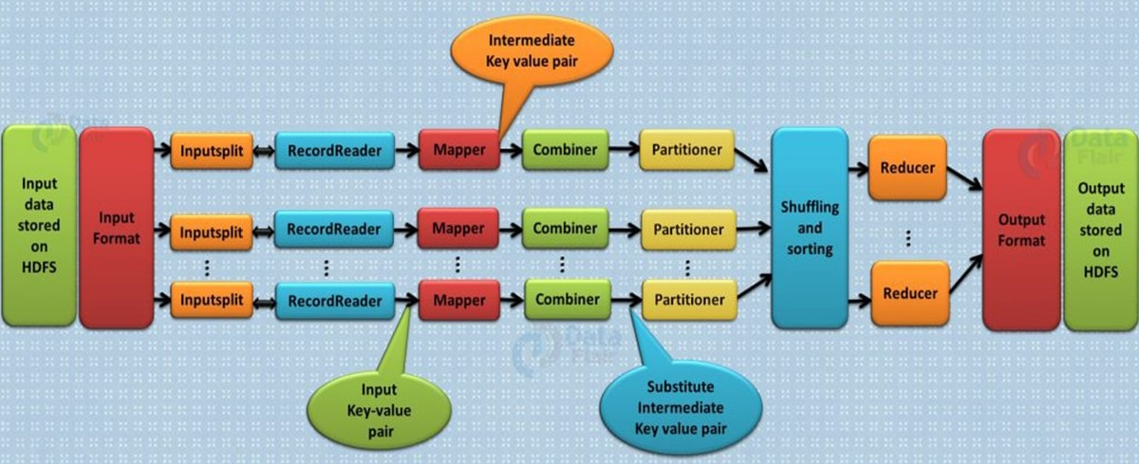
Flow Chart Of Map Reduce

Slide 6

Mapper
It is where parallel processing take place on datasets.
Business logical Model is implemented.
Semi processed Key, Value pair generated as output.
Crucial stage of Map Reduce where actual processing takes place.

Slide 7
Combiner
It’s main function is to summarize the mapper output records with the same key.
Also called Mini Reducer.
It Aggregate data coming out from mapper.

Slide 8
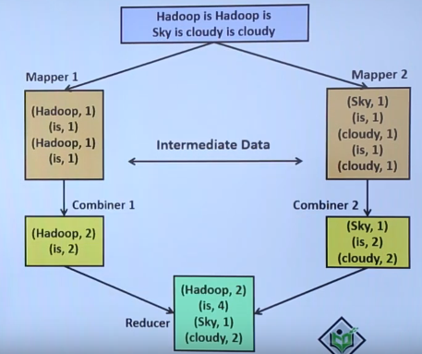
Flow Chart of Combiner

Slide 9
Partitioner
It partitions the key-value pairs of intermediate Mapper outputs.
It partition data using user-defined function (like hash function).
Different practitioners' assign different partition keys.
Partition keys are used to map key, value paired data to a particular reducer.
Number of Practitioners' = Number of Reducers

Slide 10

Flow Chart Of Partitioner
Partitioner 1
Reducer 1
A, 2
B, 3
A, 5
A, 4
B, 4
C, 3
B, 1
C, 2
Data As Output of Mapper
A, {2,5,4}
C, {3,2}
B, 8
PK #1
I know #2
Partitioner 2
Reducer 2
B, {3,4,1}
A, 11
C, 5
PK #2
I know #1

Slide 11
Sorting
It’s an intermediate stage where in coming data get sorted.
Sorting take place according to key of paired data.
Sorting speed up the reducer process.

Slide 12
Reducer
Reducer is the final stage of Map Reduce.
It take the preprocessed data coming from some intermediate stages and do either aggregation, filtration or summation independently.
The OutputCollector.collect() method, writes the output of the reduce task to the HDFS file system.
Reducer output is not sorted when stored .

Slide 13

Compression
Compression saves storage, network flow, processing cost significantly.
Without compression hadoop would become impractical as it would be using enormous resources.
General format used to store files in hadoop are Snappy, bZip2, AVOC, Parquet etc.

Slide 14
Features to care before selecting the right format
Compressed file should be optimal in storage.
Faster read and write can be done after compression.
Compressed file should split if needed. (Distributive Nature)
Should follow the dynamic schema even after compression.

Slide 15
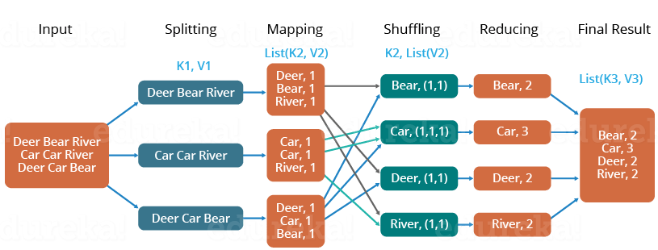
Flow Chart Of Map Reduce With Example
Solving Word Count Problem With Map Reduce

