Slide 1

National Institute of Technology, Karnataka
Analysis of Co-Authorship network using Scopus databases
Presented by-
Gavali Deshabhakt Nagnath
Mohammad Ahsan
Mayur Anil Shimpi
Course Instructor: Dr. Pushparaj Shetty
Subject: Big Data Analytics
Specialization: CDS
Date: 07/05/2021

Slide 2
Agenda
Downloading Database
Data Preprocessing
Generating files necessary for analysis
Finding answers

Slide 3
Downloading Database
Scopus
Keyword – Artificial intelligence
Document type – Article
Subject area – Engineering
Query:
TITLE-ABS-KEY(Artificial Intelligence) AND ( LIMIT-TO ( DOCTYPE,"ar" ) OR LIMIT-TO ( DOCTYPE,"ENGI" ) OR LIMIT-TO ( DOCTYPE,"Artificial Intelligence" ) )

Slide 4
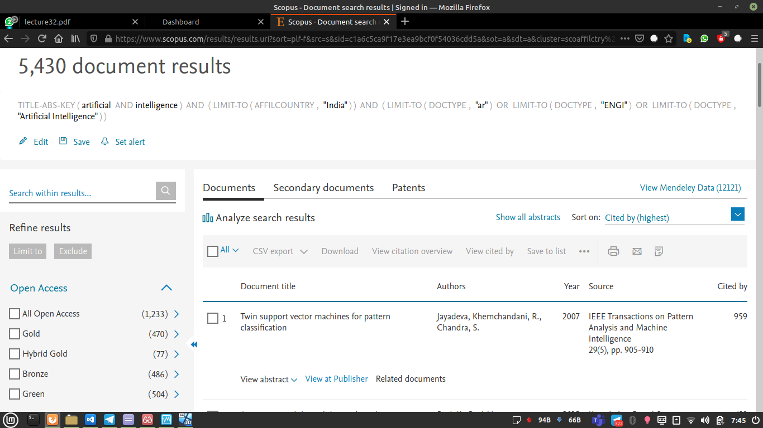
Downloading India’s Database
TITLE-ABS-KEY(Artificial Intelligence) AND ( LIMIT-TO ( AFFILCOUNTRY,"India" ) ) AND ( LIMIT-TO ( DOCTYPE,"ar" ) OR LIMIT-TO ( DOCTYPE,"ENGI" ) OR LIMIT-TO ( DOCTYPE,"Artificial Intelligence" ) )

Slide 5
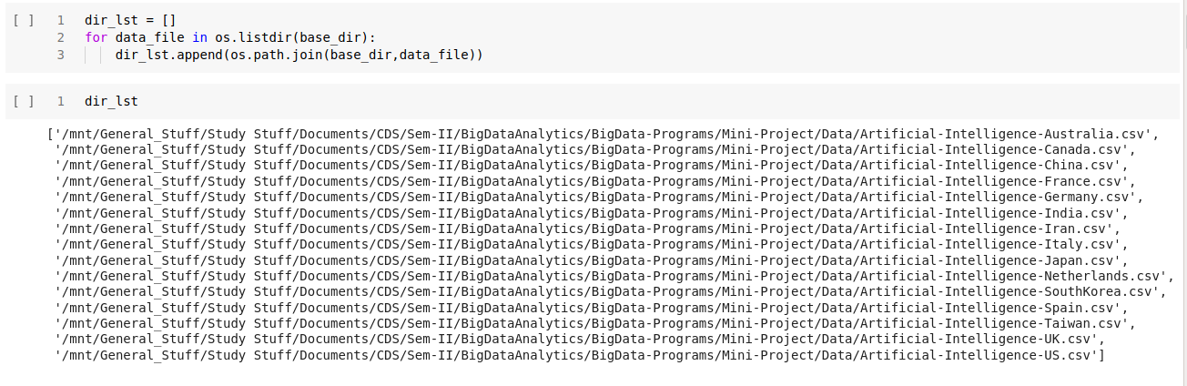
Setting path of Data directory

Slide 6
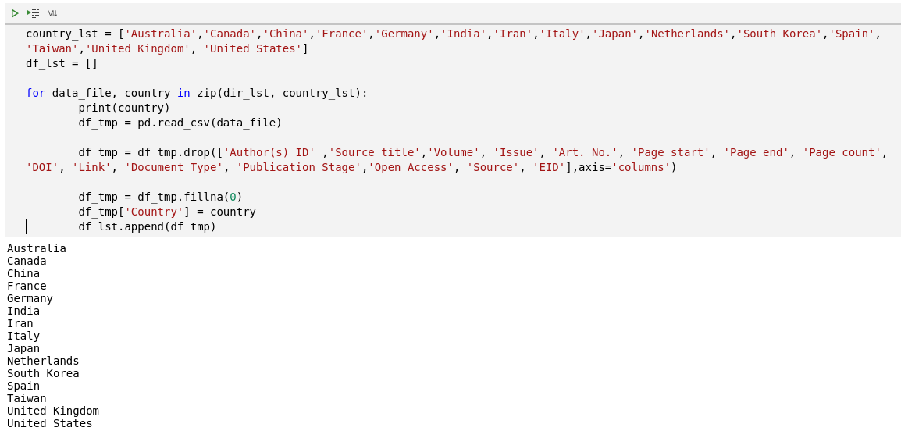
Importing and preprocessing country-wise database

Slide 7
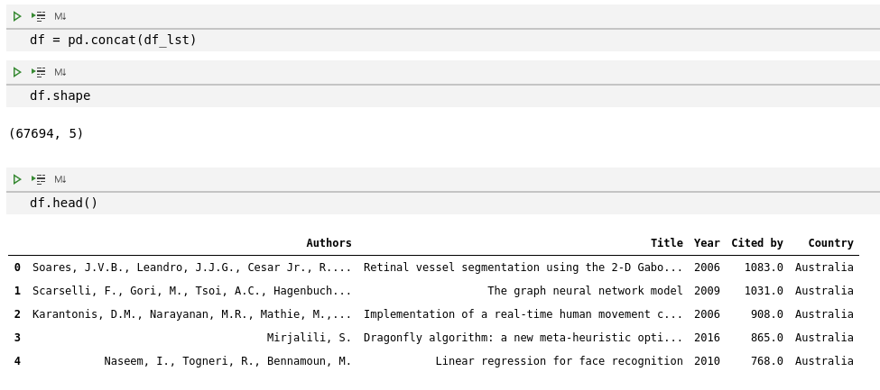
Forming Main Dataframe

Slide 8
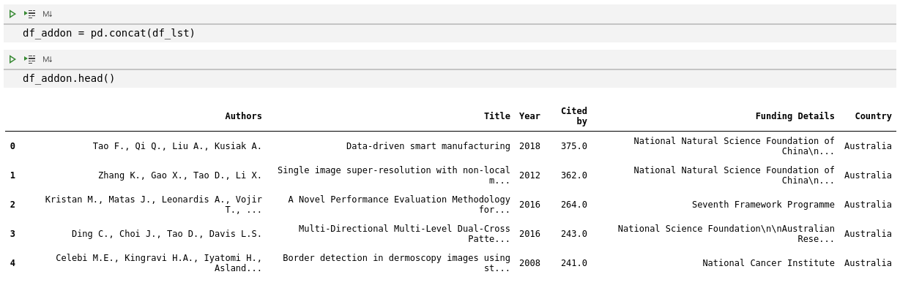
Applying same data pipeline to Database with sponsorship column

Slide 9
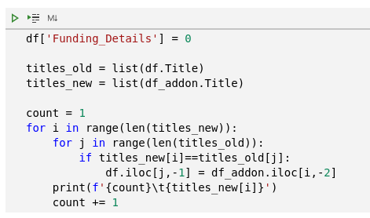
Updating Funding details of Main Dataframe

Slide 10
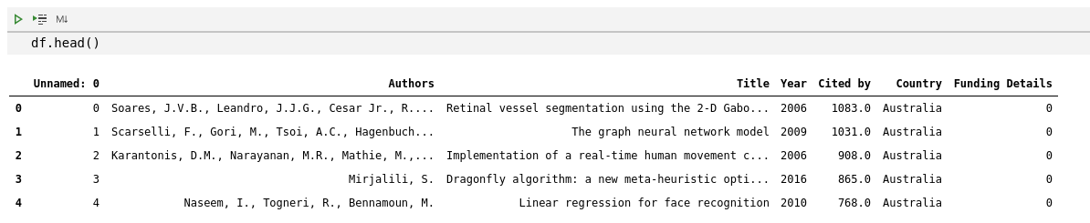

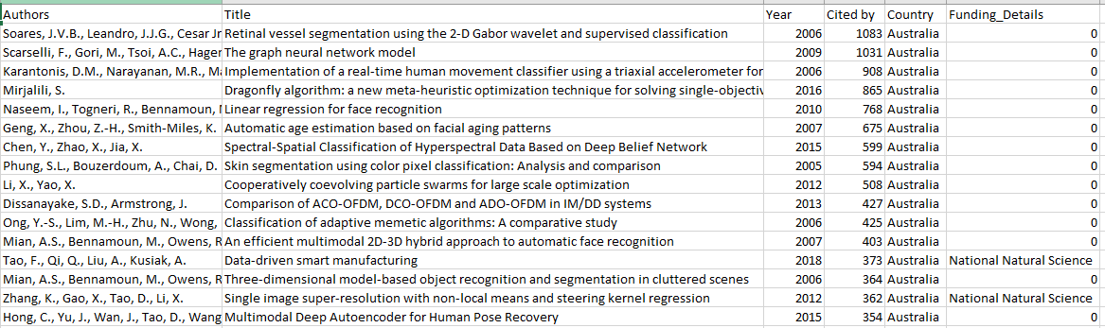
Saving Database to csv File

Slide 11
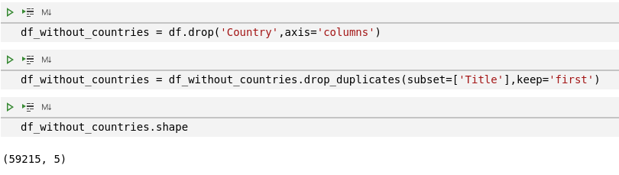
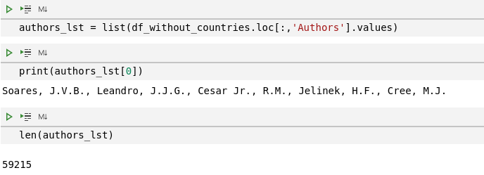
Generating Files necessary for further Analysis

Slide 12
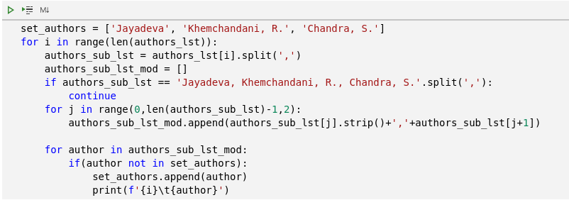

Separating Author Names

Slide 13

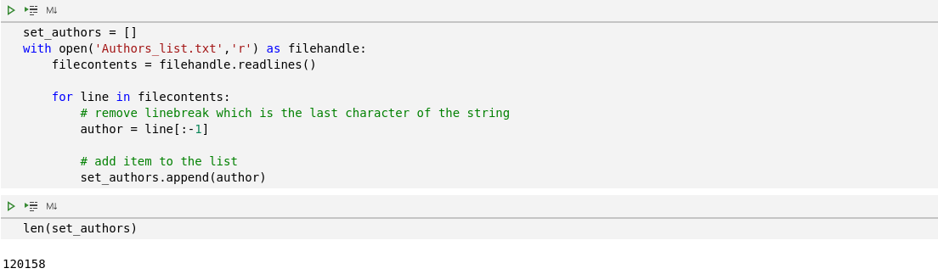
Storing Author Names to Text File
Reading Author Names from Text File

Slide 14
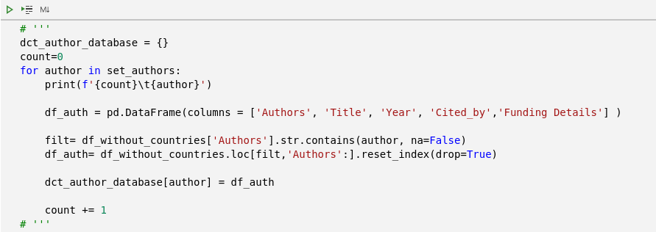
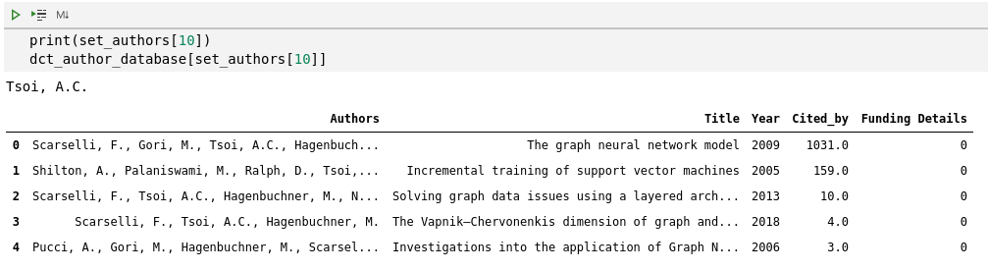
Creating Author: Database Dictionary

Slide 15
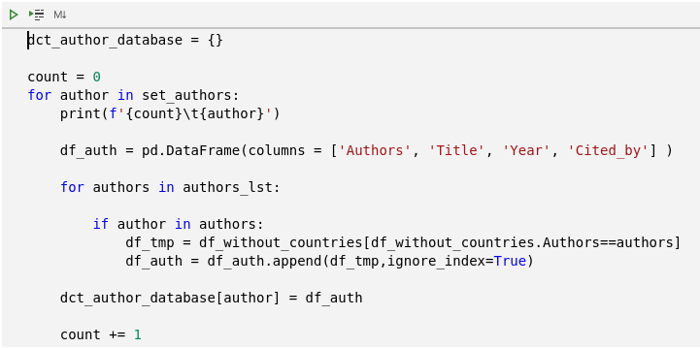
Alternative code

Slide 16

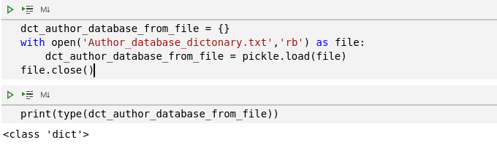
Storing dictionary to text file
Reading dictionary from text file

Slide 17
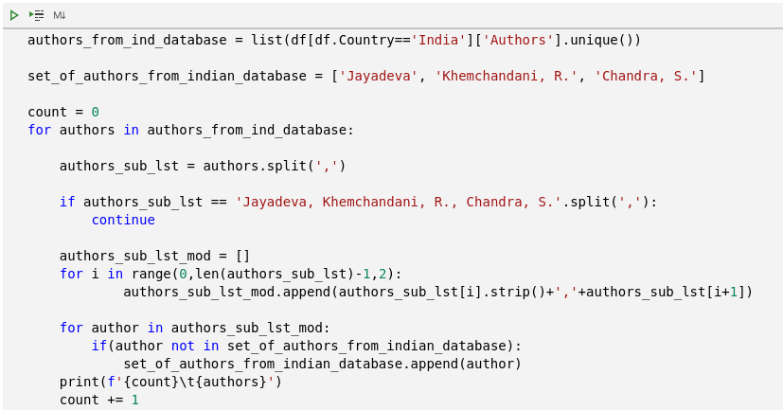
Separating Indian Authors Names

Slide 18
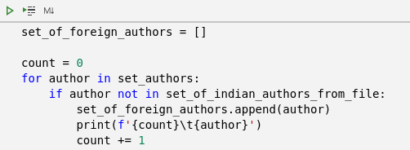
Separating Foreign Authors Names

Slide 19
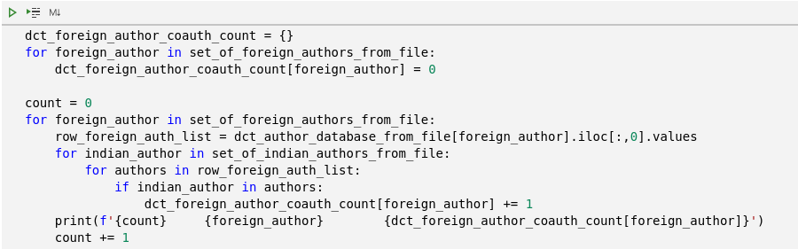
Generating Author :Publication count with Indian authors Dictionary

Slide 20
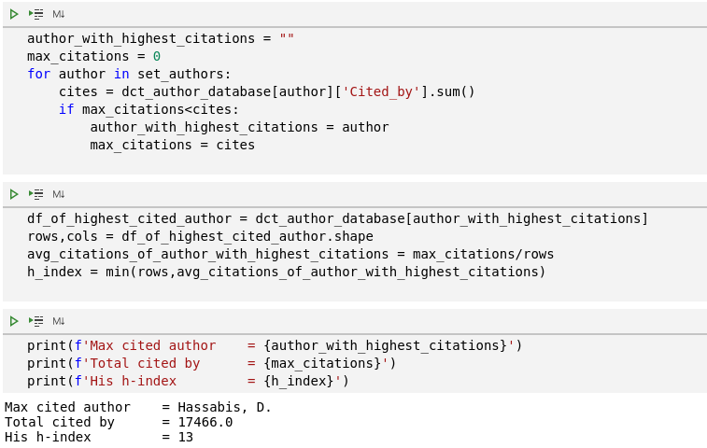
1. Highest cited author and his h-index (from the world)

Slide 21
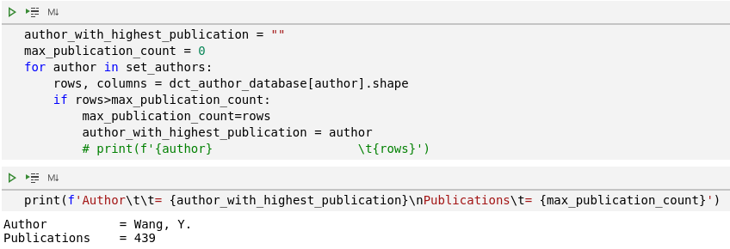
2. Highest publication author

Slide 22
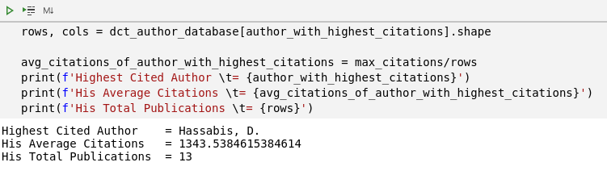
3. Highest cited authors average citations, and the country name
A google search with above author's name tells us that he's from 'United Kingdom' and doing research on 'Artificial Intelligence'

Slide 23
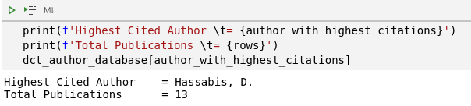
4. Total number of publications of the highest cited author

Slide 24
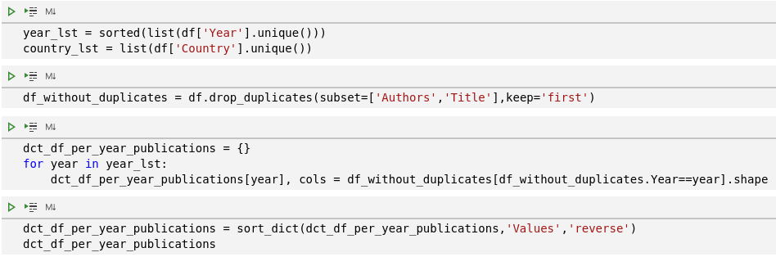
5. Total publication in year
*Output in next slide

Slide 25
{2020: 6222,
2019: 4688,
2018: 4122,
2016: 3341,
2014: 3159,
2015: 3117,
2017: 3049,
2021: 2688,
2013: 2277,
2004: 2191,
2012: 2010,
2008: 1933,
2009: 1565,
2011: 1559,
2010: 1542,
2006: 1464,
2007: 1401,
2003: 1357,
2005: 1346,
2000: 793,
1989: 734,
1999: 730,
2001: 726,
1997: 718,
1996: 713,
1994: 703,
2002: 702,
1998: 697,
1995: 601,
1988: 531,
1991: 394,
1992: 357,
1987: 351,
1986: 165,
1985: 117,
1984: 70,
1983: 25,
1982: 23,
1977: 17,
1980: 13,
1973: 12,
1978: 12,
1979: 12,
1993: 485,
1990: 457,
1981: 11,
1974: 8,
1975: 8,
1976: 8,
1971: 7,
1972: 6,
1970: 3,
1962: 1,
1963: 1,
1964: 1,
1965: 1,
1968: 1,
1969: 1}

Slide 26
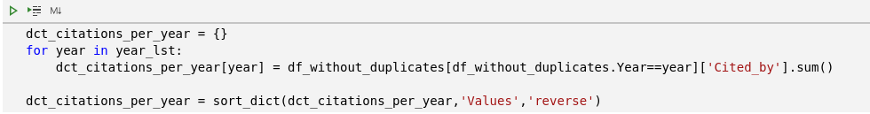
6. Total citation per year
{2008: 86548.0,
2016: 85426.0,
2015: 81343.0,
2005: 78325.0,
2004: 75544.0,
2007: 73896.0,
2006: 73652.0,
2014: 69065.0,
2009: 68433.0,
2018: 66871.0,
2013: 63245.0,
2017: 61390.0,
2010: 61118.0,
2012: 56435.0,
2011: 55280.0,
2019: 42281.0,
2000: 36085.0,
2003: 32783.0,
1999: 28128.0,
1998: 26193.0,
2002: 25418.0,
2001: 25176.0,
1997: 21638.0,
2020: 21386.0,
1995: 18774.0,
1994: 18694.0,
1996: 16943.0,
1989: 12072.0,
1992: 10540.0,
1990: 9800.0,
1993: 8807.0,
1991: 8453.0,
1988: 8385.0,
1987: 5439.0,
1986: 3652.0,
1980: 2616.0,
1985: 1930.0,
1977: 1644.0,
2021: 1568.0,
1979: 997.0,
1984: 812.0,
1971: 446.0,
1973: 256.0,
1978: 252.0,
1976: 215.0,
1983: 208.0,
1982: 202.0,
1975: 186.0,
1970: 83.0,
1981: 76.0,
1972: 49.0,
1974: 33.0,
1963: 17.0,
1962: 16.0,
1969: 4.0,
1964: 2.0,
1965: 2.0,
1968: 0.0}

Slide 27
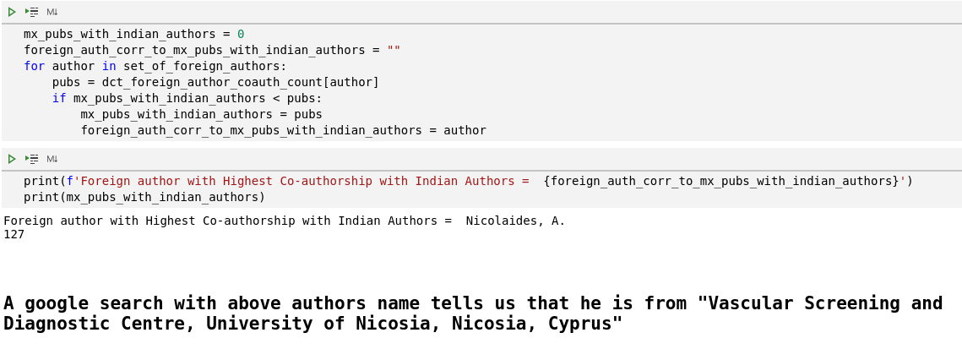
7. Author(country) having highest co-authorship with Indian authors
A google search with above authors name tells us that he is from "Vascular Screening and Diagnostic Centre, University of Nicosia, Nicosia, Cyprus"

Slide 28
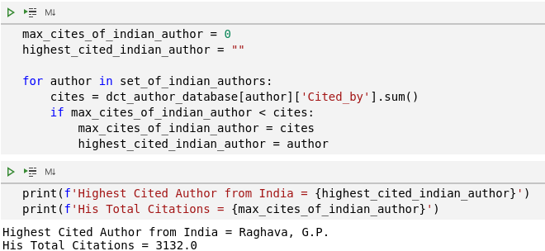
8. Highest cited author from India and the university
Raghava G.P. is a Professor & Head at Department of Computational Biology, Indraprastha Institute of Information Technology (IIIT-Delhi), India

Slide 29
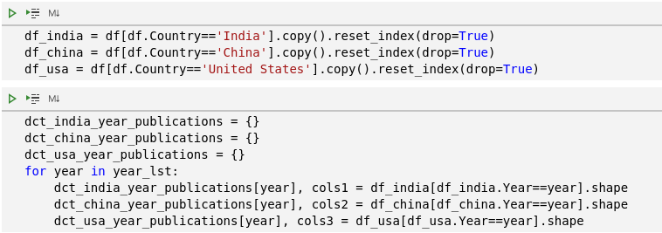
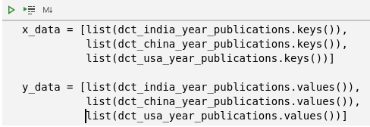
9. Comparative year wise article publication analysis of India, China and USA

Slide 30
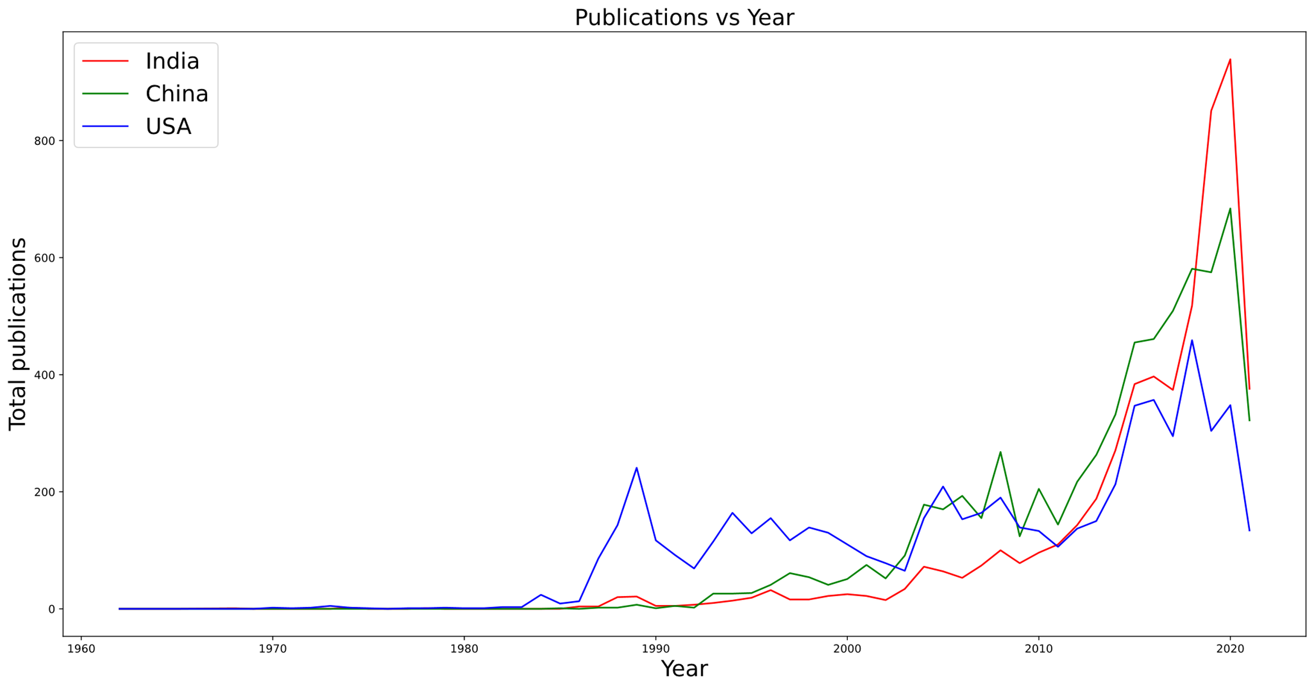
Rough Line Plot

Slide 31
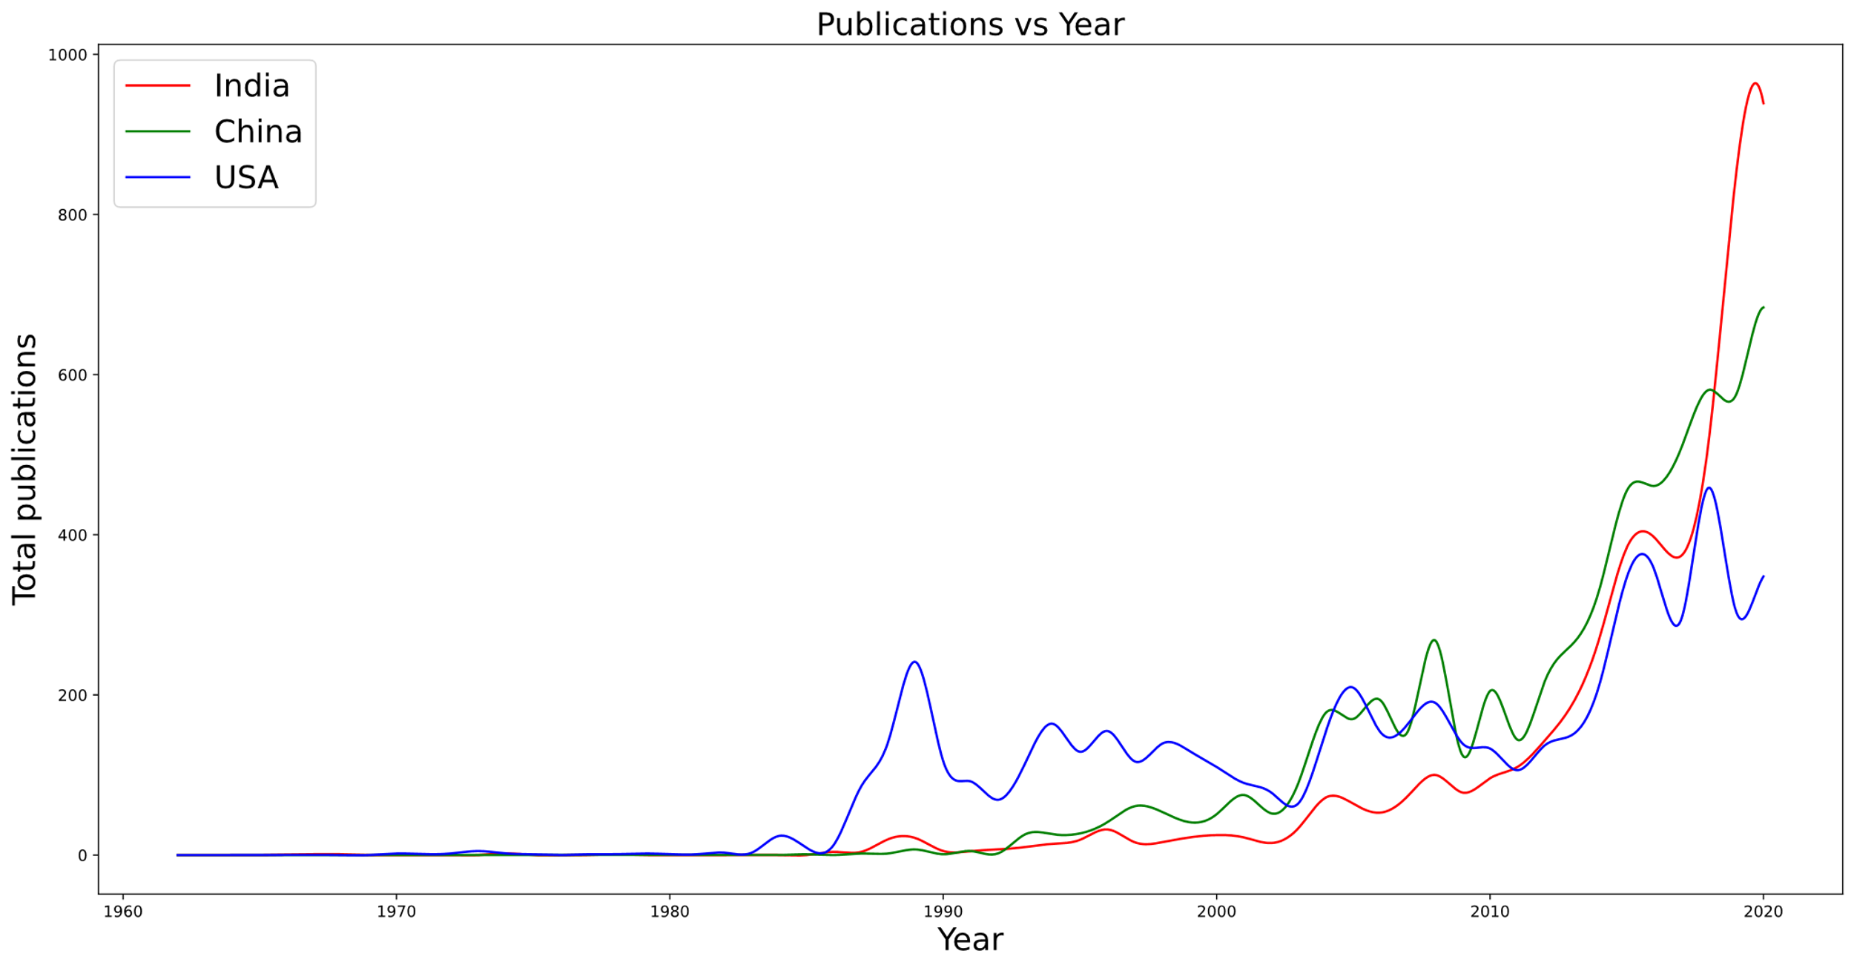
Smooth Line Plot

Slide 32
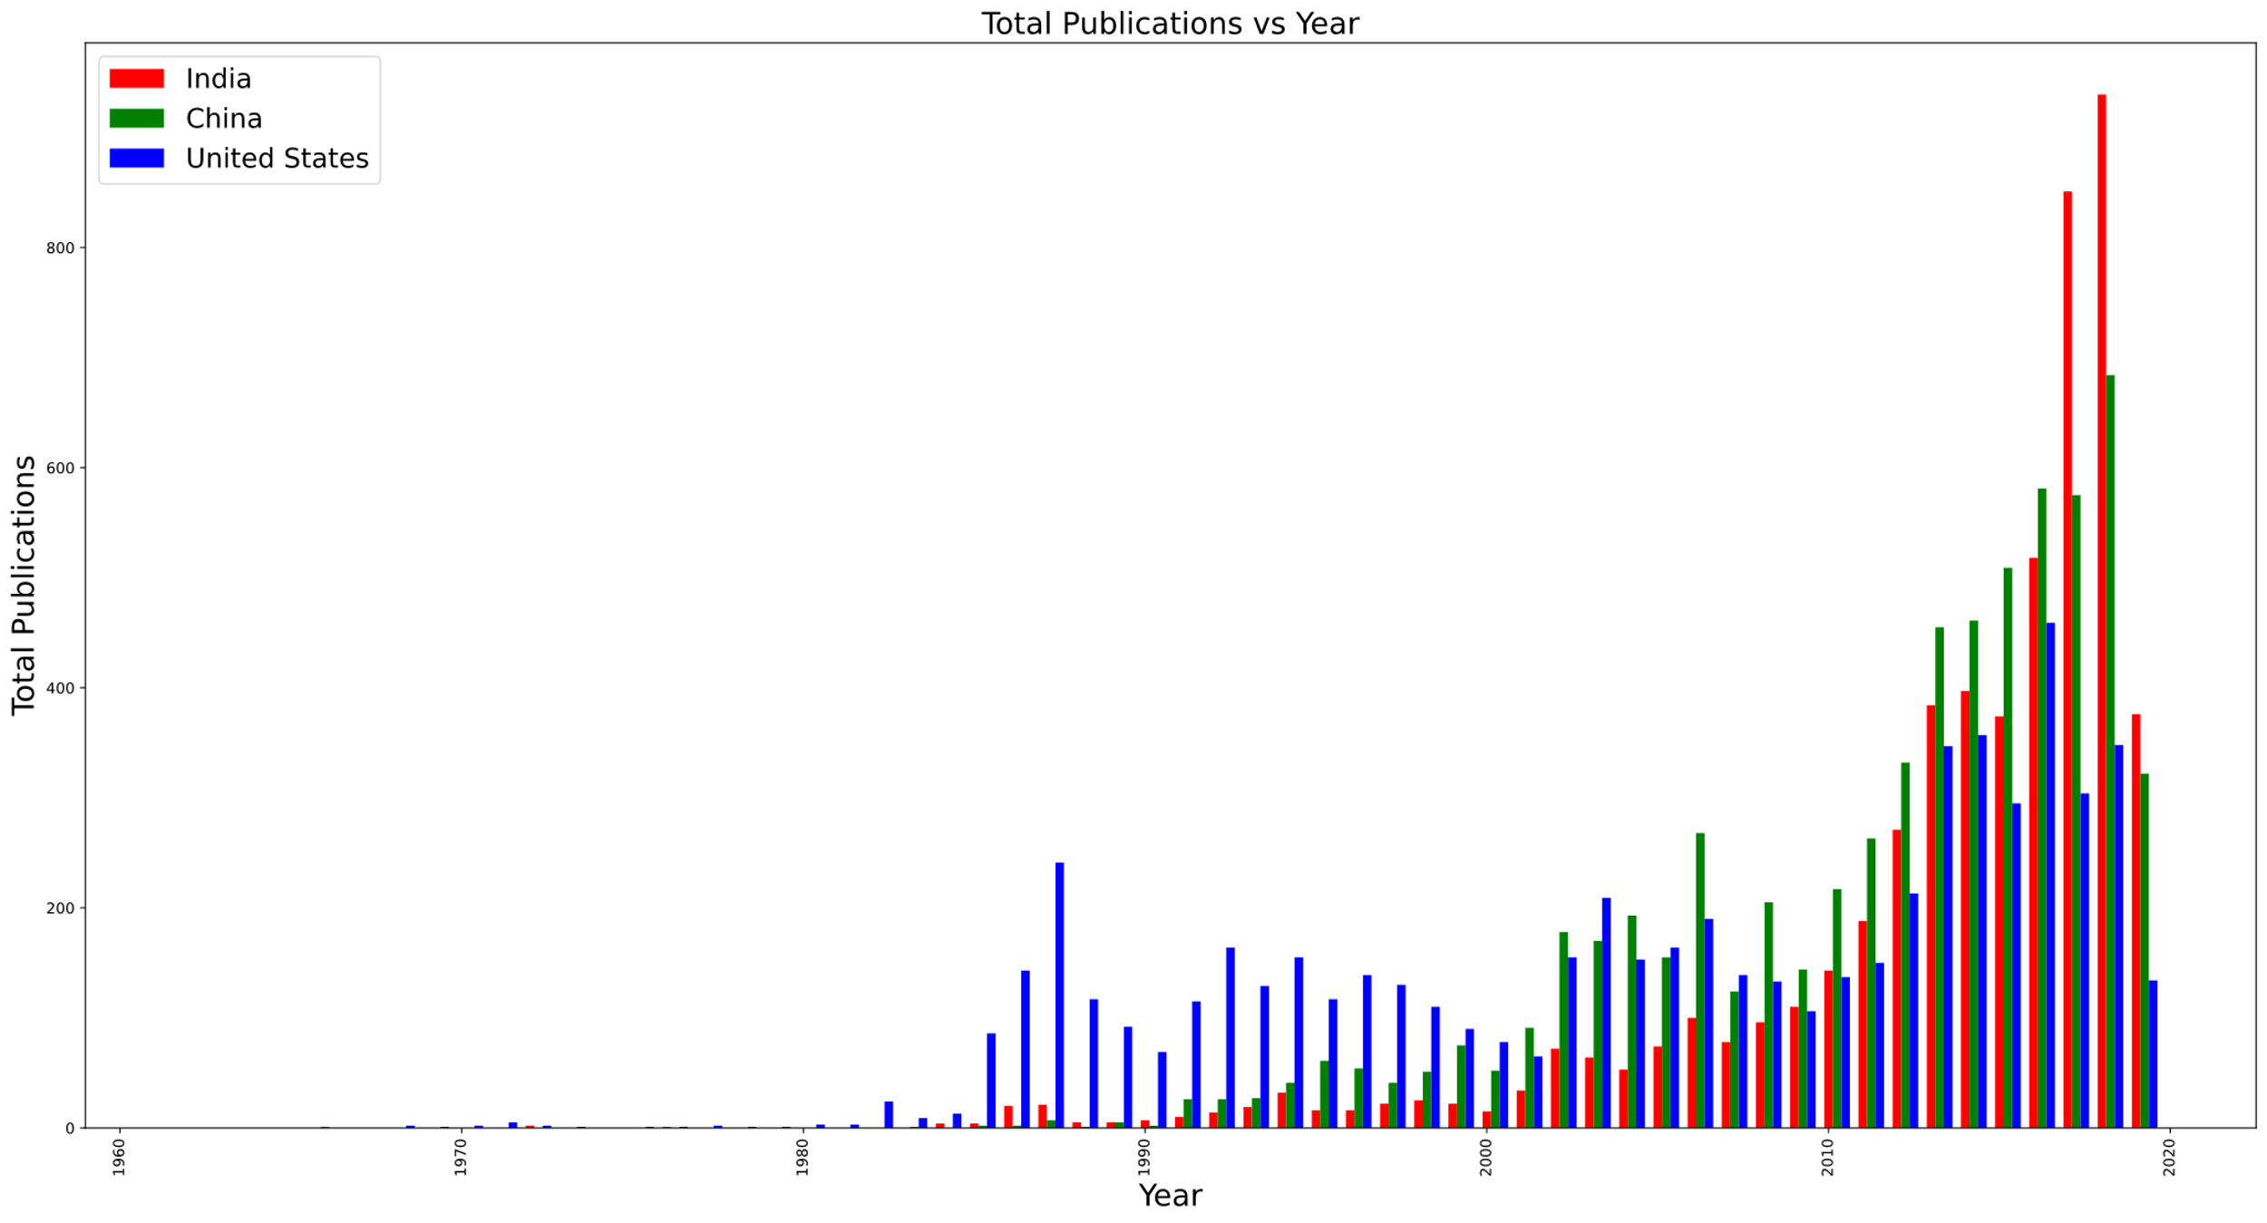
Bar Plot

Slide 33
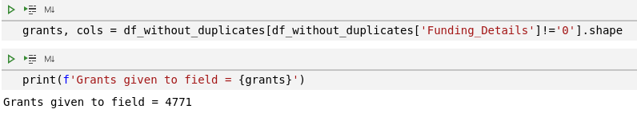
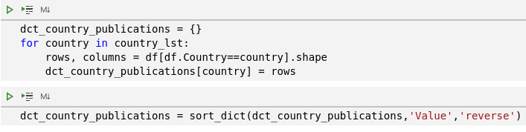
10. Total number of grants given to the field
11. Country wise total number of publication
*Output in next slide

Slide 34
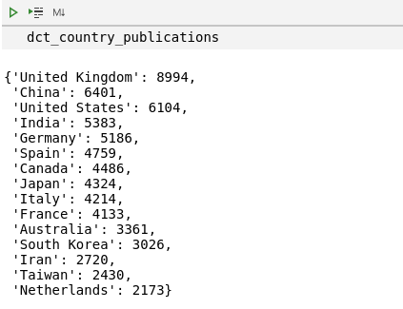

Slide 35
References
Scopus
Pandas Documentation
Numpy Documentation
Matplotlib Documentation
GeeksForGeeks
StackOverFlow

Slide 36
Thank You

