Slide 1

National Institute of Technology, Karnataka
Numerical Solution of Ordinary Differential Equations
Presented by-
Gavali Deshabhakt Nagnath
(202CD005)
Course Instructor: Dr. Chandhini G.
Subject: Numerical Methods
Specialization: CDS
Date: 20/05/2021

Slide 2
Definition & Terminology
Ordinary differential equation (ODE)
Differential equations that involve only
ONE independent variable are called
ordinary differential equations.
Examples:
➔only ordinary (or total ) derivatives

Slide 3

Order & Degree
The order of a differential equation is determined by the highest-order derivative
the degree of a differential equation is power of highest order derivative
$$\frac{d^{2}y}{dx^{2}}+{(\frac{dy}{dx})}^{2}=5$$
Order = 2 & degree = 1

Slide 4


Initial Value Problem
$\frac{ⅆy}{ⅆx}=f\left(x,y\right)$ - (1)
$y_{0}=f\left(x_{0}\right)$ -(2)
Equation (1) and (2) together is called an Initial value Problem
In order to select a particular integral from the infinite family of solution curves that constitute the general solution to (1), the differential equation will be considered in tandem with an initial condition i.e. (2)

Slide 5
Method’s Of Solving ODE
Euler’s Method
Runge-kutta methods
One-stage RK method
Two-stage RK method
Modified Euler Method
Improved Euler Method
Four-stage RK method

Slide 6
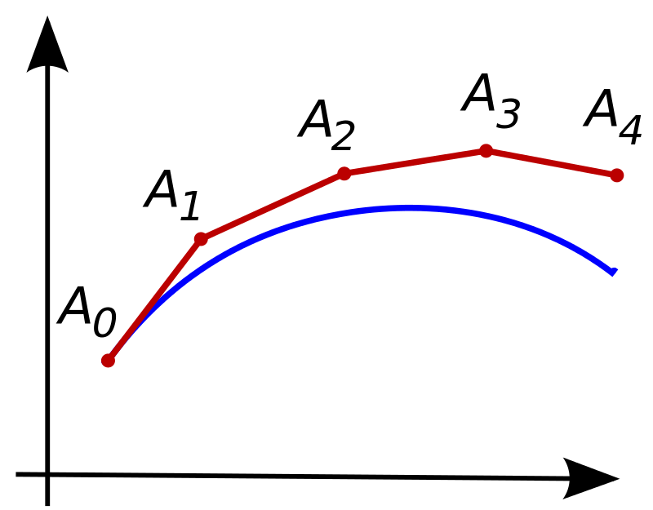



Euler’s Method
First-order method
Local Error (error per step) is proportional to the square of the step size
Global error (error at a given time) is proportional to the step size
Often serves as basis for constructing more complex methods
$\frac{ⅆy}{ⅆx}=f\left(x,y\right)$ , $a≤x ≤b$
$y_{0}=f\left(x_{0}\right)$
Iterative Formula
$$y_{n+1}=y_{n}+hf\left(x_{n},y_{n}\right)$$
where, h is step size

Slide 7

Algorithm of Euler’s Method
Input: Endpoints a, b; integer N ; initial condition α.
Output: approximation w to y at the N values of x.
Step 1: Set h = (b − a)/N ;
x = a; w = $y_{0}$
Step 2: For i = 1, 2, . . . , N do steps 3, 4.
Step 3: Set w = w + h* f(x, w) (i.e. compute wI)
Step 4: x = x + i*h (i.e. compute xi)
Step 5: STOP

Slide 8
Python function for Euler’s Method
def euler(x0,xn,y0,n,f,g):
lst = [[x0,y0,g(x0)]]
h = (xn-x0)/n
print('x0\t\ty_approx\ty_exact\n')
for i in range(n):
yn = y0 + h * f(x0, y0)
print(f'{x0:f}\t{y0:f}\t{g(x0):f}')
y0 = yn
x0 = x0+h
lst.append([x0,y0,g(x0)])
print(f'{x0:f}\t{y0:f}\t{g(x0):f}')
return lst

Slide 9
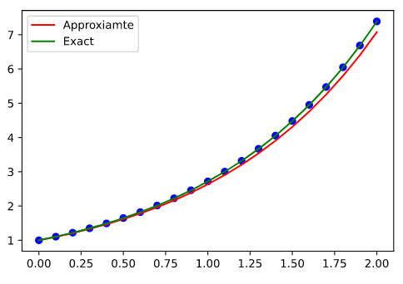


$$\frac{dy}{dx}=y 0≤x≤2 \& y\left(0\right)=1$$
$N=20$
$$solution: y= e^{x}$$
x | y | yt
0 | 1 | 1
0.1 | 1.1 | 1.105171
0.2 | 1.210517 | 1.221403
0.3 | 1.332657 | 1.349859
0.4 | 1.467643 | 1.491825
0.5 | 1.616826 | 1.648721
0.6 | 1.781698 | 1.822119
0.7 | 1.96391 | 2.013753
0.8 | 2.165285 | 2.225541
0.9 | 2.387839 | 2.459603
1 | 2.633799 | 2.718282
1.1 | 2.905628 | 3.004166
1.2 | 3.206044 | 3.320117
1.3 | 3.538056 | 3.669297
1.4 | 3.904986 | 4.0552
1.5 | 4.310506 | 4.481689
1.6 | 4.758674 | 4.953032
1.7 | 5.253978 | 5.473947
1.8 | 5.801372 | 6.049647
1.9 | 6.406337 | 6.685894
2 | 7.074927 | 7.389056

Slide 10

Runge-Kutta Methods
Runge–Kutta methods aim to achieve higher accuracy by sacrificing the efficiency of Euler’s method through re-evaluating f (·, ·) at points intermediate between (x n , y(x n )) and (x n+1 , y(x n+1 )).
The general R-stage Runge–Kutta family is defined by
$$y_{n+1}= y_{n}+h∗∅\left(x_{n},y_{n};h\right)$$
Where,
$∅\left(x,y;h\right)$ = $\sum_{r=1}^{R}{c_{r}k_{r}}$
$k_{1}=f\left(x,y\right)$
$k_{r}$ = $f\left(x+h∗a_{r} ,y+h∗\sum_{s=1}^{r−1}{c_{rs}k_{s}}\right) , r=2,…,R$
$a_{r}=\sum_{s=1}^{r−1}{c_{rs}k_{s}}$

Slide 11
Runge-Kutta Methods
For different value of R, there are different methods with corresponding number of stages
We will be discussing only following here
One Stage Runge-Kutta method
Two Stage Runge-Kutta Method
Four Stage Runge-kutta method

Slide 12


One Stage Runge-Kutta Method
This is Simply Euler’s explicit Method.
$\frac{ⅆy}{ⅆx}=f\left(x,y\right)$ , $a≤x ≤b$
& $y_{0}=f\left(x_{0}\right)$
Iterative Formula
$$y_{n+1}=y_{n}+hf\left(x_{n},y_{n}\right)$$
where, h is step size

Slide 13

Two Stage Runge-Kutta Methods
$y_{n+1}= y_{n}+h∗(c_{1}$ $k_{1 },c_{2}k_{2})$
Where,
$k_{1 }=f\left(x_{n} ,y_{n}\right)$
$k_{2 }=f\left(x_{n}+a_{2 }∗h ,y_{n}+b_{21 }∗h∗k_{1 }\right)$
Where,
$c_{1}+c_{2}=1$
$a_{2}c_{2}=b_{12}c_{2}=\frac{1}{2}$
For $b_{12}$ = $a_{2},$ the method is second-order accurate. (with $a_{2}$ as free parameter).

Slide 14

Examples of Second order Runge-Kutta Method
The Modified Euler Method: ($a_{2}$ = ½)
$y_{n+1}=y_{n}+h∗f(x_{n}+\frac{1}{2}∗h,y_{n}+ \frac{1}{2}∗k)$
The Improved Euler Method: ($a_{2}=1)$
$y_{n+1}=y_{n}+\frac{1}{2}∗h∗\left[f\left(x_{n},y_{n}\right)+f\left(x_{n}+h,y_{n}+k\right)\right]$
where,
k = $h∗f(x_{n}$, $y_{n}$)

Slide 15
Python function for Modified Euler’s Method
def eulerModified(x0,xn,y0,n,f,g):
lst = [[x0,y0,g(x0)]]
h = (xn-x0)/n
print('x0\t\ty_approx\ty_exact\n')
for i in range(n):
k = h*f(x0, y0)
yn = y0 + h * f(x0 +h/2, y0+k/2)
print(f'{x0:f}\t{y0:f}\t{g(x0):f}')
y0 = yn
x0 = x0+h
lst.append([x0,y0,g(x0)])
print(f'{x0:f}\t{y0:f}\t{g(x0):f}')
return lst

Slide 16
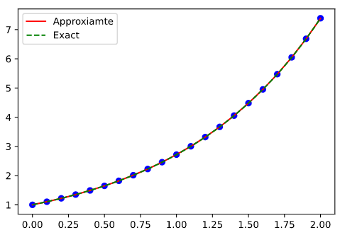


Modified Euler Method
$$\frac{dy}{dx}=y 0≤x≤2 \& y\left(0\right)=1$$
$$solution: y= e^{x}$$
$$N=20$$
x | y | yt
0 | 1 | 1
0.1 | 1.105127 | 1.105171
0.2 | 1.221311 | 1.221403
0.3 | 1.349713 | 1.349859
0.4 | 1.49162 | 1.491825
0.5 | 1.648451 | 1.648721
0.6 | 1.821776 | 1.822119
0.7 | 2.01333 | 2.013753
0.8 | 2.22503 | 2.225541
0.9 | 2.458995 | 2.459603
1 | 2.717566 | 2.718282
1.1 | 3.003331 | 3.004166
1.2 | 3.31915 | 3.320117
1.3 | 3.668185 | 3.669297
1.4 | 4.053927 | 4.0552
1.5 | 4.480239 | 4.481689
1.6 | 4.951386 | 4.953032
1.7 | 5.472084 | 5.473947
1.8 | 6.047544 | 6.049647
1.9 | 6.683526 | 6.685894
2 | 7.386395 | 7.389056

Slide 17
Python function for Improved Euler’s Method
def eulerImproved(x0,xn,y0,n,f,g):
lst = [[x0,y0,g(x0)]]
h = (xn-x0)/n
print('x0\t\ty_approx\ty_exact\n')
for i in range(n):
k = h*f(x0, y0)
yn = y0 + (h/2) *( f(x0, y0) + f(x0 + h, y0 + k) )
print(f'{x0:f}\t{y0:f}\t{g(x0):f}')
y0 = yn
x0 = x0+h
lst.append([x0,y0,g(x0)])
print(f'{x0:f}\t{y0:f}\t{g(x0):f}')
return lst

Slide 18

Improved Euler Method
$$\frac{dy}{dx}=y 0≤x≤2 \& y\left(0\right)=1$$
$$solution: y= e^{x}$$
$$N=20$$
x | y | yt
0 | 1 | 1
0.1 | 1.105259 | 1.105171
0.2 | 1.221587 | 1.221403
0.3 | 1.35015 | 1.349859
0.4 | 1.492234 | 1.491825
0.5 | 1.649262 | 1.648721
0.6 | 1.822804 | 1.822119
0.7 | 2.014597 | 2.013753
0.8 | 2.226562 | 2.225541
0.9 | 2.460819 | 2.459603
1 | 2.719713 | 2.718282
1.1 | 3.005836 | 3.004166
1.2 | 3.32205 | 3.320117
1.3 | 3.671521 | 3.669297
1.4 | 4.057746 | 4.0552
1.5 | 4.48459 | 4.481689
1.6 | 4.956326 | 4.953032
1.7 | 5.477675 | 5.473947
1.8 | 6.053855 | 6.049647
1.9 | 6.690632 | 6.685894
2 | 7.394379 | 7.389056

Slide 19

Four Stage Runge-Kutta Method
$y_{n+1}=y_{n}+ \frac{h}{6}∗\left(k_{1}+{2∗k}_{2}+2∗k_{3}+k_{4}\right)$
where,
$k_{1}=f(x_{n},y_{n})$
$k_{2}=f\left(x_{n}+\frac{h}{2}, y_{n}+\frac{1}{2}∗h∗k_{1}\right)$
$k_{3}=f\left(x_{n}+\frac{h}{2}, y_{n}+\frac{1}{2}∗h∗k_{2}\right)$
$k_{4}=f(x_{n}+h, y_{n}+h∗k_{3})$

Slide 20
Python function for Fourth-Order Runge Kutta Method
def rk4(x0,xn,y0,n,f,g):
lst = [[x0,y0,g(x0)]]
h = (xn-x0)/n
print('x0\t\ty_approx\ty_exact\n')
for i in range(n):
k1 = h*f(x0, y0)
k2 = h*f(x0+h/2,y0+k1/2)
k3 = h*f(x0+h/2,y0+k2/2)
k4 = h*f(x0+h,y0+k3)
yn = y0 + (1/6) *(k1 + 2*k2 + 2*k3 + k4)
print(f'{x0:f}\t{y0:f}\t{g(x0):f}')
y0 = yn
x0 = x0+h
lst.append([x0,y0,g(x0)])
print(f'{x0:f}\t{y0:f}\t{g(x0):f}')
return lst

Slide 21
Runge-Kutta Fourth Order
$$\frac{dy}{dx}=y 0≤x≤2 \& y\left(0\right)=1$$
$$solution: y= e^{x}$$
$$N=20$$
x | y | yt
0 | 1 | 1
0.1 | 1.105171 | 1.105171
0.2 | 1.221403 | 1.221403
0.3 | 1.349859 | 1.349859
0.4 | 1.491825 | 1.491825
0.5 | 1.648721 | 1.648721
0.6 | 1.822119 | 1.822119
0.7 | 2.013753 | 2.013753
0.8 | 2.225541 | 2.225541
0.9 | 2.459603 | 2.459603
1 | 2.718282 | 2.718282
1.1 | 3.004166 | 3.004166
1.2 | 3.320117 | 3.320117
1.3 | 3.669297 | 3.669297
1.4 | 4.0552 | 4.0552
1.5 | 4.481689 | 4.481689
1.6 | 4.953033 | 4.953032
1.7 | 5.473948 | 5.473947
1.8 | 6.049648 | 6.049647
1.9 | 6.685895 | 6.685894
2 | 7.389056 | 7.389056

Slide 22
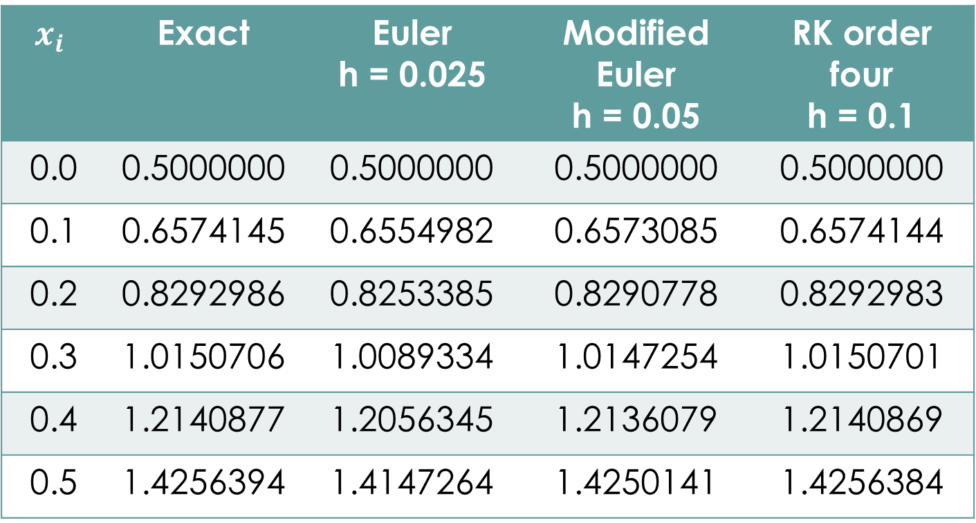
Comparison of different methods at common mesh points
$$y^{′}=y−x^{2}+1 0≤x ≤2 \& y\left(0\right)=0.5$$
$$x_{i}$$ | Exact | Euler h = 0.025 | Modified Euler h = 0.05 | RK order four h = 0.1
0.0 | 0.5000000 | 0.5000000 | 0.5000000 | 0.5000000
0.1 | 0.6574145 | 0.6554982 | 0.6573085 | 0.6574144
0.2 | 0.8292986 | 0.8253385 | 0.8290778 | 0.8292983
0.3 | 1.0150706 | 1.0089334 | 1.0147254 | 1.0150701
0.4 | 1.2140877 | 1.2056345 | 1.2136079 | 1.2140869
0.5 | 1.4256394 | 1.4147264 | 1.4250141 | 1.4256384

Slide 23
References
Numerical Analysis, by Richard L. Burden & J. Douglas Faires
Numerical Solution of Ordinary Differential Equations, by E. Süli
Wikipedia

Slide 24
Thank You

