Slide 1
National Institute of Technology, Karnataka
MAP REDUCE
IN
HADOOP
Presentation by-
Gavali Deshabhakt Naganath
Mohammad Ahsan
Mayur Anil Shimpi
Course Instructor: Dr. Pushparaj Shetty
Subject: Big Data Analytics
Specialization: CDS
Date: 14/04/2021

Slide 2
Agenda
Introduction to Hadoop
Introduction to MapReduce
Different Stages in MapReduce
MapReduce Use Case: K means clustering Algorithm
Hadoop Installation
Hadoop Demonstration
Covid-19 Database analysis

Slide 3
Key features of Hadoop
Open Source
Highly Scalable
Distributed
Massive Storage
High Availability
Fault Tolerance

Slide 4
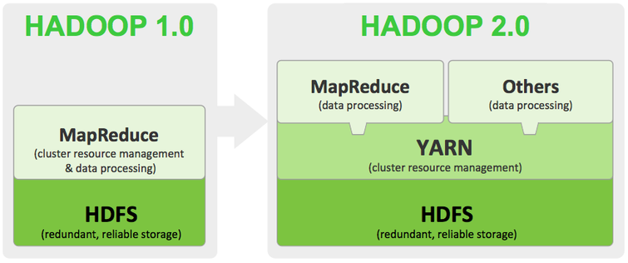
Core Components of Hadoop
HDFS
- NameNode
- DataNode
YARN
MapReduce

Slide 5
Map Reduce
Map Reduce is a programming model and an associated implementation for processing and generating big data sets with a parallel, distributed algorithm on a cluster.

Slide 6
Key Features of Map Reduce
Take small pieces of data from big data
Take Key, Value pairs as input dataset at all stage
All stages of Map Reduce generate key, value pairs as output dataset.
Work on principle of distributed data and parallel processing
Data saved within HDFS in certain format.
eg. bZip2, Snappy, AVOC ,etc.

Slide 7
Different Stages in Map Reduce
Mapper
Intermediate Stages
i) Combiner
ii) Partitioner
iii) Sorting
Reducer
Compression

Slide 8
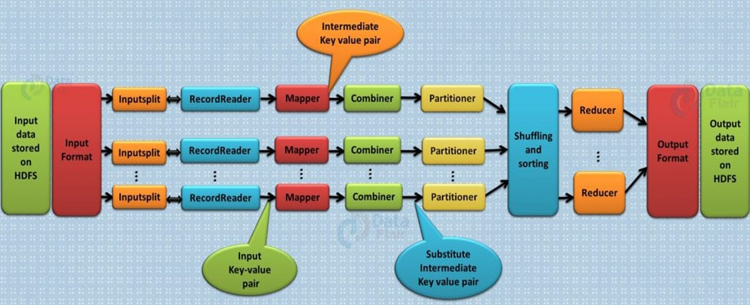
Flow Chart Of Map Reduce

Slide 9
Mapper
It is where parallel processing take place on datasets.
Business logical Model is implemented.
Semi processed Key, Value pair generated as output.
Crucial stage of Map Reduce where actual processing takes place.

Slide 10
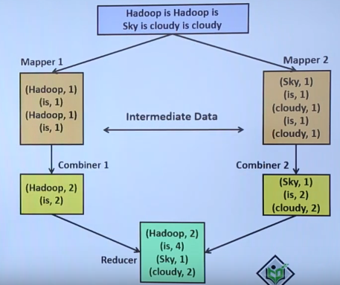
Combiner
It’s main function is to summarize the mapper output records with the same key.
Also called Mini Reducer.
It Aggregate data coming out from mapper.

Slide 11
Partitioner
It partitions the key-value pairs of intermediate Mapper outputs.
It partition data using user-defined function (like hash function).
Different practitioners' assign different partition keys.
Partition keys are used to map key, value paired data to a particular reducer.
Number of Practitioners' = Number of Reducers

Slide 12
Flow Chart Of Partitioner
Partitioner 1
Reducer 1
A, 2
B, 3
A, 5
A, 4
B, 4
C, 3
B, 1
C, 2
A, {2,5,4}
C, {3,2}
B, 8
Data As Output of Mapper
PK #1
I know #2
Partitioner 2
Reducer 2
B, {3,4,1}
A, 11
C, 5
PK #2
I know #1

Slide 13
Sorting
It’s an intermediate stage where in coming data get sorted.
Sorting take place according to key of paired data.
Sorting speed up the reducer process.
Reducer
Reducer is the final stage of Map Reduce
It take the preprocessed data coming from some intermediate stages and do either aggregation, filtration or summation independently.
The OutputCollector.collect() method, writes the output of the reduce task to the HDFS file system
Reducer output is not sorted when stored

Slide 14
Compression
Compression saves storage, network flow, processing cost significantly.
Without compression hadoop would become impractical as it would be using enormous resources.
General format used to store files in hadoop are Snappy, bZip2, AVOC, Parquet etc.

Slide 15
Features to care before selecting the right format
Compressed file should be optimal in storage.
Faster read and write can be done after compression.
Compressed file should split if needed. (Distributive Nature)
Should follow the dynamic schema even after compression.

Slide 16
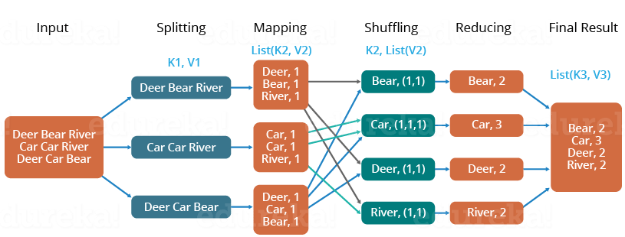
Flow Chart Of Map Reduce With Example
Solving Word Count Problem With Map Reduce

Slide 17
Clustering
Find homogeneous subgroups within the data
Data points in each cluster are as similar as possible
Similarity measures are such as Euclidean-based distance or correlation-based distance

Slide 18
K-Means Clustering
K-Means algorithm is an iterative algorithm
It partitions the dataset into K pre-defined distinct clusters where each data point belongs to only one group
It assigns data points to a cluster such that the sum of the squared distance between the data points and the cluster’s centroid is at the minimum

Slide 19
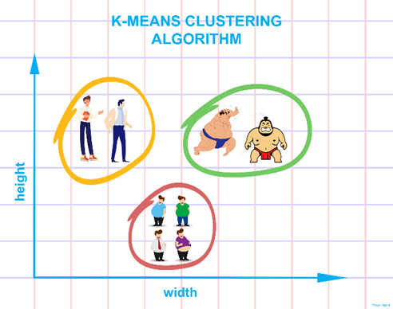

Slide 20
K-Means Algorithm
Choose k initial means µ1, . . . , µk uniformly at random from the set X.
For each point x ∈ X, find the closest mean µi and add x to a set Si
For i = 1, . . . , k, set µ_{i} to be the centroid of the points in Si
Repeat steps 2 and 3 until the means have converged.

Slide 21
K-Means via MapReduce
Two Phases of K-Means
1. Map will Assign Observations to Closest cluster Center
2. Reduce will revise cluster centers as mean of assigned observations

Slide 22
K-Means via MapReduce Algorithm
Choose k initial means µ1, . . ., µk uniformly at random from the set X.
Apply the MapReduce given by k-meansMap and k-meansReduce to X.
Compute the new means µ1, . . ., µk from the results of the MapReduce.
Broadcast the new means to each machine on the cluster.
Repeat steps 2 through 4 until the means have converged.

Slide 23
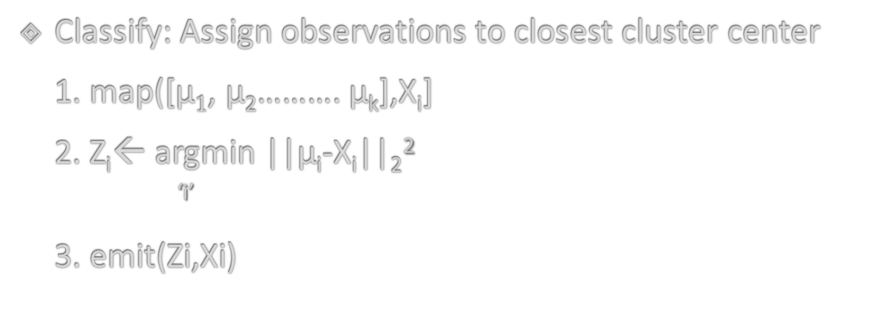
Classification step as Map
Classify: Assign observations to closest cluster center
1. map([μ$1$, μ₂………. μ_{k}],X_{i}]
2. Z_{i}← argmin ||μ_{i}-X_{i}||₂²
^{‘i’}
3. emit(Zi,Xi)

Slide 24
Re-center Step as Reduce
Recenter: Revise cluster centers as Mean of Assigned observations
1]reduce (Zi, X in cluster i:[X1,X3……….])
sum=0
count=0
2]for x in cluster i
sum +=x
count+=1
3]emit(Zi, sum/count)

Slide 25
Installation Of Hadoop
Standalone Mode - link
Pseudo Distributed mode
Distributed mode - link

Slide 26
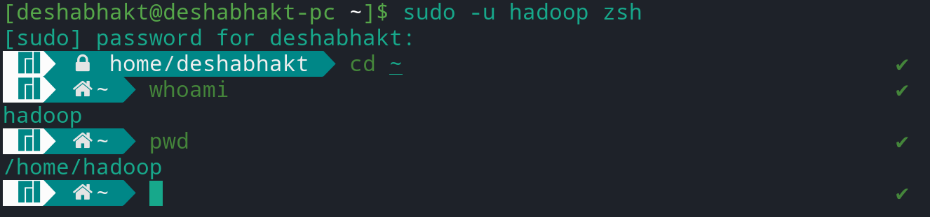
Creating Hadoop User
$ su
password:
# useradd <username>
# passwd <username>
New passwd:
Retype new passwd

Slide 27
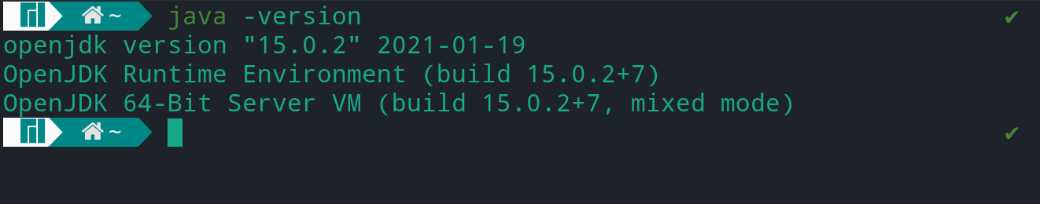
Java Installation
$ cd Downloads/
$ ls
jdk-8u281-linux-x64.tar.gz
$ tar xvf jdk-8u281-linux-x64.tar.gz
$ ls
jdk-8u281-linux-x64 jdk-7u71-linux-x64.gz

Slide 28
Installing/Configuring Hadoop
Setting up environment variables for Hadoop
export HADOOP_HOME=/home/hadoop/hadoop-3.2.2
export HADOOP_CONF_DIR=/home/hadoop/hadoop-3.2.2/etc/hadoop
export HADOOP_MAPRED_HOME=/home/hadoop/hadoop-3.2.2
export HADOOP_COMMON_HOME=/home/hadoop/hadoop-3.2.2
export HADOOP_HDFS_HOME=/home/hadoop/hadoop-3.2.2
export YARN_HOME=$HADOOP_HOME
export HADOOP_COMMON_LIB_NATIVE_DIR=/home/hadoop/hadoop-3.2.2/lib/native
export HADOOP_OPTS="-Djava.library.path=/home/hadoop/hadoop-3.2.2/lib"
export PATH=$PATH:/home/hadoop/hadoop-3.2.2/bin
export HADOOP_PID_DIR=/home/hadoop/hadoop-3.2.2/hadoop_data/hdfs/pid

Slide 29
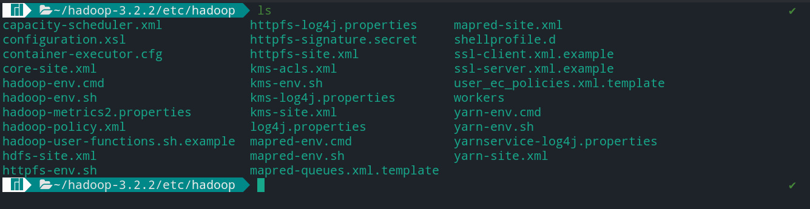
2. Hadoop Configuration
core-site.xml
hdf-site.xml
yarn-site.xml
mapred-site.xml
hadoop-env.sh

Slide 30
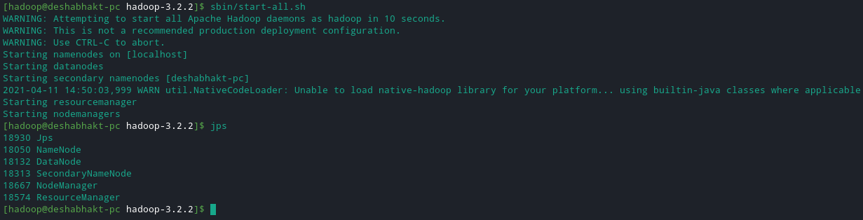
3. Verifying Hadoop Installation
‘hadoop version’
‘hdfs namenode –format
‘./start-all.sh

Slide 31
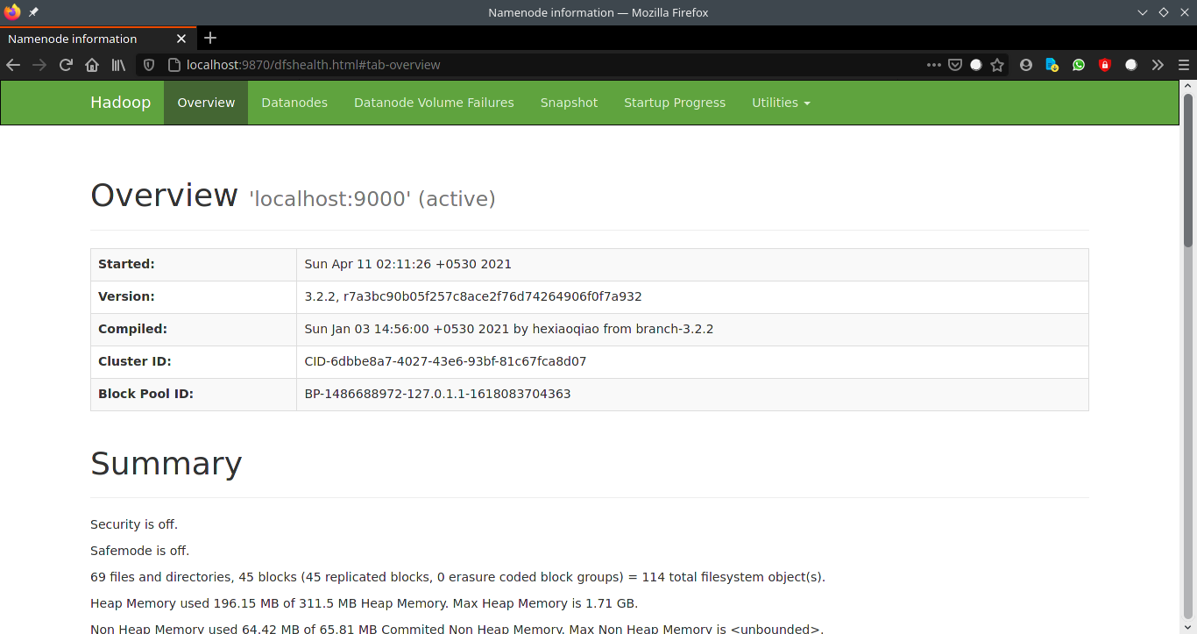
Accessing Hadoop Web UI
‘localhost:9870’

Slide 32
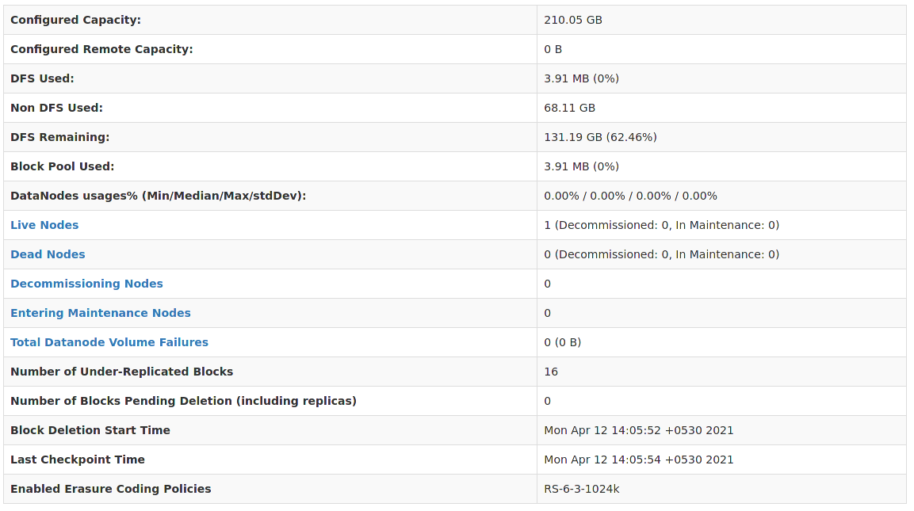
Summary of Hadoop Cluster

Slide 33
References
Acharya, Seema; Subhashini Chellappan. Big Data and Analytics, 2ed (p. 253). Kindle Edition.
https://hadoop.apache.org/docs/stable/index.html
Tutorialspoint.com
Javatpoint.com
GeeksForGeeks
https://stanford.edu/~rezab/classes/cme323/S16/projects_reports/bodoia.pdf
https://www.coursera.org/lecture/ml-clustering-and-retrieval/mapreduce-for-k-means-EhCYk
https://medium.com/@tarlanahad/a-friendly-introduction-to-k-means-clustering-algorithm-b31ff7df7ef1
https://www.baeldung.com/java-k-means-clustering-algorithm

