Slide 1

Chapter 11, Testing

Slide 2
Outlines
Today:
Terminology
Testing Activities
Unit testing
Integration testing
Testing strategy
Design patterns & testing
System testing
Function testing
Acceptance testing.
Notes:
Outline anpassen

Slide 3
Terminology
Failure: Any deviation of the observed behavior from the specified behavior
Erroneous state (error): The system is in a state such that further processing by the system can lead to a failure
Fault: The mechanical or algorithmic cause of an error (“bug”)
Validation: Activity of checking for deviations between the observed behavior of a system and its specification.

Slide 4
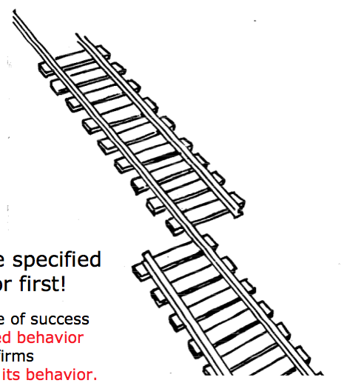
What is this?
A failure?
An error?
A fault?
We need to describe specified
and desired behavior first!

Slide 5
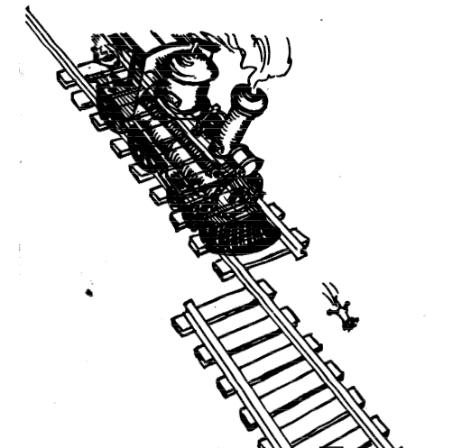
Erroneous State (“Error”)

Slide 6
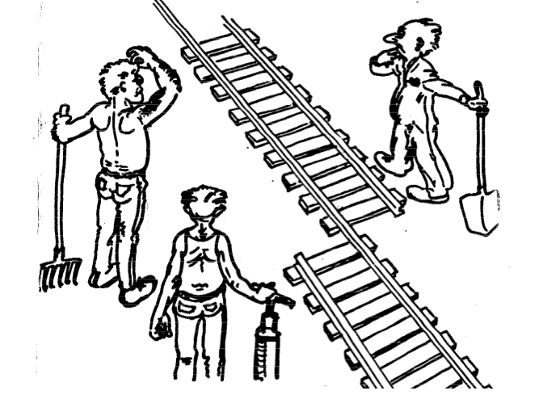
Algorithmic Fault

Slide 7
Examples of Faults and Errors
Faults in the Interface specification
Mismatch between what the client needs and what the server offers
Mismatch between requirements and implementation
Algorithmic Faults
Missing initialization
Incorrect branching condition
Missing test for null
Mechanical Faults (very hard to find)
Operating temperature outside of equipment specification
Errors
Null reference errors
Concurrency errors
Exceptions.
Notes:
Beispiel Itunes
Jeder freier song

Slide 8
How do we deal with Errors, Failures and Faults?

Slide 9
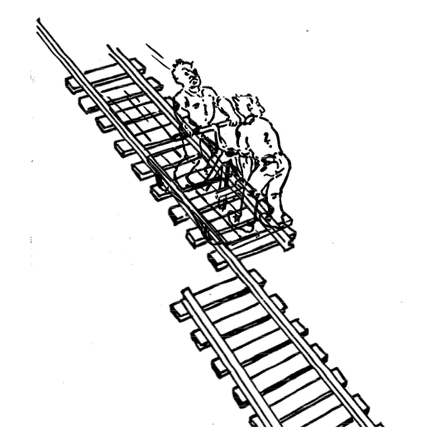
Testing

Slide 10
Another View on How to Deal with Faults
Fault avoidance
Use methodology to reduce complexity
Use configuration management to prevent inconsistency
Apply verification to prevent algorithmic faults
Use Reviews
Fault detection
Testing: Activity to provoke failures in a planned way
Debugging: Find and remove the cause (Faults) of an observed failure
Monitoring: Deliver information about state => Used during debugging
Fault tolerance
Exception handling
Modular redundancy.
Notes:
Fault avoidance (before the system is released):
Use programming methodology to reduce complexity
Use configuration management to prevent inconsistency
Apply verification to prevent algorithmic faults
Reviews
Fault detection (while system is running):
Testing: Create failures in a planned way
Debugging: Start with an unplanned failures
Monitoring: Deliver information about state. Find performance bugs
Fault tolerance (recover from failure once the system is released):
Atomic transactions (database systems)
Modular redundancy

Slide 11
Taxonomy for Fault Handling Techniques
Fault Handling
Fault Avoidance
Fault Detection
Fault Tolerance
Methodoloy
Configuration Management
Atomic Transactions
Modular Redundancy
Verification
Testing
Debugging
Unit
Testing
Integration Testing
System Testing
Notes:
Richtig machen

Slide 12
Observations
It is impossible to completely test any nontrivial module or system
Practical limitations: Complete testing is prohibitive in time and cost
Theoretical limitations: e.g. Halting problem
“Testing can only show the presence of bugs, not their absence” (Dijkstra).
Testing is not for free
=> Define your goals and priorities

Slide 13
Testing takes creativity
To develop an effective test, one must have:
Detailed understanding of the system
Application and solution domain knowledge
Knowledge of the testing techniques
Skill to apply these techniques
Testing is done best by independent testers
We often develop a certain mental attitude that the program should in a certain way when in fact it does not
Programmers often stick to the data set that makes the program work
A program often does not work when tried by somebody else.
behave
Notes:
Testing often viewed as dirty work.
To develop an effective test, one must have:
Detailed understanding of the system
Knowledge of the testing techniques
Skill to apply these techniques in an effective and efficient manner
Testing is done best by independent testers
We often develop a certain mental attitude that the program should in a certain way when in fact it does not.
Programmer often stick to the data set that makes the program work
"Don’t mess up my code!"
A program often does not work when tried by somebody else.
"Every new user uncovers a new class of bugs”

Slide 14
Testing Activities
Unit Testing
Integration Testing
System Testing
Acceptance Testing
Object Design
Document
System Design
Document
Requirements Analysis
Document
Client
Expectation
Unit Testing
Integration Testing
System Testing
Acceptance Testing
Developer
Client

Slide 15
Types of Testing
Unit Testing
Integration Testing
System Testing
Acceptance Testing
Unit Testing
Individual component (class or subsystem)
Carried out by developers
Goal: Confirm that the component or subsystem is correctly coded and carries out the intended functionality
Integration Testing
Groups of subsystems (collection of subsystems) and eventually the entire system
Carried out by developers
Goal: Test the interfaces among the subsystems.

Slide 16
Types of Testing continued...
Unit Testing
Integration Testing
System Testing
Acceptance Testing
System Testing
The entire system
Carried out by developers
Goal: Determine if the system meets the requirements (functional and nonfunctional)
Acceptance Testing
Evaluates the system delivered by developers
Carried out by the client. May involve executing typical transactions on site on a trial basis
Goal: Demonstrate that the system meets the requirements and is ready to use.

Slide 17
When should you write a test?
Traditionally after the source code is written
In XP before the source code written
Test-Driven Development Cycle
Add a test
Run the automated tests
=> see the new one fail
Write some code
Run the automated tests
=> see them succeed
Refactor code.

Slide 18
Unit Testing
Unit Testing
Integration Testing
System Testing
Acceptance Testing
Static Testing (at compile time)
Static Analysis
Review
Walk-through (informal)
Code inspection (formal)
Dynamic Testing (at run time)
Black-box testing
White-box testing.
Notes:
Static Analysis:
Manual execution: Reading the source code
Walk-through (informal presentation to others)
Code inspection (formal presentation to others)
Automated tools checking for
syntactic and semantic errors
departure from coding standards
Dynamic Analysis:
Black-box testing
White-box testing
Data-structure based testing
Black-box testing (Test the input/output behavior)
White-box testing (Test the internal logic of the subsystem or object)
Data-structure based testing (Data types determine test cases)

Slide 19
Black-box testing
Unit Testing
Integration Testing
System Testing
Acceptance Testing
Focus: I/O behavior
If for any given input, we can predict the output, then the component passes the test
Requires test oracle
Do not deal with the internal aspects of the component
Do not deal with the internal structure
Goal: Reduce number of test cases by equivalence partitioning:
Divide input conditions into equivalence classes
Choose test cases for each equivalence class.
Notes:
Focus: I/O behavior. If for any given input, we can predict the output, then the module passes the test.
Almost always impossible to generate all possible inputs ("test cases")
Goal: Reduce number of test cases by equivalence partitioning:
Divide input conditions into equivalence classes
Choose test cases for each equivalence class. (Example: If an object is supposed to accept a negative number, testing one negative number is enough)

Slide 20
Black-box testing: Test case selection
a) Input is valid across range of values
Developer selects test cases from 3 equivalence classes:
Below the range
Within the range
Above the range
b) Input is only valid, if it is a member of a discrete set
Developer selects test cases from 2 equivalence classes:
Valid discrete values
Invalid discrete values
No rules, only guidelines.
Notes:
Rauslassen?

Slide 21
Black box testing: An example
public class MyCalendar {
public int getNumDaysInMonth(int month, int year)
throws InvalidMonthException
{ … }
}
Representation for month:
1: January, 2: February, …., 12: December
Representation for year:
1904, … 1999, 2000,…, 2006, …
How many test cases do we need for the black box testing of getNumDaysInMonth()?
Notes:
Depends on calendar: gregorian calendar
Month parameter equivalence classes
30 days
31 days
February
No month 0, 13, -1
year: parameter equivalence classes
Normal year
Leap year:
/4
/100
/400
Before christ/ After Christ year -200
Before at and after 2000
=> 12 test cases

Slide 22
White-box testing overview
Unit Testing
Integration Testing
System Testing
Acceptance Testing
Focus on the internal structure of components
Code coverage
Branch coverage
Condition coverage
Path coverage

Slide 23
An example: Testing MyList
Unit to be tested
MyList
Methods under test
add()
remove()
contains()
size()
Concrete Test case
MyListTestCase

Slide 24
*
TestResult
Test
run(TestResult)
TestCase
TestSuite
testName:String
run(TestResult)
run(TestResult)
addTest()
setUp()
tearDown()
runTest()
MyListTestCase
MyList
setUp() tearDown()
runTest()
testAdd()
testRemove()
add() remove()
contains()
size()

Slide 25
Integration Testing
The entire system is viewed as a collection of subsystems (sets of classes) determined during the system and object design
Goal: Test all interfaces between subsystems and the interaction of subsystems
The Integration testing strategy determines the order in which the subsystems are selected for testing and integration.
Notes:
For the selection of the subsystems we use the system decomposition from System Design
Kürzen?
Tonspur: Übergang Unit Test zu Integration

Slide 26
Why do we do integration testing?
Unit tests only test the unit in isolation
Many failures result from faults in the interaction of subsystems
Often many Off-the-shelf components are used that cannot be unit tested
Without integration testing the system test will be very time consuming
Failures that are not discovered in integration testing will be discovered after the system is deployed and can be very expensive.

Slide 27
Stubs and drivers
Driver:
A component, that calls the TestedUnit
Controls the test cases
Stub:
A component, the TestedUnit depends on
Partial implementation
Returns fake values.
Driver
Tested
Unit
Stub

Slide 28
Big-Bang Approach
A
B
C
D
Test A
Test B
E
F
G
Test C
Test
A, B, C, D,
E, F, G
Test D
Test E
Test F
Test G
Notes:
This unit tests each of the subsystems, and then does one gigantic integration test, in which all the subsystems are immediately tested together.
Don‘t try this!! Why: The interfaces of each of the subsystems have not been tested yet.

Slide 29
Bottom-up Testing Strategy
The subsystems in the lowest layer of the call hierarchy are tested individually
Then the next subsystems are tested that call the previously tested subsystems
This is repeated until all subsystems are included
Drivers are needed.

Slide 30
Bottom-up Integration
A
A
B
B
C
C
D
D
Test E
E
E
G
F
G
F
Test B, E, F
Test F
Test
A, B, C, D,
E, F, G
Test C
Test G
Test D,G
Notes:
This unit tests each of the subsystems, and then does one gigantic integration test, in which all the subsystems are immediately tested together.
Don‘t try this!! Why: The interfaces of each of the subsystems have not been tested yet.

Slide 31
Top-down Testing Strategy
Test the top layer or the controlling subsystem first
Then combine all the subsystems that are called by the tested subsystems and test the resulting collection of subsystems
Do this until all subsystems are incorporated into the test
Stubs are needed to do the testing.

Slide 32
Top-down Integration
A
B
C
D
E
F
G
Test
A, B, C, D,
E, F, G
Test A
Test A, B, C, D
Layer I
Layer I + II
All Layers
Notes:
This unit tests each of the subsystems, and then does one gigantic integration test, in which all the subsystems are immediately tested together.
Don‘t try this!! Why: The interfaces of each of the subsystems have not been tested yet.

Slide 33
Sandwich Testing Strategy
Combines top-down strategy with bottom-up strategy
The system is viewed as having three layers
A target layer in the middle
A layer above the target
A layer below the target
Testing converges at the target layer.
Notes:
How do you select the target layer if there are more than 3 layers?
Heuristic: Try to minimize the number of stubs and drivers

Slide 34
Sandwich Testing Strategy
A
B
C
D
Test A
E
F
G
Test A,B,C, D
Test E
Test
A, B, C, D,
E, F, G
Test B, E, F
Test F
Test D,G
Test G
Notes:
Anpassen

Slide 35
Modified Sandwich Testing Strategy
Test in parallel:
Middle layer with drivers and stubs
Top layer with stubs
Bottom layer with drivers
Test in parallel:
Top layer accessing middle layer (top layer replaces drivers)
Bottom accessed by middle layer (bottom layer replaces stubs).

Slide 36
Modified Sandwich Testing
A
B
C
D
Test A
Test A,C
Test C
E
F
G
Test B
Test
A, B, C, D,
E, F, G
Test E
Test B, E, F
Test F
Test D
Test D,G
Test G

Slide 37
Continuous Testing
Continuous build:
Build from day one
Test from day one
Integrate from day one
System is always runnable
Requires integrated tool support:
Continuous build server
Automated tests with high coverage
Tool supported refactoring
Software configuration management
Issue tracking.

Slide 38
Steps in Integration Testing
1. Based on the integration strategy, select a component to be tested. Unit test all the classes in the component.
2. Put selected component together; do any preliminary fix-up necessary to make the integration test operational (drivers, stubs)
3. Test functional requirements: Define test cases that exercise all uses cases with the selected component
4. Test subsystem decomposition: Define test cases that exercise all dependencies
5. Test non-functional requirements: Execute performance tests
6. Keep records of the test cases and testing activities.
7. Repeat steps 1 to 7 until the full system is tested.
The primary goal of integration testing is to identify failures with the (current) component configuration.
.

Slide 39
System Testing
Functional Testing
Validates functional requirements
Performance Testing
Validates non-functional requirements
Acceptance Testing
Validates clients expectations
Notes:
When we are system testing, we are testing all subsystems together.
The requirements have a large impact on the quality of system testing:
The more explicit the requirements, the easier they are to test.
We distinguish the following types of system testing
Let’s walk through each of these system testing types

Slide 40
Functional Testing
Goal: Test functionality of system
Test cases are designed from the requirements analysis document (better: user manual) and centered around requirements and key functions (use cases)
The system is treated as black box
Unit test cases can be reused, but new test cases have to be developed as well.
.
Notes:
Essentially the same as black box testing
Unit test cases can be reused, but in end user oriented systems new test cases have to be developed as well.

Slide 41
Performance Testing
Goal: Try to violate non-functional requirements
Test how the system behaves when overloaded.
Can bottlenecks be identified? (First candidates for redesign in the next iteration)
Try unusual orders of execution
Call a receive() before send()
Check the system’s response to large volumes of data
If the system is supposed to handle 1000 items, try it with 1001 items.
What is the amount of time spent in different use cases?
Are typical cases executed in a timely fashion?
Notes:
Push the (integrated) system to its limits.

Slide 42
Types of Performance Testing
Stress Testing
Stress limits of system
Volume testing
Test what happens if large amounts of data are handled
Configuration testing
Test the various software and hardware configurations
Compatibility test
Test backward compatibility with existing systems
Timing testing
Evaluate response times and time to perform a function
Security testing
Try to violate security requirements
Environmental test
Test tolerances for heat, humidity, motion
Quality testing
Test reliability, maintain- ability & availability
Recovery testing
Test system’s response to presence of errors or loss of data
Human factors testing
Test with end users.
Notes:
Stress Testing
Stress limits of system (maximum # of users, peak demands, extended operation)
Volume testing
Test what happens if large amounts of data are handled
Configuration testing
Test the various software and hardware configurations
Compatibility test
Test backward compatibility with existing systems
Security testing
Try to violate security requirements

Slide 43
Acceptance Testing
Goal: Demonstrate system is ready for operational use
Choice of tests is made by client
Many tests can be taken from integration testing
Acceptance test is performed by the client, not by the developer.
Alpha test:
Client uses the software at the developer’s environment.
Software used in a controlled setting, with the developer always ready to fix bugs.
Beta test:
Conducted at client’s environment (developer is not present)
Software gets a realistic workout in target environ- ment
Notes:
Majority of all bugs in software is typically found by the client after the system is in use,
not by the developers or testers. Therefore two kinds of additional tests:
Alpha test
Beta test: … One disadvantage: Potential customers might get discouraged

Slide 44
Testing has many activities
Establish the test objectives
Design the test cases
Write the test cases
Test the test cases
Execute the tests
Evaluate the test results
Change the system
Do regression testing

Slide 45
Test Team
Professional
Tester
too familiar
Programmer
with code
Analyst
Test
System
Designer
User
Team
Configuration
Management
Specialist

Slide 46
The 4 Testing Steps
1. Select what has to be tested
Analysis: Completeness of requirements
Design: Cohesion
Implementation: Source code
2. Decide how the testing is done
Review or code inspection
Proofs (Design by Contract)
Black-box, white box,
Select integration testing strategy (big bang, bottom up, top down, sandwich)
3. Develop test cases
A test case is a set of test data or situations that will be used to exercise the unit (class, subsystem, system) being tested or about the attribute being measured
4. Create the test oracle
An oracle contains the predicted results for a set of test cases
The test oracle has to be written down before the actual testing takes place.

Slide 47
Guidance for Test Case Selection
Use analysis knowledge about functional requirements (black-box testing):
Use cases
Expected input data
Invalid input data
Use design knowledge about system structure, algorithms, data structures (white-box testing):
Control structures
Test branches, loops, ...
Data structures
Test records fields, arrays, ...
Use implementation knowledge about algorithms and datastructures:
Force a division by zero
If the upper bound of an array is 10, then use 11 as index.
Notes:
Rauslassen?

Slide 48
Summary
Testing is still a black art, but many rules and heuristics are available
Testing consists of
Unit testing
Integration testing
System testing
Acceptance testing
Design patterns can be used for integration testing
Testing has its own lifecycle

