Slide 1

Chapter 9,
Object Design:
Specifying Interfaces

Slide 2
Outline of Today’s Lecture
Object Design Activities
Visibilities
Information Hiding
Contracts
Interface specification
OCL: (Object constrain Language)

Slide 3
Requirements Analysis vs. Object Design
Requirements Analysis: The functional model and the dynamic model deliver operations for the object model
Object Design: Decide where to put these operations in the object model
  Object design is the process of
    adding details to the requirements analysis
    making implementation decisions
Thus, object design serves as the basis of implementation
  The object designer can choose among different ways to implement the system model obtained during requirements analysis.
Notes:
Object design is the process of adding details to the requirements analysis and making
implementation decisions
The object designer must choose among different ways to implement the analysis model
with the goal to minimize execution time, memory and other measures of cost.
Requirements Analysis: The functional model and the dynamic model deliver operations for the object model
Object Design: We decide on where to put these operations in the object model
Object design serves as the basis of implementation

Slide 4
Developers play 3 different Roles during Object Design of a Class
Call the Class
Class User
Developer
Class Implementor
Realize the Class
(Implement it)
Refine the Class
(Implement a
subclass)
Class Extender

Slide 5
Class user versus Class Extender
The Developer responsible
for the implementation of
Game is a class implementor
The developer responsible
for the implementation of
League is a class user of Game
League
Game
1
*
Tournament
TicTacToe
Chess
The developer responsible for
the implementation of TicTacToe
is a class extender of Game

Slide 6
Specifying Interfaces
Requirements analysis activities
  Identify attributes and operations without specifying their types or their parameters
Object design activities
  Add visibility information
  Add type signature information
  Add contracts.
Notes:
A constraint is a restriction on the degree of freedom you have in providing a solution (Leffingwell & Widrig 2000). Constraints are effectively nonfunctional requirements, such as limited development resources or a decision by senior management that restricts the way you develop a system

Slide 7
Add Visibility Information
Class User
Call Class
Developer
Class Implementor
Realize Class
Class Extender
Refine Class
Class user (“Public”): +
  Public attributes/operation can be accessed by any class
Class implementer (“Private”): -
  Private attributes and operations can be accessed only by the class in which they are defined
  They cannot be accessed by subclasses or other classes
Class extender (“Protected”): #
  Protected attributes/operations can be accessed by the class in which they are defined and by any descendent of the class.
Notes:
UML defines three levels of visibility:
- Private => Class implementor:
A private attribute can be accessed only by the class in which it is defined.
A private operation can be invoked only by the class in which it is defined.
Private attributes and operations cannot be accessed by subclasses or other classes.
# Protected => Class extender:
A protected attribute or operation can be accessed by the class in which it is defined and by any descendent of the class.
+ Public => Class user:
A public attribute or operation can be accessed by any class.

Slide 8
Implementation of UML Visibility in Java
Tournament
- maxNumPlayers: int
+ getMaxNumPlayers():int
+ getPlayers(): List
+ acceptPlayer(p:Player)
+ removePlayer(p:Player)
+ isPlayerAccepted(p:Player):boolean
public class Tournament {
private int maxNumPlayers;
public Tournament(League l, int maxNumPlayers)
public int getMaxNumPlayers() {…};
public List getPlayers() {…};
public void acceptPlayer(Player p) {…};
public void removePlayer(Player p) {…};
public boolean isPlayerAccepted(Player p) {…};

Slide 9
Information Hiding Heuristics
Carefully define the public interface for classes as well as subsystems
  For subsystems use a facade design pattern if possible
Always apply the “Need to know” principle:
  Only if somebody needs to access the information, make it publicly possible
    Provide only well defined channels, so you always know the access
The fewer details a class user has to know
  the easier the class can be changed
  the less likely they will be affected by any changes in the class implementation
Trade-off: Information hiding vs. efficiency
  Accessing a private attribute might be too slow.
Notes:
Information hiding is not a major issue during analysis, however during design it is a problem.
Limit the effect of changes so that changes can be understood clearly and do not cause a major recompilation of the whole system (also called black box design)
Accessing a private attribute might be too slow (for example in real-time systems or games)

Slide 10
Information Hiding Design Principles
Only the operations of a class are allowed to manipulate its attributes
  Access attributes only via operations
Hide external objects at subsystem boundary
  Define abstract class interfaces which mediate between the external world and the system as well as between subsystems
Do not apply an operation to the result of another operation
  Write a new operation that combines the two operations.

Slide 11
Add Type Signature Information
Hashtable
numElements:int
put()
get()
remove()
containsKey()
size()
Attributes and operations
without visibility and
type information are ok during
requirementsanalysis
Hashtable
-numElements:int
+put(key:Object,entry:Object)
+get(key:Object):Object
During object design, we decide that the hash table can handle any type of keys, not only Strings.
+remove(key:Object)
+containsKey(key:Object):boolean
+size():int

Slide 12
Modeling Constraints with Contracts
Example of constraints in Arena:
  An already registered player cannot be registered again
  The number of players in a tournament should not be more than maxNumPlayers
  One can only remove players that have been registered
These constraints cannot be modeled in UML
We model them with contracts
Contracts can be written in OCL.

Slide 13
Contract
Contract: A lawful agreement between two parties in which both parties accept obligations and on which both parties can found their rights
  The remedy for breach of a contract is usually an award of money to the injured party
Object-oriented contract: Describes the services that are provided by an object if certain conditions are fulfilled
  services = “obligations”, conditions = “rights”
  The remedy for breach of an OO-contract is the generation of an exception.
Notes:
Contract: A univocal lawful agreement between two parties in which both parties accept obligations and on which both parties can found their rights.
The remedy for breach of contract is usually an award of money damaged intended to restore the injured party to the economic position expected from the performance of the promises in the contract.
Object-oriented Contract: Describes the services that are provided by an object, if certain conditions are fulfilled.
Services = “Obligations”, Conditions = “Rights”
The remedy for breach of OO-contracts is the generation of an exception
Although the notion of contract is derived from law practice, it is not completely analogous
when employed in object-oriented development
A contract offered by an object exists independently of the presence of any client
From: http://en.wikipedia.org/wiki/Contract
Typically, the remedy for breach of contract is an award of money damages intended to restore the injured party to the economic position that he or she expected from performance of the promise or promises (known as an "expectation measure" of damages).Occasionally a court will order a party to perform his or her promise (an order of "specific performance") or to compensate for the value bestowed ("quantum meruit" or unjust enrichment), but these remedies are unusual. In the civil law, contracts are considered to be part of the general law of obligations.Contract claims (where there is usually some kind of preexisting relationship between the parties) are usually contrasted against tort claims (where there may be no such relationship).

Slide 14
Object-Oriented Contract
An object-oriented contract describes the services that are provided by an object. For each service, it specifically describes two things:
  The conditions under which the service will be provided
  A specification of the result of the service
Examples:
  A letter posted before 18:00 will be delivered on the next working day to any address in Germany
  For the price of $4 a letter with a maximum weight of 80 grams will be delivered anywhere in the USA within 4 hours of pickup.
Notes:
An object-oriented contract describes the services that are provided by an object.
For each service, it specifically describes two things:
The conditions under which the service will be provided
A specification of the result of the service that is provided, given that the conditions are fulfilled.
Examples:
A letter posted before 18:00 will be delivered on the next working day to any address in Germany.
For the price of 4 Euros a letter with a maximum weight of 80 grams will be delivered anywhere in Germany within 4 hours of pickup.

Slide 15
Object-Oriented Contract
An object-oriented contract describes the services that are provided by an object. For each service, it specifically describes two things:
  The conditions under which the service will be provided
  A specification of the result of the service that is provided.
Examples:
  A letter posted before 18:00 will be delivered on the next working day to any address in Germany.
  For the price of $4 a letter with a maximum weight of 80 grams will be delivered anywhere in Germany within 4 hours of pickup.
Notes:
An OO-contract is different from a (normal) contract
It can exist independently of the presence of any client
In the following, whenever we use the term contract alone, we mean an OO-contract.

Slide 16
Modeling OO-Contracts
Natural Language
Mathematical Notation
Models and contracts:
  A language for the formulation of constraints with the formal strength of the mathematical notation and the easiness of natural language:
  ⇒ UML + OCL (Object Constraint Language)
  Uses the abstractions of the UML model
  OCL is based on predicate calculus. It allows constraints to be formally specified on single mode elements or group of model elenments
Notes:
Natural Language:
Advantage: Contract partners already know the language
Disadvantage: When using natural language, one often makes implicit assumptions about the rights and obligations of the contract partners
Mathematical Notation:
Advantage: The contract can be precisely and uniquely specified
Disadvantage: Normal customers are not mathematicians
Models and contracts:
A language for the formulation of constraints with the formal strength of the mathematical notation and the easiness of natural language:
⇒ UML + OCL (Object Constraint Language)
Uses the abstractions of the UML model
OCL is based on predicate calculus

Slide 17
Contracts and Formal Specification
Contracts enable the caller and the provider to share the same assumptions about the class
A contract is an exact specification of the interface of an object
A contract include three types of constraints:
  Invariant:
    A predicate that is always true for all instances of a class
  Precondition (“rights”):
    Must be true before an operation is invoked
  Postcondition (“obligation”):
    Must be true after an operation is invoked.
Notes:
Contracts enable the caller and provider to share the same assumptions about the class.
A contract is an exact specification of the interface of an object.
A contract include three types of constraints:
Invariant:
A predicate that is always true for all instances of a class. Invariants are constraints associated with classes or interfaces.
Precondition (“rights”):
Preconditions are predicates associated with a specific operation and must be true before the operation is invoked.
Postcondition (“oblicgation”):
Postconditions are predicates associated with a specific operation and must be true after an operation is invoked.
If the invariants, rights and oblications in the contract are unambigious, the contract is called a formal specification
Preconditions are used to specify constraints that a caller must meet before calling an operation.
Postconditions are used to specify constraints that the object must ensure after the invocation of the operation.

Slide 18
Formal Specification
A contract is called a formal specification, if the invariants, rights and obligations in the contract are unambiguous.

Slide 19
Expressing Constraints in UML Models
A constraint can also be depicted as a note attached to the constrained UML element by a dependency relationship.
<<invariant>>
numElements >= 0
<<precondition>>
!containsKey(key)
HashTable
numElements:int
put(key,entry:Object)
<<postcondition>>
get(key) == entry
get(key):Object
remove(key:Object)
<<precondition>>
containsKey(key)
containsKey(key:Object):boolean
size():int
<<precondition>>
containsKey(key)
<<postcondition>>
!containsKey(key)

Slide 20
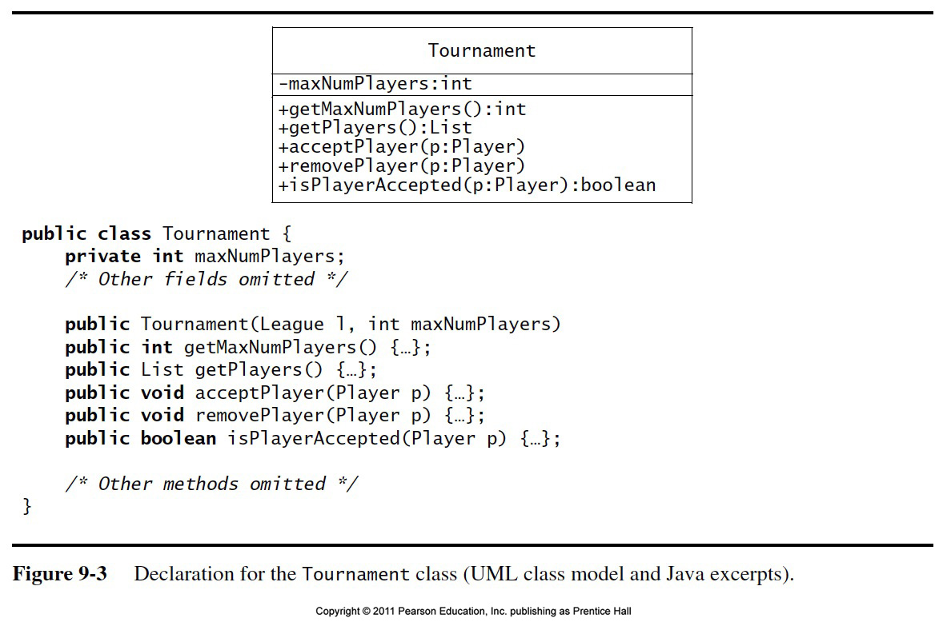


Slide 21
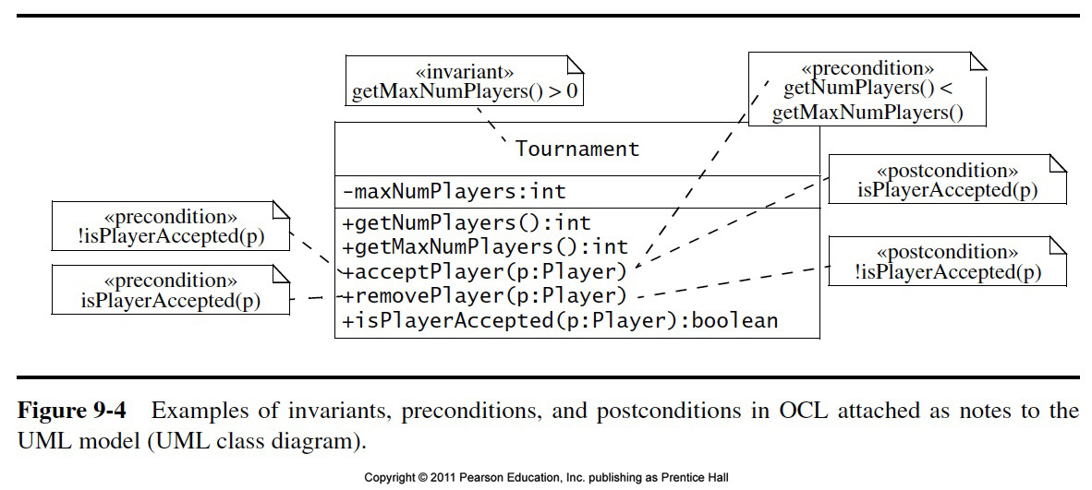

Slide 22
OCL Postconditions
Example:
context Tournament::acceptPlayer(p) post:
self.getNumPlayers() =
self@pre.getNumPlayers() + 1
In English:
  “The number of accepted player in a tournament increases by one after the completion of acceptPlayer()”
Notes:
  self@pre denotes the state of the tournament before the invocation of the operation.
  Self denotes the state of the tournament after the completion of the operation.

Slide 23
OCL Contract for acceptPlayer() in Tournament
context Tournament::acceptPlayer(p) pre:
not isPlayerAccepted(p)
context Tournament::acceptPlayer(p) pre:
getNumPlayers() < getMaxNumPlayers()
context Tournament::acceptPlayer(p) post:
isPlayerAccepted(p)
context Tournament::acceptPlayer(p) post:
getNumPlayers() = @pre.getNumPlayers() + 1

Slide 24
OCL Contract for removePlayer() in Tournament
context Tournament::removePlayer(p) pre:
isPlayerAccepted(p)
context Tournament::removePlayer(p) post:
not isPlayerAccepted(p)
context Tournament::removePlayer(p) post:
getNumPlayers() = @pre.getNumPlayers() - 1

Slide 25
Java Implementation of Tournament class
(Contract as a set of JavaDoc comments)
public class Tournament {
/** The maximum number of players
* is positive at all times.
* @invariant maxNumPlayers > 0
*/
private int maxNumPlayers;
/** The players List contains
* references to Players who are
* are registered with the
* Tournament. */
private List players;
/** Returns the current number of
* players in the tournament. */
public int getNumPlayers() {…}
/** Returns the maximum number of
* players in the tournament. */
public int getMaxNumPlayers() {…}
/** The acceptPlayer() operation
* assumes that the specified
* player has not been accepted
* in the Tournament yet.
* @pre !isPlayerAccepted(p)
* @pre getNumPlayers()<maxNumPlayers
* @post isPlayerAccepted(p)
* @post getNumPlayers() =
* @pre.getNumPlayers() + 1
*/
public void acceptPlayer (Player p) {…}
/** The removePlayer() operation
* assumes that the specified player
* is currently in the Tournament.
* @pre isPlayerAccepted(p)
* @post !isPlayerAccepted(p)
* @post getNumPlayers() =
* @pre.getNumPlayers() - 1
*/
public void removePlayer(Player p) {…}
}
Notes:
As we can see, the OCL contract is now written as a set of JavaDoc comments.
The specific OCL Javdoc tags @ invariant, @pre and @post could be read to a verification system or a runtime debugging system
That inserts specific code as a result of these tags to ensure the validity of the predicates (slows down the computation quite a bit, verification would be better, but currently not state of the art for large complex systems.

Slide 26
Example from ARENA: League, Tournament and Player
League
*
Constraints:
A Tournament’s planned duration must be under one week.
Players can be accepted in a Tournament only if they are already registered with the corresponding League.
The number of active Players in a League are those that have taken part in at least one Tournament of the League.
+start:Date
+end:Date
+getActivePlayers()
{ordered}
*
tournaments
Tournament
+start:Date
+end:Date
+acceptPlayer(p:Player)
*
tournaments
players
*
players
Player
*
+name:String
+email:String
Notes:
To better understand these constraints, we instantiate the class diagram for a specific group of instances
2 Leagues
5 Players
2 Tournaments

Slide 27
Instance Diagram: 2 Leagues
, 5 Players,
2 Tournaments
tttExpert:League
chessNovice:League
Xmas:Tournament
winter:Tournament
start=Dec 23
start=Jan 12
end= Dec 25
end= Jan 14
alice:Player
bob:Player
marc:Player
joe:Player
zoe:Player

Slide 28
3 Types of Navigation through a Class Diagram
1. Local attribute
2. Directly related class
3. Indirectly related class
Tournament
League
League
start:Date
*
end:Date
*
*
Player
Tournament
*
*
Player
Any constraint for an arbitrary UML class diagram can
be specified using only a combination of these
3 navigation types!
Notes:
Within the context of one class, e.g. tournamen, I can construct a predicate out of the attributes of this class.
Given a certain context, say League, I can specify a constraint, that involves methods and attributes of a directly associated class, say Player.
Given a certain context, say League, I can specify constraints on classes that are not directly reachable via a neighbor association, but via a couple of associations.

Slide 29
OCL Sets, Bags and Sequences
Sets, Bags and Sequences are predefined in OCL and subtypes of Collection. OCL offers a large number of predefined operations on collections. They are all of the form:
collection->operation(arguments)

Slide 30
OCL-Collection
The OCL-Type Collection is the generic superclass of a collection of objects of Type T
Subclasses of Collection are
  Set: Set in the mathematical sense. Every element _x0004_can appear only once
  Bag: A collection, in which elements can appear more than once (also called multiset)
  Sequence: A multiset, in which the elements are ordered
Example for Collections:
  Set(Integer): a set of integer numbers
  Bag(Person): a multiset of persons
  Sequence(Customer): a sequence of customers
Notes:
The element type T is the type of a primitive value (Integer, String, Boolean)
or the type of an object (e.g. Person, Tournament).

Slide 31
OCL-Operations for OCL-Collections (1)
size: Integer
Number of elements in the collection
includes(o:OclAny): Boolean
True, if the element o is in the collection
count(o:OclAny): Integer
Counts how many times an element is contained in the collection
isEmpty: Boolean
True, if the collection is empty
notEmpty: Boolean
True, if the collection is not empty
The OCL-Type OclAny is the most general OCL-Type
Notes:
OCL-Operations to determine the properties of a collection:

Slide 32
OCL-Operations for OCL-Collections(2)
union(c1:Collection)
Union with collection c1
intersection(c2:Collection)
Intersection with Collection c2 (contains only elements, which appear in the collection as well as in collection c2 auftreten)
including(o:OclAny)
Collection containing all elements of the Collection and element o
select(expr:OclExpression)
Subset of all elements of the collection, for which the OCL-expression expr is true
Notes:
Operations to generate new collections (Result is again a collection):

Slide 33
How do we get OCL-Collections?
A collection can be generated by explicitly enumerating the elements
A collection can be generated by navigating along one or more 1-N associations
  Navigation along a single 1:n association yields a Set
  Navigation along a couple of 1:n associations yields a Bag (Multiset)
  Navigation along a single 1:n association labeled with the constraint {ordered } yields a Sequence
Notes:
Of course, also by calling an OCL collection operation on an OCL collection

Slide 34
Navigation through a 1:n-Association
Example: A Customer should not have more than 4 cards
context Customer inv:
card->size <= 4
Alternative writing style
  Customer
  card->size <= 4
Customer
name:
String
titel:
String
age:
Integer
birthday:
Date
getage():
Integer
card denotes
a set of
customercards
owner
card
*
customerCard
valid:
Boolean
validSince:
Date
expires:
Date
color:
enum
{
silver,
gold}
printedName :
String

