Slide 1
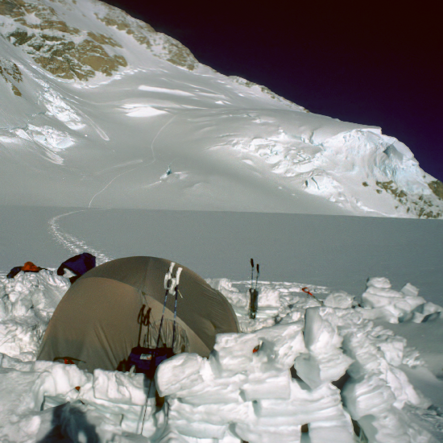
Chapter 8, Object Design: Reuse and Patterns

Slide 2
Where are we? What comes next?
We have covered:
Introduction to Software Engineering (Chapter 1)
Modeling with UML (Chapter 2)
Requirements Elicitation (Chapter 4)
Analysis (Chapter 5)
System Design (Chapter 6)
Today:
Object Design (Chapter 8)
Next week
Design Patterns (Chapter 8 and Appendix A)

Slide 3
Outline of Today
Definition and Terminoloty: Object Design vs Detailed Design
System Design vs Object Design
Object Design Activities
Reuse examples
Whitebox and Blackbox Reuse
Object design leads also to new classes
Implementation vs Specification Inheritance
Inheritance vs Delegation
Design Patterns
Usefulness of design patterns
Design Pattern Categories
Patterns covered in this lecture
Composite: Model dynamic aggregates
Facade: Interfacing to subsystems
Adapter: Interfacing to existing systems (legacy systems)
Bridge: Interfacing to existing and future systems

Slide 4
Object Design
Object design serves as the basis of implementation.
Purpose of object design:
Identify new solution objects
Adjusting off-the-shelf components
Precisely specifying each subsystem interface and class
Prepare for the implementation of the system model based on design decisions
Transform the system model (optimize it)
Notes:
O bject design is the process of adding details to the requirements analysis and making implementation decisions
The object designer must choose among different ways to implement the analysis model with the goal to minimize execution time, memory and other measures of cost.
Requirements Analysis: Use cases, functional and dynamic model deliver operations for object model
Object Design: Iterates on the models, in particular the object model and refine the models
Object Design serves as the basis of implementation

Slide 5
Terminology: Naming of Design Activities
Methodology: Object-Oriented software engineering (OOSE)
System Design
Decomposition into subsystems, etc
Object Design
Data structures and algorithms chosen
Implementation
Implementation language is chosen
Methodology: Structured analysis/structured design (SA/SD)
Preliminary Design
Decomposition into subsystems, etc
Data structures are chosen
Detailed Design
Algorithms are chosen
Data structures are refined
Implementation language is chosen.
Notes:
Object-Oriented methodologies use these terms:
The System Design activity involves the decomposition of the system into subystems

Slide 6
System Development as a Set of Activities
System Model
Problem
Application objects
Analysis
Solution objects
Design
Custom objects
- Object Design
Off-the-Shelf Components
- System Design
Existing Machine
Notes:
Off-the-shelf components are also sometimes called COTS (commercial off-the-shelf components)

Slide 7
Design means “Closing the Gap”
System Model
Problem
Application objects
Requirements gap
Solution objects
Custom objects
Develop-
ment
Gap
Object
design gap
“Higher level Virtual Machine”
System design gap
Machine
Notes:
Customization closes the Object Design Gap between Applplication Objects and
System Design Objects
What is a gap? An example of a gap is the andreas fault shown here in this image.
This image shows San Andreas Lake and Crystal Springs reservoir from the air, looking SouthEast from HERE. The highway paralleling the lakes to the left is Interstate 280, ``the most beautiful urban highway in the United States''. (And it is indeed very scenic.)This valley is remarkably straight because the San Andreas fault runs down its center. The San Andreas is a classic ``Strike Slip'' fault: the two sides (for the most part) move past each other horizontally. (San Francisco Bay is there at least partly because the block between the San Andreas on the West and the Hayward fault on the East has been downdropped a bit, but that motion is small compared to the tremendous horizontal displacements that have occurred along these faults.) The vegetation and terrain on either side of the lakes look different partly because the underlying rock IS geologically very different. The rock on the right came from the Southern Sierra Nevada mountains, and has been transported from several hundred miles to the South by motion along the fault. With each San Andreas earthquake, it continues a few more feet (or tens of feet) on its long slow journey North (eventually to be plastered onto Alaska?).San Andreas Lake (from which the fault takes its name) is a ``sag pond'' that naturally formed in the valley of the San Andreas fault. Strike slip faults are good places for lakes; the fault both creates a low spot to collect the water, and grinds up the rock underneath making an impermeable layer to hold the water in. Man has enlarged San Andreas lake with a dam, and created two additional lakes in the same valley, Upper and Lower Crystal Springs Reservoirs. The dam holding the reservoirs in place is under a bridge on highway 280 (but you might be distracted as you drive over it by the sight of the gleaming white ``dome home'', a spray-foam wonder visible from the same bridge on the other side).

Slide 8
Object Design consists of 4 Activities
1. Reuse: Identification of existing solutions
Use of inheritance
Off-the-shelf components and additional solution objects
Design patterns
2. Interface specification
Describes precisely each class interface
3. Object model restructuring
Transforms the object design model to improve its understandability and extensibility
4. Object model optimization
Transforms the object design model to address performance criteria such as response time or memory utilization.

Slide 9
Object Design Activities
Select Subsystem
Specification
Reuse
Identifying missing
Identifying components
attributes & operations
Specifying visibility
Adjusting components
Specifying types &
signatures
Identifying patterns
Specifying constraints
Specifying exceptions
Adjusting patterns
Notes:
A Detailed View of Object Design Activities

Slide 10
Detailed View of Object Design Activities (ctd)
Check Use Cases
Restructuring
Optimization
Revisiting
Optimizing access
inheritance
paths
Collapsing classes
Caching complex
computations
Realizing associations
Delaying complex
computations

Slide 11
One Way to do Object Design
Identify the missing components in the design gap
Make a build or buy decision to obtain the missing component
=> Component-Based Software Engineering:
The design gap is filled with available components (“0 % coding”).
Special Case: COTS-Development
COTS: Commercial-off-the-Shelf
The design gap is completely filled with commercial-off-the-shelf-components.
=> Design with standard components.

Slide 12
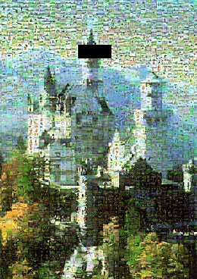
Design with Standard Components is similar to solving a Jigsaw Puzzle
Standard Puzzles:
„Corner pieces have
two straight edges“
What do we do
if that is not true?“
Puzzle Piece
(“component”)
Design Activities:
Start with the architecture (subsystem decomposition)
Identify the missing component
Make a build or buy decision for the component
Add the component to the system (finalizing the design).

Slide 13
Reuse of Code
I have a list, but my customer would like to have a stack
The list offers the operations Insert(), Find(), Delete()
The stack needs the operations Push(), Pop() and Top()
Can I reuse the existing list?
I am an employee in a company that builds cars with expensive car stereo systems
Can I reuse the existing car software in a home stero system?

Slide 14
Reuse of interfaces
I am an off-shore programmer in Hawaii. I have a contract to implement an electronic parts catalog for DaimlerChrysler
How can I and my contractor be sure that I implement it correctly?
I would like to develop a window system for Linux that behaves the same way as in Vista
How can I make sure that I follow the conventions for Vista windows and not those of MacOS X?
I have to develop a new service for cars, that automatically call a help center when the car is used the wrong way.
Can I reuse the help desk software that I developed for a company in the telecommuniction industry?

Slide 15
Reuse of existing classes
I have an implementation for a list of elements of Type int
Can I reuse this list to build
a list of customers
a spare parts catalog
a flight reservation schedule?
I have developed a class “Addressbook” in another project
Can I add it as a subsystem to my e-mail program which I purchased from a vendor (replacing the vendor-supplied addressbook)?
Can I reuse this class in the billing software of my dealer management system?

Slide 16
Customization: Build Custom Objects
Problem: Close the object design gap
Develop new functionality
Main goal:
Reuse knowledge from previous experience
Reuse functionality already available
Composition (also called Black Box Reuse)
New functionality is obtained by aggregation
The new object with more functionality is an aggregation of existing objects
Inheritance (also called White-box Reuse)
New functionality is obtained by inheritance
Notes:
Problem formulation for customization
Develop this new functionality as a set of operations of a new class or adapt an existing program to a new environment or a new customer.
So the goal is to produce custom objects to close the object design gap.

Slide 17
White Box and Black Box Reuse
White box reuse
Access to the development products (models, system design, object design, source code) must be available
Black box reuse
Access to models and designs is not available, or models do not exist
Worst case: Only executables (binary code) are available
Better case: A specification of the system interface is available.

Slide 18
Identification of new Objects during Object Design
Requirements Analysis
(Language of Application
Domain)
Incident
Report
Incident
Report
Text box
Menu
Scrollbar
Object Design
(Language of Solution Domain)

Slide 19
Application Domain vs Solution Domain Objects
Requirements Analysis (Language of Application Domain)
Subject
Observer
observers
*
subscribe(subscriber)
unsubscribe(subscriber)
notify()
update()
ConcreteSubject
ConcreteObserver
state
observeState
getState()
setState()
update()
Object Design (Language of Solution Domain)

Slide 20
Types of Whitebox Reuse
1. Implementation inheritance
Reuse of Implementations
2. Specification Inheritance
Reuse of Interfaces
Programming concepts to achieve reuse
Inheritance
Delegation
Abstract classes and Method Overriding
Interfaces
Notes:
There is a third way, reuse by Generic classes:
Reuse of data structures for different base types
We don‘t cover this in this class

Slide 21
Why Inheritance?
1. Organization (during analysis):
Inheritance helps us with the construction of taxonomies to deal with the application domain
when talking the customer and application domain experts we usually find already existing taxonomies
2. Reuse (during object design):
Inheritance helps us to reuse models and code to deal with the solution domain
when talking to developers
Notes:
Inheritance is a useful concept for two reasons

Slide 22
The use of Inheritance
Inheritance is used to achieve two different goals
Description of Taxonomies
Interface Specification
Description of Taxonomies
Used during requirements analysis
Activity: identify application domain objects that are hierarchically related
Goal: make the analysis model more understandable
Interface Specification
Used during object design
Activity: identify the signatures of all identified objects
Goal: increase reusability, enhance modifiability and extensibility
Notes:
Let us think about how we model, When we observation Modeling of the Real World, we notice that we identify existing objects.
Modeling of the real world leads to a system that reflects today’s realities but not necessarily tomorrow’s, or the visionary Scenario that drives our analysis.
Transition to next slide: “Inheritance is found either by specialization or generalization”

Slide 23
Inheritance can be used during Modeling as well as during Implementation
Starting Point is always the requirements analysis phase:
We start with use cases
We identify existing objects (“class identification“)
We investigate the relationship between these objects; “Identification of associations“:
general associations
aggregations
inheritance associations.

Slide 24
Example of Inheritance
Superclass:
Car
drive()
brake()
public class Car {
public void drive() {…}
public void brake() {…}
public void accelerate() {…}
}
accelerate()
Subclass:
public class LuxuryCar extends Car {
public void playMusic() {…}
public void ejectCD() {…}
public void resumeMusic() {…}
public void pauseMusic() {…}
}
LuxuryCar
playMusic()
ejectCD()
resumeMusic()
pauseMusic()

Slide 25
Inheritance comes in many Flavors
Inheritance is used in four ways:
Specialization
Generalization
Specification Inheritance
Implementation Inheritance.
The focus of generalization and specialization is to organize analysis objects into an understandable hierarchy
The focus of inheritance during object design is to reduce redundancy and enhance extensibility.

Slide 26
Discovering Inheritance
To “discover“ inheritance associations, we can proceed in two ways, which we call specialization and generalization
Generalization: the discovery of an inheritance relationship between two classes, where the sub class is discovered first.
Specialization: the discovery of an inheritance relationship between two classes, where the super class is discovered first.
Notes:
The distinction is subtle and depends on who is discovered first, the super class or the sub class

Slide 27
Generalization
First we find the subclass, then the super class
This type of discovery occurs often in science and engineering:
Biology: First we find individual animals (Elefant, Lion, Tiger), then we discover that these animals have common properties (mammals).
Engineering: What are the common properties of cars and airplanes?

Slide 28
Generalization Example: Modeling a Coffee Machine
VendingMachine
Generalization:
The class CoffeeMachine is
discovered first, then the class
SodaMachine, then the
superclass
VendingMachine
CoffeeMachine
totalReceipts
numberOfCups
coffeeMix
collectMoney()
makeChange()
heatWater()
dispenseBeverage()
addSugar()
addCreamer()
Notes:
After the generalization there is often an opportunity for Restructuring:
Why don‘t we move the methods totalReceipts, collectMoney(), makeChange(), dispenseBeverage()
into the super class?

Slide 29
Restructuring of Attributes and Operations is often a Consequence of Generalization
Called Remodeling if done on the model level;
called Refactoring if done on the source code level.
VendingMachine
VendingMachine
totalReceipts
collectMoney()
makeChange()
dispenseBeverage()
CoffeeMachine
totalReceipts
numberOfCups
coffeeMix
collectMoney()
CoffeeMachine
makeChange()
SodaMachine
heatWater()
numberOfCups
dispenseBeverage()
coffeeMix
cansOfBeer
addSugar()
cansOfCola
heatWater()
addCreamer()
addSugar()
chill()
addCreamer()

Slide 30
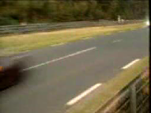
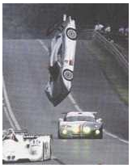
Specialization
Specialization occurs, when we find a subclass that is very similar to an existing class.
Example: A theory postulates certain particles and events which we have to find.
Specialization can also occur unintentionally:
Notes:
Example Physics: The Quarks-Theory postulates the existence of certain particles. After the theory was formulated, people started seaching for those particles and found them (others are still being looked for).
Typical occurence of specialization in software projects:
Last year we finished a project, in which we developed a machine, that delivers coffee and tee with automatic detection of empty containers.
In the new project we have to develop the same functionality for our candy machines.
„Such a machine must be possible“.

Slide 31
Which Taxonomy is correct for the Example in the previous Slide?
Car
Airplane
drive()
fly()
Airplane
Car
fly()
drive()

Slide 32
Another Example of a Specialization
CandyMachine is a new product and designed as a sub class of the superclass VendingMachine
VendingMaschine
totalReceipts
collectMoney()
makeChange()
dispenseBeverage()
A change of names might now be useful: dispenseItem() instead of
dispenseBeverage() and
dispenseSnack()
CoffeeMachine
SodaMachine
CandyMachine
numberOfCups
coffeeMix
cansOfBeer
bagsofChips
cansOfCola
numberOfCandyBars
heatWater()
addSugar()
chill()
dispenseSnack()
addCreamer()

Slide 33
Example of a Specialization (2)
VendingMaschine
totalReceipts
collectMoney()
makeChange()
dispenseItem()
CoffeeMachine
SodaMachine
numberOfCups
CandyMachine
coffeeMix
cansOfBeer
cansOfCola
bagsofChips
heatWater()
numberOfCandyBars
addSugar()
chill()
addCreamer()
dispenseItem()
dispenseItem()
dispenseItem()
Notes:
Now we have the method dispenseItem in the superclass! It should be an abstract method, implemented by each of the subclasses

Slide 34
Meta-Model for Inheritance
Object
Design
Analysis
activity
Inheritance
Taxonomy
Inheritance
for Reuse
Inheritance detected by
Inheritance
detected by
Specification
Implementation
Inheritance
Inheritance
specialization
generalization
Notes:
Inheritance is used during analysis as well as during object design! This is often confusing
for modeling novices

Slide 35
Implementation Inheritance and Specification Inheritance
Implementation inheritance
Also called class inheritance
Goal:
Extend an applications’ functionality by reusing functionality from the super class
Inherit from an existing class with some or all operations already implemented
Specification Inheritance
Also called subtyping
Goal:
Inherit from a specification
The specification is an abstract class with all operations specified, but not yet implemented.

Slide 36
Implementation Inheritance vs. Specification Inheritance
Implementation Inheritance: The combination of inheritance and implementation
The Interface of the superclass is completely inherited
Implementations of methods in the superclass ("Reference implementations") are inherited by any subclass
Specification Inheritance: The combination of inheritance and specification
The Interface of the superclass is completely inherited
Implementations of the superclass (if there are any) are not inherited.

Slide 37
Example for Implementation Inheritance
A very similar class is already implemented that does almost the same as the desired class implementation
List
Example:
• I have a List class, I need a Stack class
• How about subclassing the Stack class from the List class and implementing Push(), Pop(), Top() with Add() and Remove()?
Add()
Remove()
“Already
implemented”
Stack
Push
()
Pop()
Top()
Problem with implementation inheritance:
The inherited operations might exhibit unwanted behavior.
Example: What happens if the Stack user calls Remove() instead of Pop()?
Notes:
Inheritance is a generalization technique, in which the behavior of a superclass is shared by all its subclasses. Sometimes it is misused as an implementation technique.
Question: Can you give me an example for unwanted behavior?

Slide 38
Delegation instead of Implementation Inheritance
Inheritance: Extending a Base class by a new operation or overwriting an operation.
Delegation: Catching an operation and sending it to another object.
Which of the following models is better?
List
+Add()
Stack
List
+Remove()
+Push()
+Pop()
+Top()
Add()
Remove()
Stack
+Push()
+Pop()
+Top()

Slide 39
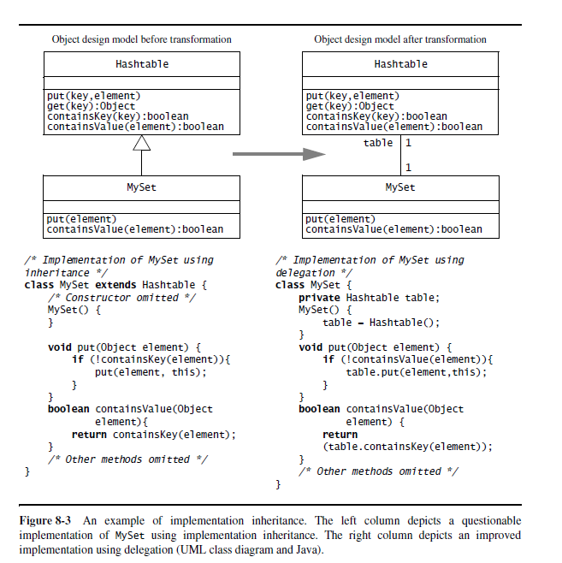
Cont..

Slide 40
Delegation
Delegation is a way of making composition as powerful for reuse as inheritance
In delegation two objects are involved in handling a request from a Client
The Receiver object delegates operations to the Delegate object
The Receiver object makes sure, that the Client does not misuse the Delegate object.
Client
Receiver
Delegate
calls
delegates to

Slide 41
Comparison: Delegation vs Implementation Inheritance
Delegation
☺ Flexibility: Any object can be replaced at run time by another one (as long as it has the same type
Inefficiency: Objects are encapsulated.
Inheritance
☺ Straightforward to use
☺ Supported by many programming languages
☺ Easy to implement new functionality
☹ Inheritance exposes a subclass to the details of its parent class
☹ Any change in the parent class implementation forces the subclass to change (which requires recompilation of both)

Slide 42
Abstract Methods and Abstract Classes
Abstract method:
A method with a signature but without an implementation (also called abstract operation)
Abstract class:
A class which contains at least one abstract method is called abstract class
Interface: An abstract class which has only abstract methods
An interface is primarily used for the specification of a system or subsystem. The implementation is provided by a subclass or by other mechanisms.

Slide 43
Example of an Abstract Method
VendingMaschine
dispenseItem() must be implemented in each subclass. We do this by specifying the operation as abstract. Abstract operations are written in UML in italics.
totalReceipts
collectMoney()
makeChange()
dispenseItem()
dispenseItem()
CoffeeMachine
SodaMachine
numberOfCups
CandyMachine
coffeeMix
cansOfBeer
cansOfCola
bagsofChips
heatWater()
numberOfCandyBars
addSugar()
chill()
dispenseItem()
dispenseItem()
addCreamer()
dispenseItem()

Slide 44
Rewriteable Methods and Strict Inheritance
Rewriteable Method: A method which allow a reimplementation.
In Java methods are rewriteable by default, i.e. there is no special keyword.
Strict inheritance
The subclass can only add new methods to the superclass, it cannot over write them
If a method cannot be overwritten in a Java program, it must be prefixed with the keyword final.

Slide 45
Strict Inheritance
Car
Superclass:
drive()
brake()
public class Car {
public final void drive() {…}
public final void brake() {…}
public final void accelerate() {…}
}
accelerate()
Subclass:
public class LuxuryCar extends Car {
public void playMusic() {…}
public void ejectCD() {…}
public void resumeMusic() {…}
public void pauseMusic() {…}
}
LuxuryCar
playMusic()
ejectCD()
resumeMusic()
pauseMusic()

Slide 46
Example: Strict Inheritance and Rewriteable Methods
help() not
overwritable
Original Java-Code:
class Device {
int serialnr;
public final void help() {….}
public void setSerialNr(int n) { serialnr = n; }
}
class Valve extends Device {
Position s;
public void on() { …. }
}
setSerialNr()
overwritable
Notes:
This implementation overwrites the method setSeriennr() from class Device

Slide 47
Example: Overwriting a Method
Original Java-Code:
class Device {
int serialnr;
public final void help() {….}
public void setSerialNr(int n) { serialnr = n; }
}
class Valve extends Device {
Position s;
public void on() { …. }
}
New Java-Code :
class Device {
int serialnr;
public final void help() {….}
public void setSerialNr(int n) { serialnr = n; }
}
class Valve extends Device {
Position s;
public void on() { …
}
public void setSerialNr(int n) { serialnr = n + s.serialnr; }
} // class Valve
Notes:
This implementation overwrites the method setSeriennr() from class Device

Slide 48
UML Class Diagram
Device
- int serialnr
+void setSerialNr(int n)
Device
- int serialnr
+void setSerialnr(int n)
Valve
-Position s
+ void on()
+ void setSerialNr()
Valve
Position s
+void on()

Slide 49
Rewriteable Methods: Usually implemented with Empty Body
class Device {
int serialnr;
public void setSerialNr(int n) {}
}
class Valve extends Device {
Position s;
public void on() {
…..
}
public void setSerialNr(int n) {
seriennr = n + s.serialnr;
}
} // class Valve
I expect, that the method setSerialNr()will be overwritten. I only write an empty body
Overwriting of the method setSerialNr() of Class Device
Notes:
The empty body is also called stub

Slide 50
Bad Use of OverwritingMethods
One can overwrite the operations of a superclass with completely new meanings.
Example:
Public class SuperClass {
public int add (int a, int b) { return a+b; }
public int subtract (int a, int b) { return a-b; }
}
Public class SubClass extends SuperClass {
public int add (int a, int b) { return a-b; }
public int subtract (int a, int b) { return a+b; }
}
We have redefined addition as subtraction and subtraction as addition!!
Notes:
Programming languages do not forbid such constructs.
But they violate our intuitive understanding of addition, and are thus a bad use of inheritance and specialization.

Slide 51
What we do to save money and time
Existing Class:
public class Auto {
public void drive() {…}
public void brake() {…}
public void accelerate() {…}
public void playMusic() {…}
public void ejectCD() {…}
public void resumeMusic() {…}
public void pauseMusic() {…}
}
Boombox:
public class Boombox extends Auto {
public void drive() {};
public void brake() {};
public void accelerate() {};
}

Slide 52
Revised Metamodel for Inheritance
Object
Design
Analysis
activity
Inheritance
Taxonomy
Inheritance
for Reuse
Inheritance detected by
Inheritance
detected by
Specification
Implementation
Inheritance
Inheritance
specialization
generalization
Strict
Inheritance
Contraction
Notes:
This is the final metamodel for modeling inheritance.
Today we have added strict inheritance and contractions as two additional ways to use implementation inheritance: We identified strict inheritance as a good citizen, and if used this way, then implementation inheritance is a good thing. And we have shown that contract is a bad idea, because it leads to unmaintainable systems and unpredictable behavior.

Slide 53
Documenting the Object Design
Object design document (ODD)
= The Requirements Analysis Document (RAD) plus...
… additions to object, functional and dynamic models (from the solution domain)
… navigational map for object model
… Specification for all classes (use Javadoc)
Notes:
ODD Management issues
Update the system models in the RAD?
Should the ODD be a separate document?
Who is the target audience for these documents (Customer, developer?)
If time is short: Focus on the Navigational Map and Javadoc documentation?
ODD Template:
http://www.oose.org

Slide 54
Documenting Object Design: ODD Conventions
Each subsystem in a system provides a service
Describes the set of operations provided by the subsystem
Specification of the service operations
Signature: Name of operation, fully typed parameter list and return type
Abstract: Describes the operation
Pre: Precondition for calling the operation
Post: Postcondition describing important state after the execution of the operation
Use JavaDoc and Contracts for the specification of service operations
Contracts are covered in the next lecture.
Notes:
Each subsystem in a system provides a service (see Chapters on System Design)
Describes the set of operations provided by the subsystem
Specifying a service operation as
Signature: Name of operation, fully typed parameter list and return type
Abstract: Describes the operation
Pre: Precondition for calling the operation
Post: Postcondition describing important state after the execution of the operation
Use JavaDoc for the specification of service operations.

Slide 55
Package it all up
Pack up design into discrete units that can be edited, compiled, linked, reused
Construct physical modules
Ideally use one package for each subsystem
System decomposition might not be good for implementation.
Two design principles for packaging
Minimize coupling:
Classes in client-supplier relationships are usually loosely coupled
Avoid large number of parameters in methods to avoid strong coupling (should be less than 4-5)
Avoid global data
Maximize cohesion: Put classes connected by associations into one package.

Slide 56
Introduction to Design Patterns
Design Patterns
Usefulness of design patterns
Design Pattern Categories
Patterns covered in this lecture
Composite: Model dynamic aggregates
Facade: Interfacing to subsystems
Adapter: Interfacing to existing systems (legacy systems)
Bridge: Interfacing to existing and future systems

Slide 57
A Game: Get-15
Start with the nine numbers 1,2,3,4, 5, 6, 7, 8 and 9.
You and your opponent take alternate turns, each taking a number
Each number can be taken only once: If you opponent has selected a number, you cannot also take it.
The first person to have any three numbers that total 15 wins the game.
Example:
You:
1
5
3
8
Opponent:
6
9
7
2
Opponent
Wins!

Slide 58
Characteristics of Get-15
Hard to play,
The game is especially hard, if you are not allowed to write anything done.
Why?
All the numbers need to be scanned to see if you have won/lost
It is hard to see what the opponent will take if you take a certain number
The choice of the number depends on all the previous numbers
Not easy to devise an simple strategy

Slide 59
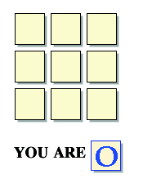
Another Game: Tic-Tac-Toe
Source: http://boulter.com/ttt/index.cgi

Slide 60
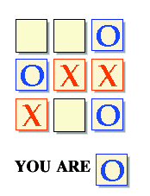
A Draw Sitation

Slide 61
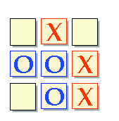
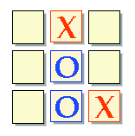
Strategy for determining a winning move

Slide 62
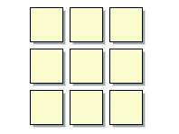
Winning Situations for Tic-Tac-Toe
Winning
Patterns

Slide 63
Get-15 and Tic-Tac-Toe are identical problems
Any three numbers that solve the 15 problem also solve tic-tac-toe.
Any tic-tac-toe solution is also a solution the 15 problem
To see the relationship between the two games, we simply arrange the 9 digits into the following pattern
8
1
6
3
5
7
4
9
2

Slide 64
You:
1
5
3
8
Opponent:
6
9
7
2
8
1
6
8
1
6
3
5
7
3
5
7
4
9
2
4
9
2

Slide 65
During Object Modeling we do many transformations and changes to the object model
It is important to make sure the object design model stays simple!

Slide 66
Modeling Heuristics
Modeling must address our mental limitations:
Our short-term memory has only limited capacity (7+-2)
Good models deal with this limitation, because they…
… do not tax the mind
A good model requires only a minimal mental effort to understand
… reduce complexity
Turn complex tasks into easy ones (by good choice of representation)
Use of symmetries
… use abstractions
taxonomies
… have organizational structure:
Memory limitations are overcome with an appropriate representation (“natural model”).

Slide 67
Finding Objects
The hardest problems in object-oriented system development are:
Identifying objects
Decomposing the system into objects
Requirements Analysis focuses on application domain:
Object identification
System Design addresses both, application and implementation domain:
Subsystem Identification
Object Design focuses on implementation domain:
Additional solution objects

Slide 68
Techniques for Finding Objects
Requirements Analysis
Start with Use Cases. Identify participating objects
Textual analysis of flow of events (find nouns, verbs, ...)
Extract application domain objects by interviewing client (application domain knowledge)
Find objects by using general knowledge
System Design
Subsystem decomposition
Try to identify layers and partitions
Object Design
Find additional objects by applying implementation domain knowledge

Slide 69
Another Source for Finding Objects : Design Patterns
What are Design Patterns?
A design pattern describes a problem which occurs over and over again in our environment
Then it describes the core of the solution to that problem, in such a way that you can use the solution a million times over, without ever doing it the same twice
Design Pattern categories:
Creational
Structural
Behavioral

Slide 70
The Liskov Substitution Principle
Provide a formal definition for specification inheritance.
If an object of type S can be substituted in all places where an object type T is expected, then S is a subtype of T.

Slide 71
Design Patterns
In object-oriented development, design patterns are template solution that developers have refined over time to solve a range of recurring problems.
A design pattern has four elements:
A name that uniquely identifies the pattern from other patterns
A problem description that describe the situation in which the pattern can be used.
A solution stated as a set of collaborating classes and interfaces
A set of consequences that describes the trade-offs and alternatives to be considered with respect to the design goals being addressed.

Slide 72
Abstract Factory: Encapsulating Platforms
Shield the client from different platforms that provide different implementations for the same set of concepts.

Slide 73
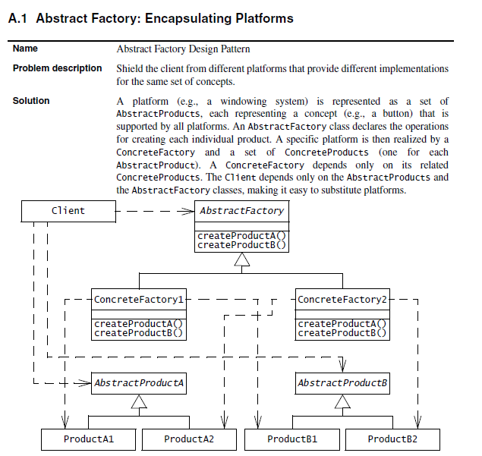

Slide 74
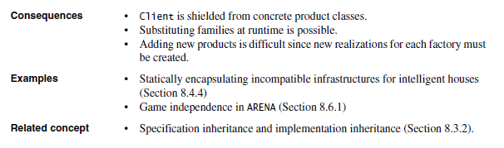

Slide 75
Introducing the Composite Pattern
Models tree structures that represent part-whole hierarchies with arbitrary depth and width.
The Composite Pattern lets client treat individual objects and compositions of these objects uniformly
Client
Component
Leaf
Operation()
Composite
Operation()
AddComponent
RemoveComponent()
GetChild()
Children

Slide 76
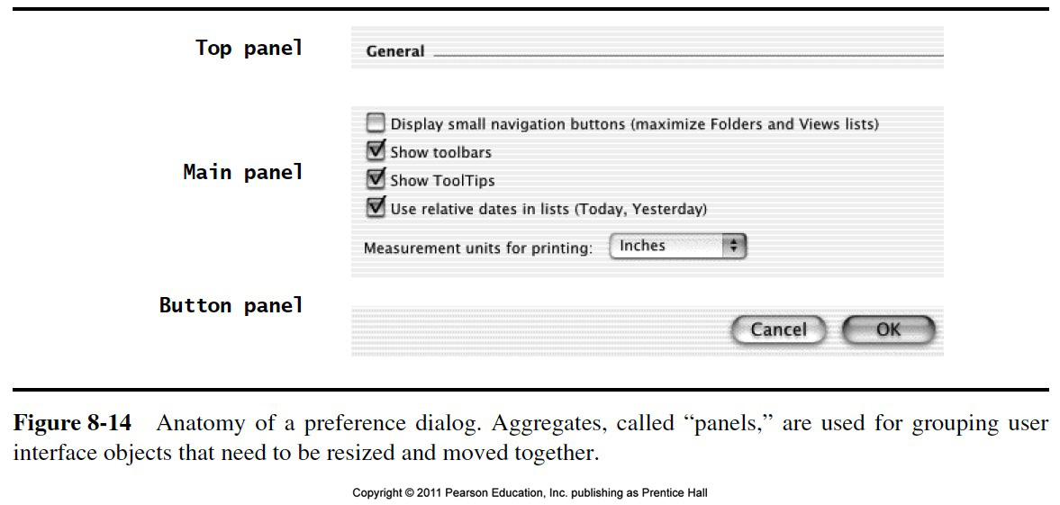

Slide 77
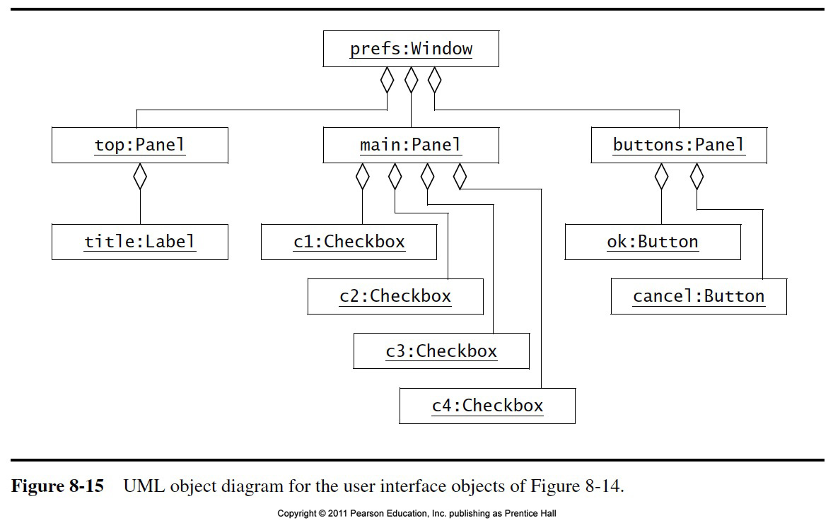

Slide 78
What is common between these definitions?
Software System:
Definition: A software system consists of subsystems which are either other subsystems or collection of classes
Composite: Subsystem (A software system consists of subsystems which consists of subsystems , which consists of subsystems, which...)
Leaf node: Class
Software Lifecycle:
Definition: The software lifecycle consists of a set of development activities which are either other actitivies or collection of tasks
Composite: Activity (The software lifecycle consists of activities which consist of activities, which consist of activities, which....)
Leaf node: Task.

Slide 79
Modeling a Software System with a Composite Pattern
User
Software
System
*
Class
Subsystem
Children

Slide 80
Modeling the Software Lifecycle with a Composite Pattern
Manager
Software
Lifecycle
*
Task
Activity
Children

Slide 81
The Composite Patterns models dynamic aggregates
Fixed Structure:
Car
*
*
Doors
Wheels
Battery
Engine
Organization Chart (variable aggregate):
*
*
Department
University
School
Composite
Pattern
Dynamic tree (recursive aggregate):
Program
Dynamic tree (recursive aggregate):
*
*
Block
Compound
Simple
Statement
Statement
Notes:
What you are seeing on this slide are what I would like to call patterns for analysis.
A pattern is a recurring theme, something once you get used to see something this way, allows you to very fast understand a situation.
It is well known, that if you show a set of chess positions of middle games tochess masters and non chess players, that chess masters are able to reconstruct these games without any effort.
However, if you give them random chess configurations, chess masters are about as bad as non-chess players in reconstructing the boards.
This tells you about the value of patterns. I would like you to learn about these aggregation patterns. In fact, I challenge you to see for your team and subsystem, if any of the analysis problems you face, can be cast in terms of one of the 3 patterns above.

Slide 82
Graphic Applications also use Composite Patterns
The Graphic Class represents both primitives (Line, Circle) and their containers (Picture)
Client
Graphic
Line
Draw()
Circle
Draw()
Picture
Draw()
Add(Graphic g)
RemoveGraphic)
GetChild(int)
Children

Slide 83
Reducing the Complexity of Models
To communicate a complex model we use navigation and reduction of complexity
We do not simply use a picture from the CASE tool and dump it in front of the user
The key is navigate through the model so the user can follow it
We start with a very simple model
Start with the key abstractions
Then decorate the model with additional classes
To reduce the complexity of the model further, we
Look for inheritance (taxonomies)
If the model is still too complex, we show subclasses on a separate slide
Then we identify or introduce patterns in the model
We make sure to use the name of the patterns.

Slide 84
Example: A Complex Model
Taxonomies
Basic Abstractions
Composite Patterns
Notes:
This model is already much more complex than the model shown on the previous slide. Its purpose is still for communication only.
Because it already has quite a number of abstractions, It can only be understood if we communicate the model well to the user. We can do this by navigating through the model and highlight basic abstractions and typical patterns.
For example, we can highlight the basic abstraction (the ones used in the previous slide) <<Proceed to first animation>> and tell the listener that these are the abstraction used in the previous slide (to make the point more clear, the instructor can move once more to the previous slide)
To reduce the complexity of the model, the instructor can then point out that Work Product, Task and Participant all are now basic leaves in a composite pattern. <<Proceed to the next animation, show the use of the composite patterns>>.
To reduce the complexity even further, the instructor finally points out the use of inheritance for the taxonomies (Resource, Staff, Work Product and Activity)
Given these three tips, the students should be able to understand the model themselves.

Slide 85
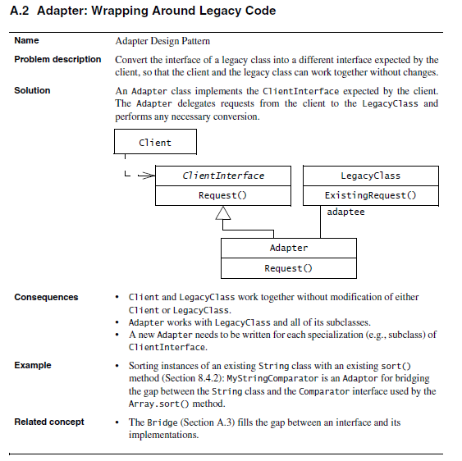
Adapter: Wrapping Around Legacy Code

Slide 86
Adapter Pattern
Client
ClientInterface
LegacyClass
Request()
ExistingRequest()
adaptee
Inheritance
Adapter
Delegation
Request()
The adapter pattern uses inheritance as well as delegation:
- Interface inheritance is used to specify the interface of the Adapter class.
- Delegation is used to bind the Adapter and the Adaptee
Notes:
Delegation is used to bind an Adapter and an Adaptee (Legacy Class)
Interface inheritance is use to specify the interface of the Adapter class.
Adaptee (usually called legacy system) pre-exist the Adapter.
Client Interface may be realized as an interface in Java.

Slide 87
Adapter Pattern
The adapter pattern lets classes work together that couldn’t otherwise because of incompatible interfaces
“Convert the interface of a class into another interface expected by a client class.”
Used to provide a new interface to existing legacy components (Interface engineering, reengineering).
Two adapter patterns:
Class adapter:
Uses multiple inheritance to adapt one interface to another
Object adapter:
Uses single inheritance and delegation
Object adapters are much more frequent.
We cover only object adapters (and call them adapters).

Slide 88
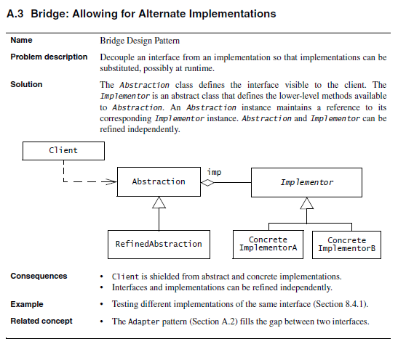
Bridge: Allowing for Alternate Implementations

Slide 89
Bridge Pattern
Use a bridge to “separate an abstraction from its implementation so that the two can vary independently” (From [Gamma et al 1995])
Also know as a Handle/Body pattern
Allows different implementations of an interface to be decided upon dynamically.
This allows to bind one from many different implementations of an interface to a client dynamically
Design decision that can be realized any time during the runtime of the system
However, usually the binding occurs at start up time of the system (e.g. in the constructor of the interface class)

Slide 90
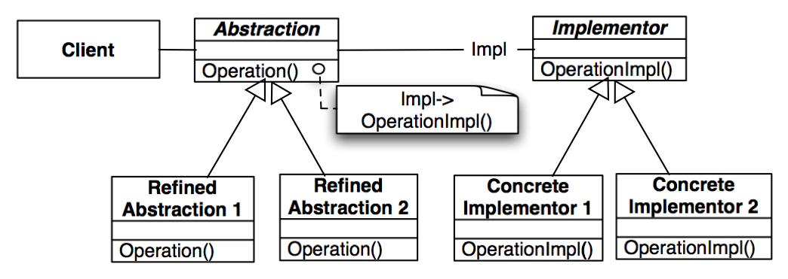
Bridge Pattern
Taxonomy in
Application Domain
Taxonomy in
Solution Domain

Slide 91
Why the Name Bridge Pattern?
Taxonomy in
Application Domain
Taxonomy in
Solution Domain
Notes:
It provides a bridge between the Abstraction (in the application domain) and the Implementor (in the solution domain)

Slide 92
Using a Bridge
The bridge pattern can be used to provide multiple implementations under the same interface
Interface to a component that is incomplete (only Stub code is available), not yet known or unavailable during testing
If seat data are required to be read, but the seat is not yet implemented (only stub code available), or only available by a simulation (AIM or SART), the bridge pattern can be used:
Seat
(in Vehicle Subsystem)
VIP
imp
SeatImplementation
GetPosition()
SetPosition()
Stub Code
AIMSeat
SARTSeat

Slide 93
Seat Implementation
public interface SeatImplementation {
public int GetPosition();
public void SetPosition(int newPosition);
}
public class Stubcode implements SeatImplementation {
public int GetPosition() {
// stub code for GetPosition
}
...
}
public class AimSeat implements SeatImplementation {
public int GetPosition() {
// actual call to the AIM simulation system
}
….
}
public class SARTSeat implements SeatImplementation {
public int GetPosition() {
// actual call to the SART seat simulator
}
...
}

Slide 94
Another use of the Bridge Pattern: Support multiple Database Vendors
Arena
imp
LeagueStore
LeagueStoreImplementor
Stub Store
XML Store
JDBC Store
Implementor
Implementor
Implementor

Slide 95
Adapter vs Bridge
Similarities:
Both are used to hide the details of the underlying implementation.
Difference:
The adapter pattern is geared towards making unrelated components work together
Applied to systems after they’re designed (reengineering, interface engineering).
“Inheritance followed by delegation”
A bridge, on the other hand, is used up-front in a design to let abstractions and implementations vary independently.
Green field engineering of an “extensible system”
New “beasts” can be added to the “object zoo”, even if these are not known at analysis or system design time.
“Delegation followed by inheritance”

Slide 96
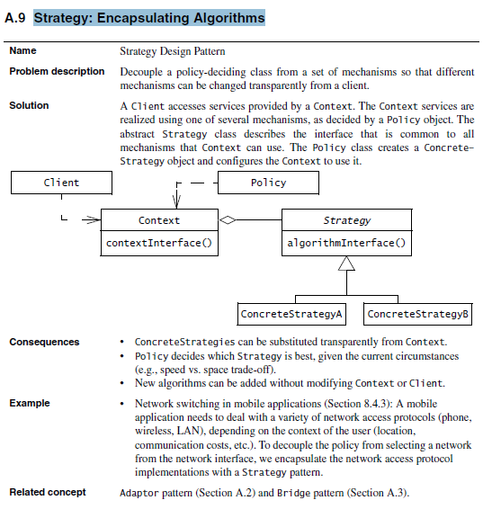
Strategy: Encapsulating Algorithms

Slide 97
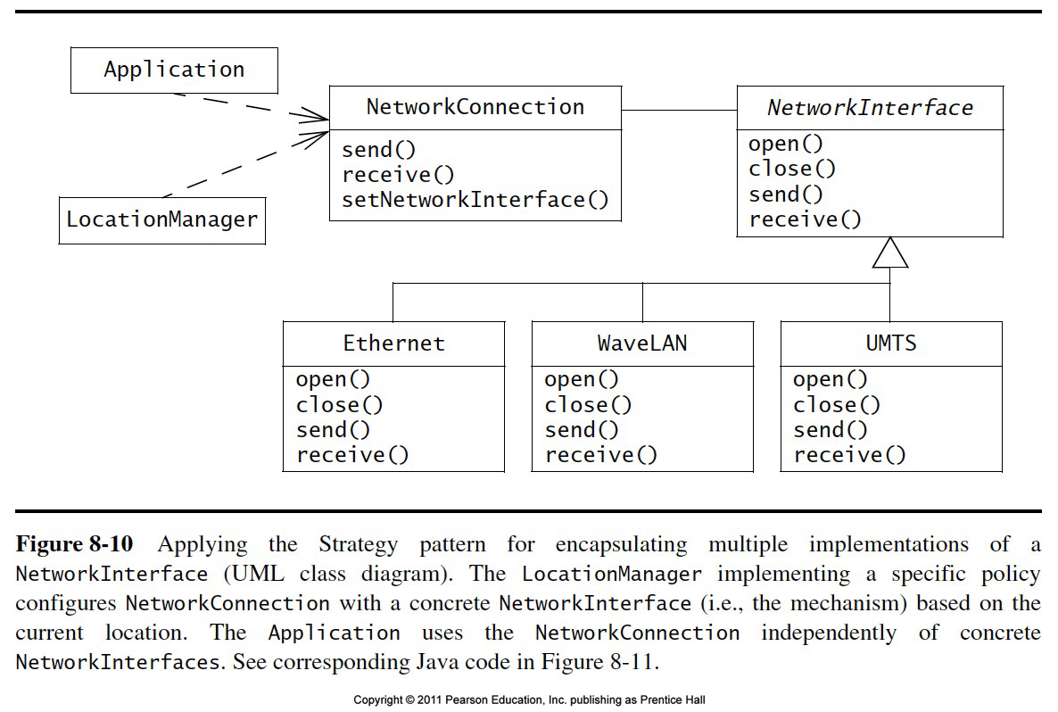
Strategy Pattern

Slide 98
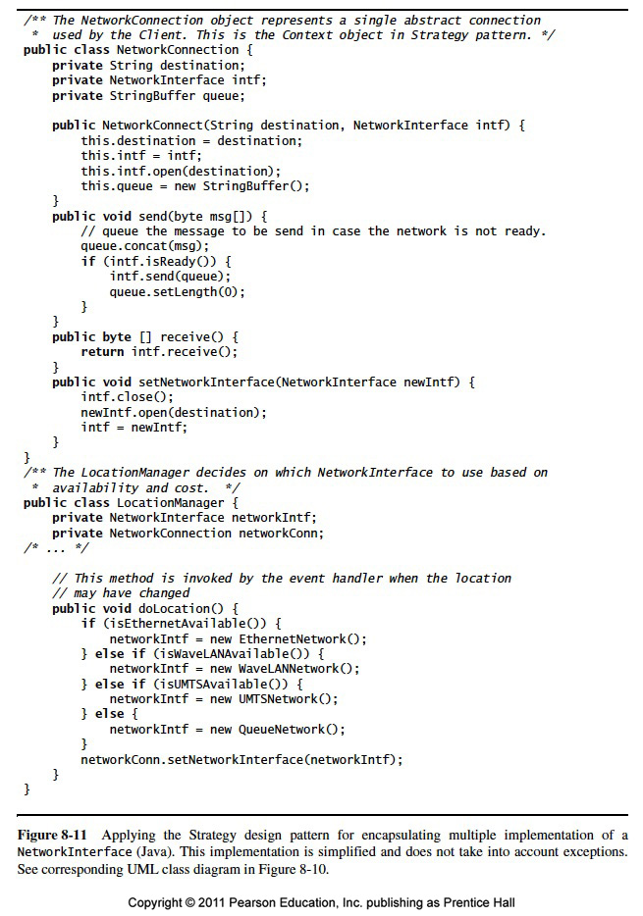

Slide 99
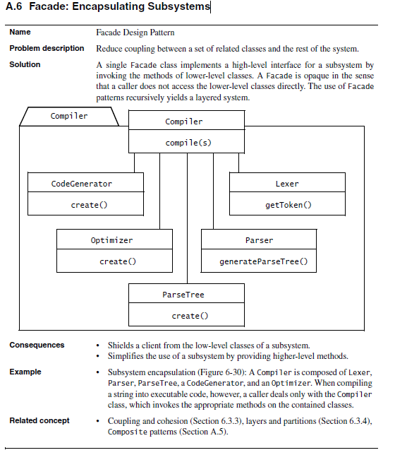
Facade: Encapsulating Subsystems

Slide 100
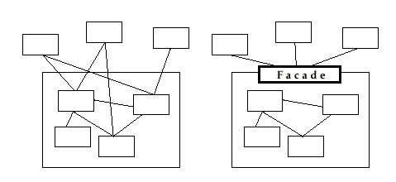
Facade Pattern
Provides a unified interface to a set of objects in a subsystem.
A facade defines a higher-level interface that makes the subsystem easier to use (i.e. it abstracts out the gory details)
Facades allow us to provide a closed architecture

Slide 101
Design Example
Subsystem 1 can look into the Subsystem 2 (vehicle subsystem) and call on any component or class operation at will.
This is “Ravioli Design”
Why is this good?
Efficiency
Why is this bad?
Can’t expect the caller to understand how the subsystem works or the complex relationships within the subsystem.
We can be assured that the subsystem will be misused, leading to non-portable code
Subsystem 1
Subsystem 2
Seat
Card
AIM
SA/RT

Slide 102
Realizing an Opaque Architecture with a Facade
VIP Subsystem
The subsystem decides exactly how it is accessed
No need to worry about misuse by callers
If a facade is used the subsystem can be used in an early integration test
We need to write only a driver
Vehicle Subsystem API
Seat
Card
AIM
SA/RT

Slide 103
Subsystem Design with Facade, Adapter, Bridge
The ideal structure of a subsystem consists of
an interface object
a set of application domain objects (entity objects) modeling real entities or existing systems
Some of the application domain objects are interfaces to existing systems
one or more control objects
We can use design patterns to realize this subsystem structure
Realization of the Interface Object: Facade
Provides the interface to the subsystem
Interface to existing systems: Adapter or Bridge
Provides the interface to existing system (legacy system)
The existing system is not necessarily object-oriented!

Slide 104
When should you use these Design Patterns?
A facade should be offered by all subsystems in a software system who a services
The facade delegates requests to the appropriate components within the subsystem. The facade usually does not have to be changed, when the components are changed
The adapter design pattern should be used to interface to existing components
Example: A smart card software system should use an adapter for a smart card reader from a specific manufacturer
The bridge design pattern should be used to interface to a set of objects
where the full set of objects is not completely known at analysis or design time.
when a subsystem or component must be replaced later after the system has been deployed and client programs use it in the field.

Slide 105
