Slide 1
Software Engineering
Dr. Erdal Kose
Office
Becton Hall, Room 401A
Email: ekose@fdu.edu

Slide 2
Objectives of the Course
Appreciate the Fundamentals of Software Engineering:
Methodologies
Process models
Description and modeling techniques
System analysis - Requirements engineering
System design
Implementation: Principles of system development

Slide 3
Focus: Acquire Technical Knowledge
Different methodologies (“philosophies”) to model and develop software systems
Different modeling notations
Different modeling methods
Different software lifecycle models (empirical control models, defined control models)
Different testing techniques (eg. vertical testing, horizontal testing)
Rationale Management
Release and Configuration Management
Notes:
Understand system modeling
Learn a modeling notation (Unified Modeling Language)
Learn different modeling methods:
Functional modeling
Object modeling
Dynamic modeling
Learn to use Tools:
CASE (Computer Aided Software Engineering)
Testing
Different testing methods
Unit, integration and system testing
Move into Component-Based Software Engineering
Design patterns and frameworks
Reuse of existing knowledge

Slide 4
Acquire Managerial Knowledge
Learn the basics of software project management
Understand how to manage with a software lifecycle
Be able to capture software development knowledge (Rationale Management)
Manage change: Configuration Management
Learn the basic methodologies
Traditional software development
Agile methods.
Notes:
Software Project Management
Distinction between Process vs Product
Greenfield engineering, Interface engineering and reengineering projects
Software Lifecycle
Learn about different software lifecycles
Iterative approaches
Rationale Management
Issue management
Solving conflicts
Configuration Management
Identification of configuration items
Methodologies
Heavy and lightweight approaches

Slide 5
Key Concept of Software Engineering
Coding without a solution design increase debagging time and increase possibility to develop wrong product

Slide 6
Overview
Software is designed and built by software engineers.
Software is used by virtually everyone in society.
Software is pervasive in our commerce, our culture, and our everyday lives.
Software engineers have a moral obligation to build reliable software that does no harm to other people..

Slide 7
Software
Software is both a product and a vehicle for delivering a product (information).
Software is engineered not manufactured.
Software does not wear out, but it does deteriorate.
Industry is moving toward component-based software construction, but most software is still custom-built.

Slide 8
Software Application Domains
System software
Application software
Engineering or Scientific Software
Embedded software
Product-line software (includes entertainment software)
Web-Applications (includes MobileApps)
Artificial intelligence software

Slide 9
New Software Challenges
Open-world computing
Creating software to allow machines of all sizes to communicate with each other across vast networks
Netsourcing
Architecting simple and sophisticated applications that benefit targeted end-user markets worldwide
Open Source
Distributing source code for computing applications so customers can make local modifications easily and reliably

Slide 10
Reasons for Legacy System Evolution
Software must be adapted to meet needs of new computing environments or technology
Software must be enhanced to implement new business requirements
Software must be extended to make it interoperable with more modern system components
Software must be re-architected to make it viable within a network environment

Slide 11
Software domain
Web Applications
Mobile application
Cloud computing
Engineering applications
Medical Applications

Slide 12
Why is Software Development difficult?
The problem is usually ambiguous
The requirements are usually unclear and changing when they become clearer
The problem domain (called application domain) is complex, and so is the solution domain
The development process is difficult to manage
Software offers extreme flexibility
Software is a discrete system
Continuous systems have no hidden surprises
Discrete systems can have hidden surprises! (Parnas)

Slide 13
Software Development is more than just Writing Code
It is problem solving
Understanding a problem
Proposing a solution and plan
Engineering a system based on the proposed solution using a good design
It is about dealing with complexity
Creating abstractions and models
Notations for abstractions
It is knowledge management
Elicitation, analysis, design, validation of the system and the solution process
It is rationale management
Making the design and development decisions explicit to all stakeholders involved.

Slide 14
Techniques, Methodologies and Tools
Techniques:
Techniques are well known procedures that you know will produce a result (Algorithms, cook book recipes are examples of techniques).
Formal procedures for producing results using some well-defined notation
Methodologies:
A collection of techniques is called a methodology. (A cookbook is a methodology).
Collection of techniques applied across software development and unified by a philosophical approach
Tools:
Instruments or automated systems to accomplish a technique
Interactive Development Environment (IDE)
Computer Aided Software Engineering (CASE)

Slide 15
Computer Science vs. Engineering
Computer Scientist
Assumes techniques and tools have to be developed.
Proves theorems about algorithms, designs languages, defines knowledge representation schemes
Has infinite time…
Engineer
Develops a solution for a problem formulated by a client
Uses computers & languages, techniques and tools
Software Engineer
Works in multiple application domains
Has only 3 months...
…while changes occurs in the problem formulation (requirements) and also in the available technology.

Slide 16
Software Engineering: A Problem Solving Activity
Analysis:
Understand the nature of the problem and break the problem into pieces
Synthesis:
Put the pieces together into a large structure
For problem solving we use techniques, methodologies and tools.

Slide 17
Software Engineering
Software Engineering is a collection of techniques, methodologies and tools that help with the production of a software
Provides techniques to simplify the development of a software (computer program)
It is the use of a combination of project management, computer science techniques and other techniques to specify, design, develop, and maintain a software application
A high quality software system developed with a given budget before a given deadline while change occurs

Slide 18
Cont..
What is Software Engineering?
The goal is to produce high quality software to satisfy a set of functional and nonfunctional requirements.
How do we do that?
First, and foremost, by acknowledging that it is a problem solving activity. That is, it has to rely on well known techniques that are used all over the world for solving problems. There are two major parts of any problem solving process:
Analysis:
Understand the nature of the problem. This is done by looking at the problem and trying to see if there are sub aspects that can be solved independently from each other. This means, that we need to identify the pieces of the puzzle (In object-oriented development, we will call this object identification).
Synthesis:
Once you have identified the pieces, you want to put them back together into a larger structure, usually by keeping some type of structure within the structure.

Slide 19
Life Cycle of an Information System
System
A collection of pieces working together to achieve a common goal
An information system includes:
Data
People
Procedures
Hardware
Software

Slide 20
System Development Life Cycle
To create modern software, an entire team is needed
Programs require many phases to complete
Must be available for multiple operating systems and work over networks
Must be free of errors and well supported

Slide 21
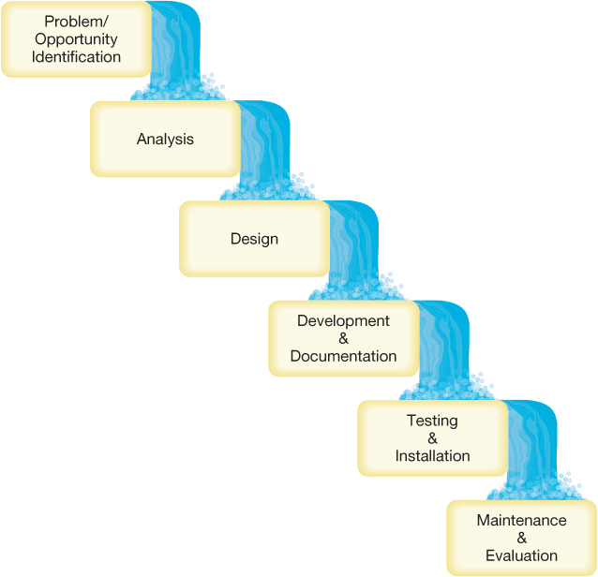
Six Steps in the SDLC
Each step must be completed before you can progress to the next step.

Slide 22
Problem & Opportunity Identification
Development steering committee formed to evaluate systems development proposals
Reviews ideas
Decides which projects to take forward based on available resources
Personnel and funding

Slide 23
Analysis
Analysts explore problem to be solved
Develop program specifications
Clear statement of goals and objectives of project
Feasibility assessment is performed
User requirements are defined
Analysts recommend a plan of action

Slide 24
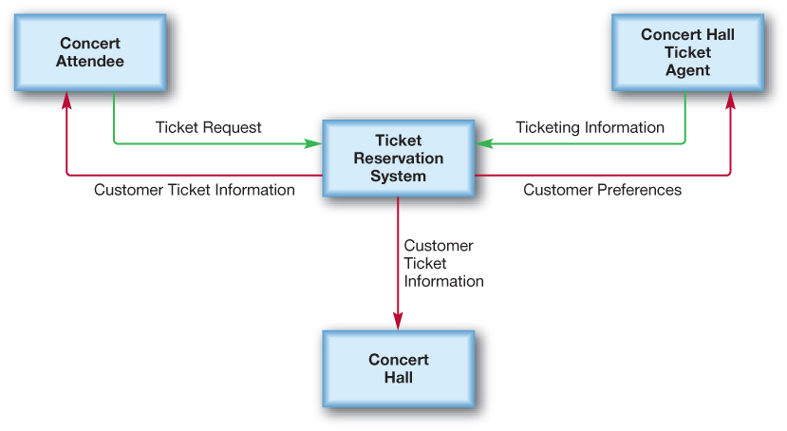
Design
A detailed plan for programmers is developed
Flowcharts and data-flow diagrams are used for the current and proposed system
Data-flow diagram
Notes:
system from the point at which data enters the system to the point of its final resting place (storage or output).

Slide 25
Development and Documentation
Actual programming takes place
First phase of the program development life cycle (PDLC)

Slide 26
Testing and Installation
Program is tested to ensure it works properly
Program is installed for use

Slide 27
Maintenance and Evaluation
Performance of the system is monitored
Corrections and modifications to the program are made
Additional enhancements that users request are evaluated
Appropriate program modifications are made

Slide 28
Joint Application Development
JAD helps designers adapt to changes in program specifications
Includes customer involvement
No communication delays
Also referred to as:
Accelerated design
Facilitated team technique
Notes:
In each phase of the SDLC, a style of interaction named joint application development (JAD) is useful in creating successful, flexible results. JAD is popular because it helps designers adapt quickly to changes in program specifications. In JAD, the customer is involved in the project very closely, right from the beginning. Slow communication and lengthy feedback time are reasons the traditional development process is so time consuming. In JAD “workshops,” there are no communication delays. Workshops usually include end users, developers, subject experts, observers (such as senior management), and a facilitator. The facilitator enforces the rules of the meeting to make sure all voices are heard and agreement is reached as quickly as possible. Also called accelerated design or facilitated team technique, the goal of JAD is to improve design quality by fostering clear communication.

Slide 29
The Life Cycle of a Program
Programming is the process of translating a task into a series of commands a computer will use to perform that task
Programming involves:
Identifying the parts of a task the computer can perform
Describing tasks in a highly specific and complete manner
Translating this description into a language understood by the computer’s CPU

Slide 30
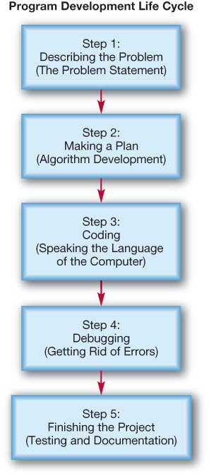
Program Development Life Cycle

Slide 31
Step 1: Describing the Problem
Programmers develop a complete description of problem
Problem statement identifies task to be automated
Statement describes how software will behave

Slide 32
Step 2: Making a Plan
Problem statement is translated into a set of specific, sequential steps known as an algorithm
Algorithm is written in natural ordinary language such as English

Slide 33
Step 3: Coding
Algorithm is translated into programming code
Programmers must think in terms of operations that a CPU can perform

Slide 34

Step 4: Debugging
Code goes through process of debugging
Programmers repair any errors found in code

Slide 35
Step 5: Finishing the Project
Software is tested
Programming team
People who will use program
Results of entire project are documented
Users are trained to use program efficiently

Slide 36
Describing the Problem
The Problem Statement
Staring point of programming work
Clear description of tasks the computer program must accomplish
How the program will execute these tasks
How the program will respond to unusual situations

Slide 37
Creating Problem Statements
Programmers interact with users to describe three relevant things:
Data – raw input users have at the start
Information – result users require
Method – process of how program converts the inputs to correct outputs

Slide 38
Parking Garage Example
Program Goal: | To compute the total pay for a fixed number of hours worked at a parking garage.
Inputs: | Number of Hours Worked........................ a positive number
Outputs: | Total Pay Earned .................................... a positive number
Process: | The Total Pay Earned is computed as $7.50 per hour for the first eight hours worked each day. Any hours worked beyond the first eight are billed at $11.25 per hour.
Error Handling: | The input (Number of Hours Worked) must be a positive real number. If it is a negative number or other non-acceptable character, the program will force the user to re-enter the information.
Testing Plan: | INPUT | OUTPUT | NOTES
 | 8 | 8*7.50 | Testing positive input
 | 3 | 3*7.50 | Testing positive input
 | 12 | 8*7.50 + 4*11.25 | Testing overtime input
 | –6 | Error message/ask user to re-enter value | Handling error

Slide 39
Making a Plan
Algorithm Development
Set of specific sequential steps
Describe exactly what computer program must do to complete task
Use natural language

Slide 40
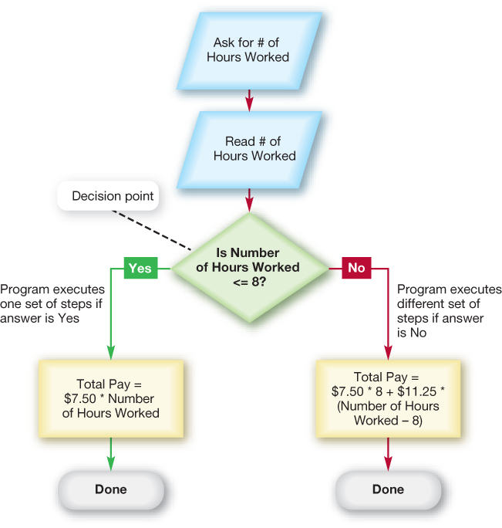
Flowchart

Slide 41
Pseudocode
Bold terms show actions that are common in programming, such as reading data, making decisions, printing, and so on.
1. Ask the user how many hours they worked today
2. If the number of hours worked < = 8,
compute total pay without overtime
otherwise,
compute total pay with overtime pay
3. Print total pay
Underlined words are information items that appear repeatedly in the algorithm.

Slide 42
Developing the Algorithm
Decision Making and Design
Convert problem statement into list of steps or actions
Only simplest algorithms execute same series of actions every time they run
Complex problems involve choices and include decision points

Slide 43
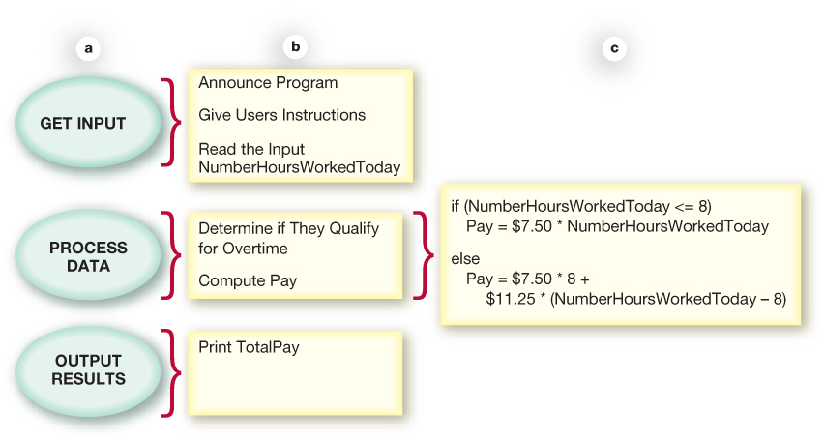
Top-Down Design
Problem is divided into a series of high-level tasks
Detailed subtasks are created from high-level tasks

Slide 44
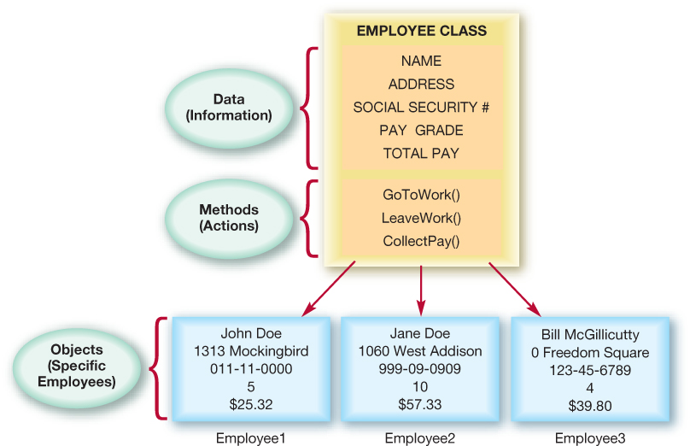
Object-Oriented Analysis
Classes (categories of inputs) are identified
Classes are defined by information (data) and actions (methods or behaviors)
Reusability is key

Slide 45
Object Oriented Problem Solving
Object- Oriented System Analysis and Design (OOSA & D)
A problem solution is a program consisting of a system of interacting classes of objects
A class is a set of objects having the same type
For example a solution with JAVA consist of
A class with a single module (function)
Several functions and/ or classes working together
Other blocks of code

Slide 46
Abstraction
Abstraction separates the purpose of an object from its implementation
Specification of each module or class are written before the implementation
Abstract Data types (ADT):
A collection of data and a set of operation that perform on the data
An ADT’s operations can be used without knowing their implementations or how data is stored, as long as the interface to the ADT is precisely specified

Slide 47
Object-Oriented Analysis and Design (OOA & D)
Analysis:
is the process of breaking down the problem in order to understand it more clearly.
It uses the domain knowledge
The goal is to definite what the solution must do, not how it must do it
OOA (Object Oriented Analysis)
tries to cast the problem into a collection of interacting objects
It define an understating of the problem and the requirements of a solution in terms of objects
It does not provide a solution

Slide 48
Object-Oriented Design (OOD)
OOD is the act of using the results of an object-oriented analysis to describe a solution as a set of objects and how they interact
Interactions between a pair of objects are called collaborations.
One object sends message to another as a means of asking the latter to perform some service or task on its behalf.

