Slide 1
INLOCFIX
From Invisible Work to Trusted Service
D. Vivek
V. Siddharth
K. Revanth
E. Keshav Patel
G. Vamshikrishna
K. Abhisathwik

Slide 2
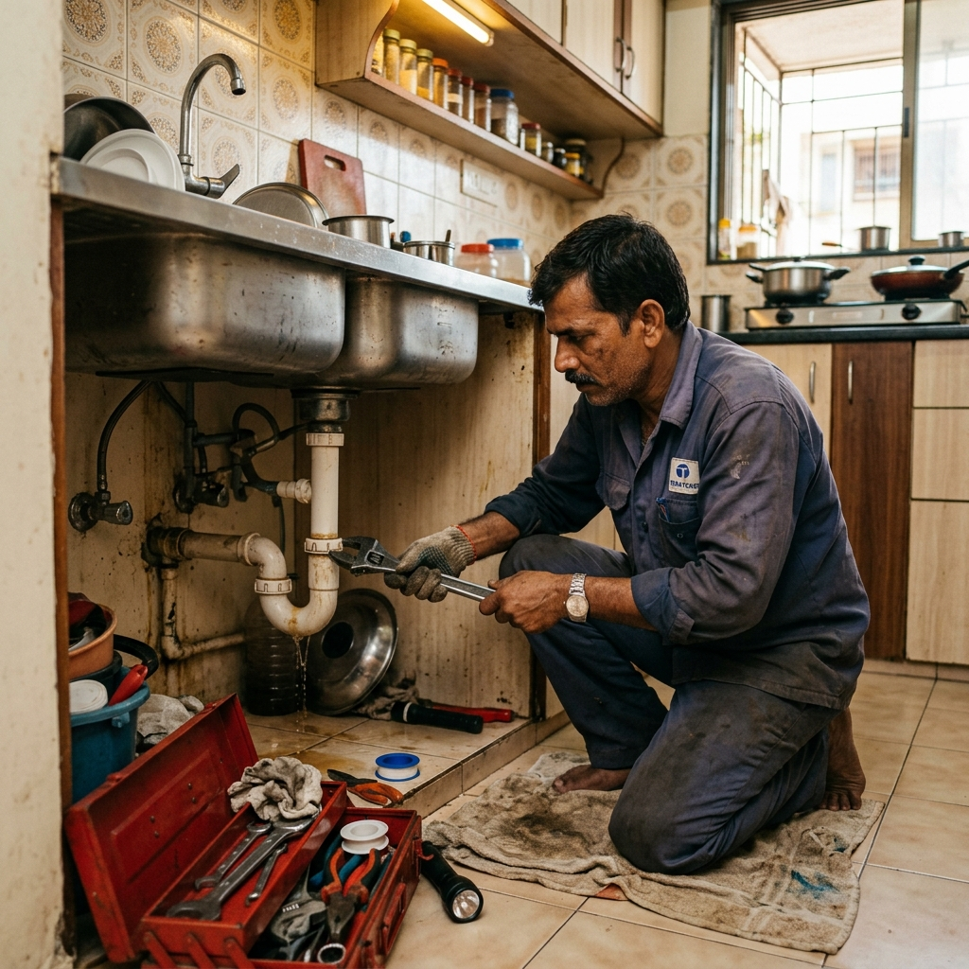
The Broken
Local Service
Experience
● Skilled workers stay invisible in neighborhoods
● Customers trust random phone contacts blindly
● No accountability, no consistency, no safety

Slide 3
A Massive Yet Ignored Market
Existing Urban Apps
Informal Local Reality
▸ Funded & organized platforms
▸ 80% workers are invisible
▸ Metro-city focused only
▸ Word-of-mouth discovery
▸ High commission structures
▸ Zero digital presence
▸ Tech-savvy user base
▸ No trust verification
₹30,000 Cr+ unorganized local services market waiting to be digitized

Slide 4
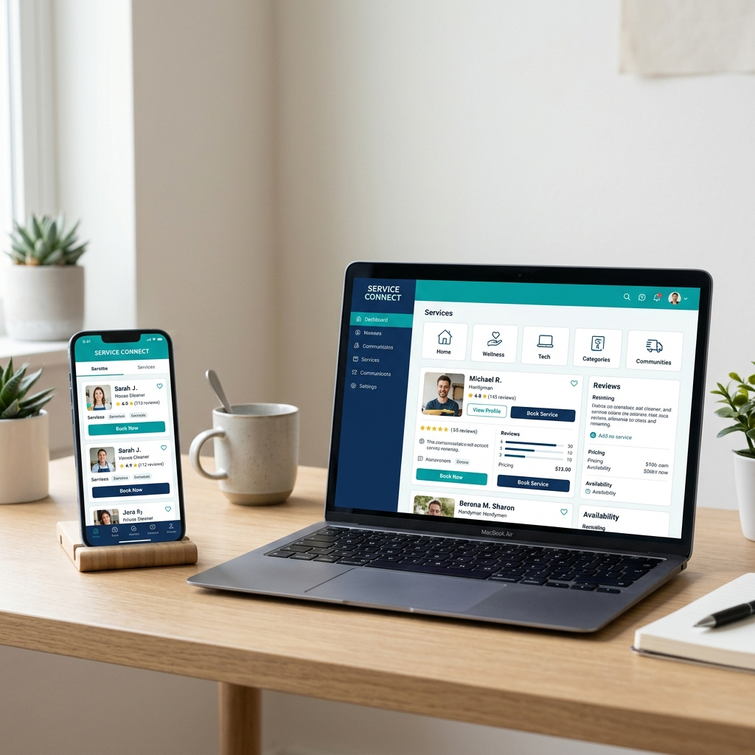
Digitizing Local Trust
Verified Worker Profiles
Transparent Ratings
Instant Local Discovery
Background-checked local professionals
Honest reviews from your neighbors
Find trusted help within 2 km radius

Slide 5
How INLOCFIX Works
01
02
03
04
Search Need
Get Verified Match
Complete Service
Build Trust
Tell us what service you need
We match you with trusted locals
Get the job done at your doorstep
Rate & review to help your community

Slide 6
A Dual-Sided Value Engine
CUSTOMERS
WORKERS
Speed
Visibility
Find help in minutes, not hours
Get discovered by nearby customers
Safety
Income
Verified & community-vetted workers
Steady work pipeline, fair pay
Trust
Credibility
Reviews from your own neighborhood
Build a digital professional profile

Slide 7
Scalable & Sustainable
Business Model
₹
★
⟳
Service Commission
Featured Listings
Partner Referrals
8-12%
₹299/mo
₹50/lead
Per completed booking
Premium worker visibility boost
Local hardware store partnerships

Slide 8
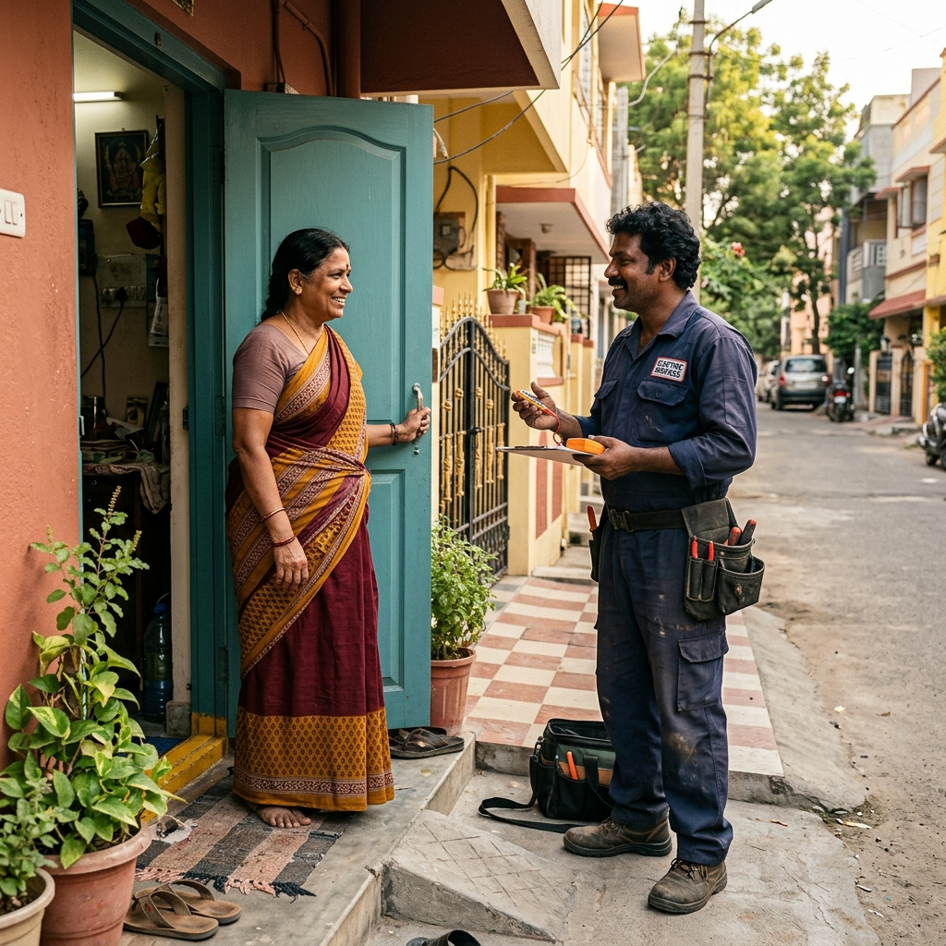
Hyperlocal
Growth
Strategy
01
Hardware Store Partnerships
On-ground worker onboarding
02
Social Media Campaigns
Hyperlocal area-targeted ads
03
Referral Network
Customer-to-customer word of mouth
04
Community Flyers
Offline trust-building in neighborhoods

Slide 9
Why INLOCFIX Will Matter
01
02
03
Built for Informal India
Simple Low-Tech Onboarding
Community-First Verification
Designed ground-up for Tier 2/3 cities and semi-urban neighborhoods where 80% of service workers operate outside any platform.
WhatsApp-based registration, missed call verification, and vernacular support — zero barriers to entry for workers.
Neighborhood vouching system where local trust replaces expensive background checks — authentic and scalable.

Slide 10
BUILDING INDIA'S TRUSTED
LOCAL SERVICE NETWORK
Empowering invisible workers.
Creating reliable service access.
Scaling trust one neighborhood at a time.
INLOCFIX

