Slide 1
Assignment No - 8
Problem Statement –
Write a Program read the temperature sensor and send the values to the serial monitor on the computer.
Code –
// C++ code
int Celsius = 0; void setup()
{
pinMode(A0, INPUT); Serial.begin(9600);
}
void loop()
{
Celsius = map(((analogRead(A0) - 20) * 3.04), 0, 1023, -40,
125);
Serial.print("Temperature : " ); Serial.println(Celsius);
delay(3000);
}

Slide 2
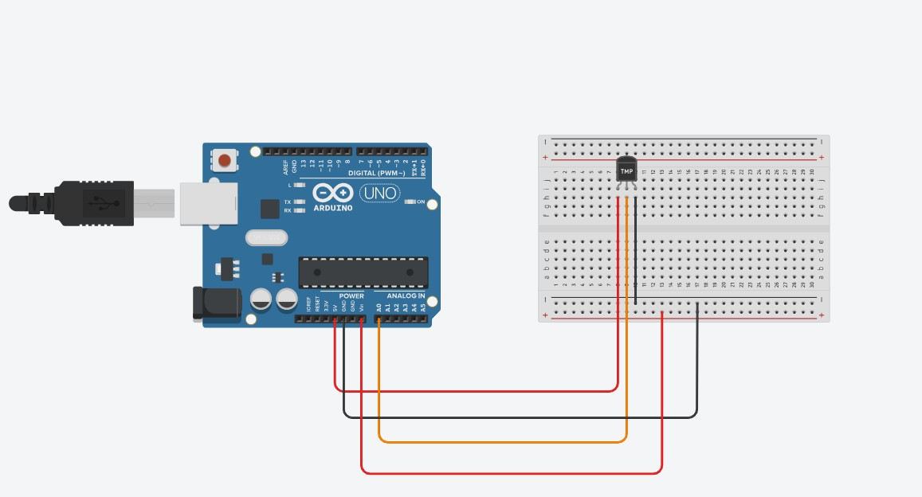
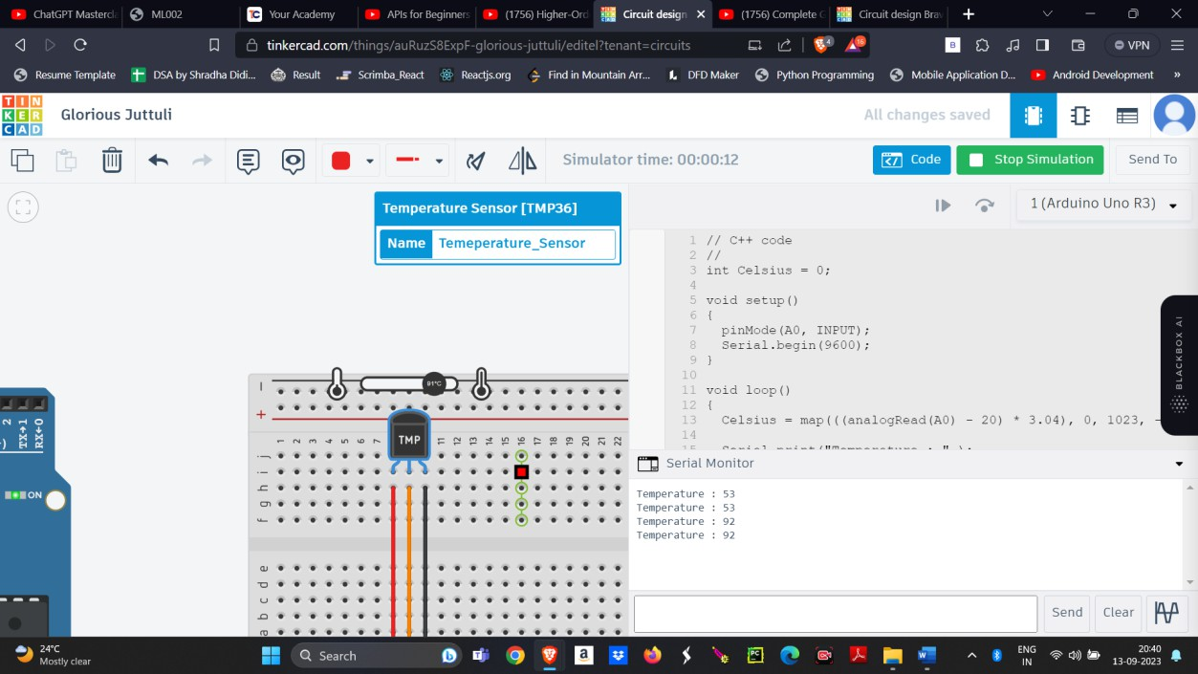
Output –

