Slide 1
Assignment No – 9
Problem Statement –
Write a program read the temperature sensor and send the values to the serial monitor on the computer.
Code –
#include <LiquidCrystal.h> LiquidCrystal lcd(12,11,5,4,3,2);
int celsius = 0;
int fahrenheit = 0;
void setup(){ pinMode(A0, INPUT); Serial.begin(9600);
}
void loop(){ lcd.begin(16,2);
celsius = map(((analogRead(A0) - 20) * 3.04), 0, 1023, -40,125);
fahrenheit = ((celsius * 9) / 5 + 32);

Slide 2
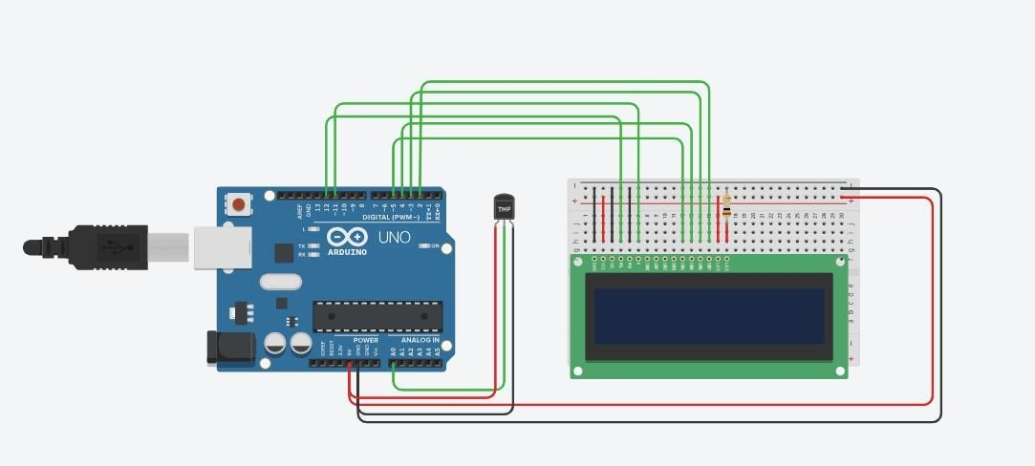
Serial.print(celsius); Serial.println(" C"); Serial.print(fahrenheit); Serial.println(" F");
lcd.setCursor(0, 0); lcd.print("Celsius :"); lcd.print(celsius); lcd.setCursor(0,4); lcd.print("Fahrenheit :"); lcd.print(fahrenheit);
delay(1000);
}
Output –

Slide 3



