Slide 1
Assignment No – 3
Problem Statement –
Write an application to read the temperature from environment. If the temperature crosses the threshold value, then it will notify with buzzer.
Code –
// C++ code
int buzzerPin = 8; int Celsius = 0;
void setup()
{
pinMode(INPUT, A0); Serial.begin(9600);
}
void loop()
{
Celsius = map(((analogRead(A0) - 20) * 3.04), 0, 1023, -40, 125); if(Celsius >= 35 ){
tone(buzzerPin, 2000);

Slide 2
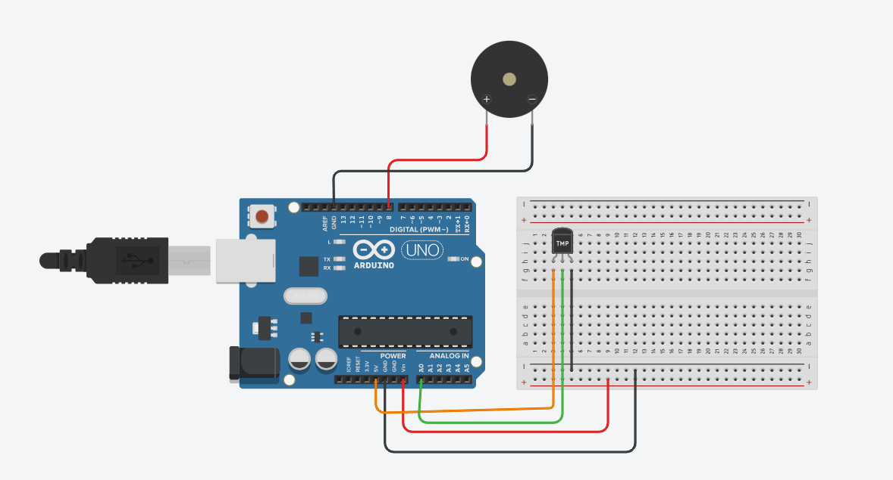
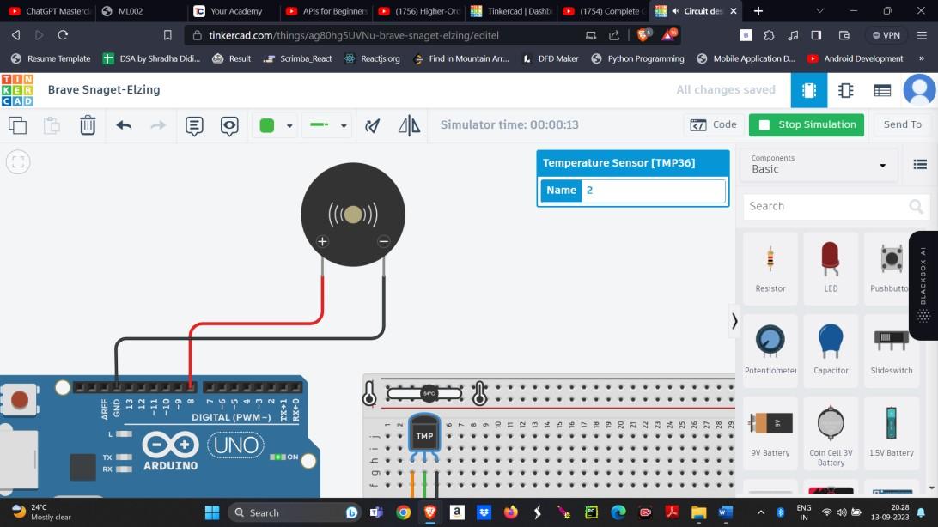
delay(2000);
}
else{
noTone(buzzerPin); delay(2000);
}
}
Output –

