Slide 1
Assignment No – 4
Problem Statement –
Write a program using Arduino to control LED (One or more ON/OFF). Or Blinking.
Code –
// C++ code
int LED_pin = 13;
void setup()
{
pinMode(LED_pin, OUTPUT);
}
void loop()
{
digitalWrite(LED_BUILTIN, HIGH); delay(2000); // Wait for 1000 millisecond(s)
digitalWrite(LED_BUILTIN, LOW); delay(2000); // Wait for 1000 millisecond(s)
}

Slide 2
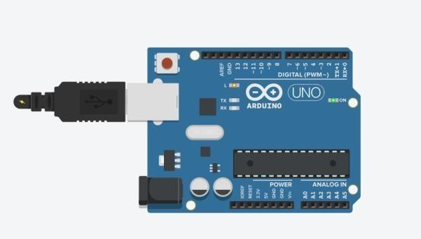
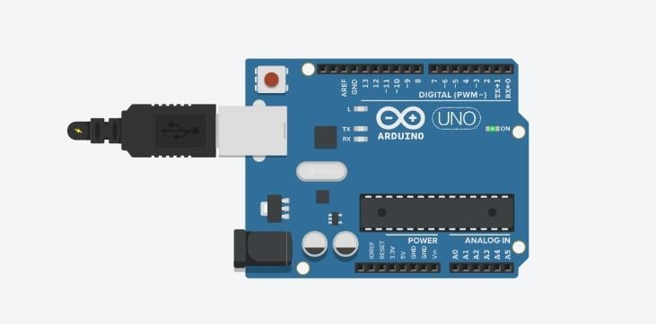
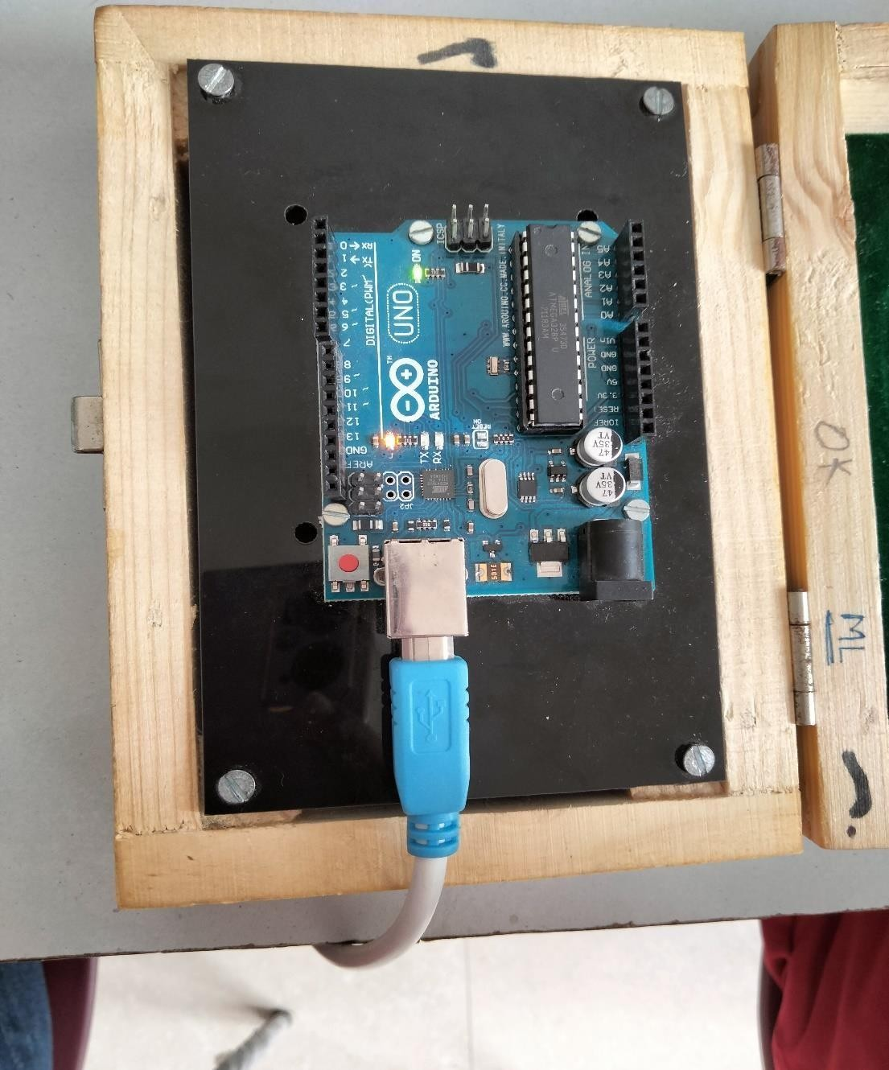
Output –

