Slide 1
Assignment No – 5
Problem Statement –
Create a program so that when the user enters ‘b’ the green light blinks, ‘g’ the green light is illuminated ‘y’ the yellow light is illuminated and ‘r’ the red light is illuminated.
Code –
// C++ code
int redLED = 13; int greenLED = 12; int yellowLED = 8;
void setup()
{
pinMode(redLED, OUTPUT);
pinMode(greenLED, OUTPUT); pinMode(yellowLED, OUTPUT);
Serial.begin(9600);
}
void loop()
{
if(Serial.available() > 0){

Slide 2
char inputCharacter = Serial.read();
if(inputCharacter == 'b' || inputCharacter == 'B'){ digitalWrite(greenLED, HIGH);
delay(500); // Wait for 1000 millisecond(s) digitalWrite(greenLED, LOW);
delay(500); // Wait for 1000 millisecond(s)
}else if(inputCharacter == 'r' || inputCharacter ==
'R'){
digitalWrite(redLED, HIGH);
delay(2000); // Wait for 1000 millisecond(s) digitalWrite(redLED, LOW);
delay(2000); // Wait for 1000 millisecond(s)
}else if(inputCharacter == 'y' || inputCharacter ==
'Y'){
digitalWrite(yellowLED, HIGH);
delay(2000); // Wait for 1000 millisecond(s) digitalWrite(yellowLED, LOW);
delay(2000); // Wait for 1000 millisecond(s)
}else if(inputCharacter == 'G' || inputCharacter ==
'g'){
digitalWrite(greenLED, HIGH);
delay(2000); // Wait for 1000 millisecond(s) digitalWrite(greenLED, LOW);

Slide 3
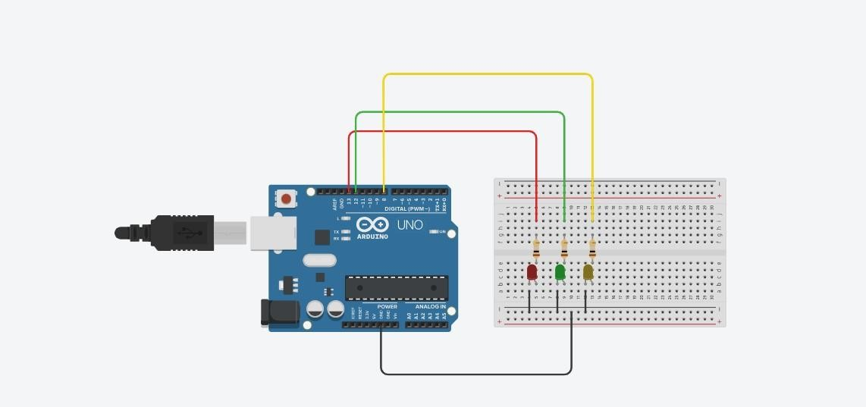
delay(2000); // Wait for 1000 millisecond(s)
}else{
Serial.println("Please enter valid choice ............ ");
}
}
}
Output –

Slide 4
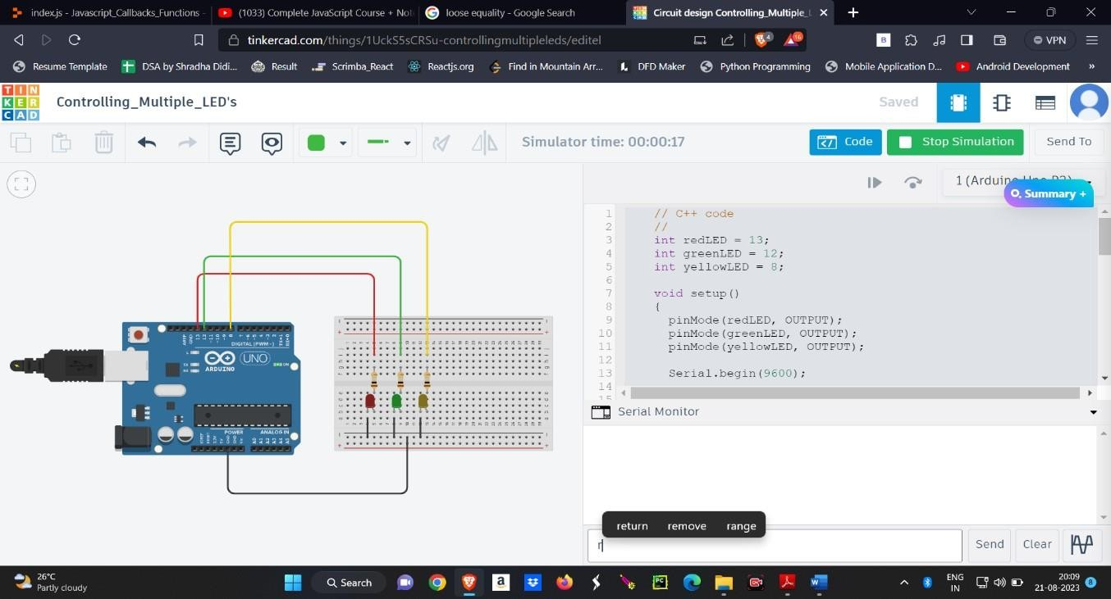
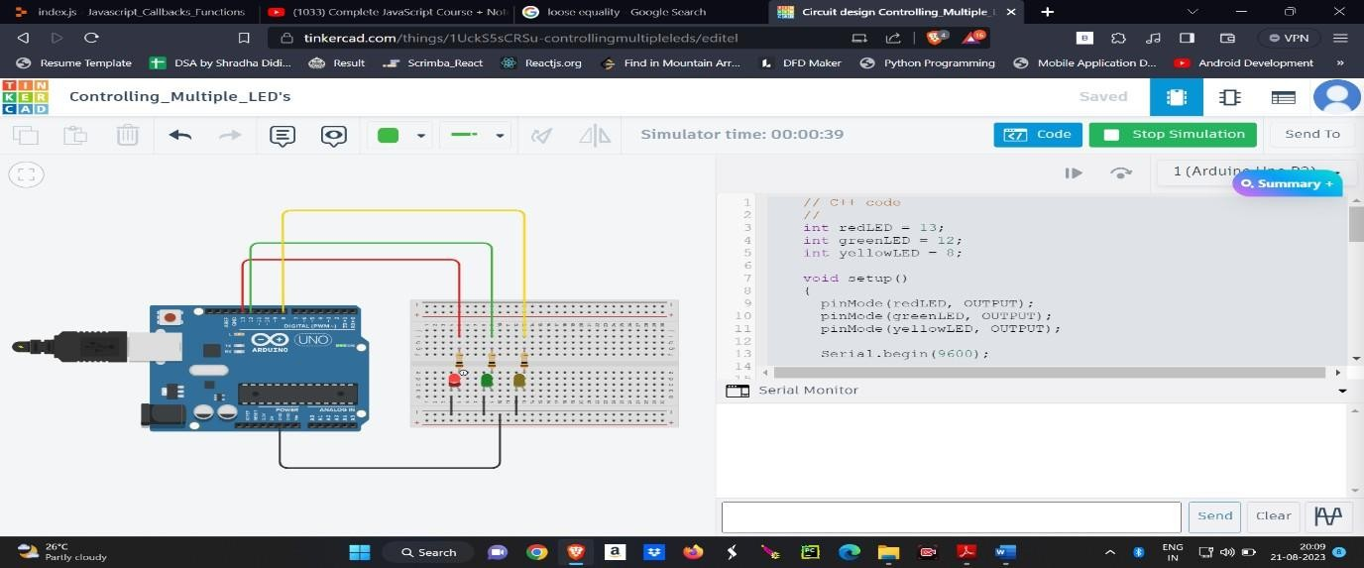
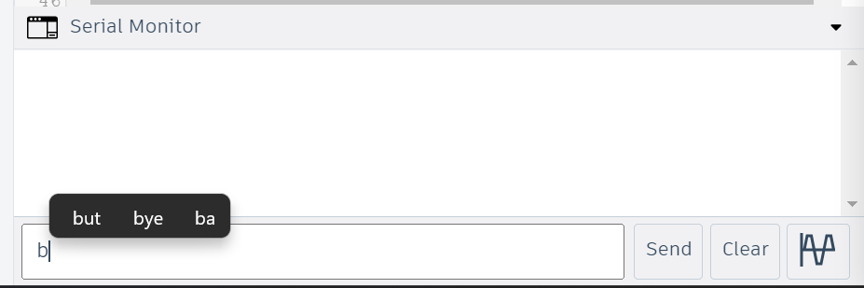
Bliking Red LED -
Blinking Green LED –

Slide 5
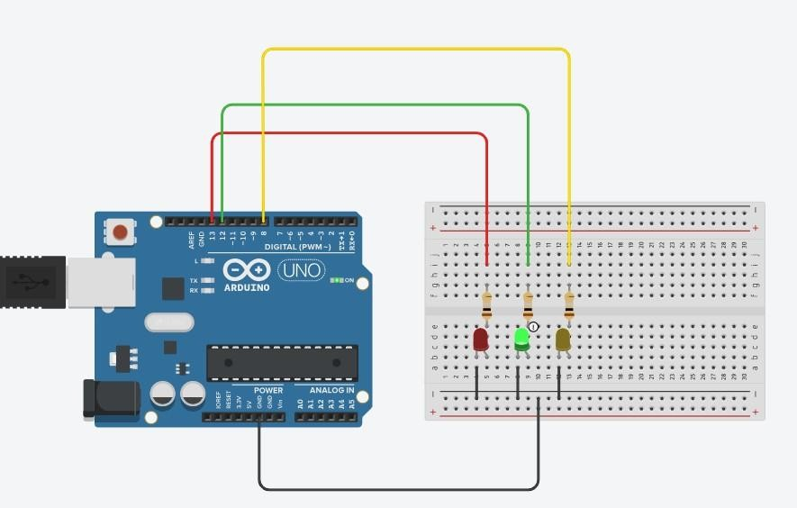
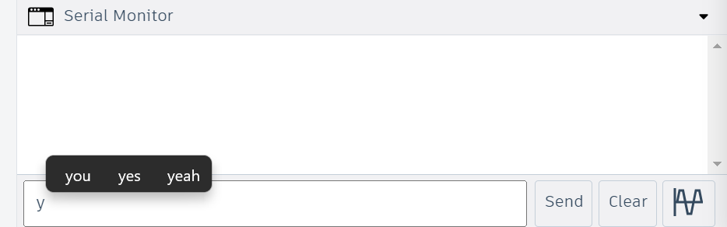
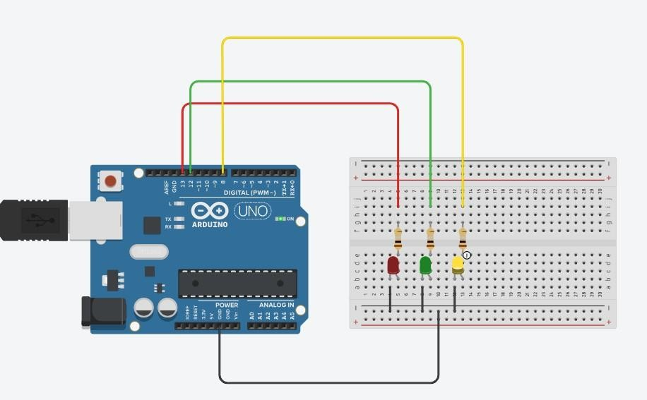
Blinking Yellow LED –

