Slide 1

HACK ASCENSION 2026
RESPONIX
NEURAFORGE
DOMAIN : Real time emergency and staff response system
ID : 6
A PROJECT BUILT FOR HACK ASCENSION 2026

Slide 2

HACK ASCENSION 2026
02 / 12
01 | PROBLEM STATEMENT
STAFF NO-SHOW PANIC BUTTON
1
2
3
TARGET USERS
IMPACT
CONTEXT
HOSPITALS
POLICE AND ARMY
RESTAURANTS
RETAIL STORES
A Single staff no-show can disrupt an entire shift. Our system minimizes downtime by rapidly finding the right qualified replacement and restoring operations before service is affected.
In high-dependency workplaces, unexpected staff absence can immediately affect operations. A fast, reliable replacement mechanism is essential to maintain continuity.

Slide 3
HACK ASCENSION 2026
03 / 12
02 | PROBLEM UNDERSTANDING & EXISTING GAPS
CURRENT APPROACH
Managers typically handle staff no-show manually by calling or messaging available employees, checking schedules, and arranging replacements based on availability
EXISTING GAPS
01
02
03
04
SLOW RESPONSE :
Manual calling and coordination wastes critical time during an unexpected absence.
WRONG MATCH :
Replacement is often chosen based on availability rather than skill, role, workload and proximity.
NO INTELLIGENT ESCALATION :
If the 1st person doesn’t respond, manages must manually search for the next replacement.
NO IMPACT AWARENESS :
Existing approaches rarely determine which absence is most critical or prioritize recovery accordingly.
KEY INSIGHT
Existing systems manage workforce schedules; our solution manages the unexpected moment when the schedule fails.

Slide 4
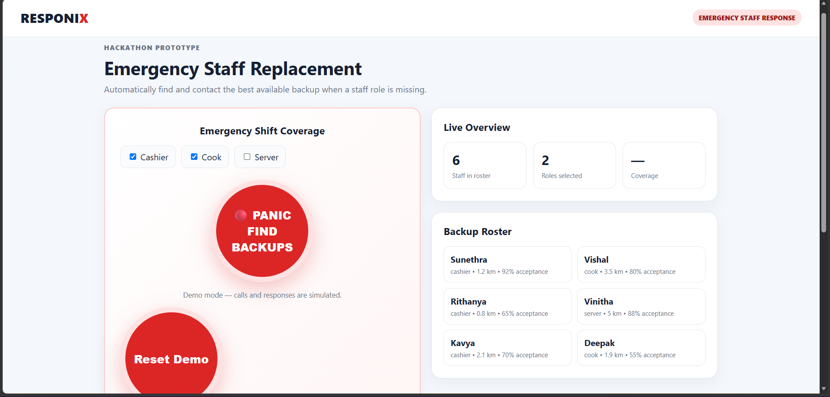
HACK ASCENSION 2026
04 / 12
03 | PROPOSED SOLUTION
[ONE-LINE SOLUTION DESCRIPTION]
INPUT :
Staff no-show + Role + Shift + Location
→
PROCESS :
Assess critically match skills rank candidates
Optimize response time.
→
SOLUTION :
AI Recovery Engine + Automated Escalation
→
IMPACT :
Faster replacement, Less disruption, Continuous operations
AI RECOVERY SCORE : AI ranks replacements by skill, proximity, availability, workload, and reliability to find the best fit.
1
AUTONOMOUS ESCALATION :
Automatically contacts candidates in priority order and escalates until the shift is successfully covered.
2
CRITICALITY-AWARE RECOVERY :
Identifies the operational impact of each no-show and prioritizes the most critical vacancies first.
3

Slide 5
HACK ASCENSION 2026
05 / 12
04 | INNOVATION & UNIQUENESS
EXISTING SOLUTIONS
OUR SOLUTION
Focus on planned scheduling.
•Focus on sudden emergency no-shows
Manager manually searches for replacements.
•AI automatically ranks the best-fit replacement
Mainly considers availability.
•Considers skill, distance, workload and reliability
Sends requests/ notification.
•Automatically escalates until the shift is covered
KEY INNOVATIONS
01
02
03
RIGHT PERSON :
AI finds the best fit qualified replacement, not simply an available one.
RIGHT ORDER :
AI contacts candidates in the optimal sequence escalates automatically.
RIGHT PRIORITY :
AI identifies which absence matters most and recovers critical roles first.
WHY US?
From “Who can replace them?” to “Who can restore operations fastest?”

Slide 6
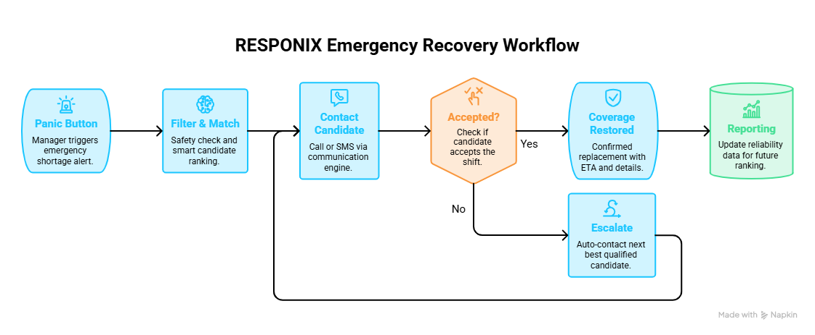
HACK ASCENSION 2026
06 / 12
05 | SYSTEM ARCHITECTURE / WORKFLOW
INPUT
PROCESSING
OUTPUT
Staff shortage + Staff Data
Eligibilty - AI ranking – Call/SMS - Automatic escalations
Qualified replacement confirmed + coverage restored

Slide 7
HACK ASCENSION 2026
07 / 12
06 | TECHNOLOGY STACK & IMPLEMENTATION
1
FRONTEND
2
BACKEND
3
DATABASE
React.js + Tailwind CSS + Vite
Python + FastAPI + WebSockets
Firebase firestore
4
AI / ML
5
CLOUD / TOOLS
6
HARDWARE
Scikit-learn + Python – Recovery Score & Candidate Ranking
Firebase + GitHub + Google Maps API
Smartphone / PC – No additional hardware required
IMPLEMENTATION HIGHLIGHTS
REAL TIME RECOVERY :
WebSockets instantly update no-shows alerts, candidate responses and recovery status.
INTELLIGENT MATCHING :
Weighted AI scoring ranks candidates by skill, proximity, workload, availability and reliability.
AUTOMATED ESCALATION :
The system automatically contacts the next-best candidate until the critical shift is successfully covered.

Slide 8
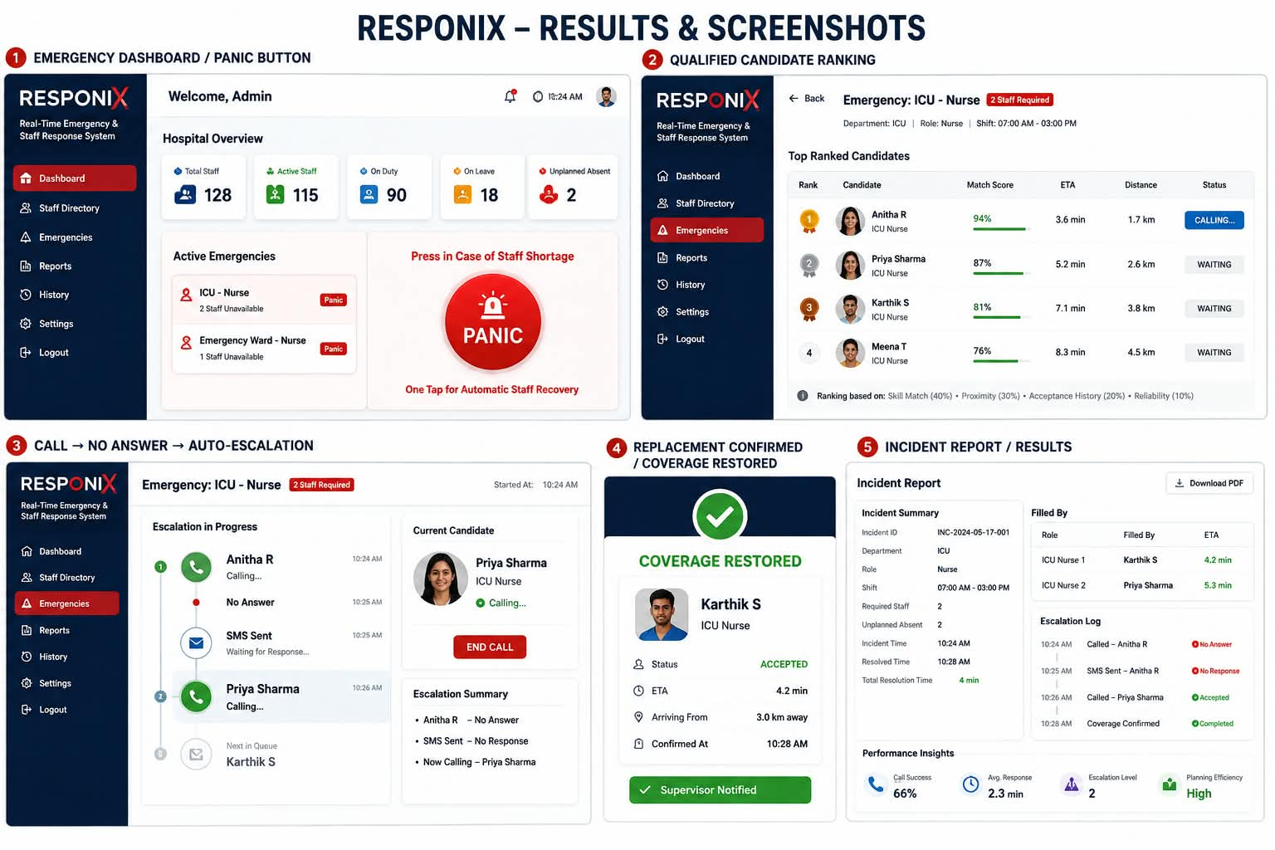
HACK ASCENSION 2026
08 / 12
07 | RESULTS & SCREENSHOTS
[SCREENSHOT 01]
[SCREENSHOT 02]
[SCREENSHOT 03]
KEY RESULTS
66%
100%
50%
CALL SUCCESS RATE
EMERGENCY COVERAGE RESTORED
REDUCTION IN STA

Slide 9
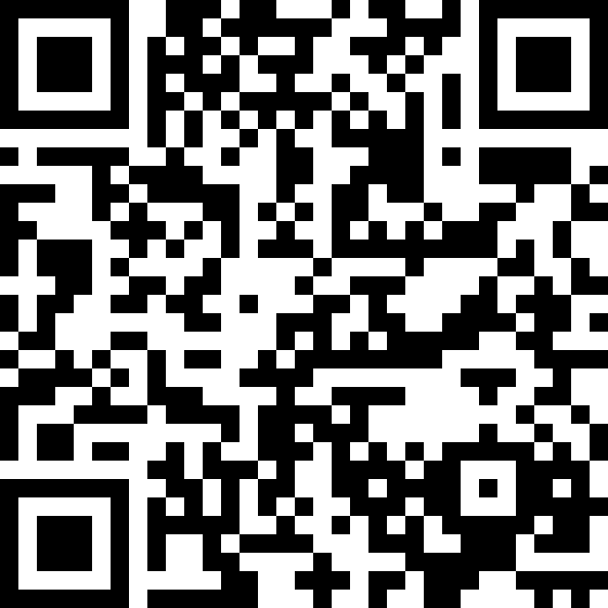
HACK ASCENSION 2026
09 / 12
08 | GITHUB & AI DISCLOSURE
MANDATORY AI TOOLS DISCLOSURE
GITHUB REPOSITORY
AI TOOL | PURPOSE | USAGE
CHATGPT | DOCUMENTATION SUPPORT | Idea refinement & content preparation
CLAUDE | CODE ASSISTANCE | Implementation support
NAPKIN AI | UI IDEAS | Visual layouts
https://github.com/deshnadeshu26-lgtm/NEURAFORGE.git
[QR CODE
PLACEHOLDER]
Teams must disclose all AI tools used during ideation, research, coding, design, testing, or development.

Slide 10
HACK ASCENSION 2026
10 / 12
09 | FUTURE SCOPE
1
2
3
4
FUTURE
PREDICTIVE & AUTONOMOUS INTELLIGENCE
NOW
NEXT
SCALE
WORKING MVP
AI + REAL TIME DATA
CLOUD + MULTI ORGANIZATION DEPLOYMENT

Slide 11
HACK ASCENSION 2026
11 / 12
10 | TEAM MEMBERS
TEAM NAME: [TEAM NAME]
DESHNA G
YASMINI G
JAYASHREE K.M
DURGALAKSHMI V
Team Leader
Tech Head
Researcher
Design Wizard
CSE – 1st Year
AID – 1st Year
CSE – 1st Year
CSE – 1st Year
Leading the team, selecting the problem statement, analyzing the problem statement.
Gives solution and builts the prototype.
Collects data, and analysis it deeply.
PPT preparation.

Slide 12
THANK YOU
HACK ASCENSION 2026 · NEURAFORGE

