Slide 1
Visualization of Misconduct in NYPD
Group 1: Akshay Deshpande
Chaitanya Mundle
Pranav Kalbhor

Slide 2

Key Attributes unique_mos_id first_namE year_received year_closed mos_ethnicity complainant_ethnicity complainant_gender fado_type allegation Precinct rank_incident
DATASET SOURCE:
https://www.propublica.org/datastore/dataset/civilian-complaints-against-new-york-city-police-officers
Dataset Description
The dataset we are working on gives details about the complaints launched on New York Police By Citizens of different ethnicity
The Categories of Allegations that are recorded in this dataset are:
Abuse of Authority
Discourtesy
Force
Offensive Language

Slide 3
Story Description
Visualization 1:
The First Visualization on our website describes the Trend of complaints from 1985 to 2019
This Visualization explains how the complaints have increased over the years
Visualization 2:
The Second Visualization describes the number of allegations with respect to citizens of different ethnicity using the map of new York city
This Visualization complements the first visualization by describing the number of allegations across different precincts
We can identify which percent has contributed towards maximum and minimum number of allegations
Visualization 3:
The Third Visualization describes the Details of the second Visualization using a Sankey graph to describe the number of Allegations with respect to ethnicity of the citizens
This Graph describes the distributions of allegations as per the ethnicity of the citizen and indicates most of the allegations are on white officers and by citizens of black ethnicity

Slide 4
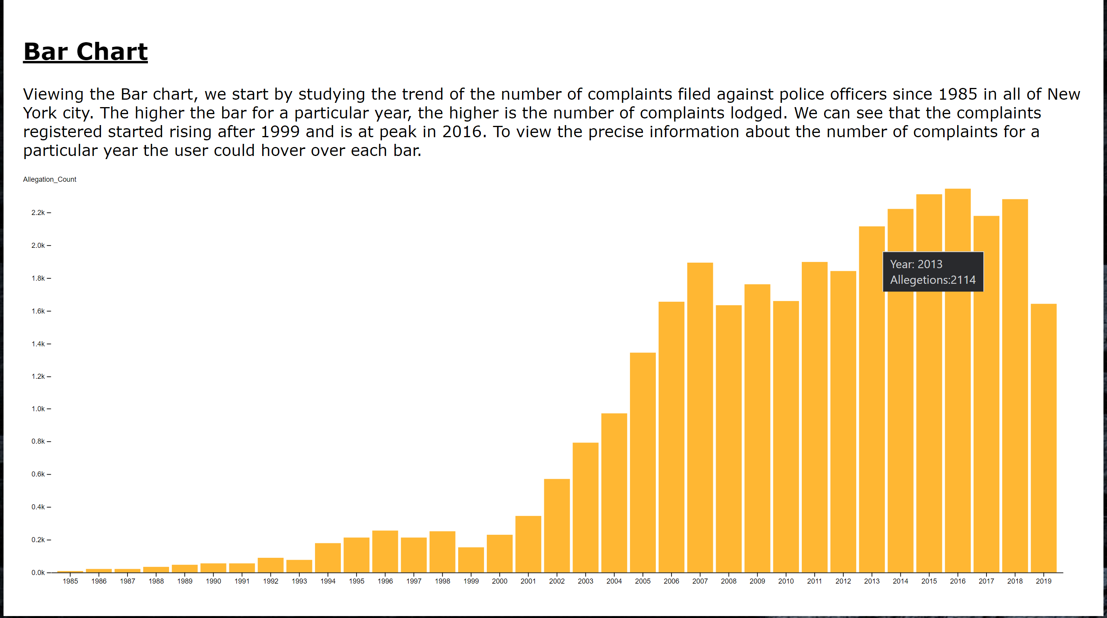
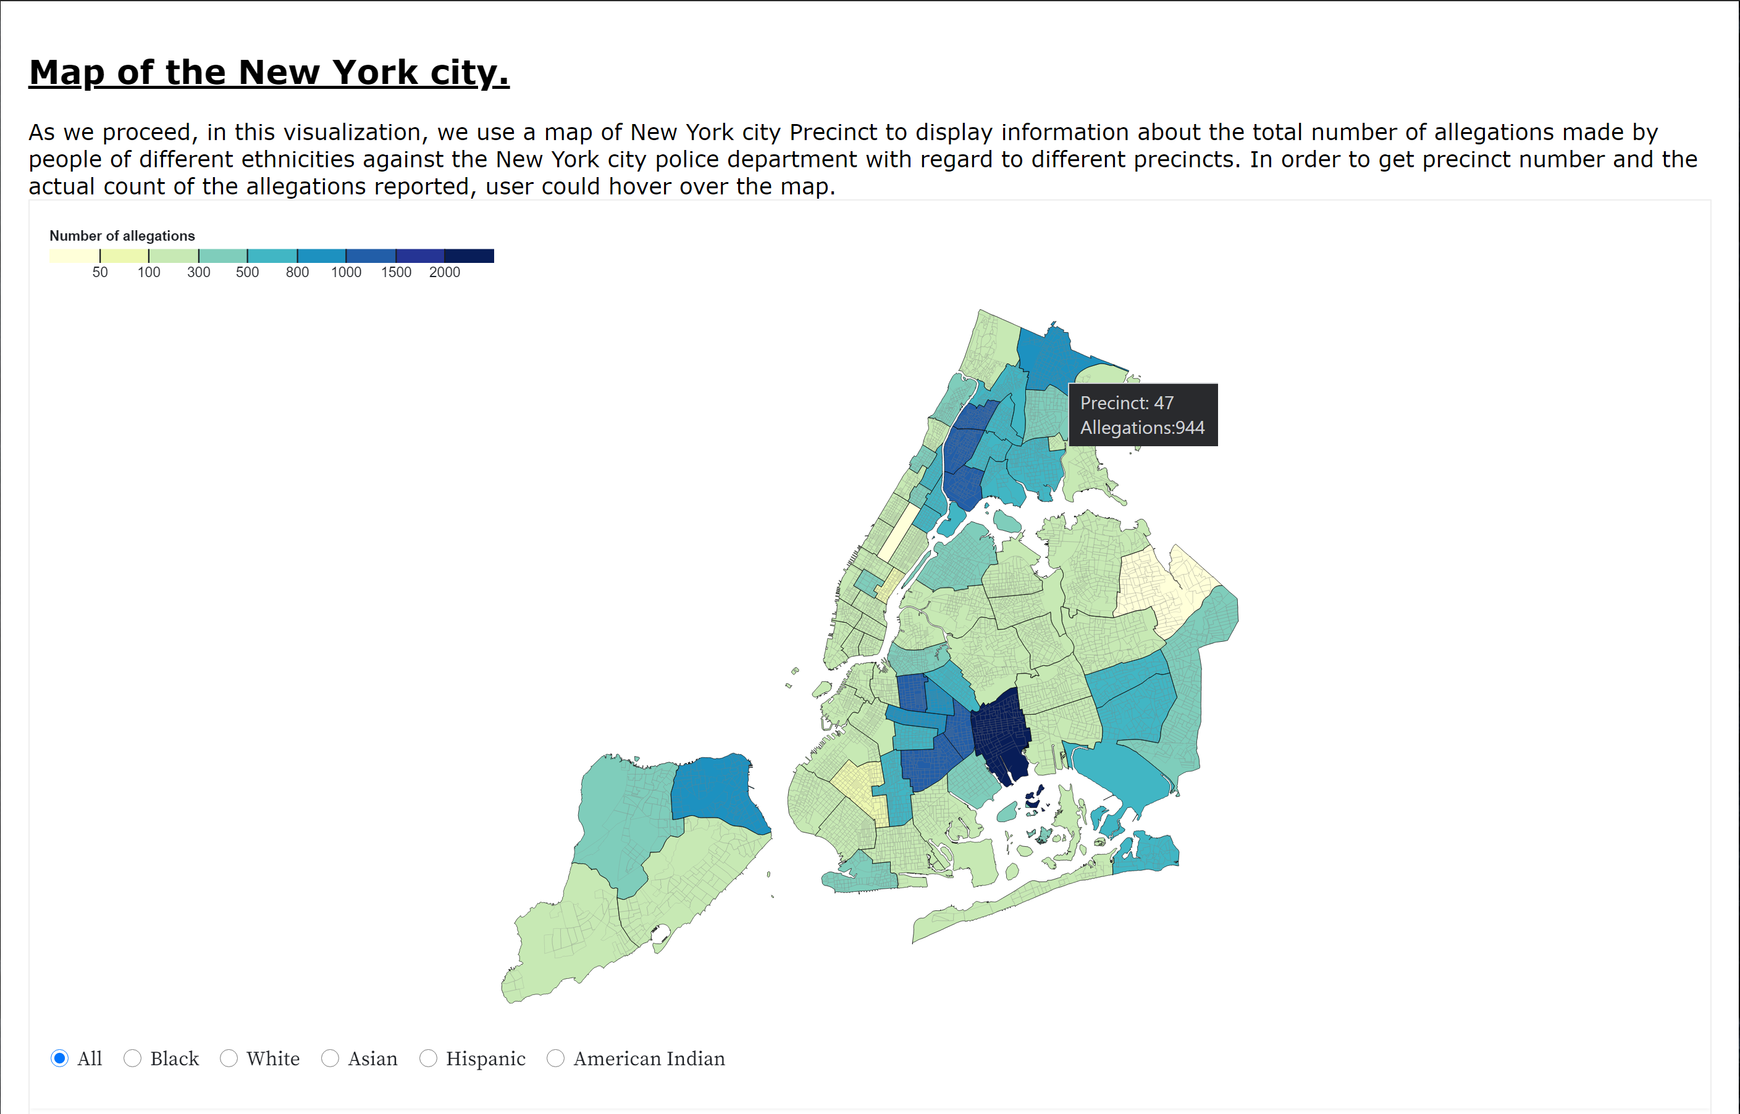
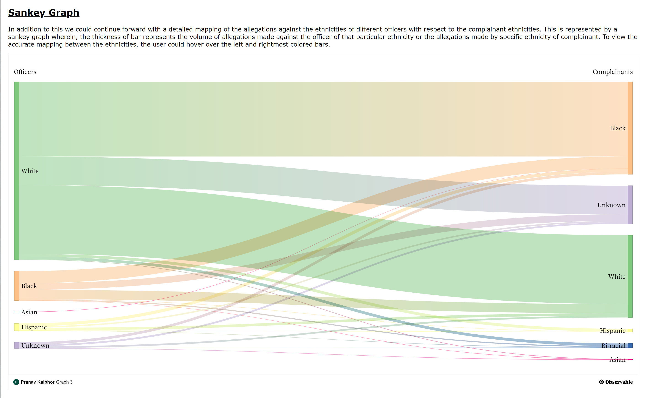
Visualizations on the website

Slide 5

Website Demo
https://deshpa2.github.io/DataViz/

