Slide 1
Releasing Soon
Team 12 : ShaMAL, VANDANA, GAURANG, VIHAR

Slide 2
Objective
Three main objectives of this project are -
Analyze movie data comprising of IMDB, Facebook and Twitter.
Predict the range of ratings (box office success) for a future movie.
Validate Rating for movies with past dated release movies

Slide 3
Data Sources:
IMDB : Movie Name, Actors, Director, Writers, Ratings, Genre, Languages etc.
Facebook : Fan count and talk about count
Twitter : Tweets for particular movie

Slide 4
How was data collected: (All credits Python)
IMDB Data of over 40000 movies were extracted.
Record years 1900 – Present
Real Time Twitter and Facebook data on demand (Java Api’s).

Slide 5
Original Data Structure :
Fields
Year | Runtime | IMDB Rating (78) | Genre (25) | IMDB ID
MetaScore | Title | IMDB Votes | Type | Language (236)
Director (14484) | Award | Actor (52120) | Country (106) | Rated
Writer (47061) | Released | Twitter Follower Count | FB Talking About Count | FB Fan Count
Note : Fields in brackets imply distinct values in sample

Slide 6
Facebook JSON Response
{ "id": "216410885045047", "name": "Titanic", "fan_count": 55951883, "talking_about_count": 74434 }

Slide 7
Twitter JSON Format
{"id":12509262,"id_str":"12509262","name":"TITANIC","screen_name":"titanic","location":"Germany","profile_location":null,"description":"Das endg\u00fcltige Satiremagazin. Pflichtblatt f\u00fcr Zwitscherer. Und Zwitscherinnen!","url":"http:\/\/t.co\/vXvl1Nngft","entities":{"url":{"urls":[{"url":"http:\/\/t.co\/vXvl1Nngft","expanded_url":"http:\/\/www.titanic-magazin.de\/","display_url":"titanic-magazin.de","indices":[0,22]}]},"description":{"urls":[]}},"protected":false,"followers_count":379357,"friends_count":0,"listed_count":2860,"created_at":"Mon Jan 21 21:00:57 +0000 2008","favourites_count":0,"utc_offset":3600,"time_zone":"Berlin","geo_enabled":false,"verified":true,"statuses_count":12931,"lang":"en","status":{"created_at":"Mon Dec 12 12:58:07 +0000 2016","id":808294861950459904,"id_str":"808294861950459904","text":"Neu im Newsticker: TITANIC Meinung: Warum nicht mal ein Schreckenskabinett? https:\/\/t.co\/ayI8LlmIaQ","truncated":false,"entities":{"hashtags":[],"symbols":[],"user_mentions":[],"urls":[{"url":"https:\/\/t.co\/ayI8LlmIaQ","expanded_url":"http:\/\/dlvr.it\/MsXH06","display_url":"dlvr.it\/MsXH06","indices":[77,100]}]},"source":"\u003ca href=\"https:\/\/dlvrit.com\/\" rel=\"nofollow\"\u003edlvr.it\u003c\/a\u003e","in_reply_to_status_id":null,"in_reply_to_status_id_str":null,"in_reply_to_user_id":null,"in_reply_to_user_id_str":null,"in_reply_to_screen_name":null,"geo":null,"coordinates":null,"place":null,"contributors":null,"is_quote_status":false,"retweet_count":0,"favorite_count":2,"favorited":false,"retweeted":false,"possibly_sensitive":false,"lang":"de"},"contributors_enabled":false,"is_translator":false,"is_translation_enabled":false,"profile_background_color":"D50000","profile_background_image_url":"http:\/\/pbs.twimg.com\/profile_background_images\/1840412\/titanic_logo_quer.png","profile_background_image_url_https":"https:\/\/pbs.twimg.com\/profile_background_images\/1840412\/titanic_logo_quer.png","profile_background_tile":false,"profile_image_url":"http:\/\/pbs.twimg.com\/profile_images\/45362052\/titanic_logo_normal.png","profile_image_url_https":"https:\/\/pbs.twimg.com\/profile_images\/45362052\/titanic_logo_normal.png","profile_link_color":"D50000","profile_sidebar_border_color":"EBEBEB","profile_sidebar_fill_color":"EBEBEB","profile_text_color":"000000","profile_use_background_image":true,"has_extended_profile":false,"default_profile":false,"default_profile_image":false,"following":false,"follow_request_sent":false,"notifications":false,"translator_type":"none"}

Slide 8
Wait complex JSON is yet to come…

Slide 9
Twitter JSON Format - To Big
Data Volume : 0.5 MB per Movie
40,000 Movies – Approx 19.2 Gigs
We came up with way to filter out data in extraction process, thus preventing resource consumption.
GET Data… Break Data… Extract Useful Things ☺
Storing SINGLE Data in a variable and then processing is better than getting all data staged and then filtering.

Slide 10
IMDB JSON Format
{"Title":"Titanic","Year":"1997","Rated":"PG-13","Released":"19 Dec 1997","Runtime":"194 min","Genre":"Drama, Romance","Director":"James Cameron","Writer":"James Cameron","Actors":"Leonardo DiCaprio, Kate Winslet, Billy Zane, Kathy Bates","Plot":"A seventeen-year-old aristocrat falls in love with a kind but poor artist aboard the luxurious, ill-fated R.M.S. Titanic.","Language":"English","Country":"USA","Awards":"Won 11 Oscars. Another 110 wins & 73 nominations.","Poster":"https://images-na.ssl-images-amazon.com/images/M/MV5BZDNiMjE0NDgtZWRhNC00YTlhLTk2ZjItZTQzNTU2NjAzNWNkXkEyXkFqcGdeQXVyNjUwNzk3NDc@._V1_SX300.jpg","Metascore":"74","imdbRating":"7.7","imdbVotes":"811,881","imdbID":"tt0120338","Type":"movie","Response":"True"}

Slide 11
Data Conditioning
Years Categorized in decades (1911 – 1919 IN ONE CATEGORY) (11 Columns)
Films from 2010 onwards will be placed in one category
We have 25 genres & all split in different columns
IMdB Votes (For normalization with all columns as they have huge numbers divided it by 10000 and minimized it to 3)
Type (3 Columns) [Movie, Episodes, Series ]
Director (Average over span)
Actor (Average over span)
Writer (Average over span)

Slide 12
Twitter : Exponential Normalization
FB Talking About Count : Exponential Normalization
FB Fan Count : Exponential Normalization
Result : Split Range 5 Columns
0-2, 2-4, 4-8, 8-10
We have total 51 columns | 46 Inputs & 5 Outputs

Slide 13
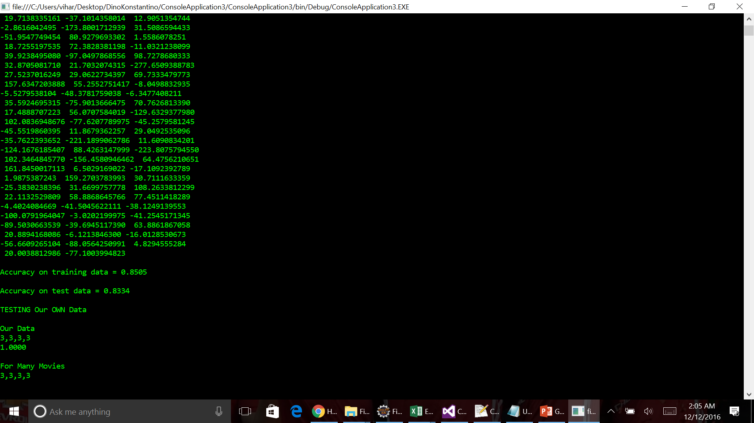
Genetic ANN(46-3-5 ANN)
Accuracy :
Test (85.35%)
Train (83.34%)
Data 40000 – More Time
Now Training with 10181 – 2-5 minutes

Slide 14
Average Over Span
E.g. :
Summation (Ratings for an entity) / Count of rated entities
Vihar as a director has rating of 4,5,6,6,4,5 in 6 movies
So his rating will be (4+5+6+6+4+5)/6 = 5;

Slide 15
Exponential Normalization
4 Base Ratings (As 2/3rd of data had no record available)
Rating : 5 - 0-1000
Rating : 6 - 1000-10000
Rating : 7 - 10000-50000
Rating : 8 - 50000- 200000
Rating : 9 - 200000-1000000
Rating : 10 – 1000000
Min : 1 and Max 10636825 with diverse distribution

Slide 16
Our Ratings vs IMDB Ratings
Year | IMDB Rating | Movie | Our Range
1993 | 8.1 | The Wonderful, Horrible Life of Leni Riefenstahl | 6 | 8
1994 | 8.5 | The Lion King | 8 | 10
1993 | 6 | Little Buddha | 6 | 8
1994 | 6.4 | New Nightmare | 6 | 8
1994 | 6.9 | The Mask | 6 | 8
1994 | 7 | Maverick | 6 | 8
1994 | 6.4 | Mrs. Parker and the Vicious Circle | 4 | 6
1994 | 6.4 | Naked Gun 33 1/3: The Final Insult | 6 | 8
1994 | 6.6 | The Paper | 6 | 8
1994 | 6.6 | Reality Bites | 6 | 8
1993 | 7 | Red Rock West | 6 | 8
1994 | 5.2 | Ri¢hie Ri¢h | 6 | 8
1994 | 6.4 | Safe Passage | 6 | 8
1994 | 6.3 | The River Wild | 6 | 8
1994 | 7.2 | Speed | 6 | 8
1994 | 5.7 | Speechless | 4 | 6

Slide 17
Future Awaits. . .

Slide 18
Raees Our Prediction Range 4 - 6
Movie Name:Raees
Genre:Action, Crime, Thriller
Year:2017
Type:movie
IMDBRatings:N/A
IMDBVotes:N/A
Actors:Shah Rukh Khan, Sunny Leone, Nawazuddin Siddiqui, Farhan Akhtar
Writer:Rahul Dholakia, Harit Mehta, Niraj Shukla, Ashish Vashi
Director:Rahul Dholakia
Fan Count:68117
Trending Count:36322
Follower Count:71
Hash Tag Count:571
Total Hash Tag Count:1196
location Count:571
Total location Count:1037

Slide 19
Our Prediction For Fast 8 Range 6-8
Data fetched for:Fast8 Movie
Name:Fast 8
Genre:Action, Crime, Thriller
Year:2017 Type:movie
IMDBRatings:N/A
IMDBVotes:N/A
Actors:Dwayne Johnson, Charlize Theron, Jason Statham, Vin Diesel
Writer:Chris Morgan, Gary Scott Thompson (characters)
Director:F. Gary Gray
Fan Count:40
Trending Count:0
Follower Count:3
Total Hash Tag Count:1058
Total location Count:1072

Slide 20
Our Prediction For Kong Skull Island Range 4-6
Genre:Action, Adventure, Fantasy
Year:2017
Type:movie
IMDBRatings:N/A
IMDBVotes:N/A
Actors:Brie Larson, Tom Hiddleston, Toby Kebbell, Samuel L. Jackson
Writer:Dan Gilroy (screenplay), Dan Gilroy (screenplay), Max Borenstein (screenplay), John Gatins (story), Dan Gilroy (story)
Director:Jordan Vogt-Roberts
Fan Count:245082
Trending Count:1666
Follower Count:12970
Hash Tag Count:600
Total Hash Tag Count:1207
location Count:600
Total location Count:1017

Slide 21
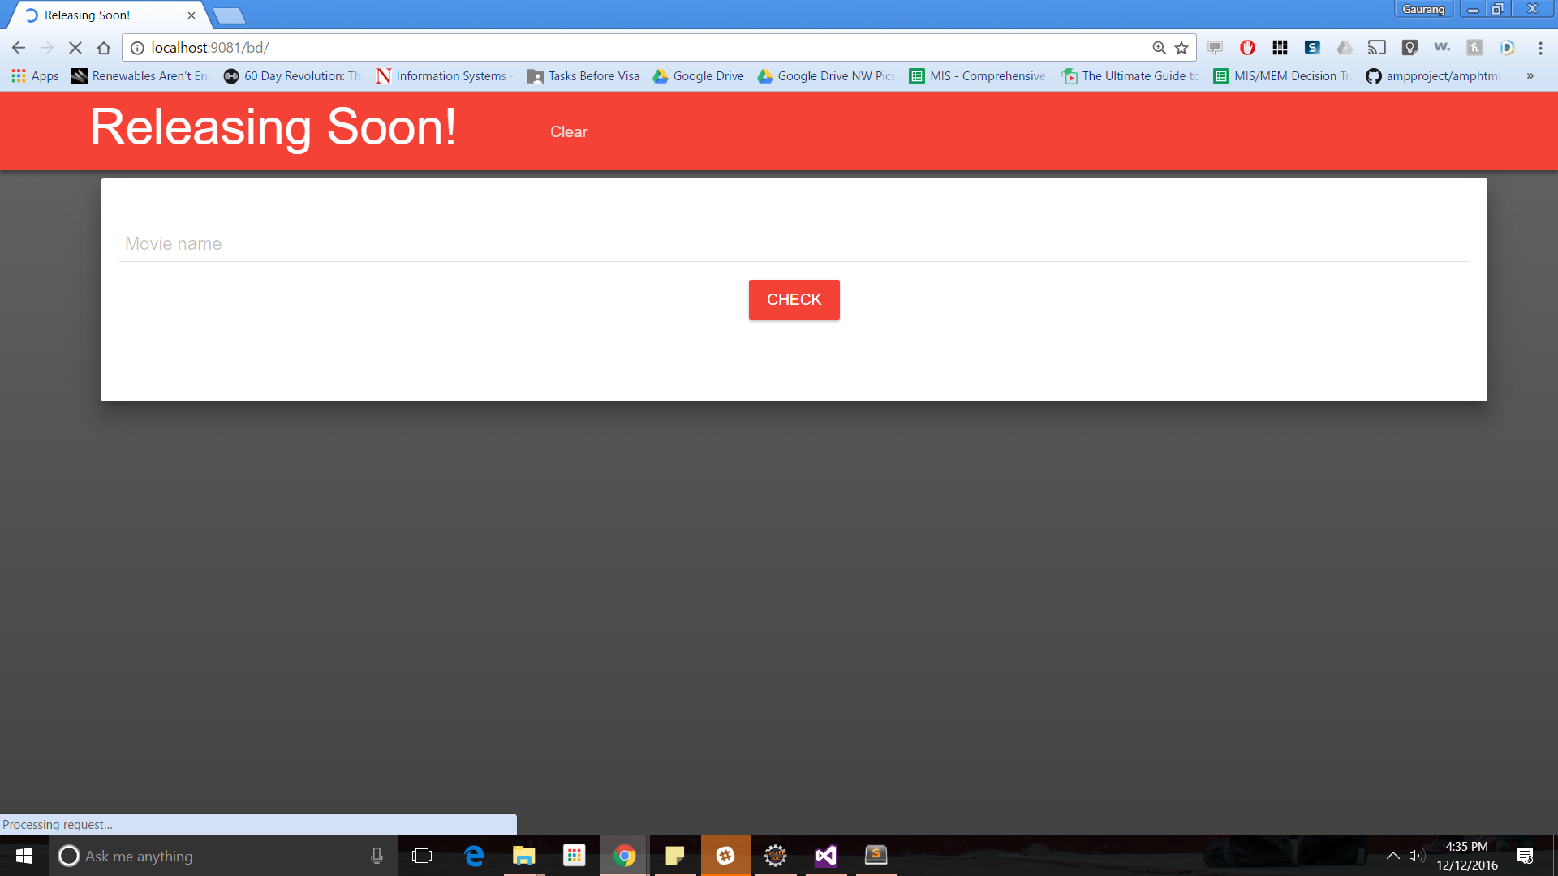

Slide 22
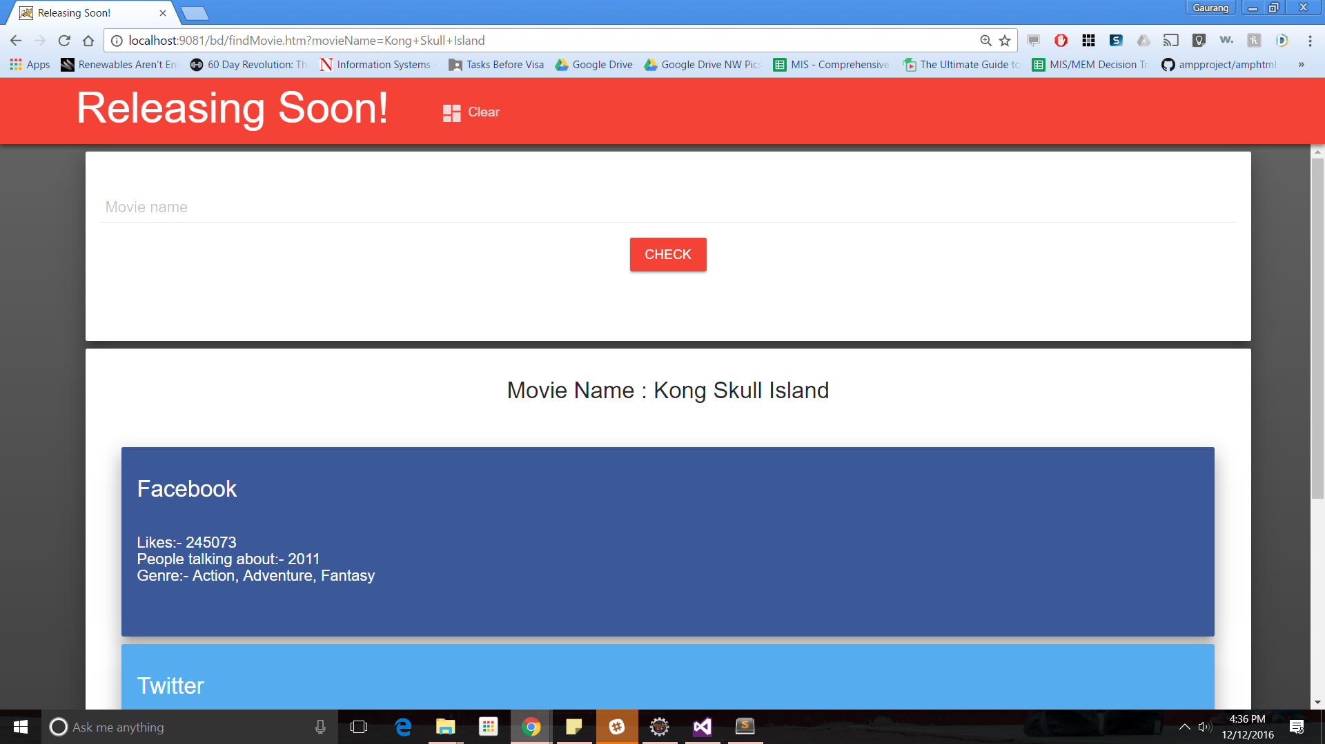

Slide 23
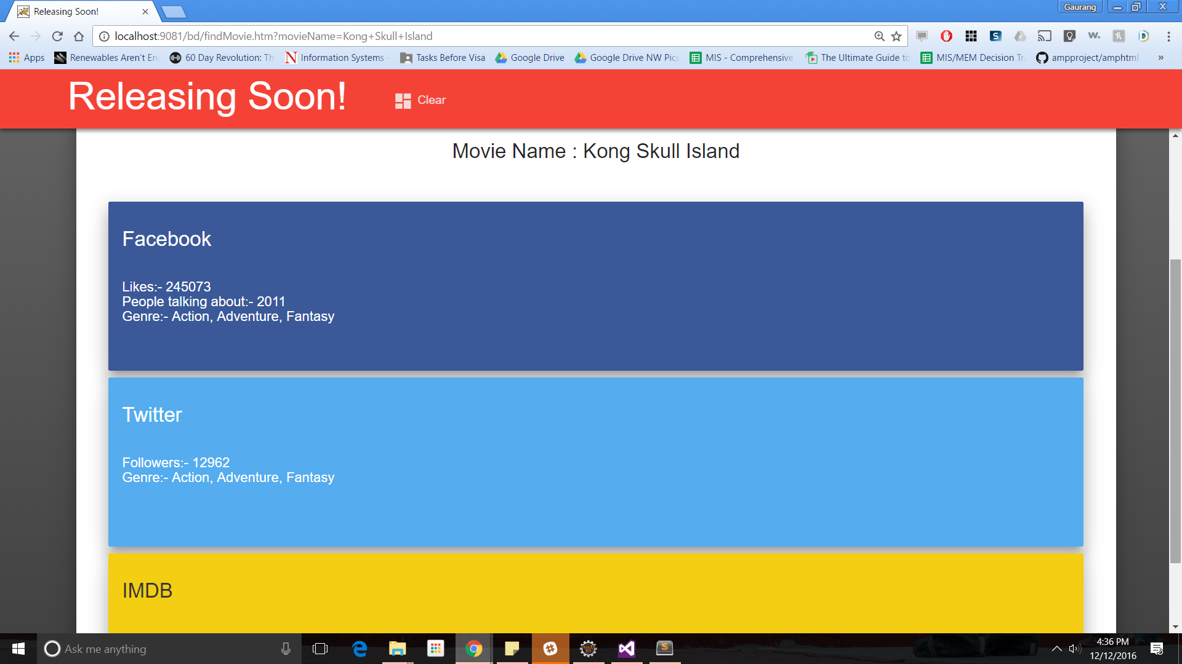

Slide 24
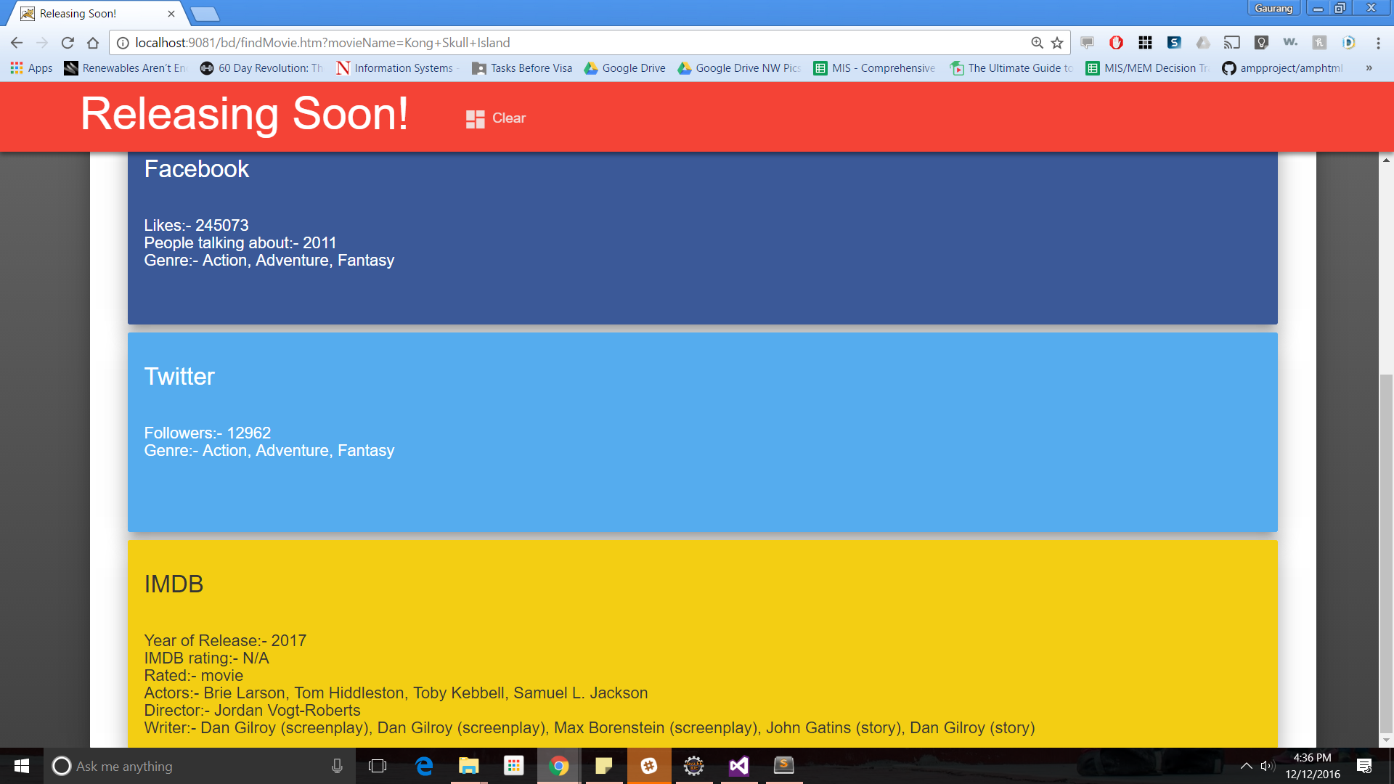

Slide 25
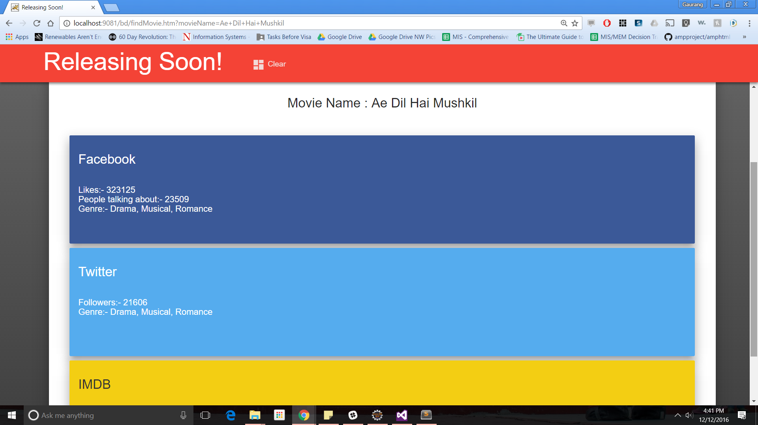

Slide 26
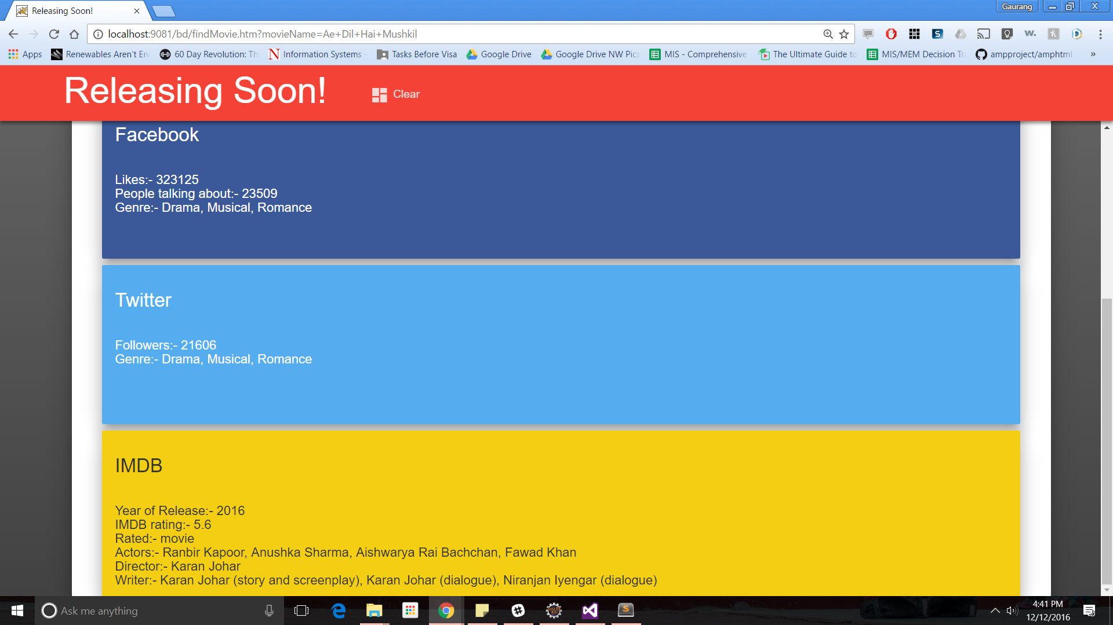

Slide 27
Thanks!!!!!!! Happy Vacations

