Slide 1
Hospital Management
{
“name” : “Gaurang Deshpande”
“email” : “gaurangdeshpande89@gmail.com”
}

Slide 2
Problem statement
Simulating a database design for a hospital management system implementing the concepts like database design principles, EER diagram, relational model, queries, stored procedures, triggers, users, views, transactions, privileges, backups, subqueries, joins, normalization techniques, indexing and functions.

Slide 3
Entities
Hospital
Departments
Staff
Person
Patient
Address
Role
Appointment
Procedures
Prescriptions
Medicines
Surgeries
Billing
Insurance

Slide 4
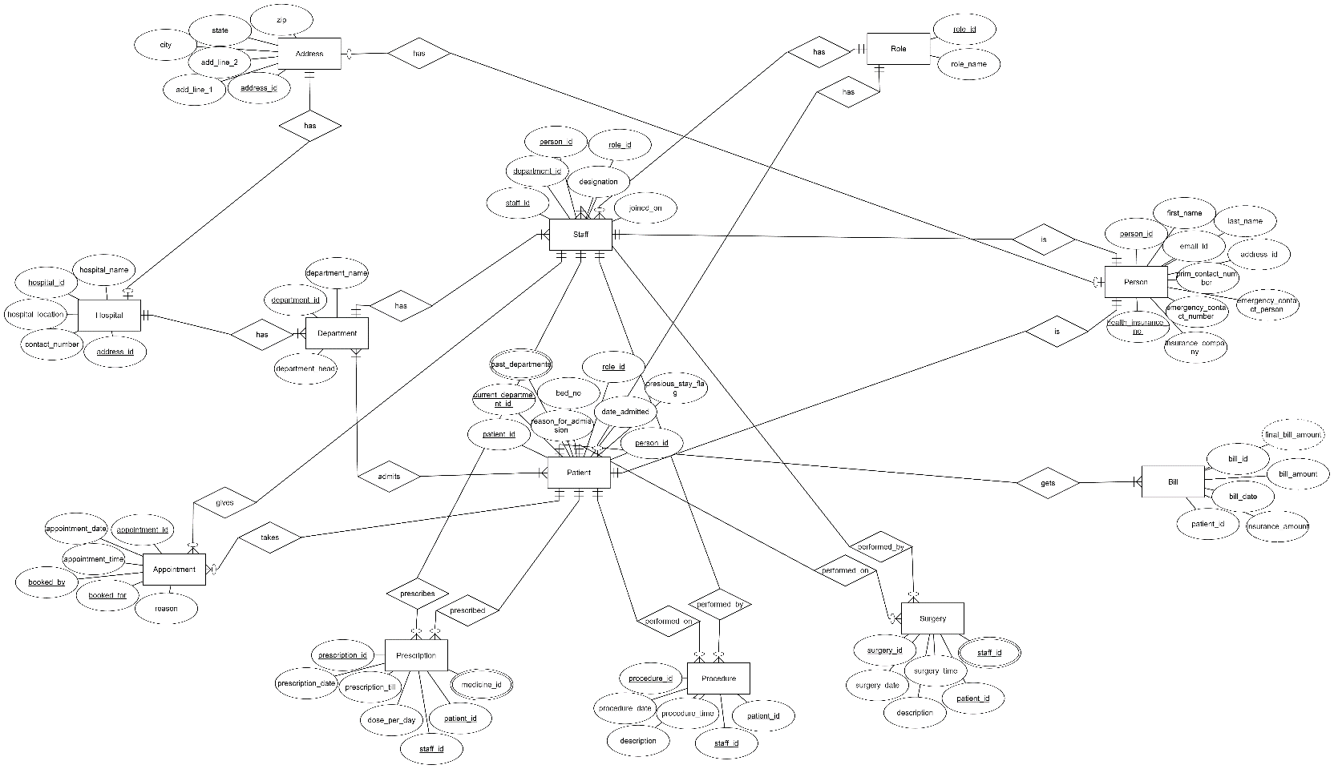
EER Diagram

Slide 5
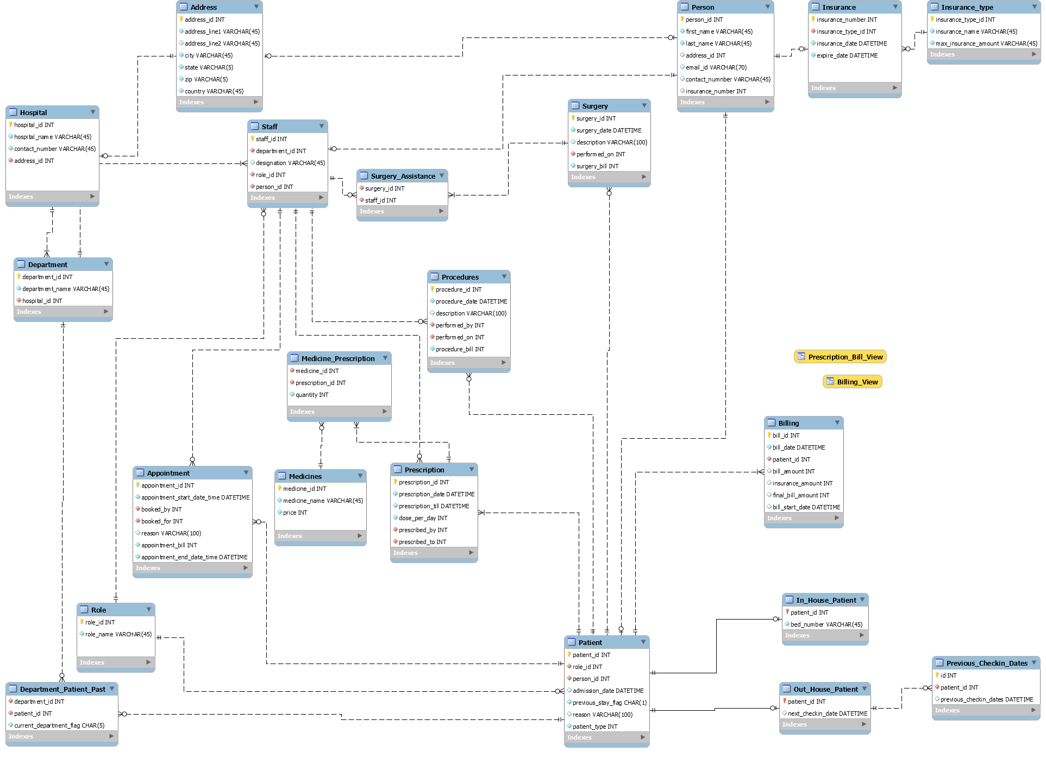
Relational Model

Slide 6
Normalization techniques
Removed multivalued attributes by creating new table for them
Many-to-many relationships were handled by creating association table
Partial dependencies are removed by normalizing it in 2NF form
Transient dependencies are removed by normalizing it in 3NF form

Slide 7
Important implementations
Kept the normalization up-to 3NF only
Tried to eliminate all insert, update and delete anomalies by cascading and/or restricting the update and delete operations in case of foreign key constraints
Created different users and granted respective privileges to each user
Inserted data using csv import method
Implemented Views for calculating prescription billing
Implemented stored procedures to calculate bill for a patient
Implemented stored procedure to debug a stored procedure
Implemented triggers for auditing purposes, auto modification of data in next check-in date for patient on booking appointment and validating email and contact number in person table

Slide 8
Important implementations Cont.
Implemented the backup features using command line, workbench, and shell scripts
Uploaded the backed up files on AWS RDS instance
The EER and relational model shows the before and after part of normalization process
Implemented mongodb as document database for storing hospital system data in NoSQL format
Implemented indexing on patient and staff for person column
Implemented queries that simulate transactions, subqueries, joins and functions

Slide 9
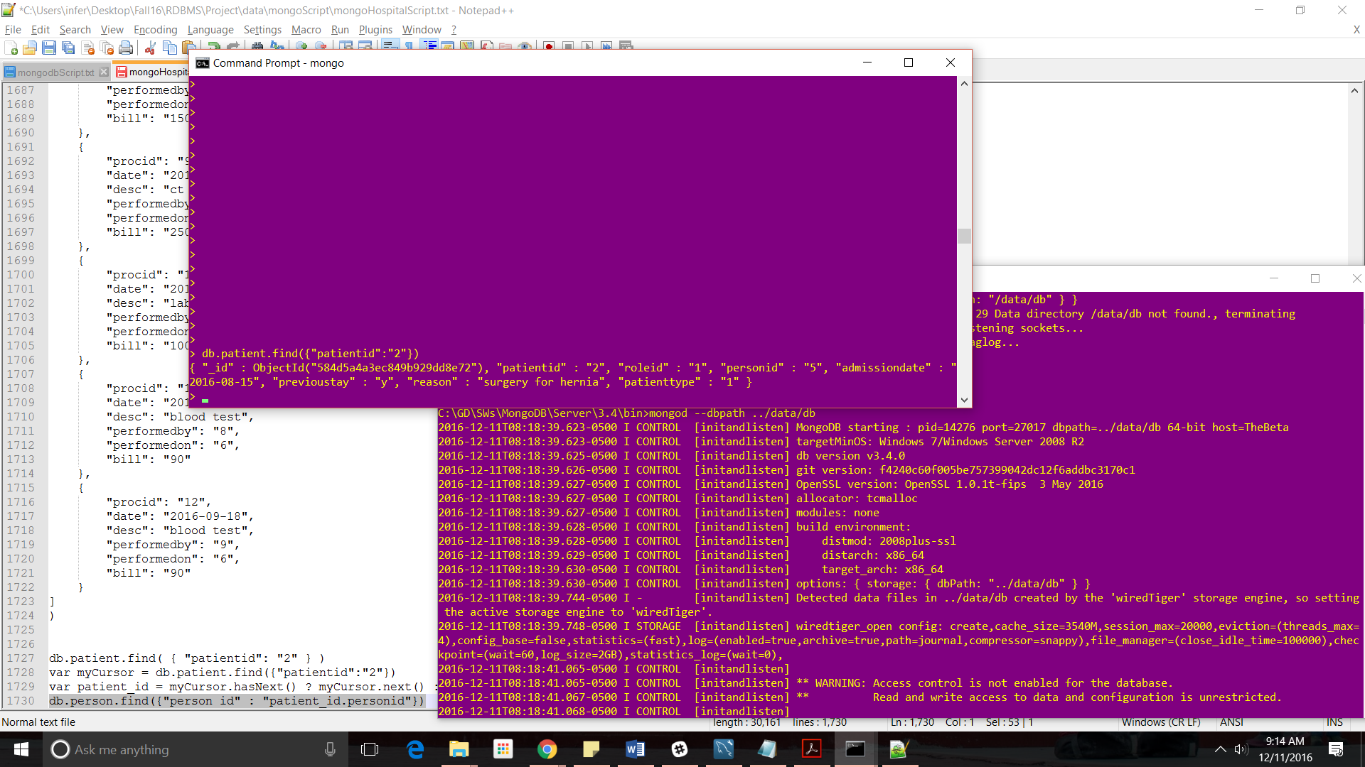
Mongodb

Slide 10
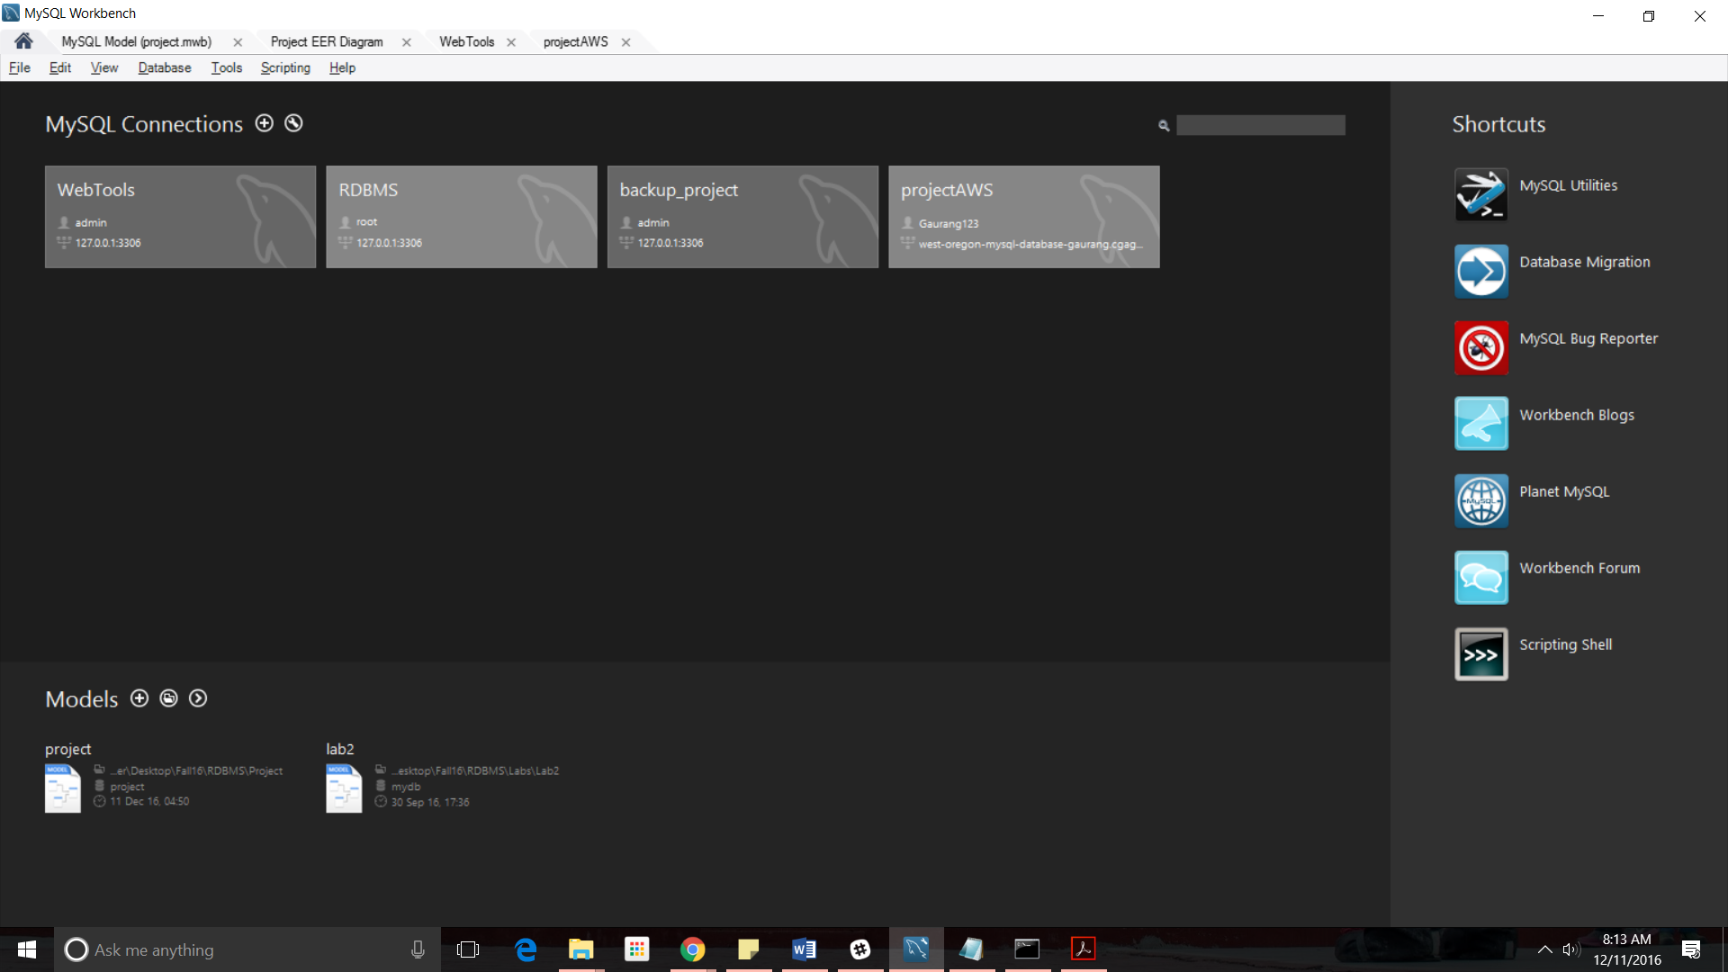
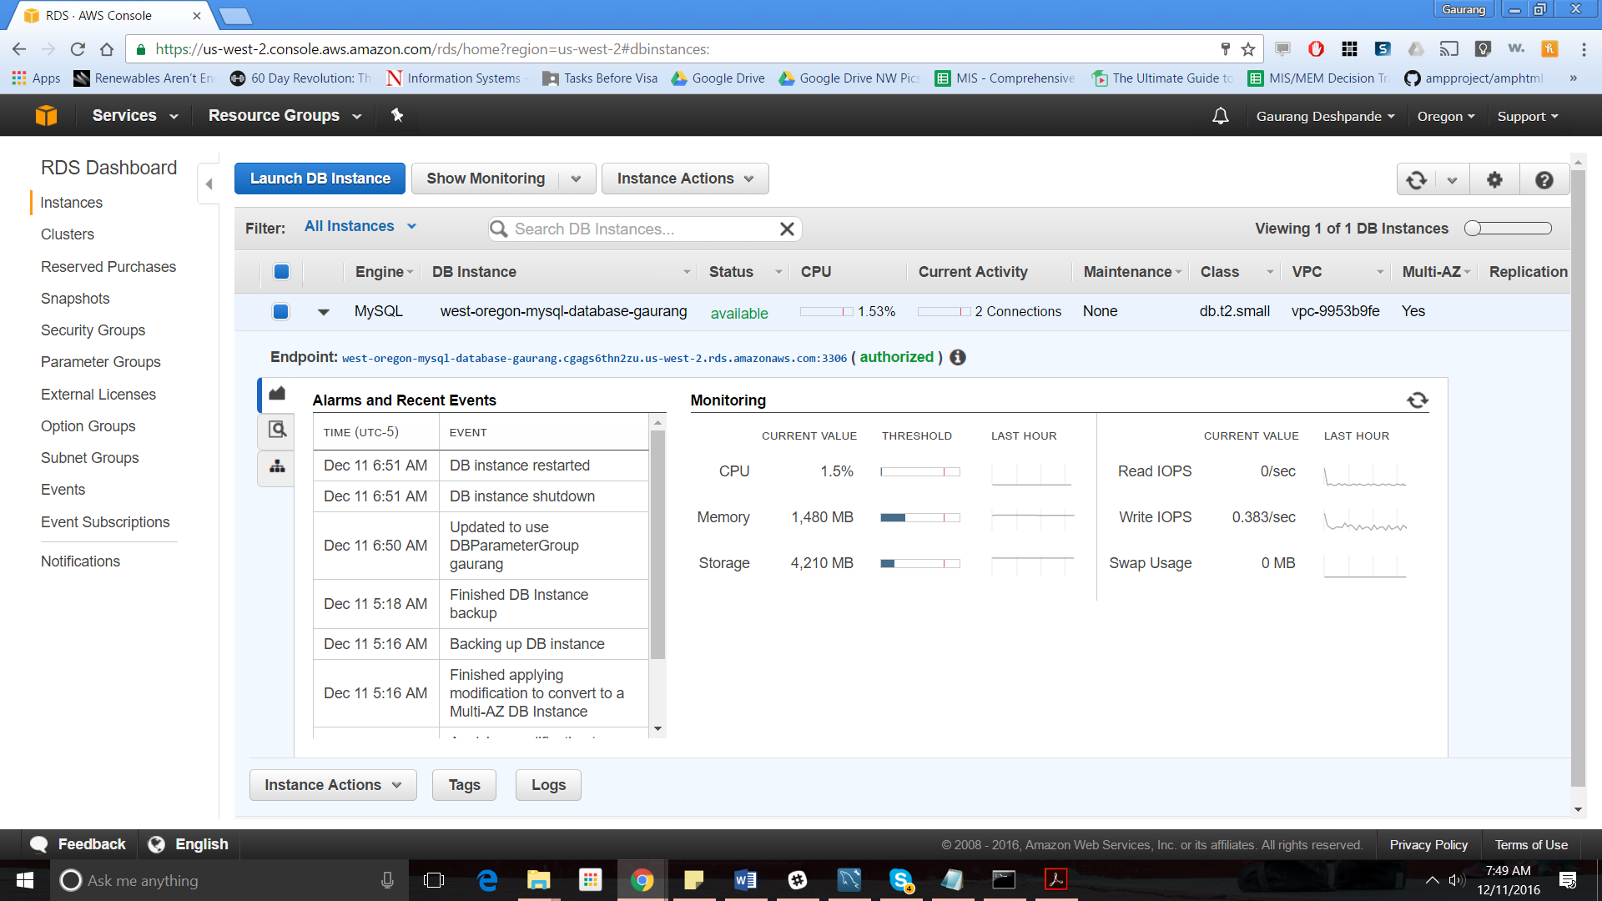
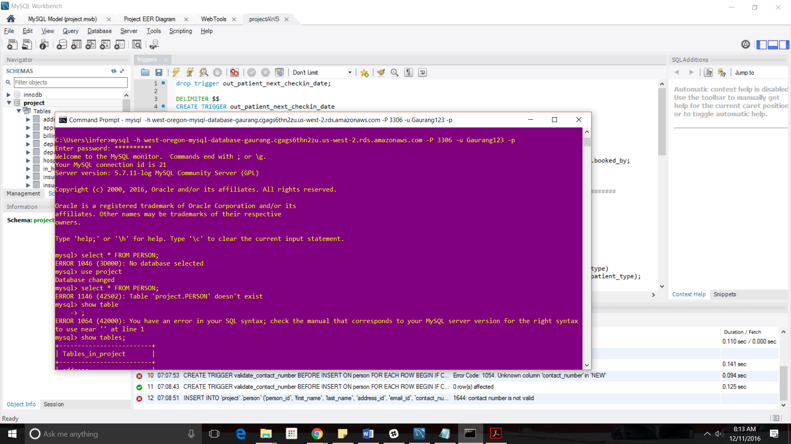
AWS RDS instance connection

Slide 11
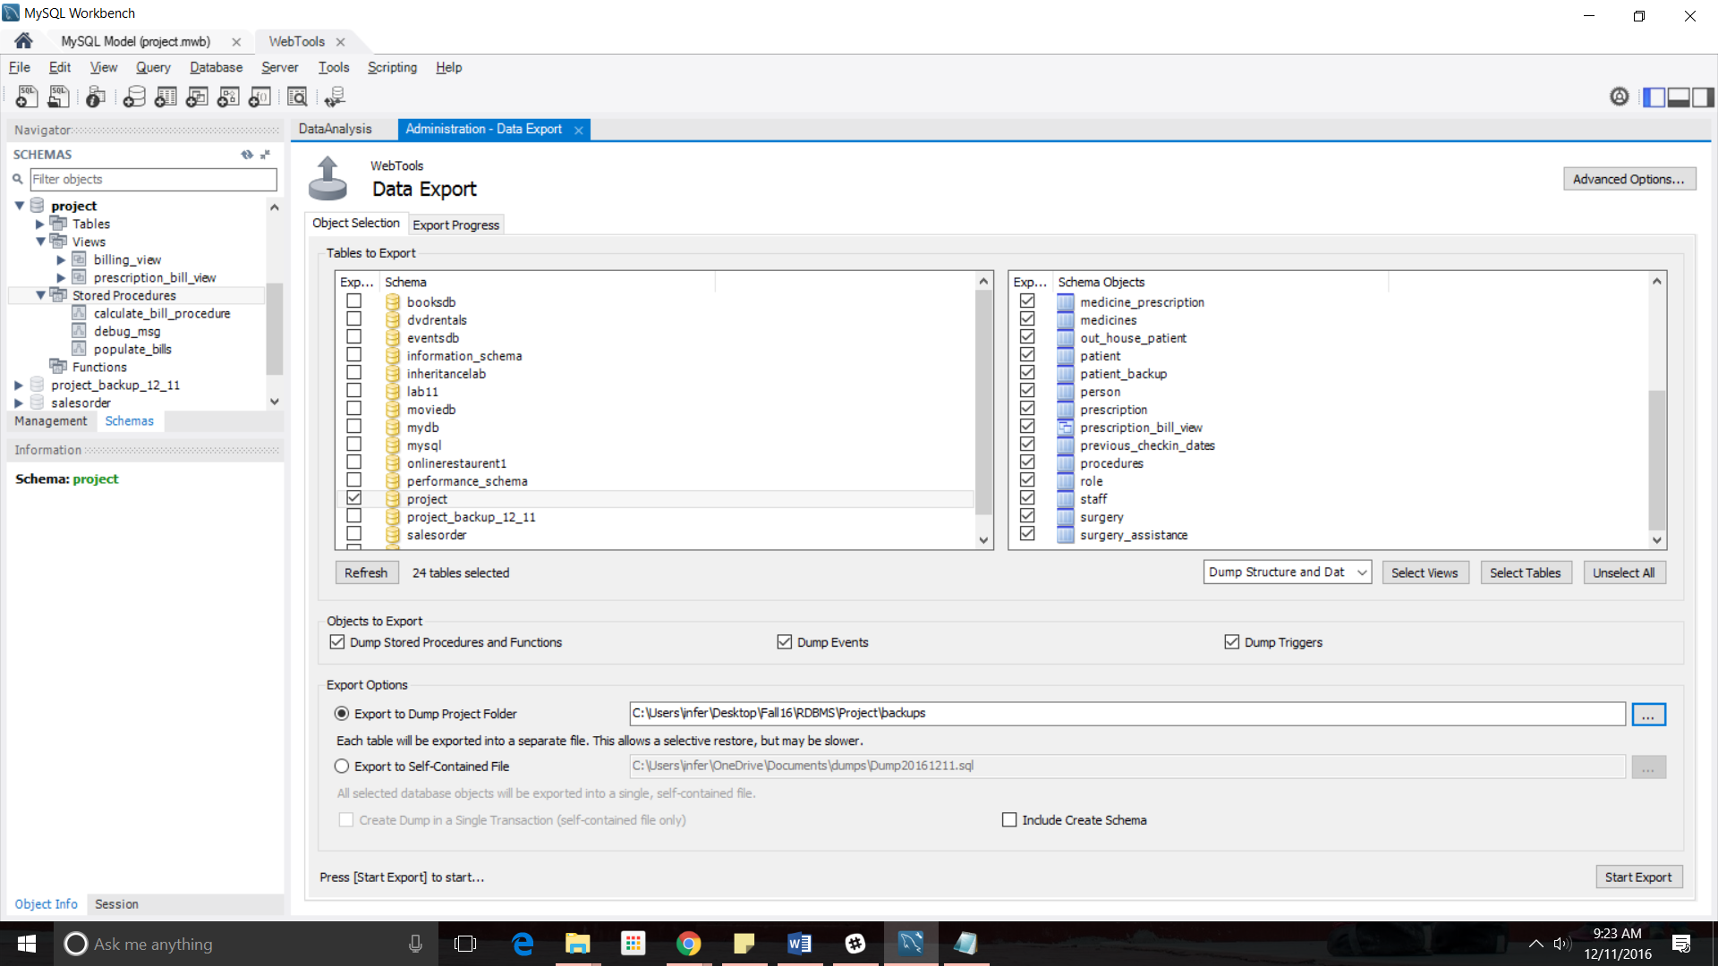
Backups

Slide 12
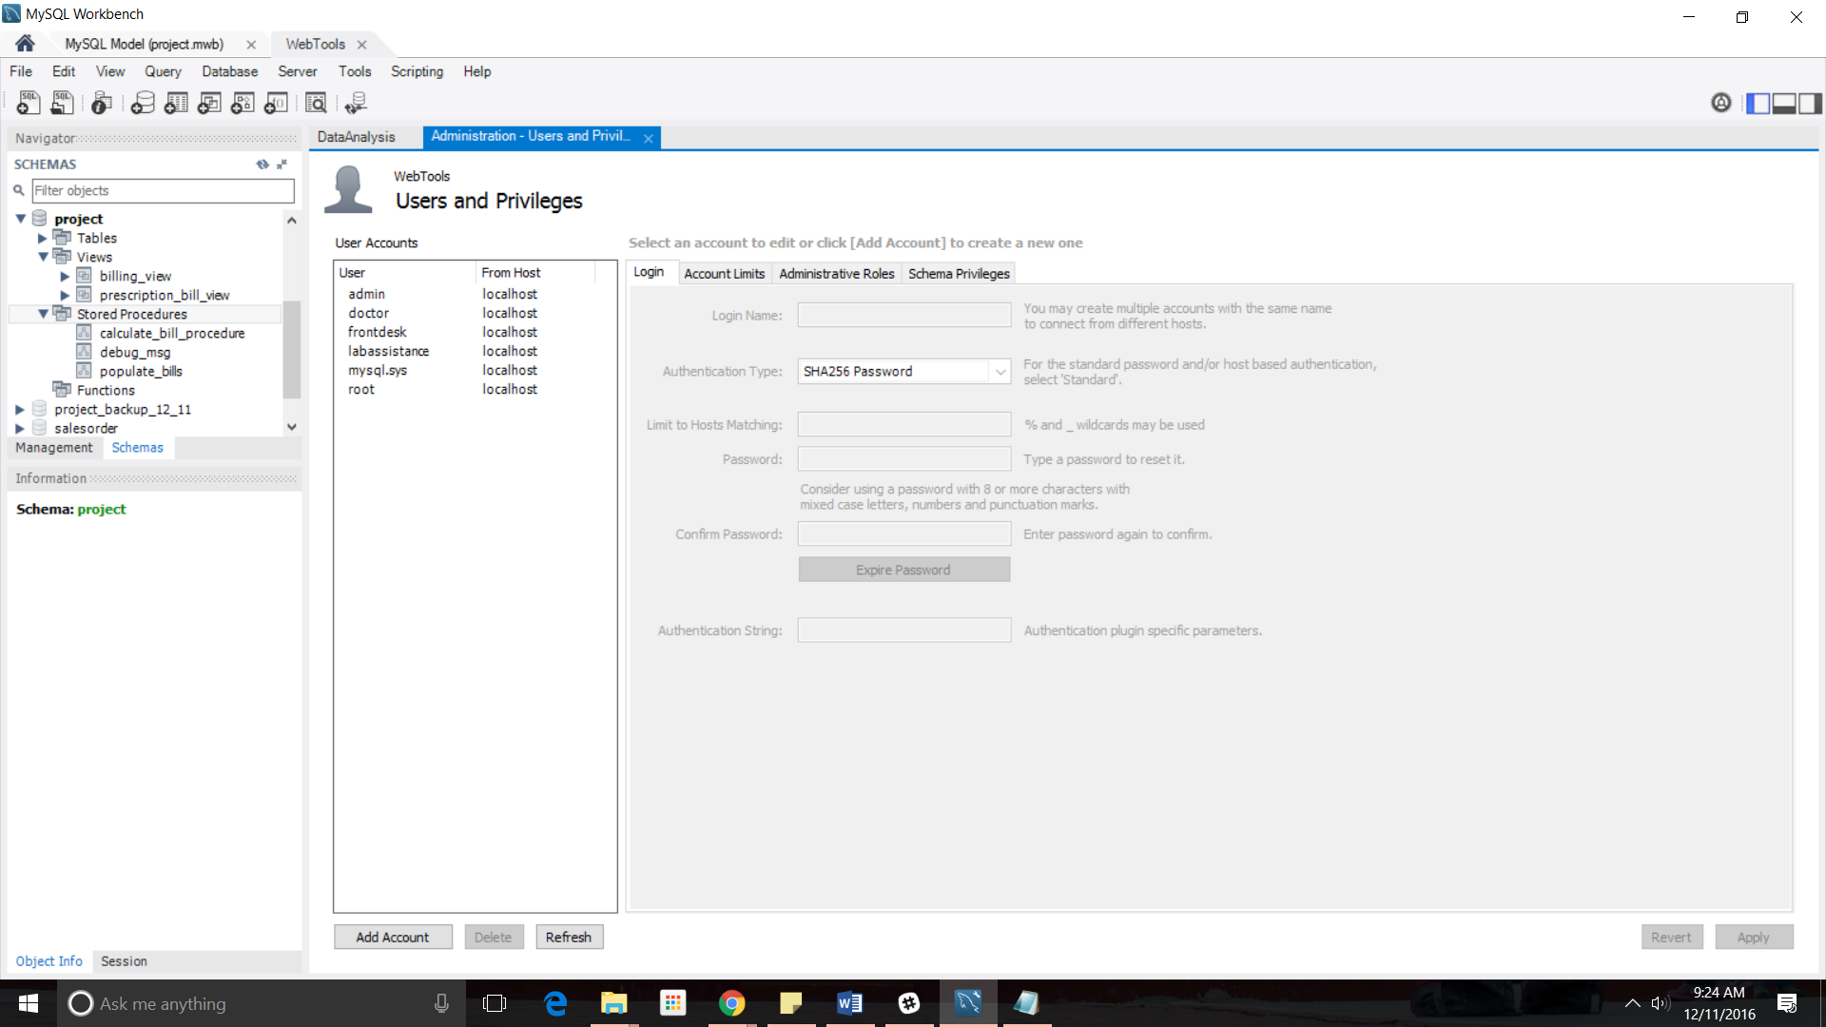
Users & privileges

Slide 13
Demo

Slide 14
Thank You

