Slide 1
USER EXPERIENCE DESIGN & TESTING Mid Term Presentation
Gaurang Deshpande
Rashmi Karunanithi
Shruti Chanage

Slide 2
Project Summary
Unable to gather all the information in one place
Need to access many websites to know about the department
Design a website with all the information
Easy for all the users to know information about the department

Slide 3
Concepts used
Implemented the concepts learnt in class, assignments and research
Five Planes Concept:
Strategy
Scope
Structure
Skeleton
Surface
Bottom-Up Approach (Scope Driven)
&
Top-Down Approach (Strategy Driven)

Slide 4
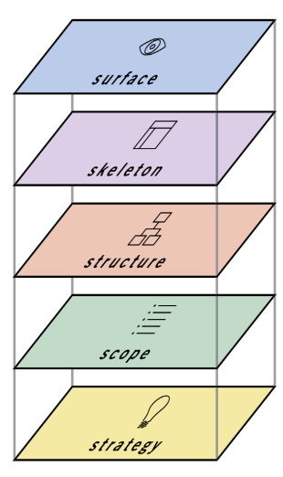
Five Planes Bottom-Up Approach
To do ( Developing front end using RWD concept and front end technologies)
Wireframes using Balsamiq, Implemented Navigation Types
Information Architecture
Defining a Scope, Versioning the product, Defining Requirements
Business Goals, User Needs, Card Sorting, Storyboarding

Slide 5
Strategy
Business Goals : Collaborate all the information about IS department in one place/ one website.
User Needs : Survey from real users which helped us to identify the user needs.
Card Sorting :
Open Card Sorting
https://www.optimalworkshop.com/optimalsort/g1gq35rp/4ppr21fp/shared-results/y7777u317d64552dtf5o3u351l7gbw1s

Slide 6
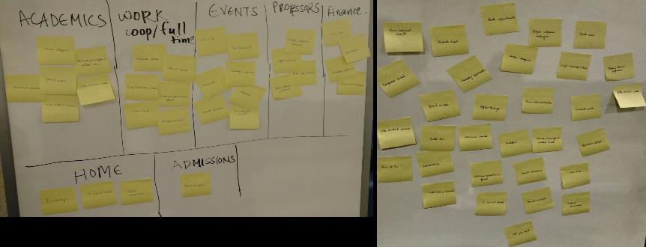
Strategy
Closed Card Sorting
Story Boarding

Slide 7
SCOPE
Defining a Scope
What we are building and what we are not building
Versioning the Product
Version 1.0 : Mockups and website for desktop.
Version 1.1: Mockups and modifications for mobile website, including alumni and students hired details
Defining Requirements

Slide 8
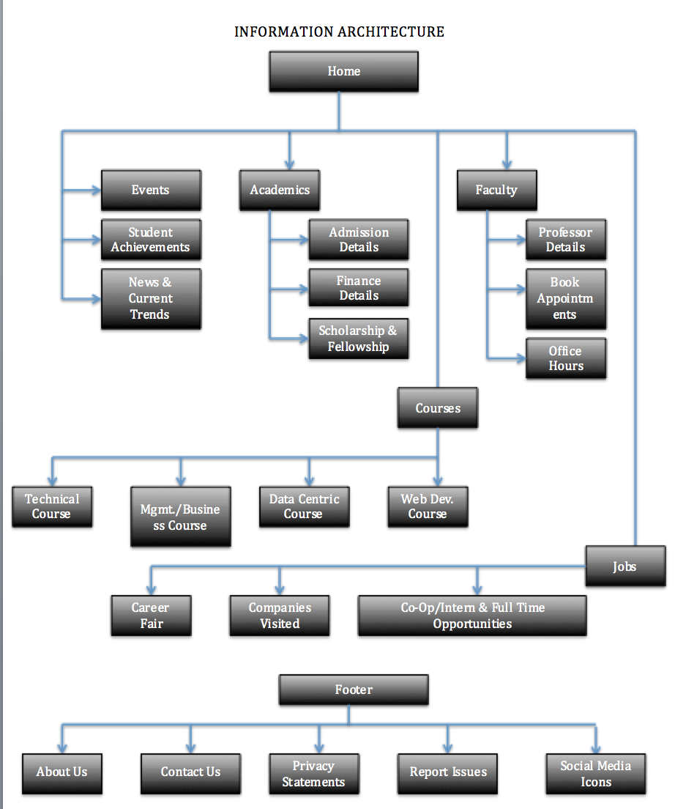
structure
Information Architecture

Slide 9
Skeleton
Wireframes using Balsamiq
Implemented Navigation Types
Global Navigation
Local Navigation
Contextual Navigation
Supplementary Navigation
Remote Navigation
Courtesy Navigation

Slide 10
Future scope
Mobile Wireframes
Alumni Details
Students Hired Details

Slide 11
Questions
or Suggestions ?

Slide 12
THANK YOU!!!

