Slide 1
Mechanism Synthesis
A Data Driven Approach

Slide 2
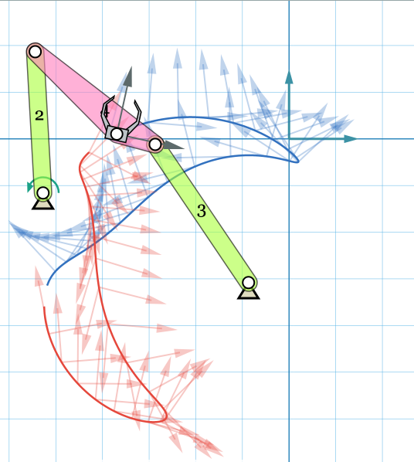
Motion Generation
Task is to synthesize a planar linkage,
which produces a desired planar motion
without dis-assembly .
Linkage might also have to satisfy
some other constraints

Slide 3
Unsolved Problems in Kinematic Synthesis
Defects in Mechanism
Branch Defect
Circuit Defect
Order Defect

Slide 4
Tools required for Synthesis
Incorporation of Practical Constraints
Region Constraints for pivots
Obstacle Avoidance
Torque-Velocity Constraints
Tool having a dialogue with mechanism designer
An interactive tool which user can tinker with to get his job done
Tool should provide visualization of process that is being carried out
Variational Synthesis

Slide 5
Our Prior Work…
N-Constraint Motion Generation with minimum algebraic fitting error. Presently no consideration is given to find defect free linkage.
Regional constraints can be modeled and linkage with minimum fitting error can be found.
Real-time solution for the above said problems

Slide 6
Problems with Task Formulation
Finite Position Synthesis inherently ignores continuity requirement of coupler curve
Precision Pose constraint is an accuracy overkill for specifying a motion
Sometimes user needs is a higher-level general sense of motion instead of precise interpolation at particular points.
N-pose least square synthesis also suffers from this formulation

Slide 7
Atlas/ Catalogue/ Database Approach
Pros:
Always finds defect free mechanism
Comes up with many concept solutions
Can be generalized to give any type of linkage
Cons:
Not a standalone method, (requires server with database)
Subsequent Optimization for fine tuning is needed

Slide 8
Literature Review
Ullah and Kota[1]:
Method for shape comparison of closed planar curves.
Cumulative Angular Deviant function which is independent of scale, rotation, and translation
The function is represented as Fourier series. (First 20 harmonics)
It is used as objective function in path synthesis via optimization.

Slide 9
Literature Review
Huafeng Ding et. al[2]:
Synthesis of the whole family of planar 1-DOF kinematic chains and creation of their atlas database
An atlas database of 1-DOF kinematic chains with 6–14 links is established.
The atlas database contains all the valid topological graphs classified by their structural characteristics. Once topology is selected, the dimensions are calculated by some other methods.

Slide 10
Literature Review
Jinkui Chu et. al[3]:
Dimension Synthesis of Spatial Four-Bar Linkage Through Numerical Atlas Method
Atlas for Function Synthesis and Path Synthesis is created

Slide 11
Literature Review
Constraint-Based Design & Optimization Group (CBDO), Mechanical Engineering, University of Bath:
Specify the required output path
Use the catalogues to find a suitable candidate mechanism
Additional constraints can then be imposed and constraint modelling software used to adapt the selected mechanism to meet these.

Slide 12
Literature Review
Atlas based Methods are developed only for Close Path Synthesis
Possible Reasons
closed loop paths were the important ones
But, Open paths and motions gaining increasing importance with advent of Modern technologies like nanotechnology or bio-mechatronics,
complex spatial and coupled movements or mechanisms for miniature and micro assemblies
Its easier; don’t have to deal with partial matching (part-to-whole)

Slide 13
Algorithm
Build a database of trajectories generated by a uniform distribution of four-bar linkages in its parameters space.
Parameter space is chosen such that mechanism has realistic dimensions and all shapes of coupler curves can be generated.
Store Compact Invariant Representation of trajectories
For a given trajectory find the set of close trajectories from database.
Clustering of Trajectories
Find the set of mechanisms corresponding to such trajectories.

Slide 14
Clustering of Trajectories
Trajectory is a series of discrete poses
High Dimensional (for 60 poses = 60x3 = 180 numbers)
Naïve Clustering suffers from curse of dimensionality
Need compact and tolerant representation of Four-bar Trajectories
Auto-Encoders
Clustering in the reduced space is easy!

Slide 15
Auto-Encoders : Training
BottleNeck
Encoder
Minimum
Neurons
Possible
Reconstructed
Input
Input
Decoder
[50]
[5]
[150]
[150]
[180]

Slide 16
Training Data
Total 200,000 Trajectories
Each trajectory is a set of 60 poses
Dim of each trajectory => [60, 3] flattened to [180]
For cross validation, training and test trajectories are randomly divided into 160:40 split
Error results are same for each such runs.

Slide 17
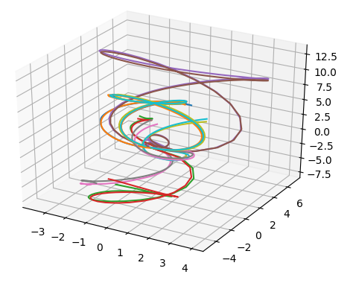
Implementation Details
Different Number of Bottle-Neck Neurons are tried out
Best fit with compact Neuron layer : # neurons = 5
Each trajectory is reconstructed by using its 5 dim z_feature
10 Trajectories along with their reconstructions

Slide 18
Auto-Encoders : Encoding -> Clustering
BottleNeck
Z Features
(a Compact
Representation
Sufficient for
Reconstruction of
Input)
Input
Encoder
Clustering

Slide 19
Clustering
DBSCAN
Finds core samples of high density
expands clusters from them
Estimated number of clusters for: 5-dimesion case = 183

Slide 20
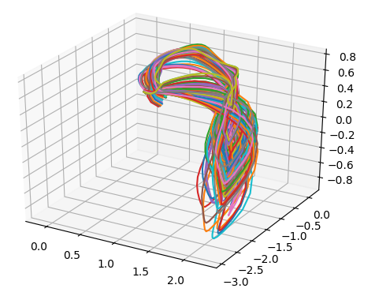
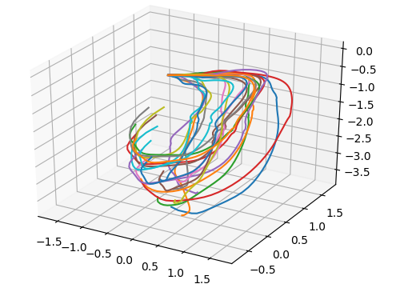
Some Interesting clusters

Slide 21
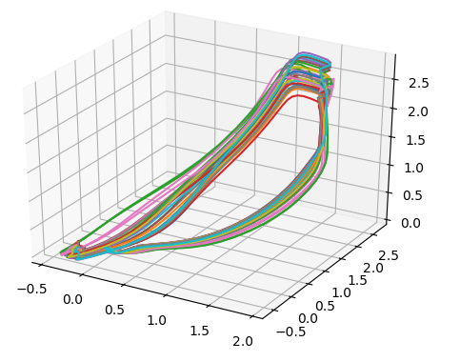
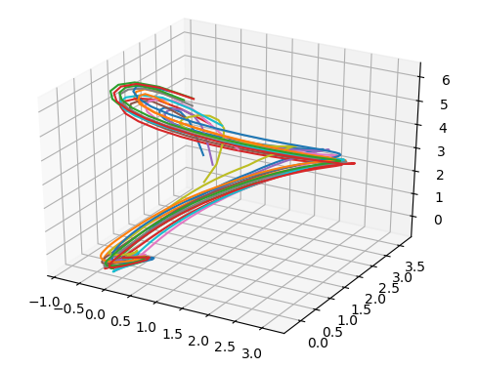
Some Interesting clusters

Slide 22
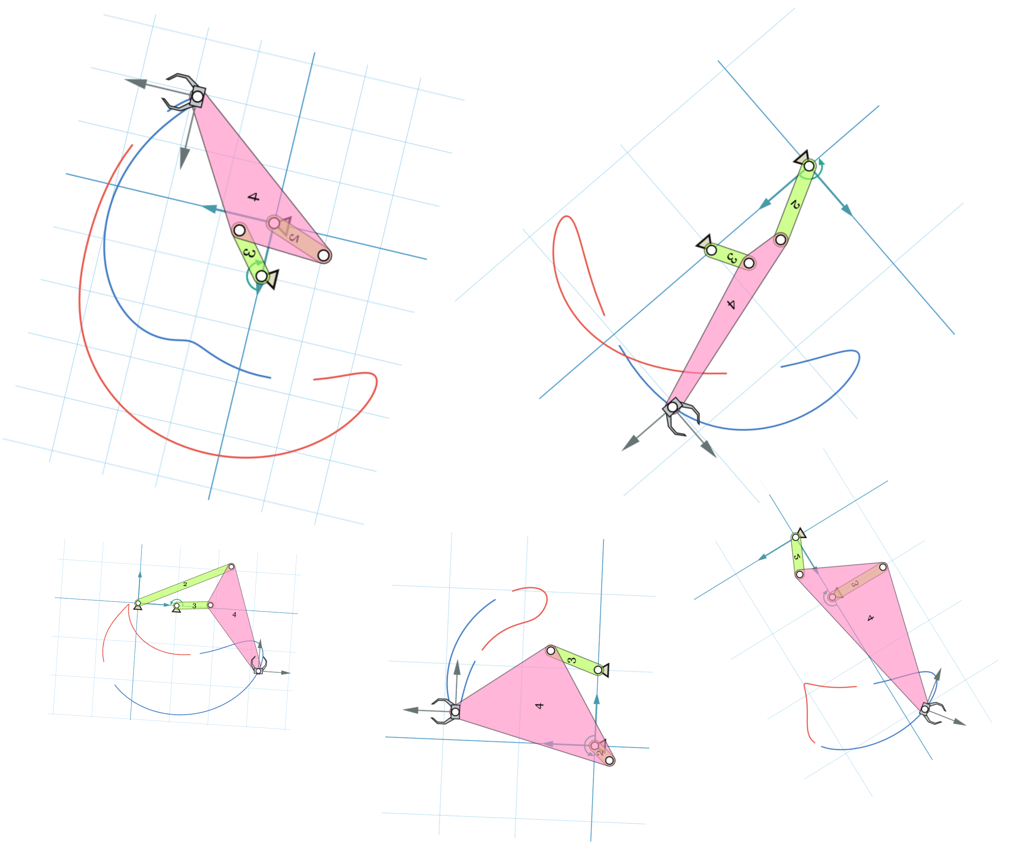
Different Mechanisms With Similar Motion

Slide 23
Trajectory Signatures
Motion of the coupler is divided into path and angle.
Compute the invariant signatures of Path first
Couple the signature with orientation.

Slide 24
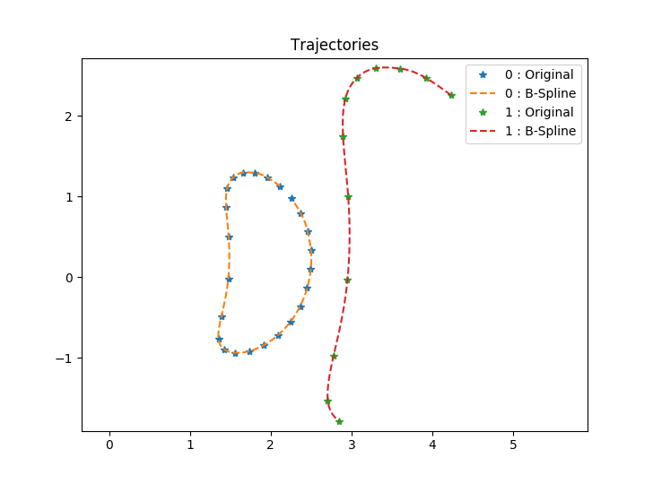
Path Signature
Fit piecewise cubic B-splines to target path.

Slide 25
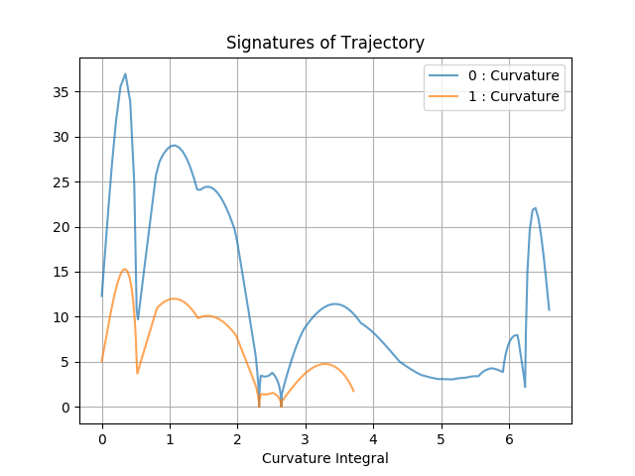



Path Signature
Fit piecewise cubic B-splines to target path.
Compute,
Where,
Calculate, cumulative Integral

Slide 26
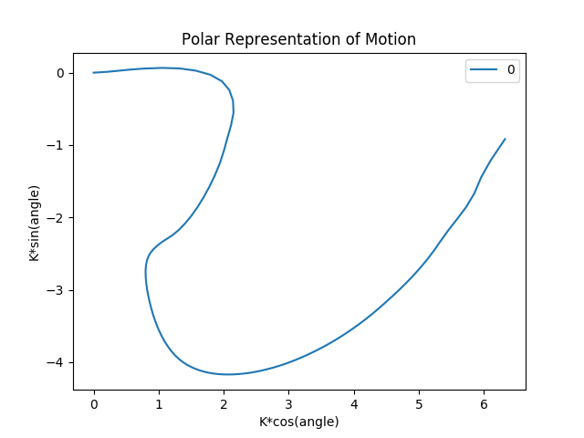
Invariant Representation of motin

Slide 27
Orientation Prediction
Coupled information of path and orientation
Database can be used to learn this sequential information
Analogous to Text prediction and completion implemented in Cell-Phones
Quick Real-Time feedback by onboard computation

Slide 28
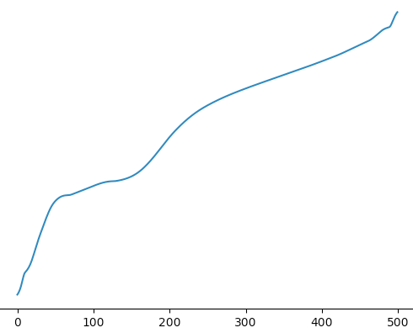
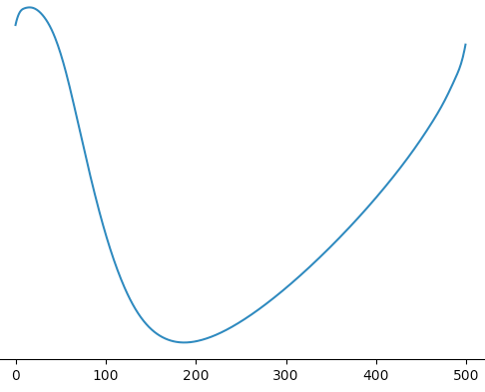
Sequence Learning for coupler orientation
LSTM
RNN
Path Sequence
Orientation Sequence

