Slide 1
AI Driven Mechanism Design for Motion and Path Generation
Shrinath Deshpande

Slide 2
Aim
To develop an AI driven framework that generates high number of feasible concept solutions for motion and path generation problem.
The framework should learn from the past, improving the user feedback on produced solutions.

Slide 3
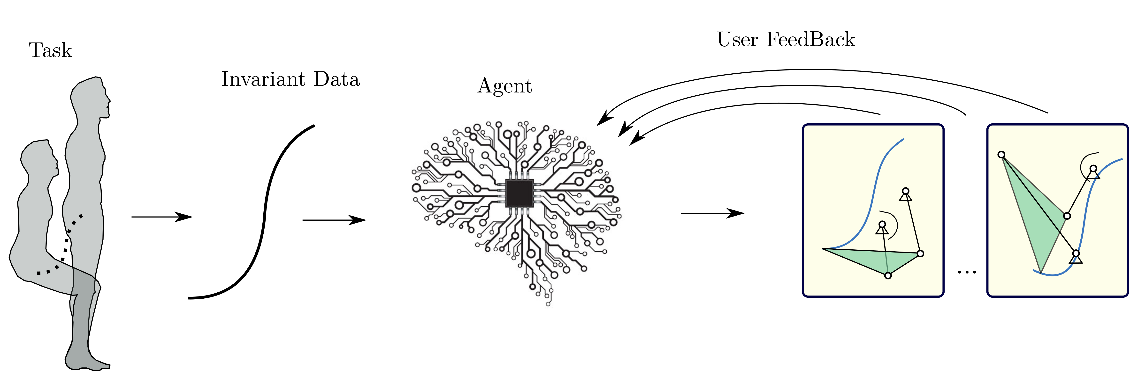
Overall Approach

Slide 4
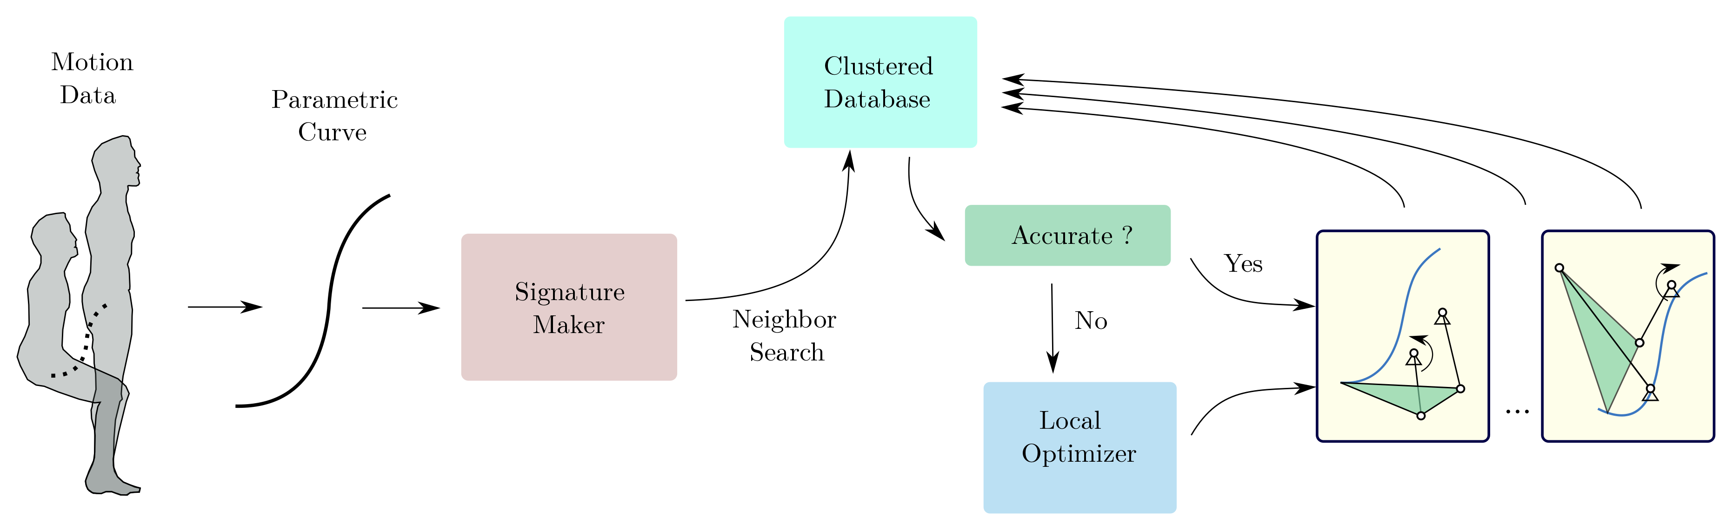
Current Progress

Slide 5
What’s New
Problem Formulation
  Motion / Path continuity
  Rotation, Scale, Translation, Flip Invariant
  Partial Matching of motion/ paths
Smoother Objective Function
  Smooth at Topological Singularities
Prolific Defect-free Solutions

Slide 6
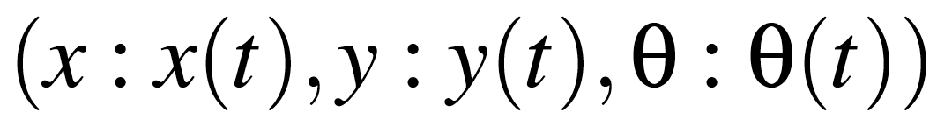
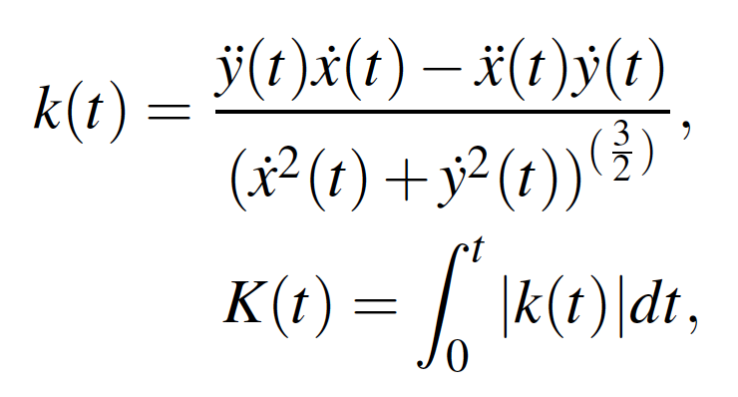
Signatures
Convert Motion Data to Parametric Form
Compute Curvature and It’s Integral,
Resample k at Equal Intervals of K; Path Signature
Resample at Equal Intervals of K; Motion Signature

Slide 7
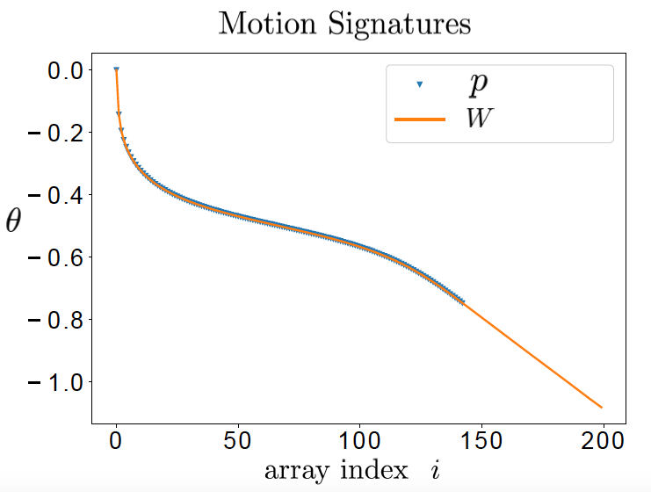
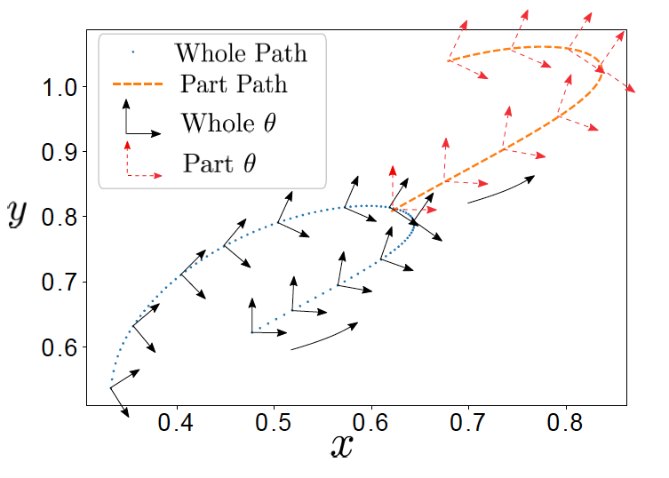
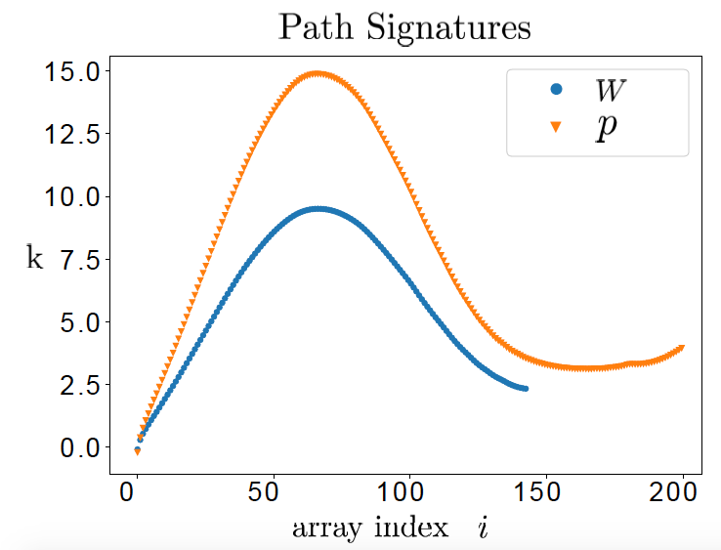
Signatures

Slide 8
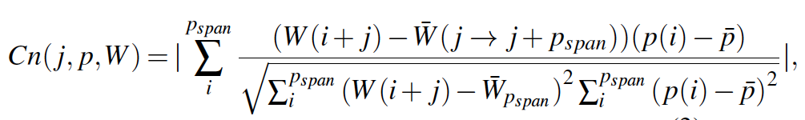
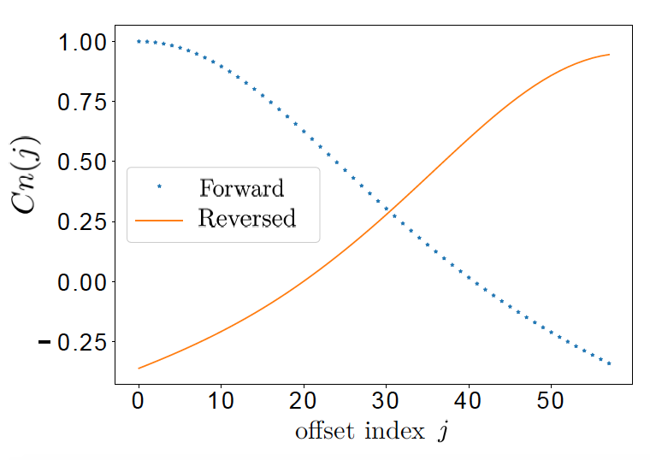
Path Similarity Matching
Normalized Cross Correlation

Slide 9
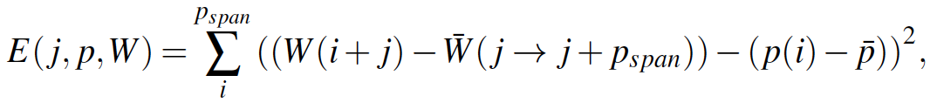
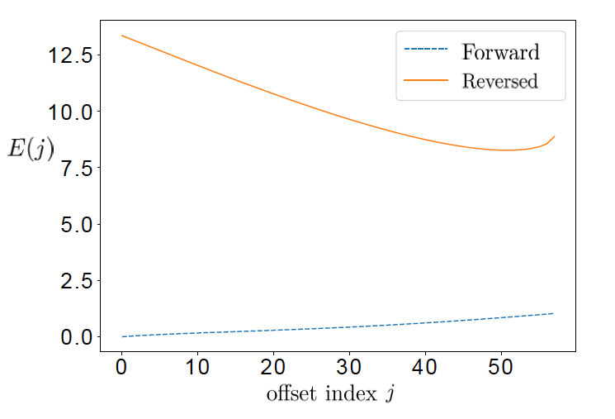
Motion Similarity Matching
Motion Error Function

Slide 10
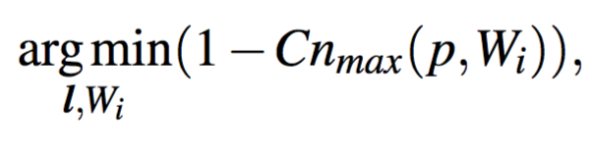
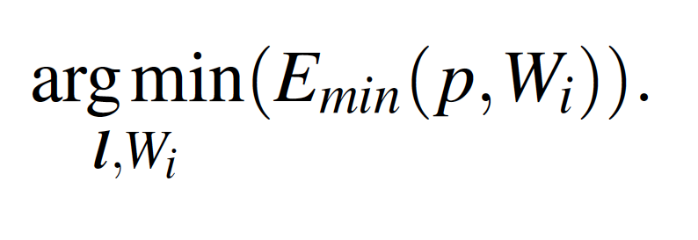
Objective Function for Synthesis
Path Synthesis
Motion Synthesis

Slide 11
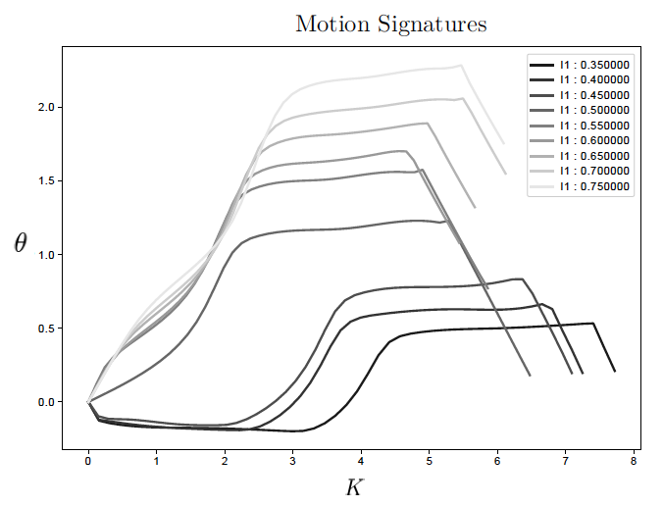
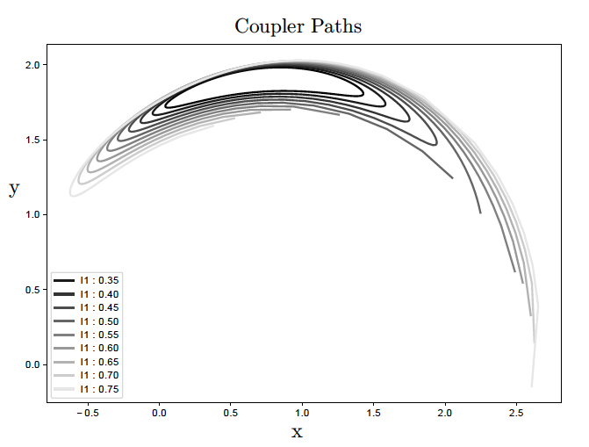
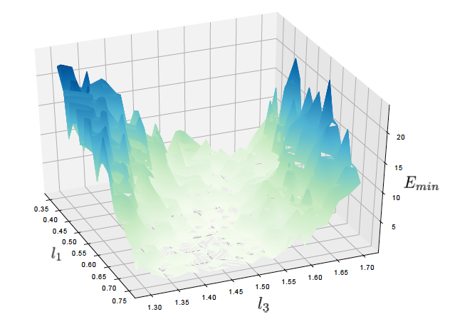
Sensitivity Analysis

Slide 12
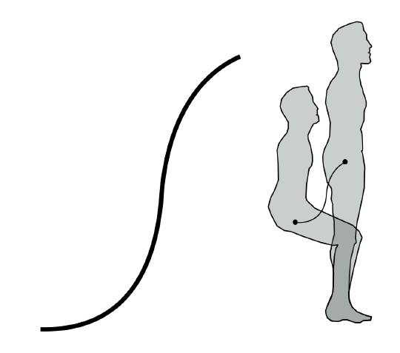
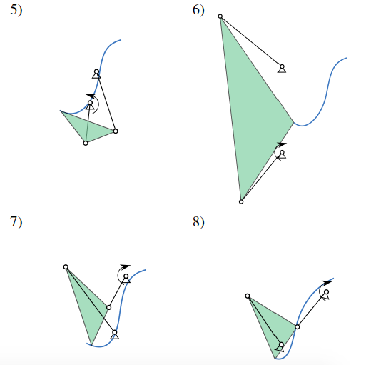
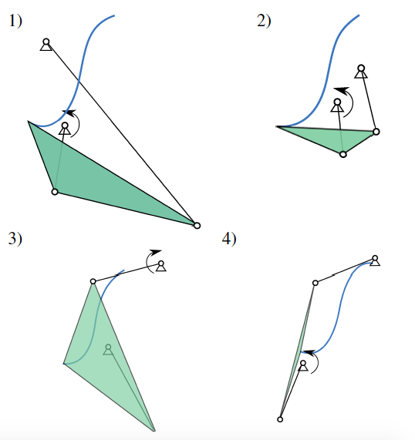
Example: Path Synthesis (Sit to Stand)

Slide 13
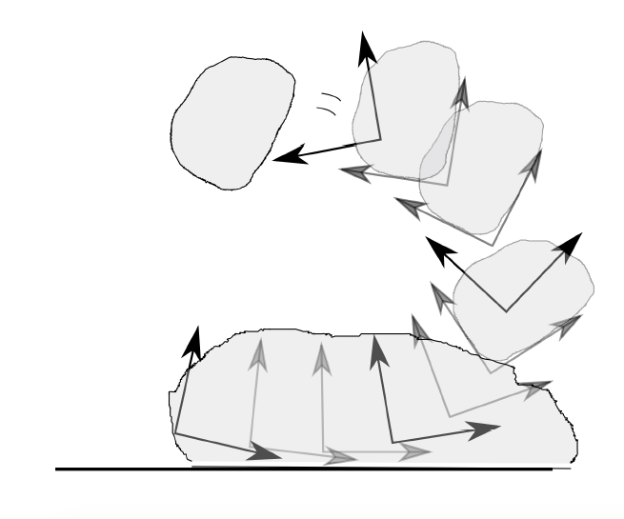
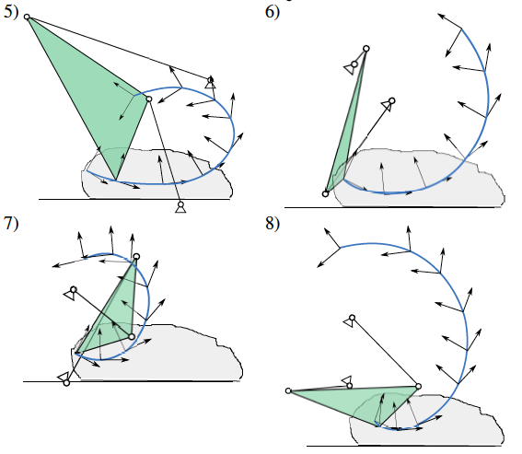
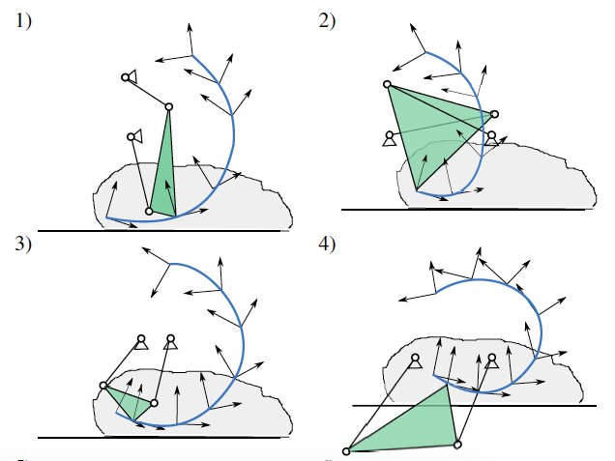
Example: Motion Synthesis (Sit to Stand)

Slide 14
Next Steps
Reinforcement Learning instead of Optimization
  An agent that minimizes the objective
  Learns from past experiences: Faster Convergence
  Hindsight Experience Replay
  Modelling of Complex Constraints; Obstacle avoidance
  Improves from User-Feedback
Motion prediction from Path
  Similar to Predictive Text in Smart Phones
  Helps improving User Interaction with Platform

Slide 15
Plan of Work
Task | Duration
Basic RL for Motion and Path | Apr 18 – July 18
Incorporation of Practical Constraints | May 18 – July 18
Multi-Loop Synthesis | July 18 – Nov 18
Spatial Mechanism Synthesis | Nov 18 – March 18

