Slide 1
BGS SV target selection
ChangHoon Hahn (Berkeley)
Omar Ruiz Macias (Durham)
target selection telecon — August 1, 2018
Notes:
outline of talk:
motivation: We seek to determine the feasibility more accurately than what we’ve been doing so far using using simulations and contentious bright sky/moon models by using spectroscopic data from the GAMA survey.

Slide 2
BGS SV superset target selection criteria
magnitude limit
bright object mask
star-galaxy separation
Notes:
maybe a slide on legacy survey?

Slide 3
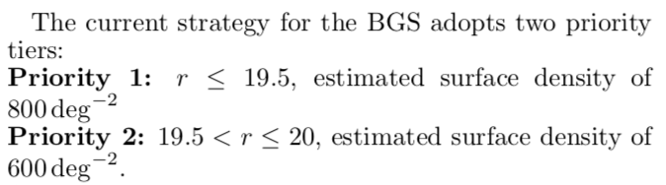
magnitude limit
for the BGS superset, push the magnitude limit to r < 20.1
https://www.overleaf.com/5923731xwddpv#/19875270/
Notes:
maybe a slide on legacy survey?

Slide 4
bright object mask — DR5
Notes:
maybe a slide on legacy survey?

Slide 5
bright object mask — DR5
Notes:
maybe a slide on legacy survey?

Slide 6
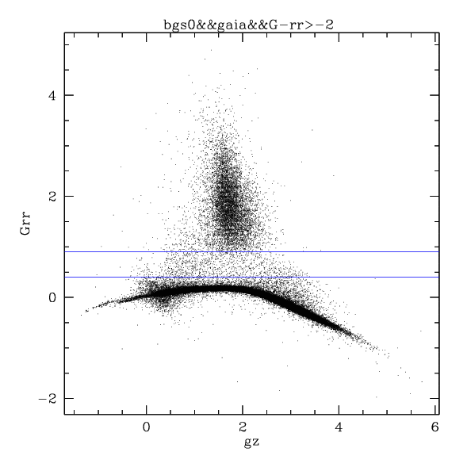
star-galaxy separation
tractor TYPE != “PSF” using GAIA
< 0.1% stars
GAIA G - r
stars
for the BGS superset, allow 10% of objects classified as stars to be targeted to test star-galaxy separation
credit: Daniel Eisenstein
Notes:
maybe a slide on legacy survey?

Slide 7
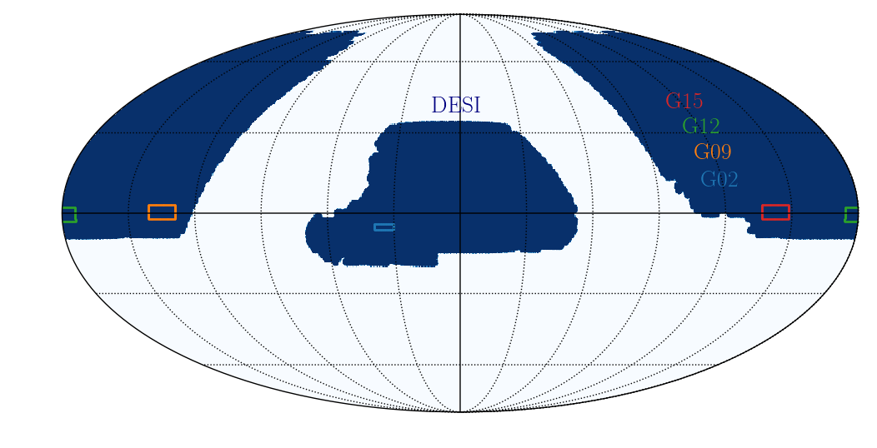
BGS survey validation
GAMA fields — spectroscopic truth tables
Notes:
maybe a slide on legacy survey?

Slide 8
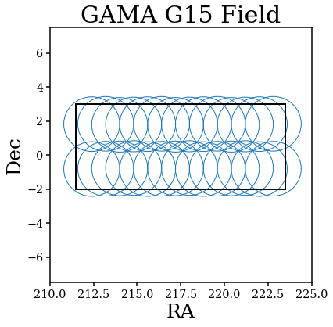
BGS survey validation
tiling by Kyle Dawson, David Schlegel
Notes:
maybe a slide on legacy survey?

Slide 9
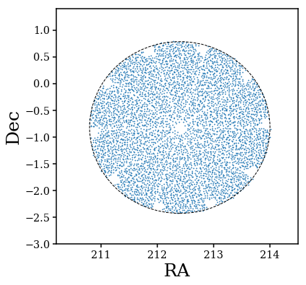
BGS survey validation
DECaLS DR5 targets by Adam Myers
fiberassign by Jaime Forero-Romero https://github.com/forero/fiberassign_sv/
Notes:
maybe a slide on legacy survey?

