Slide 1

Nagendra Yadav
Struts2

Slide 2
Agenda
What is JUnit
Usefulness of Junit
Terminology
Once more, in pictures
Creating JUnit Test cases.

Slide 3
What Is JUnit?
JUnit is an open source, regression-testing framework for Java that developers can use to write unit tests as they develop systems.
Unit tests are so named because they test a single unit of code, which can be a single class for Java.
Hence, the focus is less on module level functional tests and more on testing the fundamental building blocks of a system one block at a time.

Slide 4
Usefulness of Junit
The JUnit API provides a very flexible and simple framework for a developer to make sure that the code that is written is robust.
For better the quality of the final product. Write a test, run all the tests, observe the new one fail, fix the code to make the test pass, and refactor to remove any duplication. Repeat the cycle through your development cycle.
We can debug the system more effectively until the test passes.

Slide 5
Terminology
A test fixture sets up the data (both objects and primitives) that are needed to run tests
  Example: If you are testing code that updates an employee record, you need an employee record to test it on
A unit test is a test of a single class
A test case tests the response of a single method to a particular set of inputs
A test suite is a collection of test cases
A test runner is software that runs tests and reports results
An integration test is a test of how well classes work together

Slide 6
Once more, in pictures
test suite
test runner
another unit test
A unit test tests the methods in a single class
A test case tests (insofar as possible) a single method
  You can have multiple test cases for a single method
A test suite combines unit tests
The test fixture provides software support for all this
The test runner runs unit tests or an entire test suite
Integration testing (testing that it all works together) is not well supported by JUnit
test case (for one method)
another test case
another unit test
another test case
another test case
another test case
unit test (for one class)
test case (for one method)
another test case
test fixture

Slide 7
Life Cycle of a JUnit 3.8 Test Case Class
A JUnit 3.8 test case class contains a
setUp() method,
a tearDown() method and
multiple testXXX() methods.
When calling a test runner to run this test class, the runner will execute those methods in a specific order giving the test case class an execution life cycle like this:
setUp()
testXXX1()
tearDown()

Slide 8
Life Cycle of a JUnit 4.4 Test Class
A JUnit 4.4 test class contains a
@Before method,
an @After method and
multiple @test methods.
When calling a test runner to run this test class, the runner will execute those methods in a specific order giving the test class an execution life cycle like this:
@Before
@Test XXX1
@After

Slide 9
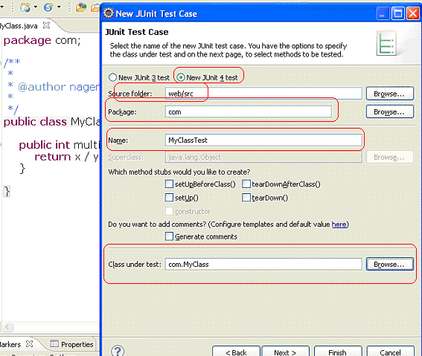
Creating JUnit Test cases.

Slide 10
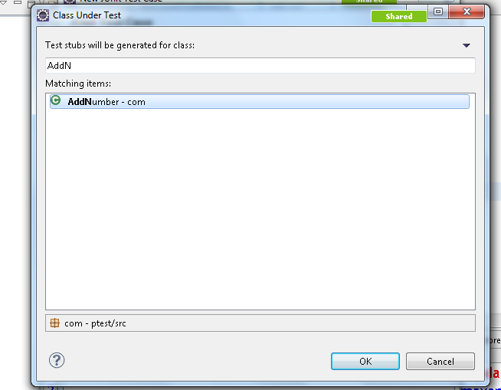

Slide 11
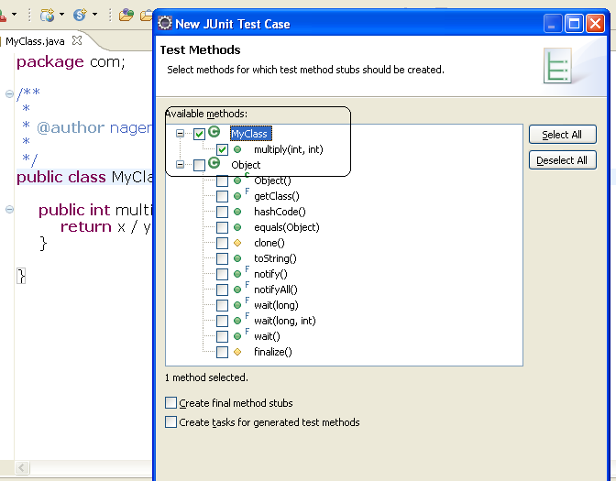
Creating JUnit Test cases.

Slide 12
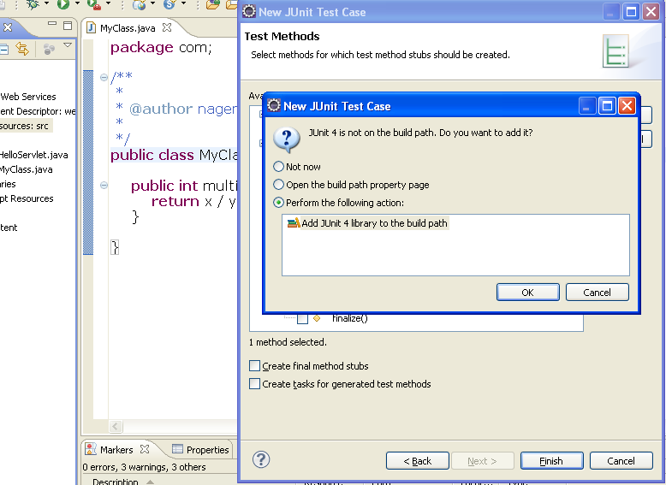
Creating JUnit Test cases.

Slide 13
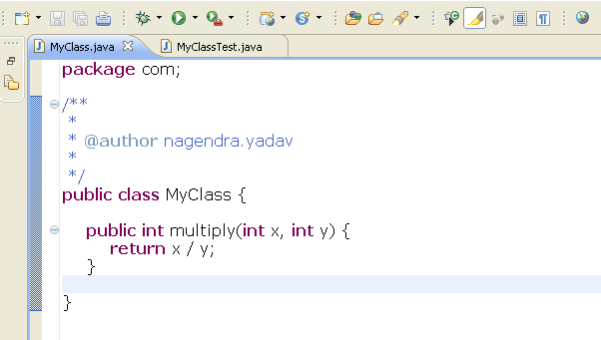
MyClass.java

Slide 14
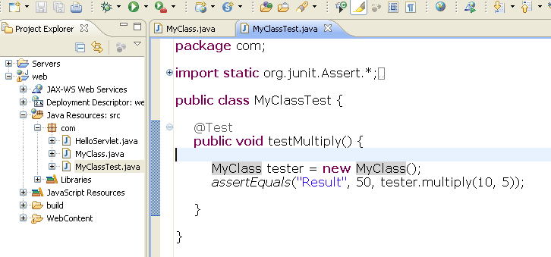
MyClassTest.java

Slide 15
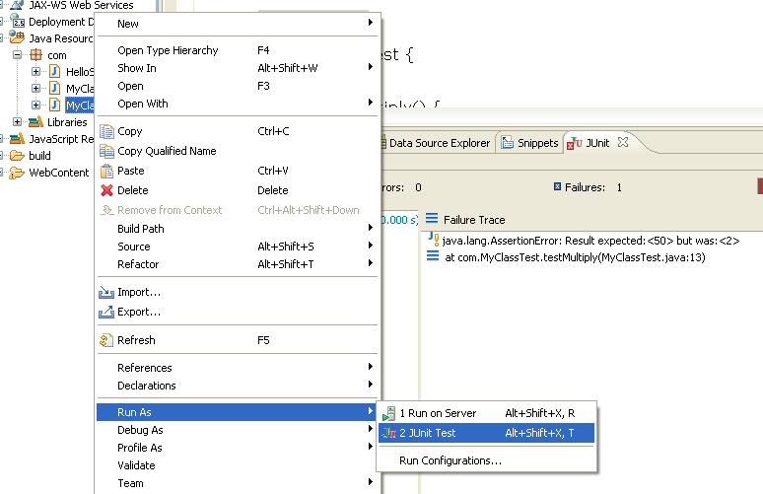
Run JUnit Test Case :-

Slide 16
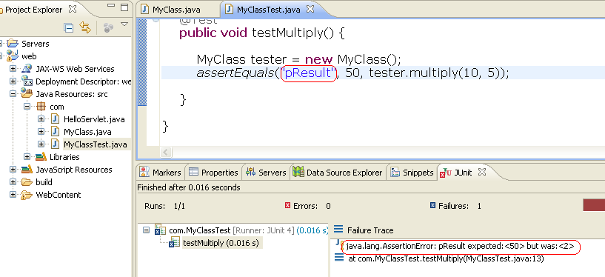
Output:-

Slide 17
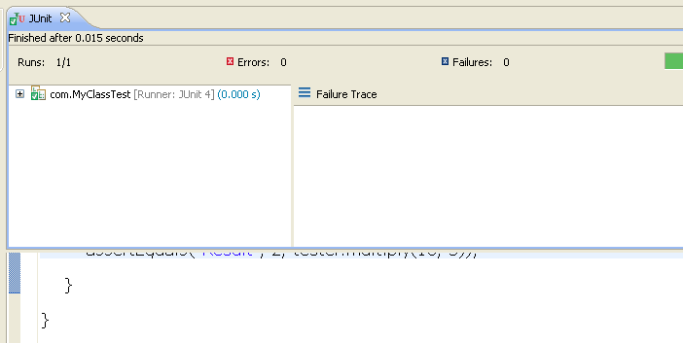
Output

Slide 18
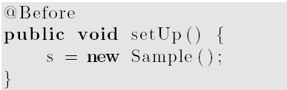
Creating Test Suite
If you have several tests you can combine them into a test suite. All test in this test suite will then be executed if you run the test suite. To create a new test suite, select your test classes, right mouse click-> New-> Other -> JUnit -Test Suite
Prepare (or set up) the test environment: the different actions to realize this are to be implemented in one or several methods,
annotated with @Before. Those methods are then executed before each test case (test method).

Slide 19
@After
Clean up (or tear down) the test environment is done in one or several methods,that are run after execution of each test method. To belong to this group, a method has to be annotated with @After.
@After
public void tearDown ( ) {
s = null ;
}

Slide 20
Ignoring a Test
JUnit gives also the possibility not to execute a test method. For that, the method has to be annotated with @Ignore. This may be desirable for instance in cases where a test method is incomplete.
@Ignore ( "Not Ready , to be changed" )
@Test
public void doNothing ( ) {
}

Slide 21
Building Test Suites:-
To group test cases into test suites, a suite class has to be defined. The annotation @Suite.SuiteClasses is used to specify the test classes to be incorporated to the
suite.

Slide 22
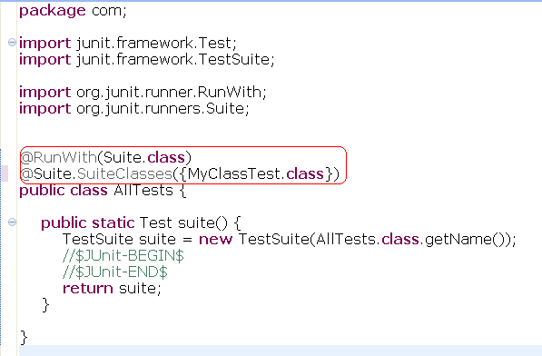
Building Test Suites:-

Slide 23
Run your test via code
We can also run your test via your own coding.
The class "org.junit.runner.JUnitCore" provides the method runClasses() which allows you to run one or several tests classes. As a return parameter you receive an object of type "org.junit.runner.Result".
This object can be used to retrieve information about the tests and provides information about the failed tests.
Create in your "test" folder a new class "MyTestRunner" with the following coding. This class will execute your test class and write potential failures to the console.

Slide 24
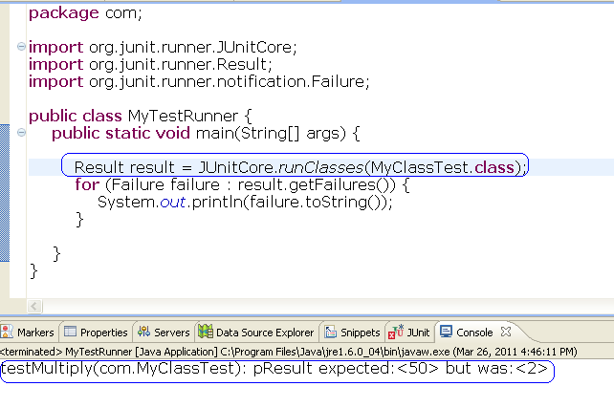
Run your test via code

Slide 25
Annotations
@Test public void method()
Annotation @Test identifies that this method is a test method.
@Before public void method()
Will perform the method() before each test. This method can prepare the test environment, e.g. read input data, initialize the class)
@After public void method()
Test method must start with test
@BeforeClass public void method()
Will perform the method before the start of all tests. This can be used to perform time intensive activities for example be used to connect to a database

Slide 26
Annotations
@AfterClass public void method()
Will perform the method after all tests have finished. This can be used to perform clean-up activities for example be used to disconnect to a database
@Ignore
Will ignore the test method, e.g. useful if the underlying code has been changed and the test has not yet been adapted or if the runtime of this test is just to long to be included.
@Test(expected=IllegalArgumentException.class)
Tests if the method throws the named exception.
@Test(timeout=100)
Fails if the method takes longer then 100 milliseconds

Slide 27
Assert statements
assertsEquals([String message], expected, actual)
Test if the values are the same. Note: for arrays the reference is checked not the content of the arrays
assertNull([message], object)
Checks if the object is null
assertNotNull([message], object)
Check if the object is not null
assertTrue(true);
True

Slide 28
Assert statements
assertSame([String], expected, actual)
Check if both variables refer to the same object
assertNotSame([String], expected, actual)
Check that both variables refer not to the same object
assertTrue([message], boolean condition)
Check if the boolean condition is true.

Slide 29
References
http://www.vogella.de/articles/JUnit/article.html#juniteclipse

