Slide 1
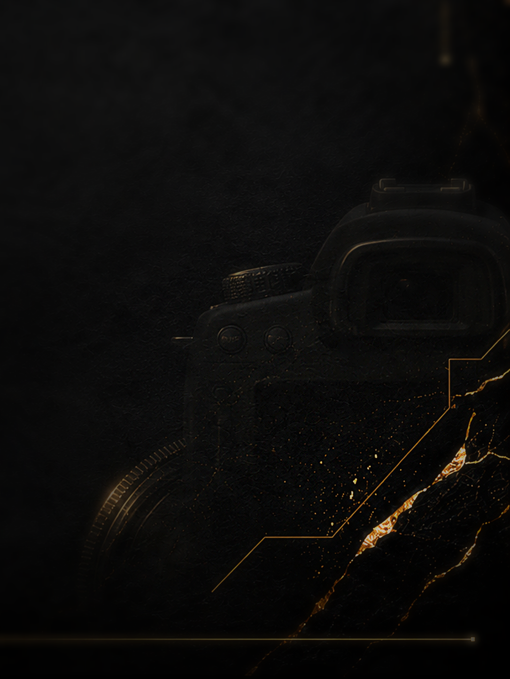

COMPANY PROFILE
BUILT OVER MONTHS.
SEEN IN SECONDS.
Premium time-lapse documentation, corporate video and broadcast-ready production for every industry across the UAE & GCC.
01
CAPTURE
02
PROGRESS
03
REVEAL
TIME-LAPSE VIDEO PRODUCTION
Every Industry · Across the UAE & GCC
www.goldline-production.com | info@goldline-production.com | +971 50 677 3781
GOLD LINE PRODUCTION
01

Slide 2
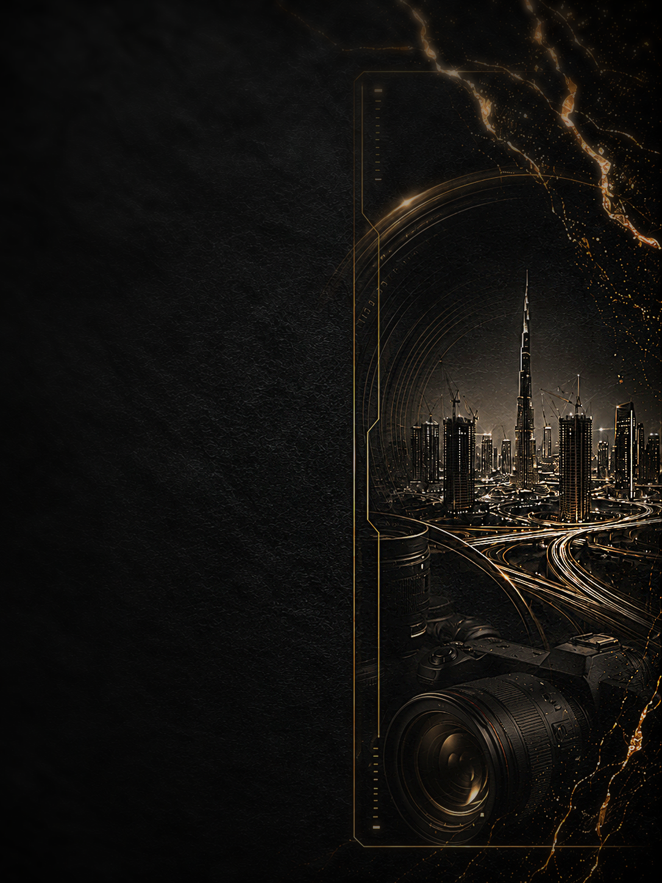
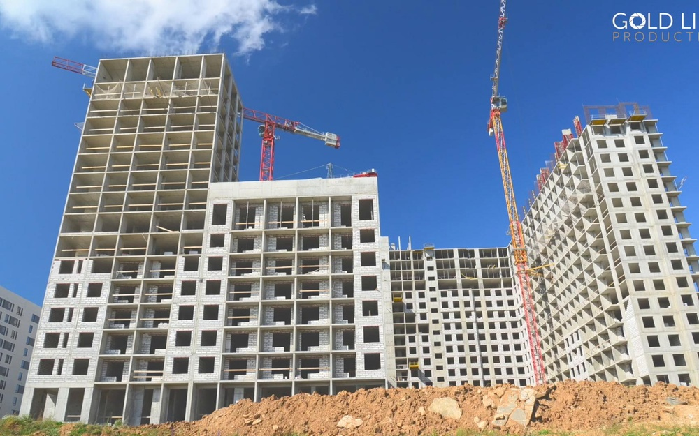
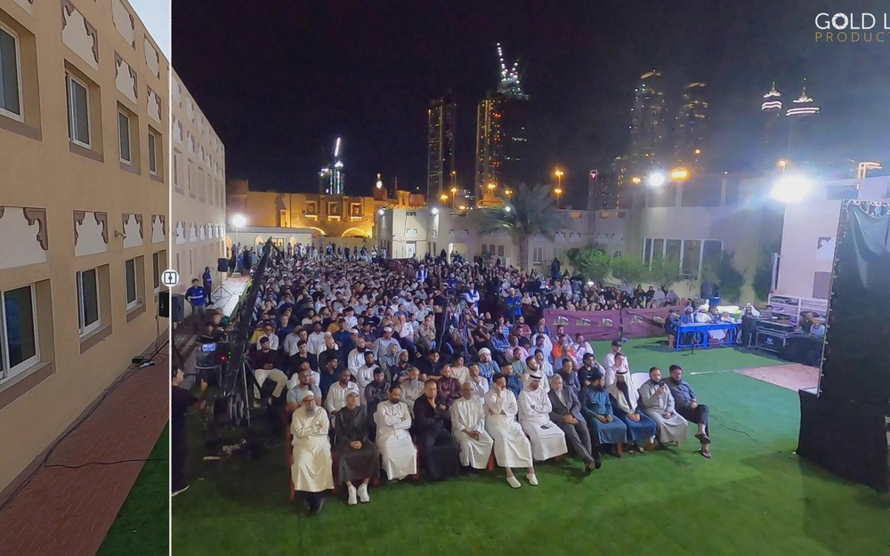
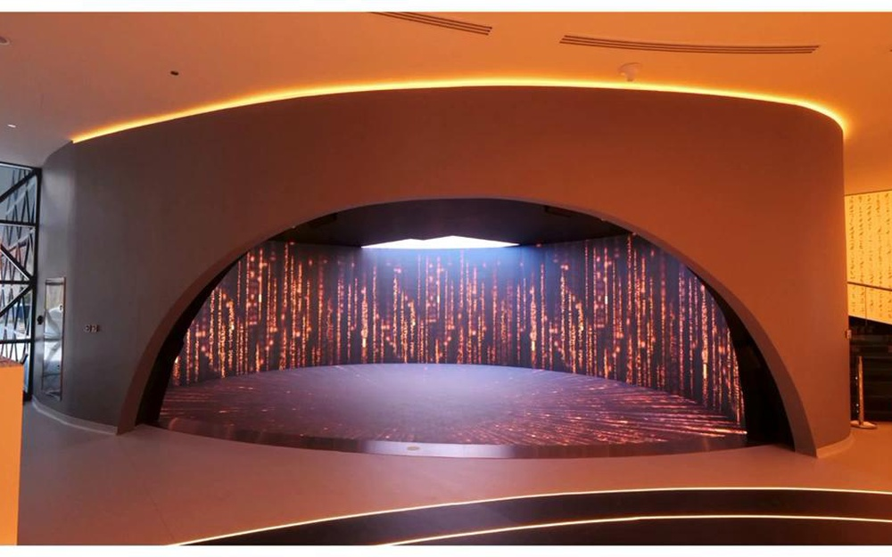
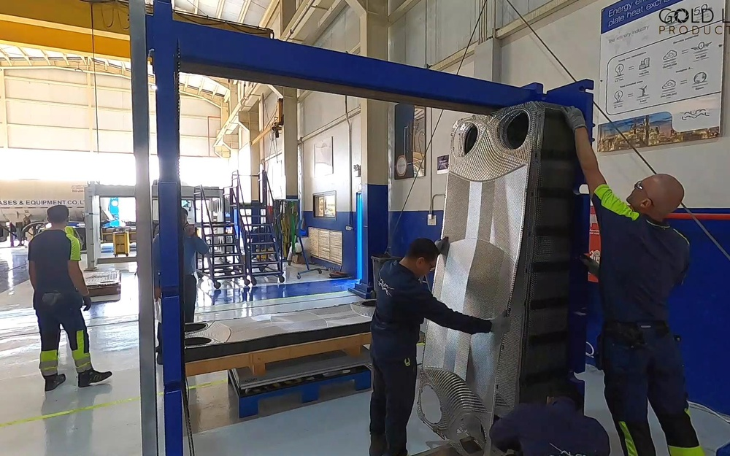
WHO WE ARE
Transforming months of progress into seconds of impact
Gold Line Production is a UAE-based production house specializing in time-lapse documentation, corporate video and broadcast-ready content. From high-rise construction to industrial installations, our team captures the full story of progress with technical reliability and cinematic delivery.
Construction & Real Estate
01
Cross-industry capability
Construction, live events, AV/broadcast installs, industrial works and infrastructure projects — one agile production team.
02
Live Events & Public Gatherings
Self-contained capture hardware
Solar-powered 8MP / 24MP / 48MP cameras built for unmanned, long-duration site documentation.
03
End-to-end delivery
AV / Broadcast / Immersive
From raw on-site capture through editing, branding, progress reels and broadcast-ready final content.
Industrial & Energy
ONE PRODUCTION PARTNER. EVERY INDUSTRY. EVERY MILESTONE CAPTURED.
GOLD LINE PRODUCTION
02

Slide 3

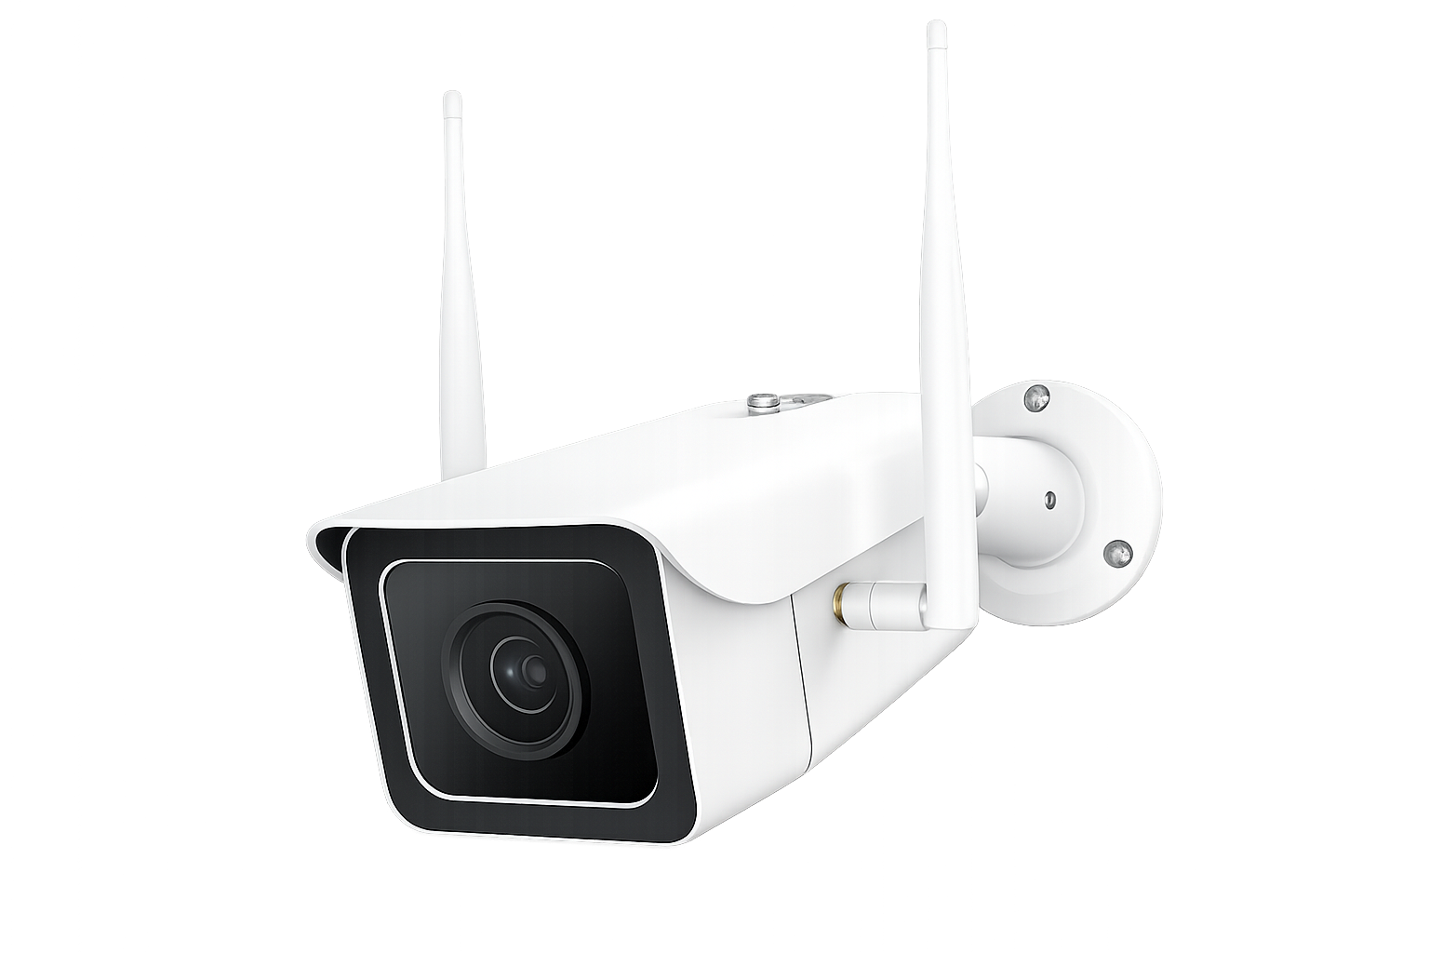
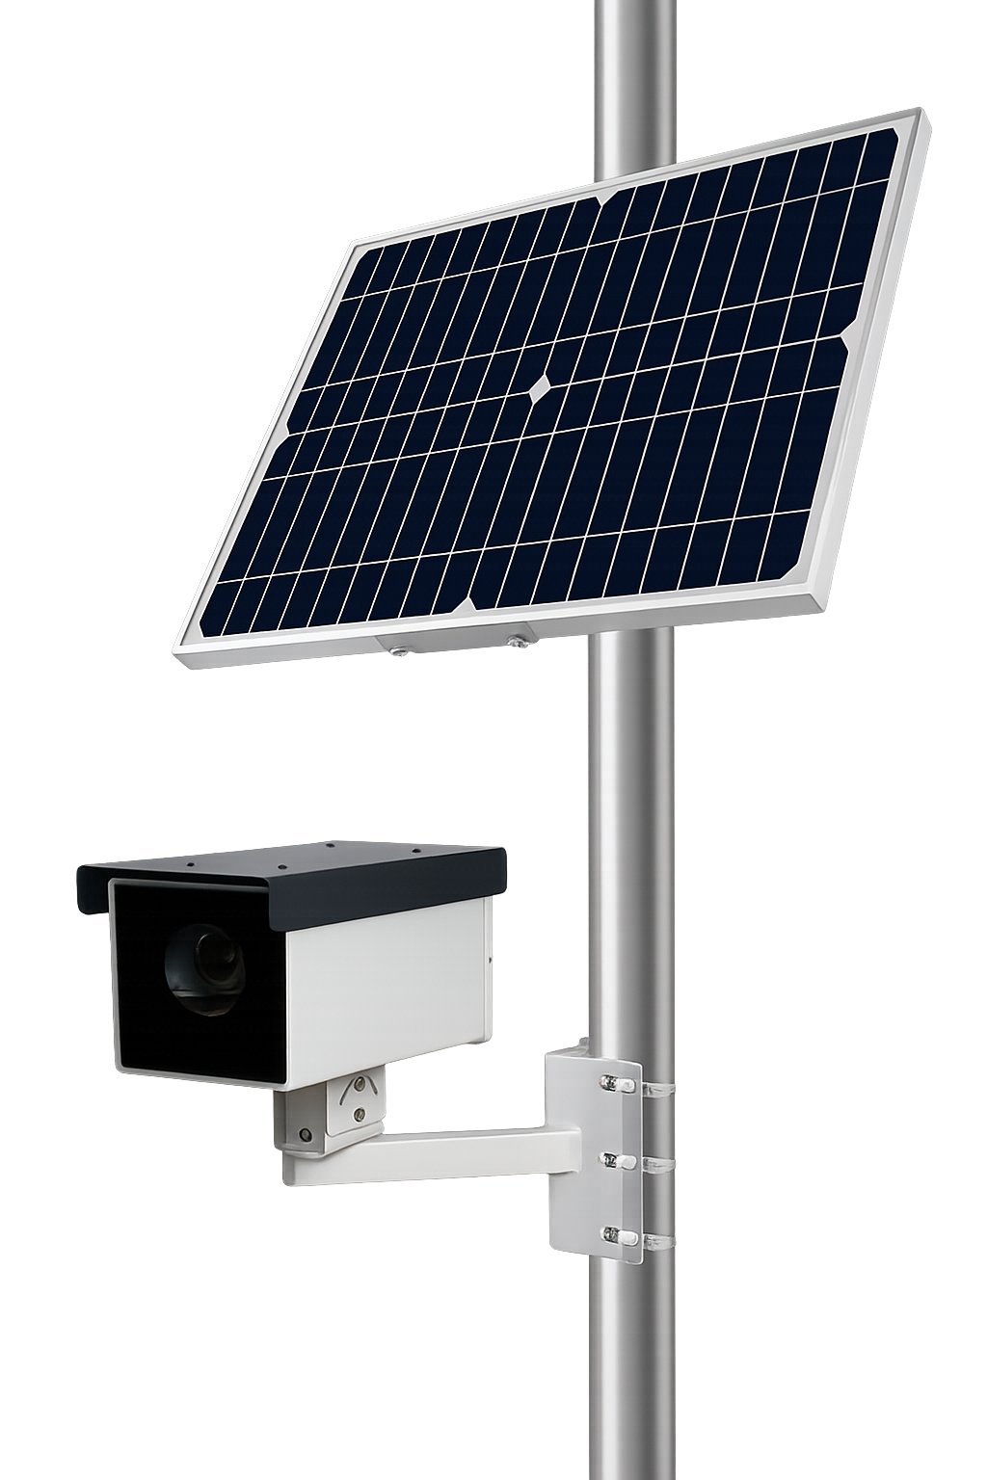
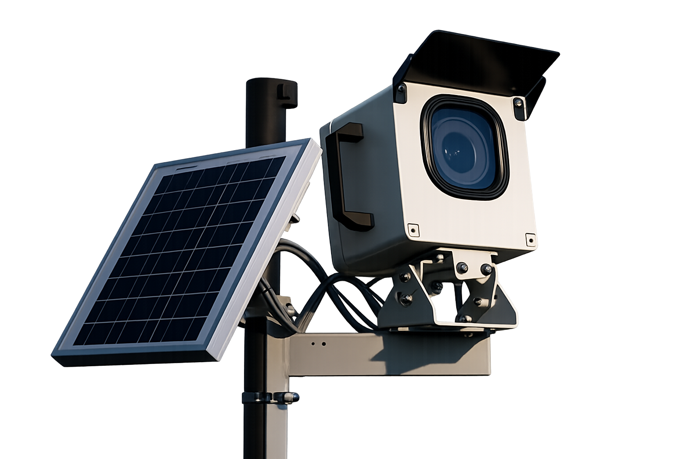
OUR SERVICES
Time-lapse and video production across every project type
A precise service portfolio covering documentation from groundbreak to broadcast.
01
Building Construction Time-lapse
02
Infrastructure Projects Time-lapse
Groundbreak through topping-out, full structural progression for stakeholders and marketing.
Large-scale civil works, roads, structural builds and long-term progress records.
03
Industrial Facilities Time-lapse
04
Renovations & Fit-outs Time-lapse
Plant, warehouse, energy and process facility documentation.
Interior and shell transformations captured from before to after.
05
Live Events & Public Gatherings
06
Corporate Video & Broadcast Production
Setup, rigging, stage build-up and live event coverage from empty venue to audience.
Brand films, event videos and polished, broadcast-ready final content.
CAPTURE HARDWARE
Solar-powered cameras built for unmanned, long-duration capture — no external power required for projects that run for months at a time.
8MP
Reliable documentation
24MP
Higher-resolution capture
48MP
Flagship clarity & zoom
GOLD LINE PRODUCTION
03

Slide 4













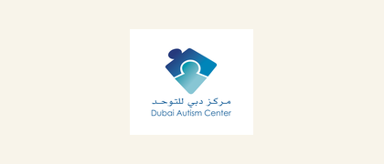


OUR CLIENTS
Trusted by teams across industries
A selection of brands and organizations we have supported with time-lapse documentation, corporate video and production coverage across construction, industrial, healthcare, retail, media and public-facing environments.
Construction
Industrial
Events
Corporate
Project progress records
Equipment & facilities
Setup to live delivery
Brand & broadcast content
Logos shown are property of their respective owners and used with permission to represent past work.
GOLD LINE PRODUCTION
04

Slide 5







LET'S DOCUMENT WHAT'S NEXT
Timelapse · Corporate Video · Broadcast Production — every industry, across the GCC
WEBSITE
www.goldline-production.com
EMAIL
info@goldline-production.com
PHONE
+971 50 677 3781
LOCATION
Dubai, United Arab Emirates — serving the GCC
FOLLOW US
GOLD LINE PRODUCTION
GOLD LINE PRODUCTION
05

