Slide 1
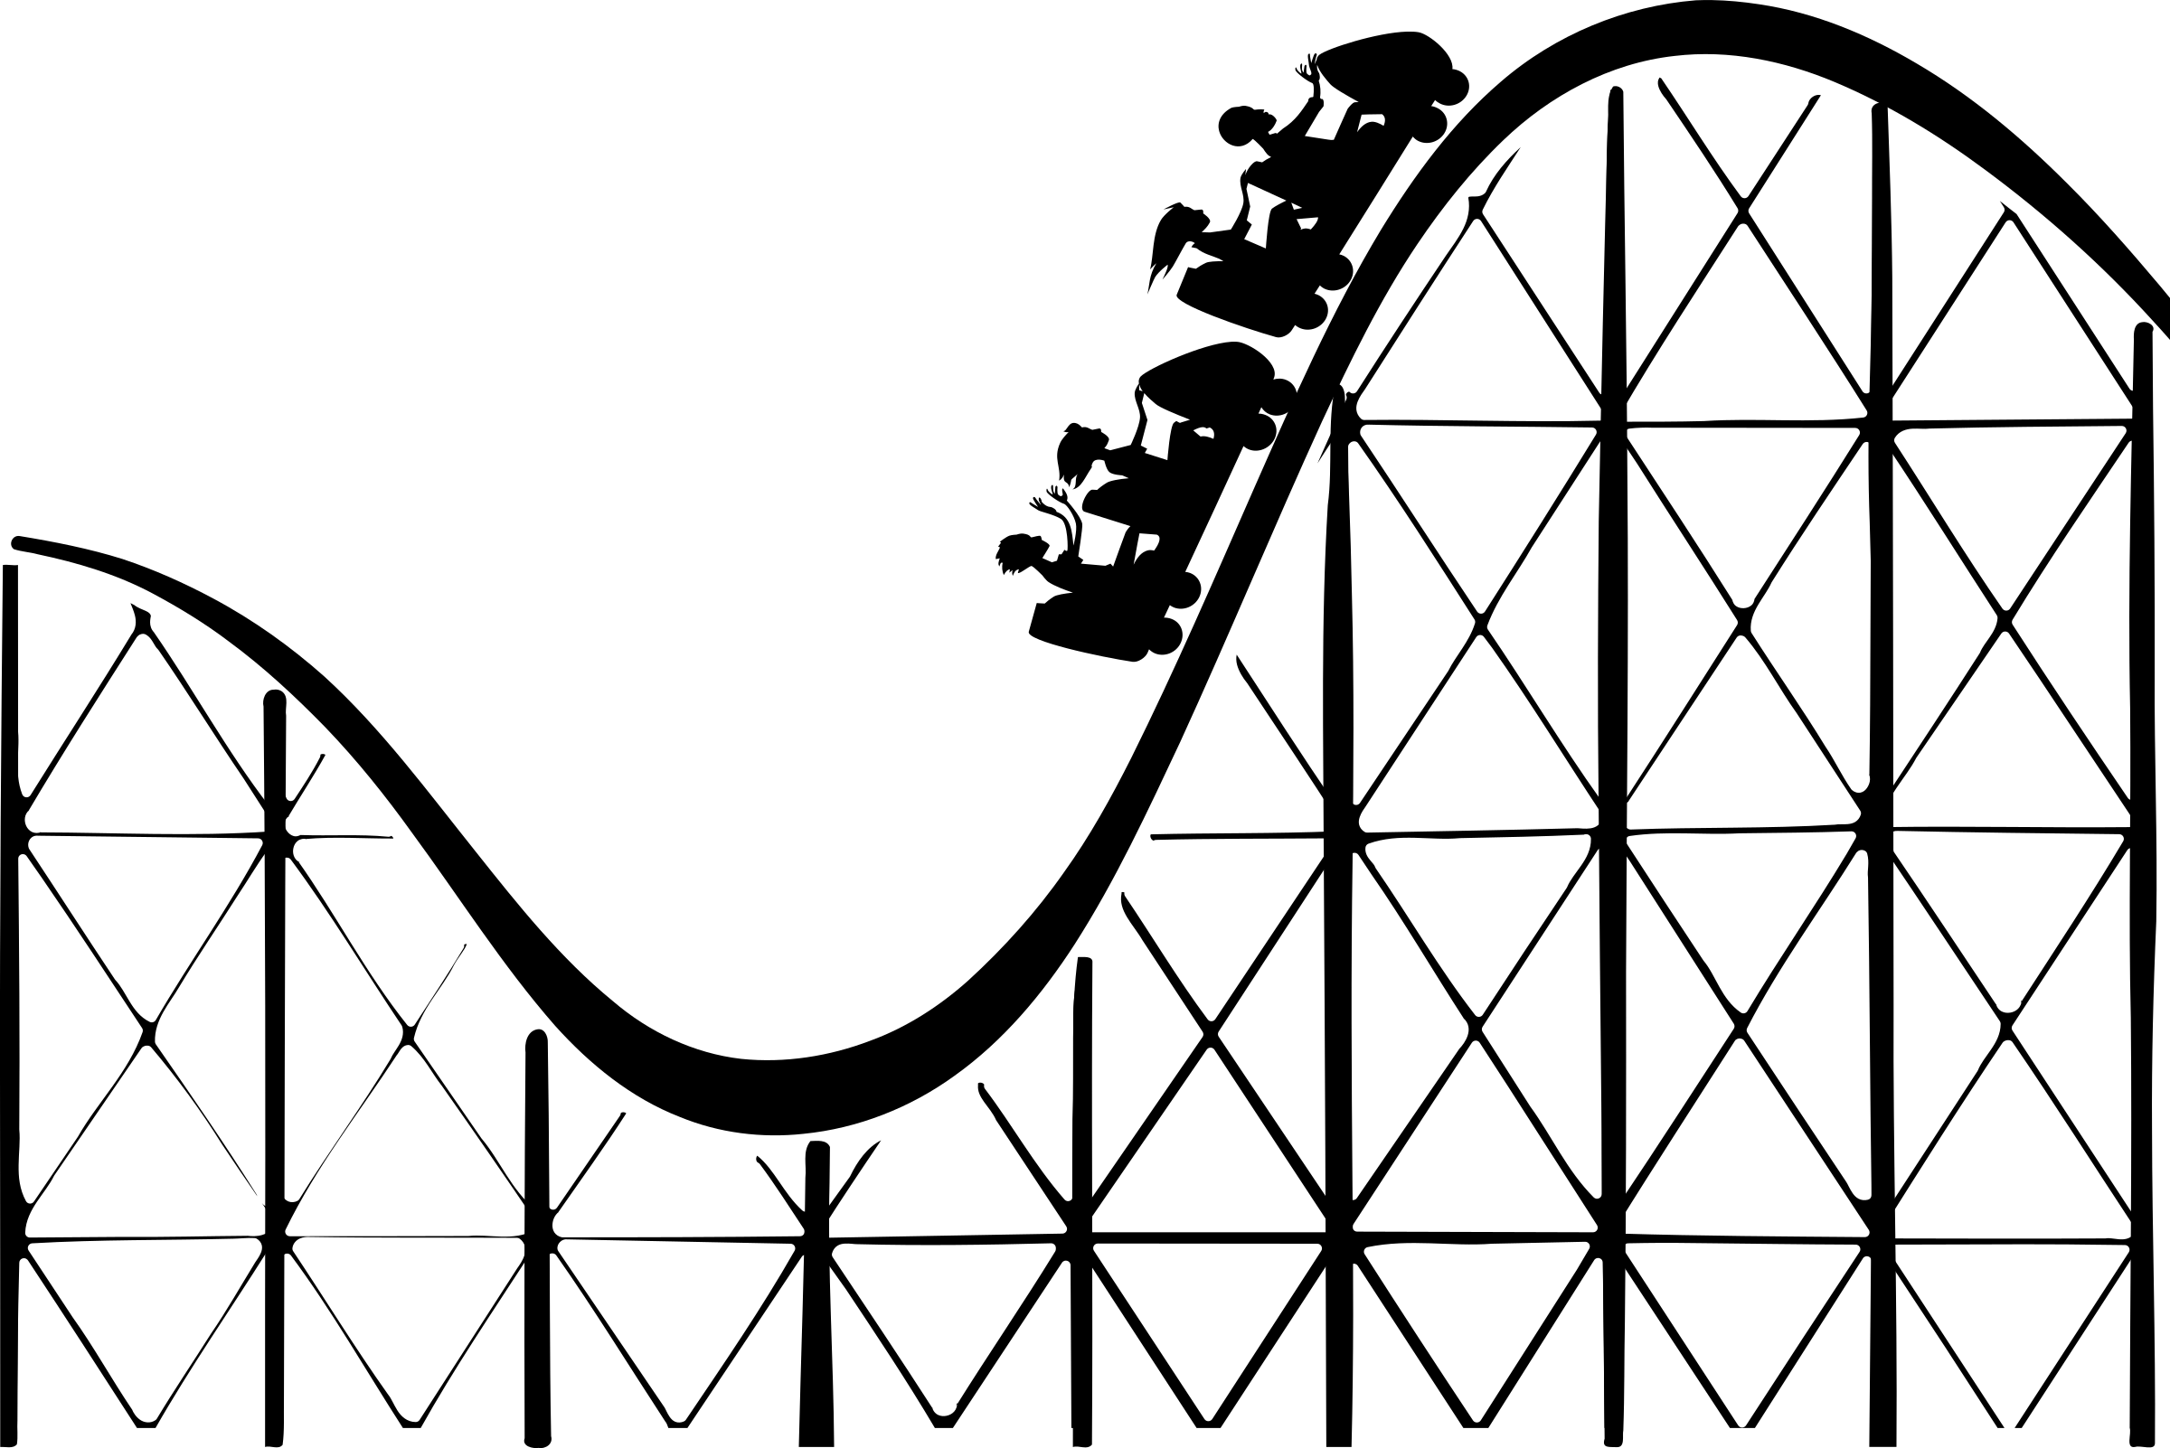


Roller Coaster Track Design Behavioral Experiment
Murtuza Shergadwala
Jitesh H. Panchal
Karthik N. Kannan
School of Mechanical Engineering
Purdue University
Krannert School of Management
Purdue University

Slide 2

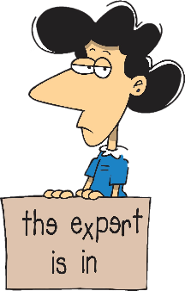

Research Question
We know…
$$≫$$
Expert
Novice
However,
How can we quantify the impact of expertise on solution quality?

Slide 3
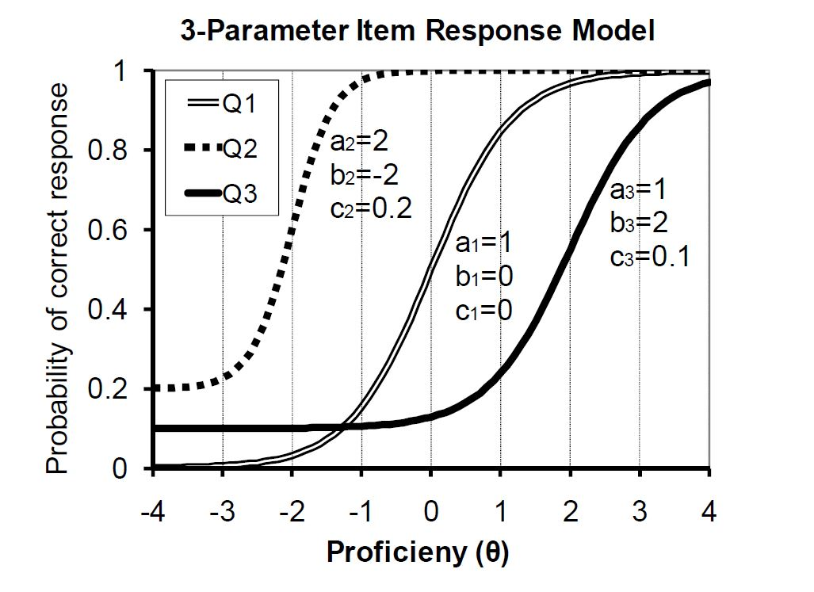

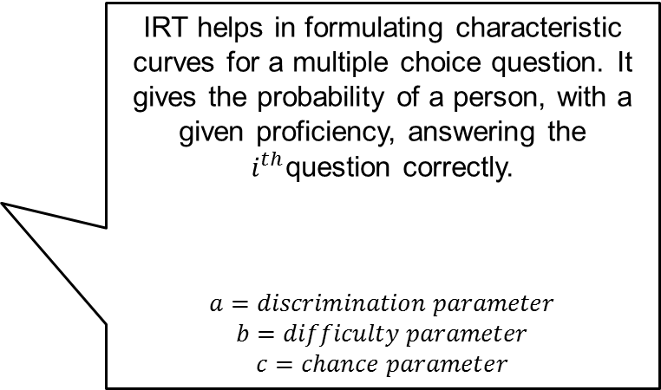
Expertise Quantification: State of the Art
Item Response Theory ( IRT ) is a psychometric assessment model that is based on the idea that “the probability of a correct/keyed response to an item/question is a mathematical function of person and item parameters.”
IRT helps in formulating characteristic curves for a multiple choice question. It gives the probability of a person, with a given proficiency, answering the $i^{th}$question correctly.
$$a=discrimination parameter$$
$$b=difficulty parameter$$
$$c=chance parameter$$
$$P_{i}\left(θ\right)=c_{i}+ \frac{1−c_{i}}{1+exp⁡[−1.7a_{i}\left(θ−b_{i}\right)]}$$
3 Parameter Item Response Model [1]
[1] Wang, J., & Bao, L. (2010). Analyzing force concept inventory with item response theory. American Journal of Physics, 78(10), 1064-1070.

Slide 4
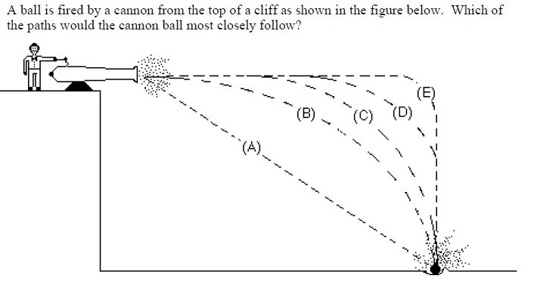
Concept Inventories (CIs)
Concept Inventories ( CIs ) is a form of test, whose scores provide a quantification of an examinee’s knowledge about a set of concepts. The Force Concept Inventory ( FCI ) [2] is one such CI that tests Newtonian concepts of force.
A sample question from the Force Concept Inventory. [2]
[2] Hestenes, D., Wells, M., & Swackhamer, G. (1992). Force concept inventory. The physics teacher, 30(3), 141-158.

Slide 5

Reliability of the CI Scores as an Expertise Metric
The IRT can be used to validate the CI. The work of Wang and Bao[1] utilize the FCI as an example CI and validate the FCI using IRT.
$$θ≈0.147S−2.324$$
The empirical equation that quantifies the relationship between proficiency from IRT and the FCI score
[1] Wang, J., & Bao, L. (2010). Analyzing force concept inventory with item response theory. American Journal of Physics, 78(10), 1064-1070.

Slide 6
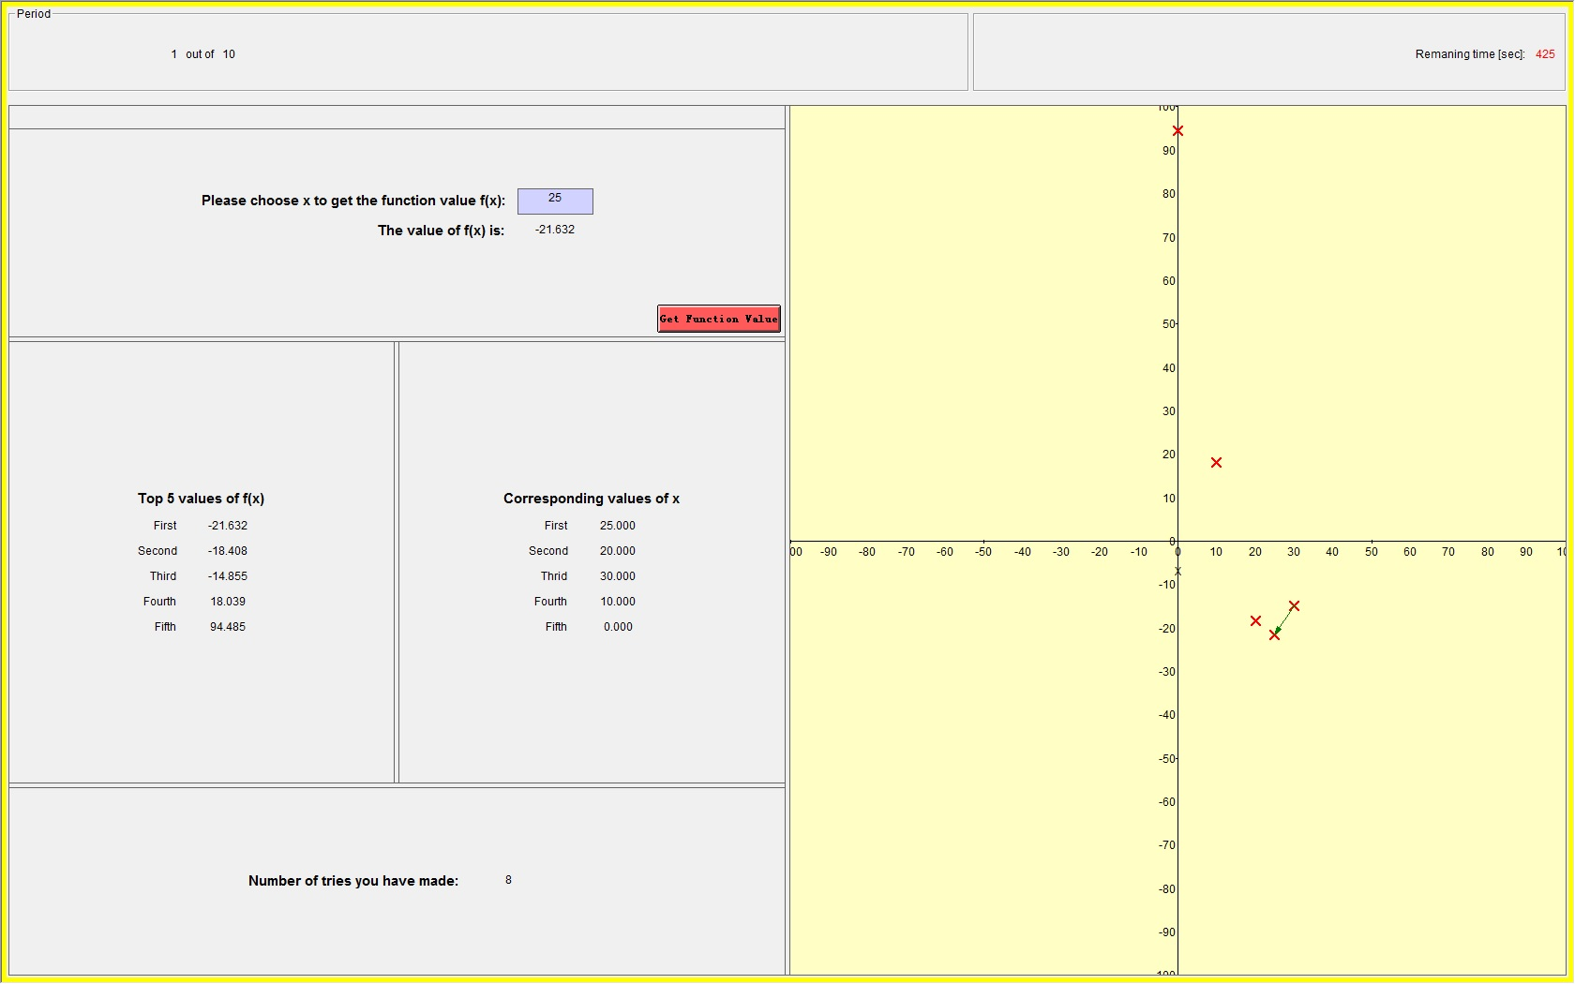






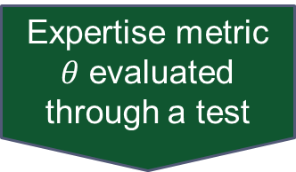
Why a Behavioral Experiment?
The state of the art theories help validate the expertise metric. However, the behavioral experiment will help verify the utilization of the expertise metric for quantification of expertise impact on quality.
Expertise metric $θ$ evaluated through a test
Correlation between $θ$ and performance
A roller coaster track design behavioral experiment
$$N$$
$$mg$$
How do we correlate design performance with expertise metric $θ$?

Slide 7
Why a Track Design Behavioral Experiment?
As the expertise metric is based on the knowledge of Newtonian concepts of Force we need a design task that encapsulates the tested concepts. We thus formulate a track design behavioral experiment.
$$N$$
$$mg$$
How do we correlate design performance with expertise metric $θ$?

Slide 8
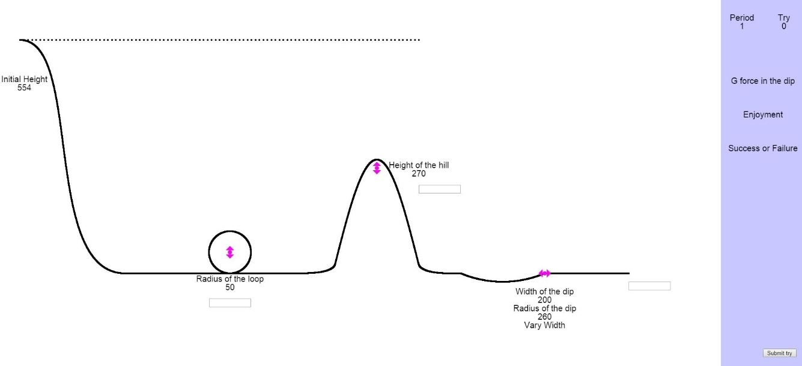
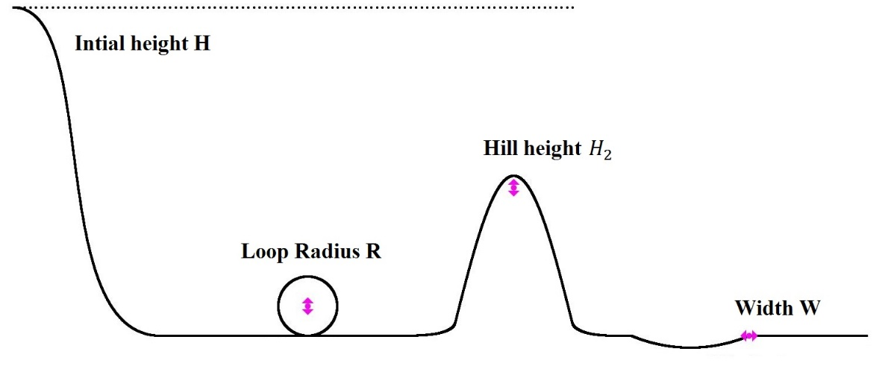
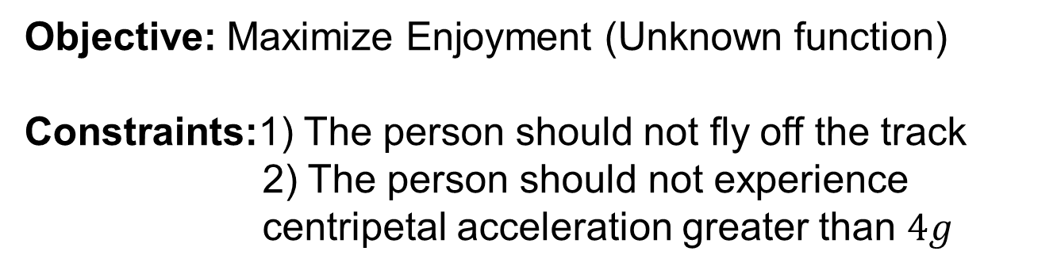
Behavioral Experiment: Track Design Game
Objective: Maximize Enjoyment (Unknown function)
Constraints:1) The person should not fly off the track
2) The person should not experience centripetal acceleration greater than $4g$
The game interface

Slide 9
Experiment Procedure
Prescreening
46 Purdue University students
Take the FCI
Play the game
Survey

Slide 10

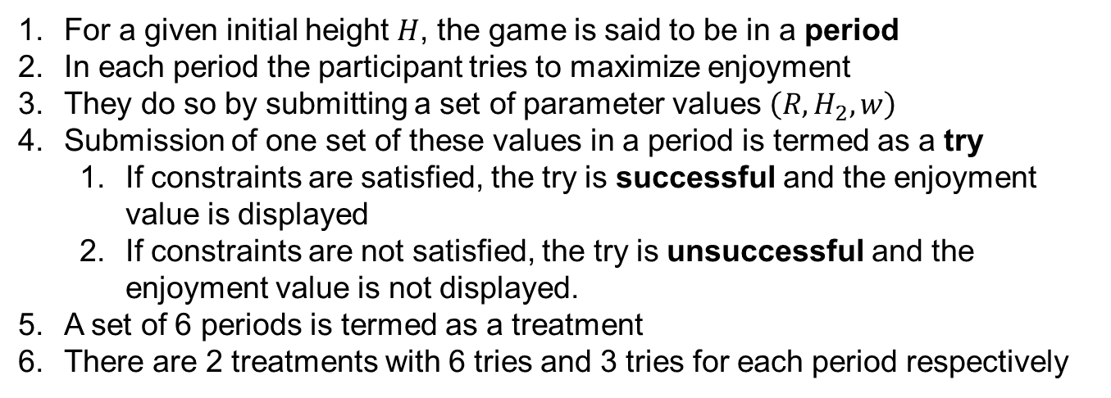
Game Details
For a given initial height $H$, the game is said to be in a period
In each period the participant tries to maximize enjoyment
They do so by submitting a set of parameter values $\left(R, H_{2}, w\right)$
Submission of one set of these values in a period is termed as a try
If constraints are satisfied, the try is successful and the enjoyment value is displayed
If constraints are not satisfied, the try is unsuccessful and the enjoyment value is not displayed.
A set of 6 periods is termed as a treatment
There are 2 treatments with 6 tries and 3 tries for each period respectively
Treatment
2 treatments
Period
6 periods
Initial Height $H$randomly generated
successful
Try
3 tries or 6 tries per period
unsuccessful

Slide 11

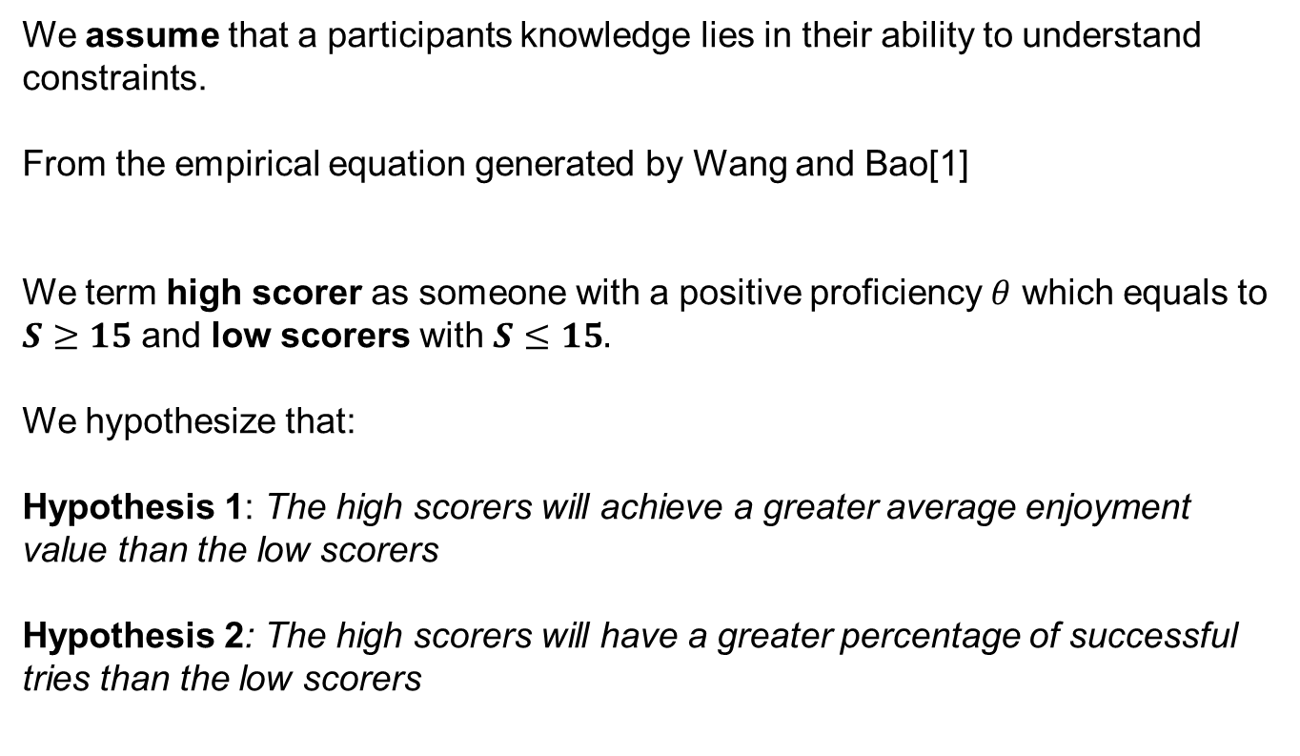
Hypothesis formulation
We assume that a participants knowledge lies in their ability to understand constraints.
From the empirical equation generated by Wang and Bao[1]
We term high scorer as someone with a positive proficiency $θ$ which equals to $S≥15$ and low scorers with $S≤15.$
We hypothesize that:
Hypothesis 1: The high scorers will achieve a greater average enjoyment value than the low scorers
Hypothesis 2: The high scorers will have a greater percentage of successful tries than the low scorers
$$θ≈0.147S−2.324$$
[1] Wang, J., & Bao, L. (2010). Analyzing force concept inventory with item response theory. American Journal of Physics, 78(10), 1064-1070.

Slide 12


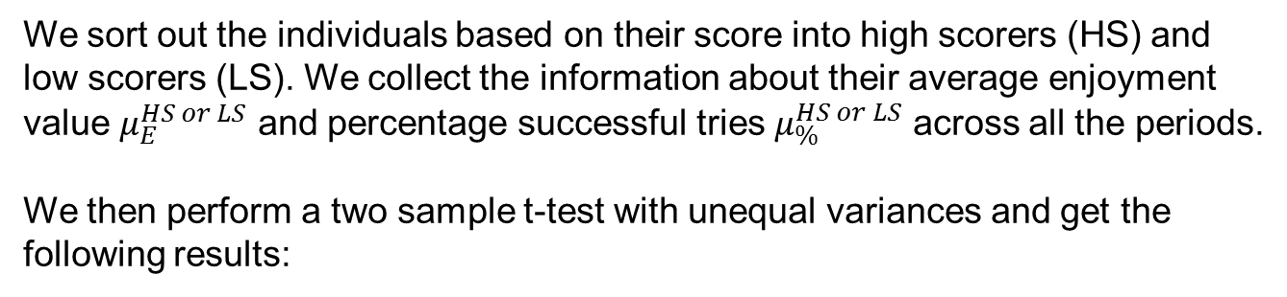
Results
We sort out the individuals based on their score into high scorers (HS) and low scorers (LS). We collect the information about their average enjoyment value $μ_{E}^{HS or LS}$ and percentage successful tries $μ_{\%}^{HS or LS}$ across all the periods.
We then perform a two sample t-test with unequal variances and get the following results:
Hypothesis 1: The high scorers will achieve a greater average enjoyment value than the low scorers
Hypothesis 2: The high scorers will have a greater percentage of successful tries than the low scorers
As the p-values are lower than the level of significance ($α=0.05$) we reject the null for both the hypothesis.

Slide 13
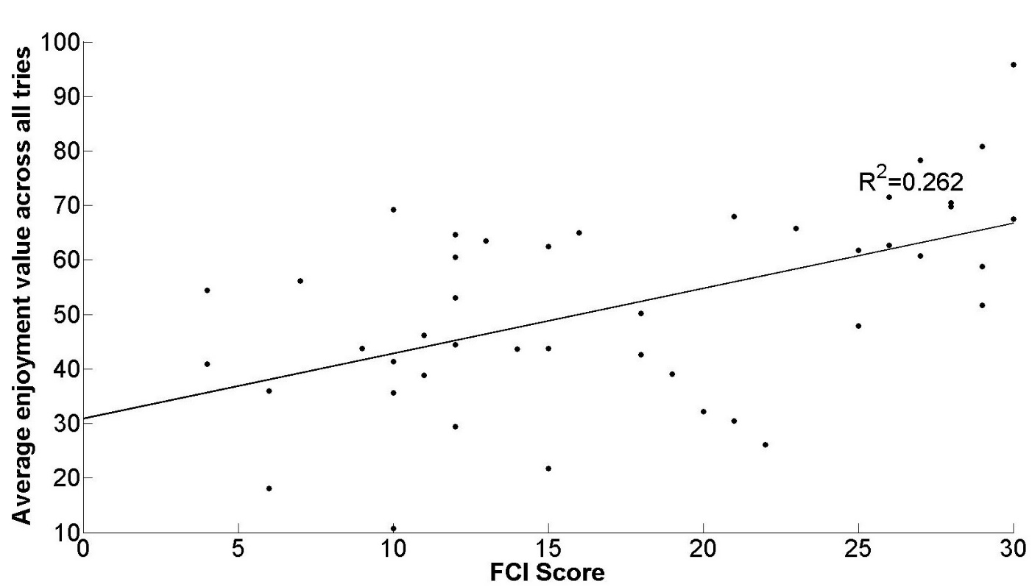
Results
We perform a single predictor linear regression between FCI score S and average enjoyment value achieved.
Relationship between Enjoyment $(E)$ and FCI score $(S)$ modeled as
$$E=β_{0}+β_{1}S$$

Slide 14



Observations
We had two treatments with 6 tries and 3 tries respectively per period as we wanted to observe behavioral differences if any between the high scorers and low scorers as solution quality is also affected by the number of tries.
Treatment
$$Quality$$
Period
$$f(efforts, expertise)$$
Try
$$θ$$
We observed that high scorers maintained their average enjoyment values irrespective of the treatments whereas low scorers had a lower average enjoyment value with lesser tries.

Slide 15


Future Work
What is the impact of expertise in crowdsourcing tournaments?
How do we model the strategic decision making process?
Task 1
Task 2
Quantifying expertise impact on quality
Modeling decision making process of the individuals
Approach
Game Theory
Behavioral Experimentation
Task 4
Task 3
Utilizing game theoretic models with behavioral experimentation
Understanding the impact of strategic decision making

