Slide 1
DCC’16 Workshop on Games for Design Research and Education
Orbital Federates
Paul T. Grogan, Ph.D.
Assistant Professor
School of Systems and Enterprises

Slide 2
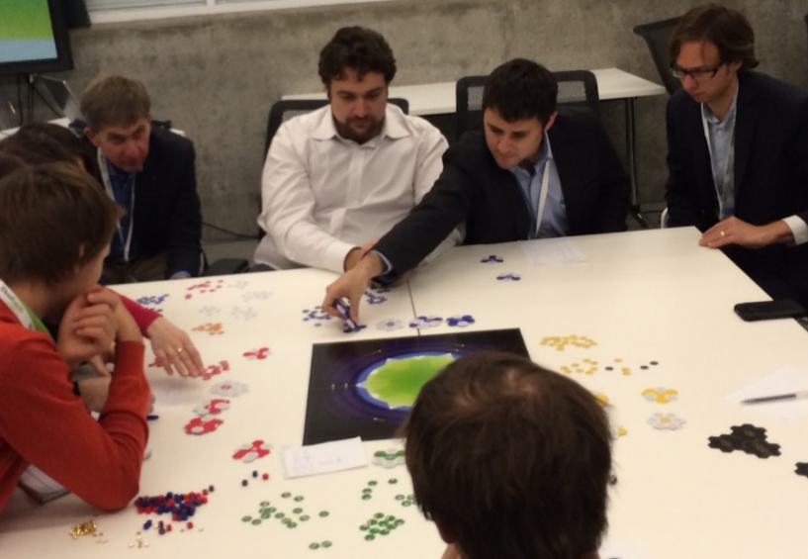
Orbital Federates
Purpose: exploration (and teaching)
Context: federated satellite systems (FSS)
Interactive board game
Low cost, simplified model
Operate satellites for profit
Compete or collaborate
Observe in game-play:
How and why do players choose to collaborate?
What mechanisms or incentives improve collaboration?
P.T. Grogan and O.L. de Weck (2015). “Interactive Simulation Games to Assess Federated Satellite System Concepts,” 2015 IEEE Aerospace Conference.

Slide 3
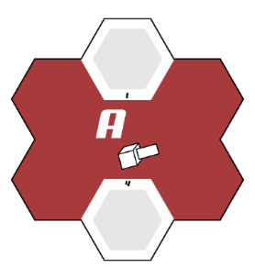

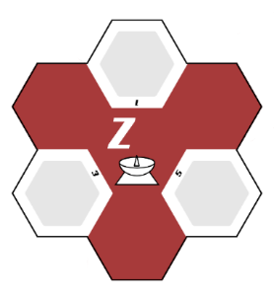

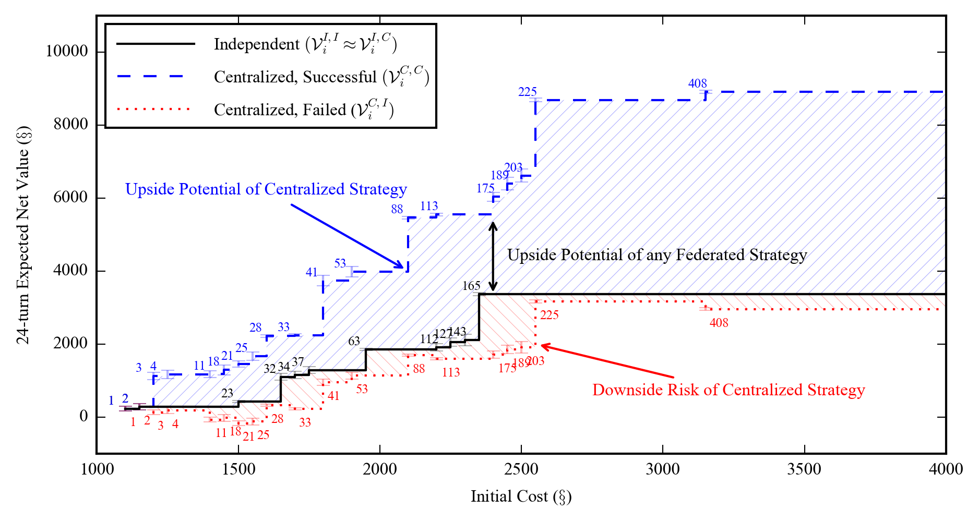




Orbital Federates Simulation
Demonstration of multi-actor system value model
P.T. Grogan et al. (2016). “Bounding the Value of Collaboration in Federated Systems,” 2016 IEEE International Systems Conference.

Slide 4
Paul T. Grogan
pgrogan@stevens.edu

