Slide 1
Programming in C#
C.K.Leng

Slide 2
Course URL
https://CSCourses.azurewebsites.net/MOC55339

Slide 3
Class Schedule
Duration: 5 Days
Training Hour: 9am ~ 5pm
Short Breaks:
Morning: 10:30am~10:45am
Afternoon: 3:30pm~3:45pm
Lunch Break: 12:30pm~1:30pm (Friday 2:30pm)

Slide 4
Your Instructor
LENG Chee Kong
ckleng1964@gmail.com
019-21333329 (No call please. WhatsApp or SMS Only)
https://my.linkedin.com/in/chee-kong-leng/en-us

Slide 5
What is .NET Framework
Operating Environment (OE)
Win3.1
.NET
Operating System (OS)
DOS
Windows
.NET

Slide 6
What is .NET Framework
WPF
WF
WCF
Card Space
FC
ASP.NET
ADO.NET
CTS
CLR
Debugger
JIT
Security Manager
GC
OS
HARDWARE

Slide 7
What is .NET Framework
VB.NET
C++
C#
F#
C
C
C
C
CIL/MSIL
CLR
JIT
HARDWARE
Native Code

Slide 8
Why .NET Framework?
All technologies seamlessly integrated
More enhancement to existing technologies
Support all range of application types
Cross platform
Many supporting languages, also enable hybrid development
OOOS (Object-Oriented Operating System)

Slide 9
From Modular to Object-Oriented
Software Crisis
C++
Information Hiding
“Do the right things” Vs “Do the things right”
The Software Complexity grow until we can’t manage
Programming in the Large
Increase Likelihood of success
WHAT
HOW

Slide 10
What is Object?
Object can be
Physical (Tangible)
Logical (Intangible)
From another perspective, Object can be
Simple
Complex
Depends on Context
Vary by Perception
Every object must has Unique Identity

Slide 11



Aspects of Object
Attributes
Name=Trump
Gender=Male
Age=74
Height=6’3”
Wight=243Pound
Attribute
Values
Stingy
Hot Temper
Behavior
Adjective
State
Examples:
Rich/Poor
Young/Old
Noun
President of United State
Father of Ivanka Trump
Relationship

Slide 12
Classification and Encapsulation
Concept
Language as Tool
Vocabulary of language provides symbolic representation of Concepts
Classification = Process of grouping objects by comparing their common aspects to form concepts about them.
Classification
Attribute Set
Attribute Value/State
Relationship
Behavior
Concept
Encapsulation
Class
Behavior
Name
Operation (WHAT)
Attributes
Method
(HOW)

Slide 13
Abstraction
Model represents the understanding of developer about the problem domain.
Do we need to capture every single aspects of objects in to the model?
Abstraction = The process of focusing on essential but ignoring non-essential aspects during modeling process.

Slide 14



Abstraction
Constraints that stop you from fully understand the objects:
Question: Do you really need to understand everything about the objects in order to solve problem?
Answer: No. We just need to understand sufficiently
Definition: The process of simplify the real world problem by focusing on essential aspects and ignoring the rest in order to achieve certain objective
Skill Set
Time
Budget
Abstraction

Slide 15

Modeling
Encapsulation
Model
Problem Domain
+
Abstraction

Slide 16
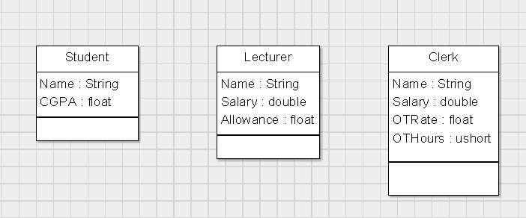
Example Modeling: University
Initial Model:
s1
s2

Slide 17
Modeling Refinement: Generalization
Focus on those common aspects in model and Refactor-Up:

Slide 18
Modeling Refinement: Generalization
Focus on those common aspects in model and Refactor-Up:

Slide 19
Modeling Refinement: Specialization
How to justify new specific classes generated?
Three Types of specialization:
Restriction (-)
Extension (+)
Overriding (*)
Polymorphism

Slide 20
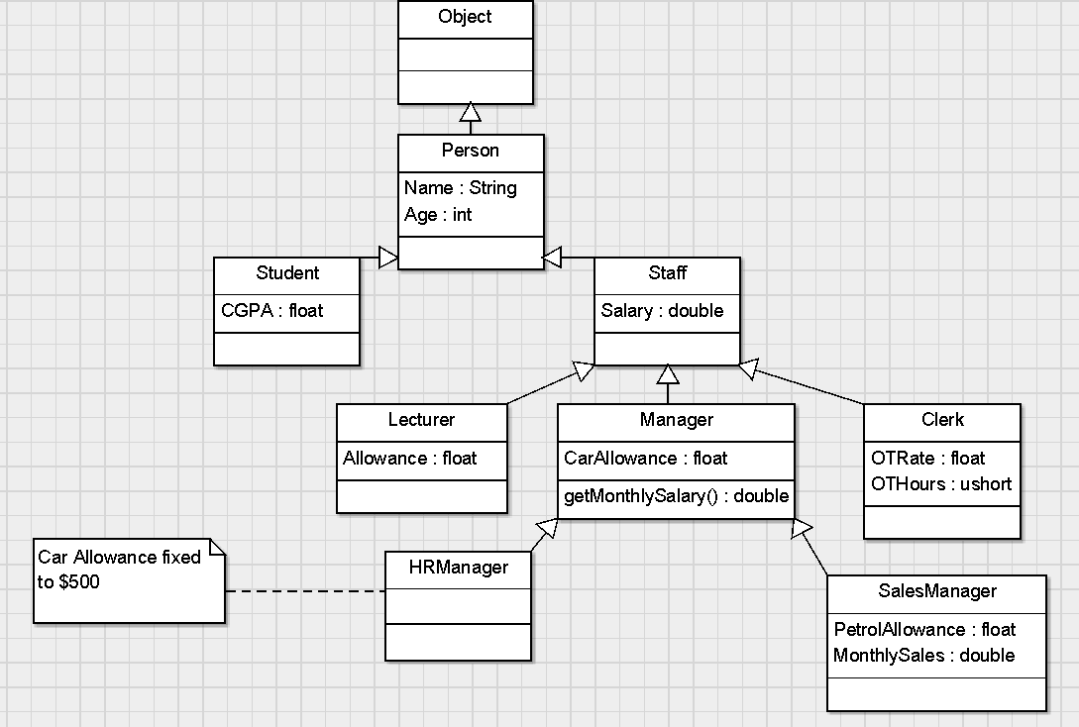
Model after refinement

Slide 21
Relationships
Following are different types of relationship
IS-A (or Kind-Of)
Part-Of (Aggregation)
Part-Of (Composition)
Association
Dependency
Realization
In this course, we only cover the first 4 types

Slide 22
Relationship: Cardinality/Multiplicity
1 to 1
1 to Many
Many to 1
Many to Many

Slide 23
Aggregation Vs Composition
Both are Part-Of relationship
Under Composition, component can’t exists alone without the composite.
Composition is stronger form of Part-Of
Example:
Car
4
Wheel
OR
Car
4
Wheel
Car Sales System
Car repair Workshop

Slide 24
How to identify relationship type?
Given class X relate to class Y with relation R. How to determine type of R?
Steps:
Test for IS-A relationship
Test for Part-Of relationship
Define Association
Client
order
Product

Slide 25
Test for Is-A relationship
Answer both of the following questions:
Is X a Y?
Is Y a X?
Both questions will provide result either in True or False.
Is-A exists only when only one of the question is True.
Next, you have to determine which class is more general and which is more specific
Cardinality is NOT applicable to Is-A relationship

Slide 26
Test for Part-Of relationship
Answer both of the following questions:
Is X part-of Y?
Is Y part-of X?
Both questions will provide result either in True or False.
Part-Of exists only when one or both of the questions are True.
Next, you have to determine which class is composite and which is component.
The Cardinality should be either 1-to-1 or 1-to-Many. If you encountered the cardinality is Many-to-Many, It is NOT Part-Of, should be Association instead.

Slide 27
Define Association
Can be directional or bidirectional
Can use Association Name or Role
Have to decide Cardinality

Slide 28
Roles
Use Roles?
Student
Learner
Teacher
Lecturer
Mentee
Mentor

Slide 29
Your Challenge
Given the following, can you determine the type of relation for R?
Circle
Ellipse
(Oval)
R

Slide 30
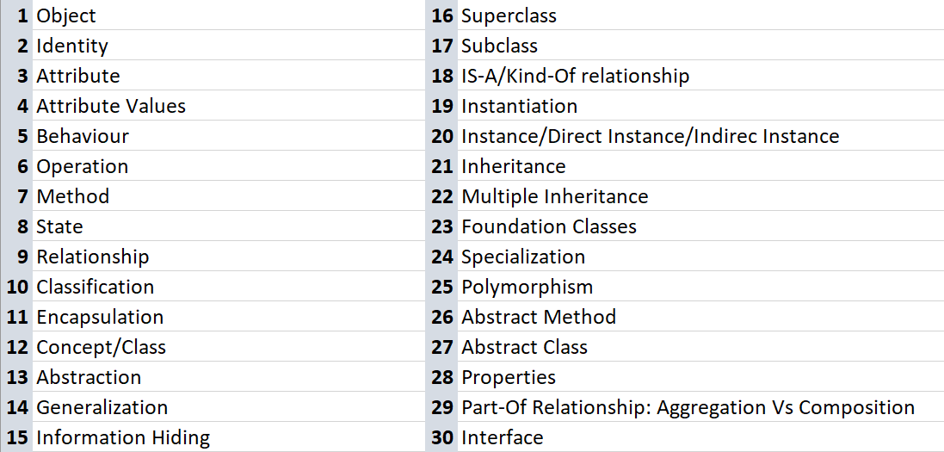
OO Terms

Slide 31
Value Vs Reference Types
class Circle{
}
Circle c1 = new Circle(100);
Circle c2 = c1;
Circle
c1
r=100
c2

Slide 32
Value Vs Reference Types
struct Circle{
}
Circle c1 = new Circle(100);
Circle c2 = c1;
int x = 100;
int y = x;
Circle
c1
r=100
c2
r=100

Slide 33
Value Vs Reference Types
class X{
int V
}
X a = new X(5);
X b = new X(5);
X
a
b
V=5
V=5

Slide 34
Bubble Sort
3
5
1
4
6
2
lhs
rhs

Slide 35
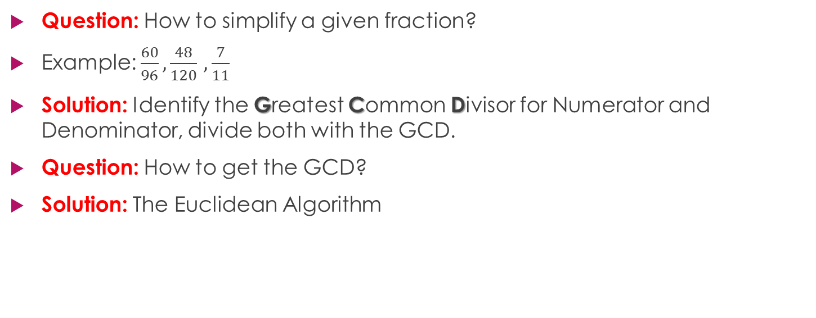
Fraction Challenge
Question: How to simplify a given fraction?
Example: $\frac{60}{96},\frac{48}{120}$ $,\frac{7}{11}$
Solution: Identify the Greatest Common Divisor for Numerator and Denominator, divide both with the GCD.
Question: How to get the GCD?
Solution: The Euclidean Algorithm

Slide 36
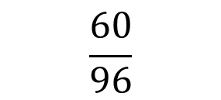
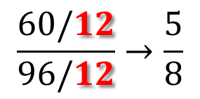
Euclidean Algorithm
$$\frac{60}{96}$$
X
Y
96
60
60
36
$$\frac{60/12}{96/12}→\frac{5}{8}$$
36
24
24
12
12
0
GCD(96,60)

Slide 37
Isolated Island
class X{
String Name;
X Sibling
}
X
a
b
A
B
C
D
c

Slide 38
Types
Type
Complex
Homogeneous
Heterogeneous
Simple
Array
Array of Array
Jagged Array
Single-Dimensional
Multi-Dimensional

