Slide 1
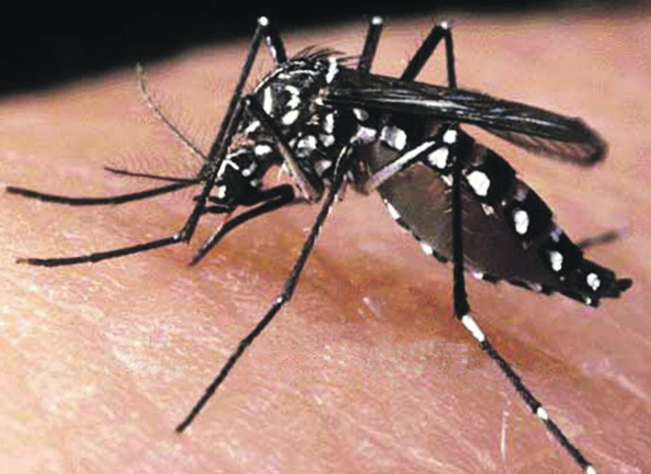
Challenge: Combating Zika and Future Threats

Slide 2
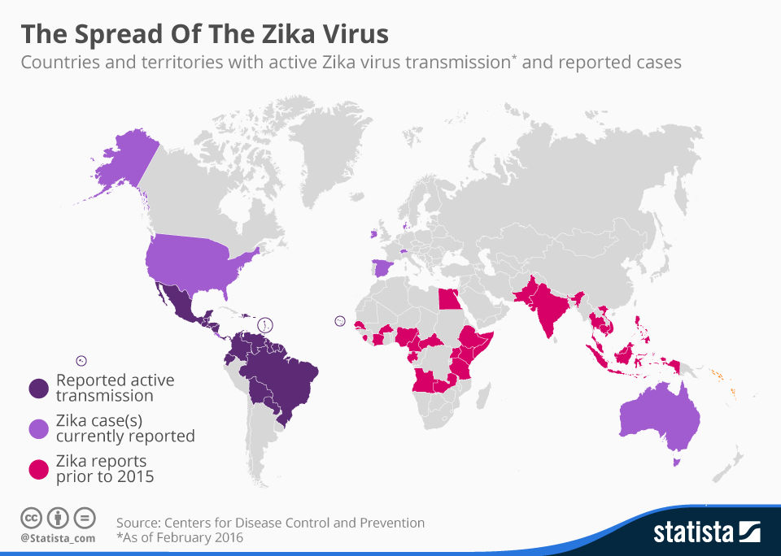
Notes:
What is Zika? Why is it important?
Zika is a disease caused by the Zika virus, which is spread to people primarily through the bite of an infected Aedes species mosquito
[Other modes of transmission such as blood transfusion or sexual transmission are being investigated]
The most common symptoms of Zika are fever, rash, joint pain, and conjunctivitis (red eyes)
According to WHO(World Health Organization) Zika is projected to infect as many as four million people by the end of this year

Slide 3
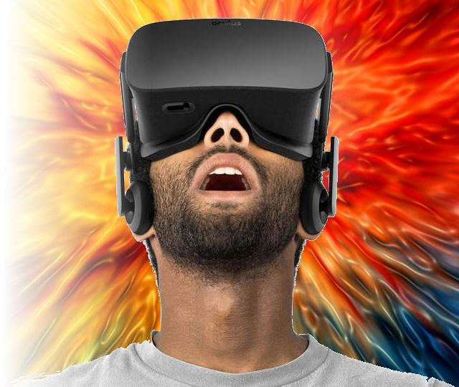
Proposed Solution
Use mixed reality to educate travelers on Zika causes and prevention techniques
Notes:
We believe that mixed reality is an effective format to help travelers understand:
the types of places where Zika-infected mosquitoes live, and
effective Zika prevention techniques.
We have created a mixed reality experience with two modules addressing the points above:
Module 1 allows users to experience four common environments where Zika-infected mosquitoes live, and has been augmented to highlight specific “danger zones” to avoid.
Module 2 introduces users to three prevention techniques and illustrates proper implementation.

Slide 4
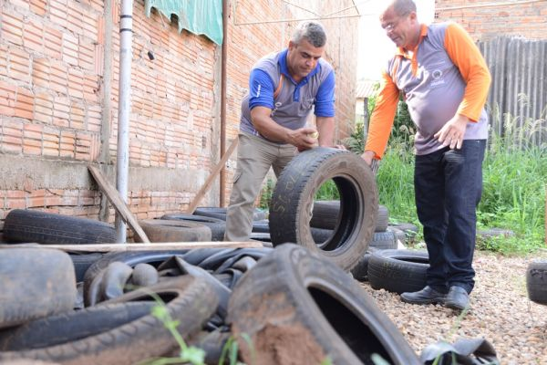
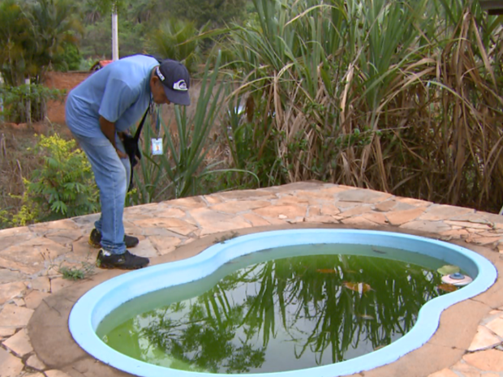
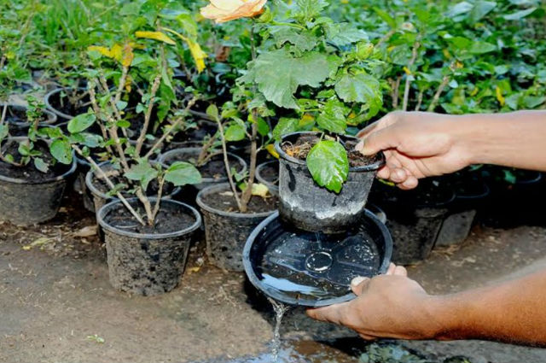
Demo: How to avoid the Zika Virus
VR demo showing (x location)
Notes:
Mosquito likes to lay eggs in and around standing water
vases
pet water bowls
flowerpot saucers
discarded tires
buckets
pool covers
...
Aedes mosquitoes usually bite during early morning

Slide 5
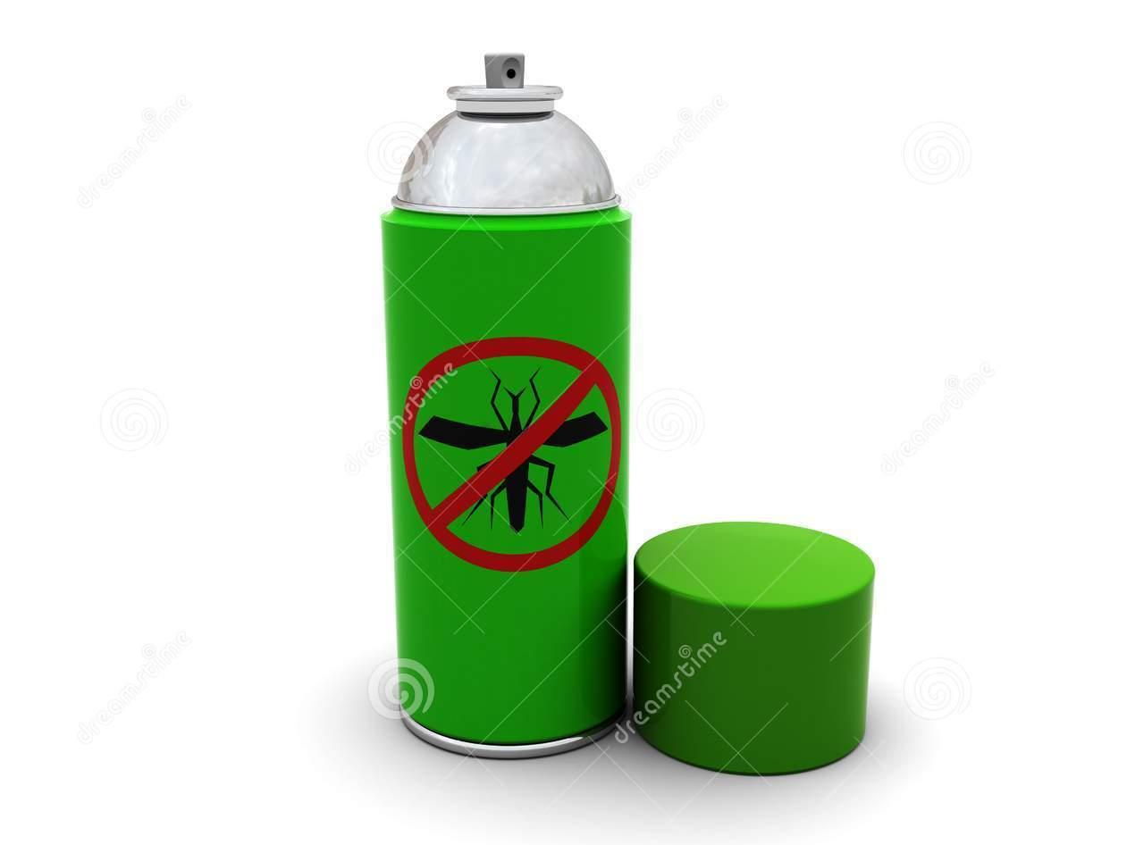
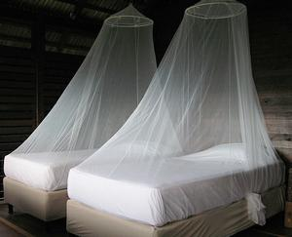

Demo: What you can do to prevent the Zika Virus
VR demo showing a bednet
Notes:
Protection against mosquito bites is a key measure to prevent Zika virus infection
[There is currently no vaccine available and no specific treatment]
What you can do:
Do not leave standing water
Use larvicides to treat large containers of water
Bednets
Screens
Use an outdoor flying insect spray

Slide 6
User Feedback
Textual information is helpful in augmented reality
Image quality is very important in VR
Test VR image effects early (quite different from web images)
Animation (e.g. mosquitos flying ) adding to VR images can be effective
Future Effort
Crowdsource images
Improve prorotypes and test on-site
Create suggestion for travelers
Notes:
Suggestion for Travelers
Long sleeve shirts
Cover Exposed Skin: wear long-sleeved shirts, long pants, socks, and a hat
Bednets: buy, or ask hotel
Use Mosquito repellent
Use EPA-registered insect repellents that contain at least 20% DEET ([TODO-Whats is EPA and DEET??])
If you are also using sunscreen, apply it first, let it dry, and then apply repellent
Do not spray repellent on the skin under clothing

Slide 7
Questions?

