Slide 1
Persona- apprentice, visionary, helper, doer
#research at Code for SF
Larry, Jacob, Jaoyi, Carla, Jamie, John-Michael

Slide 2
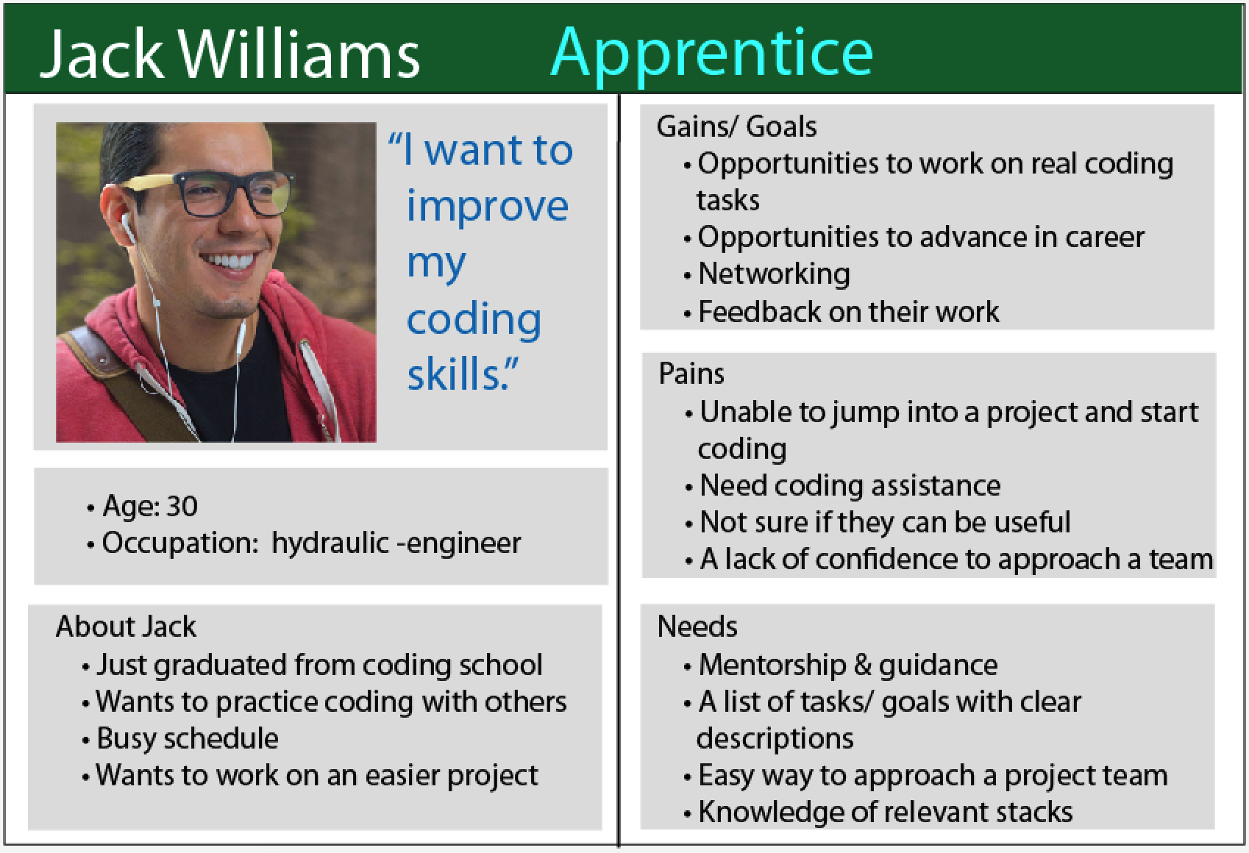

Slide 3
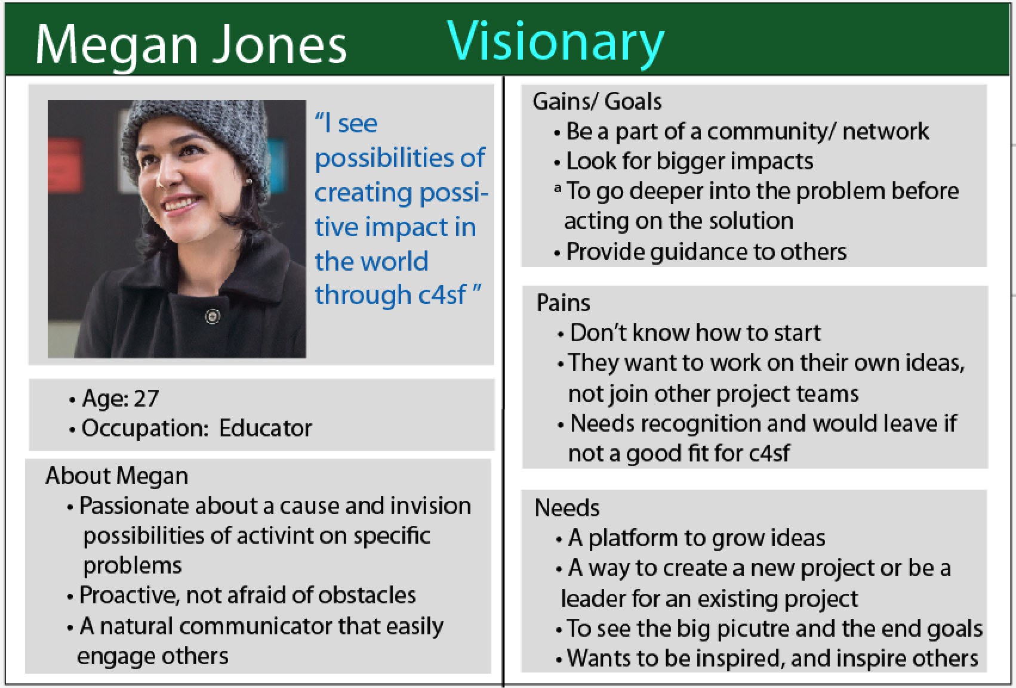

Slide 4
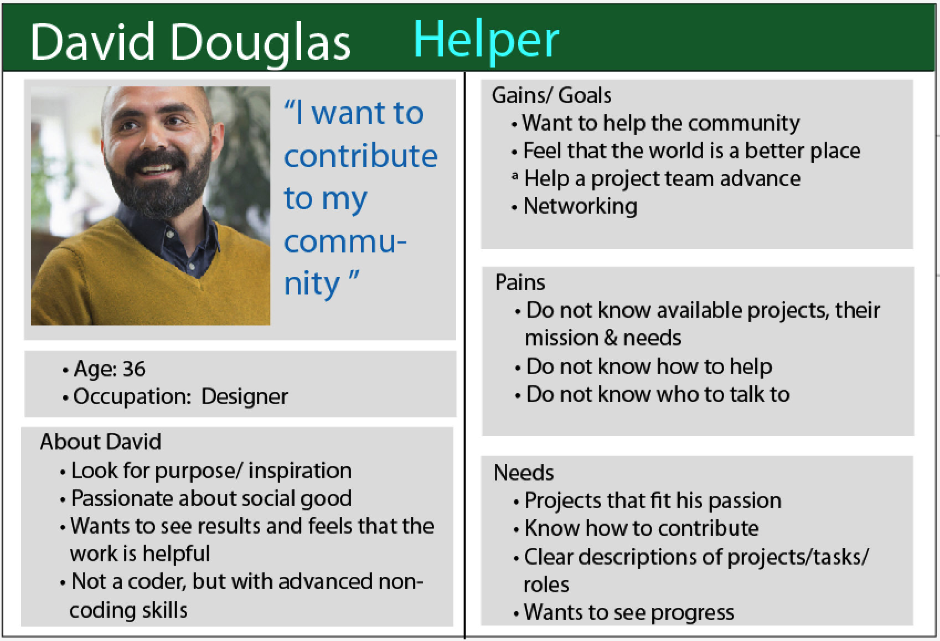

Slide 5
