Slide 1
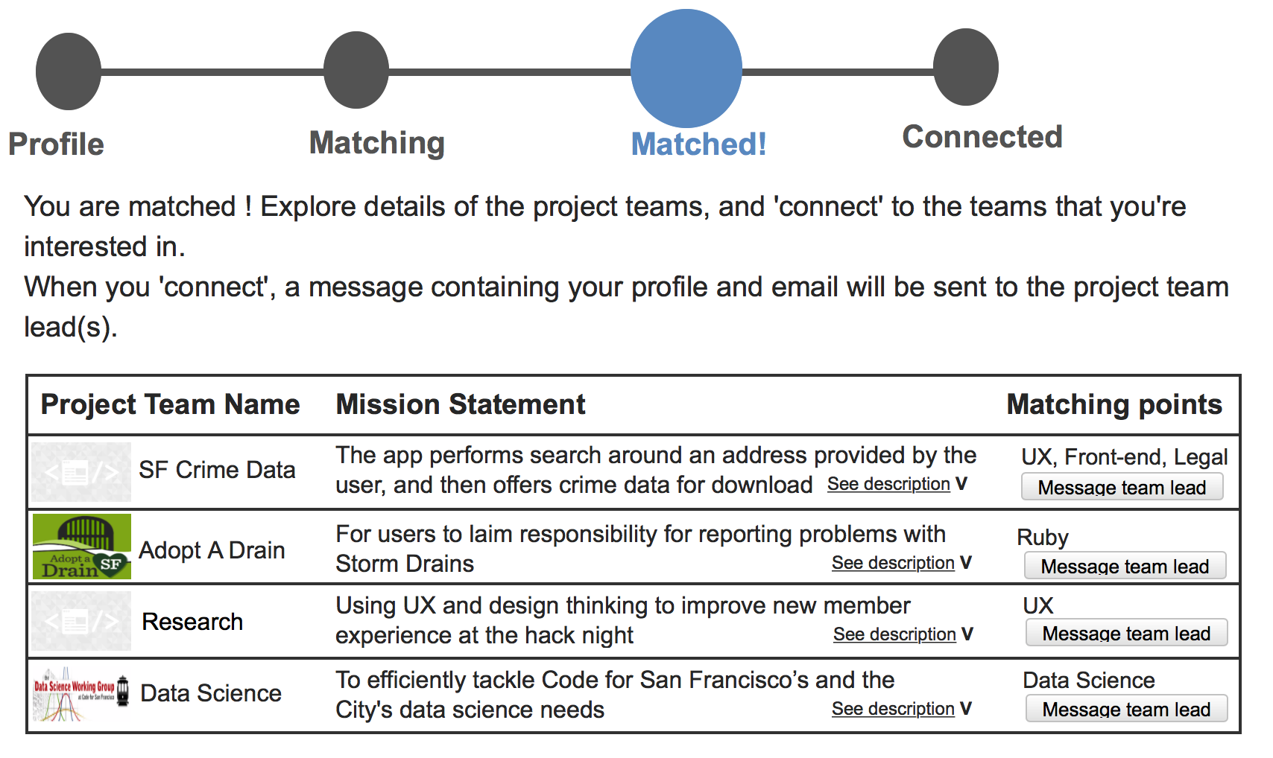

Slide 2
Problems of the current design
“Message the team lead” could be intimidating. “Connect” could be vague.
New members feel like they are ‘passively waiting’, or ‘left in the dark’.
Unknown if the team lead has received the message
Unknown if the team lead will get back to them and how
They want to have a more direct way to reach out
They want to have a record of the matches and the teams they have contacted

Slide 3
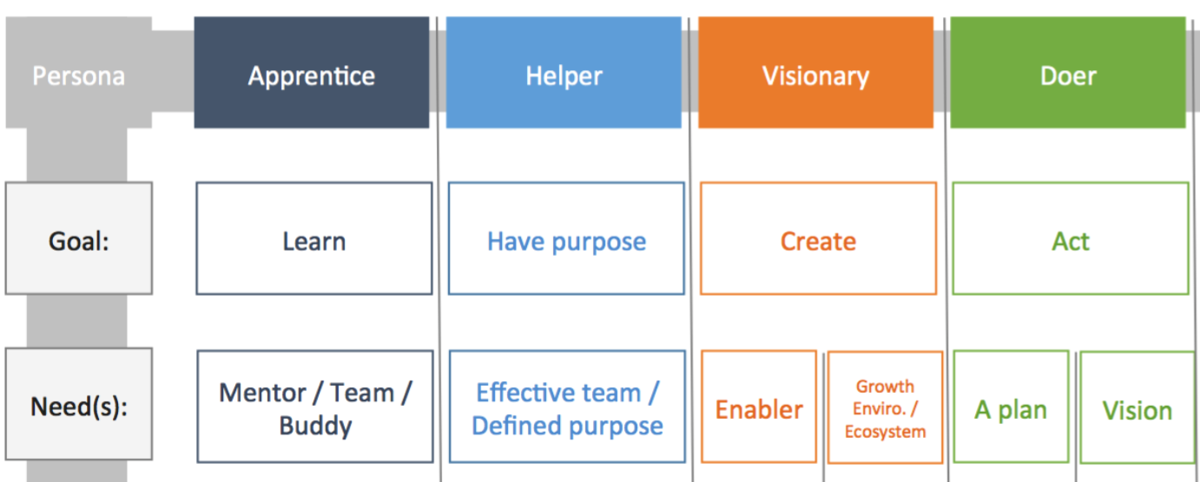
Personas
•Apprentice: improve or learn
•Helper: help the community
•Visionary: solve a specific problem
•Doer: work on existing problems

Slide 4
Pain Points and Needs
Team gallery
Mission statement
Needs/ ways to contribute
Participation level
Frequency of meeting/ working
Learning opportunities
Accept inexperienced members?
Deliverables, progress
Team lead(s)
2. Hard to approach teams
Inexperienced or/and non-coders
Introvert
3. Hard to gain traction or get involved
A lack of communication channels
Matching Hat is the result of all these needs !

Slide 5
Next steps-
Redesign the ‘connect module’
Redesign the ‘project listing module’

