Slide 1
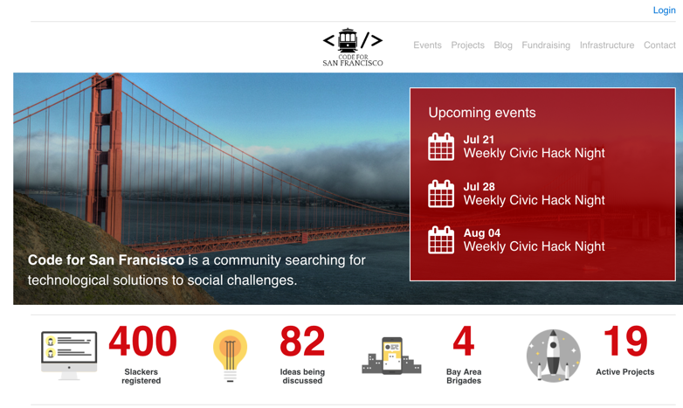
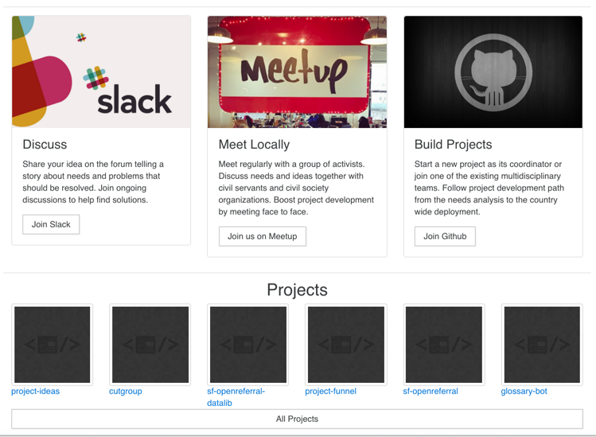
3. Login: unclear meaning
Suggestion: hover-over explanation, an alternative name e.g. ‘github signin’
(rating: 2)
1. Light gray font hard to read. Suggestion: use a darker gray. (rating: 1)
2. The numbers here look ‘clickable’ and catch attention more than the top nav.
Suggestion: make them clickable
(rating: 3)
4. Intro of ‘code for san francisco’ is missing.
Suggestion: add ‘what is code for sf’ before call to actions
(rating: 2)

Slide 2
5. Upcoming events repeat every week, seem redundant. Red color triggers negative feelings.
Suggestions: possibly use this part for ‘what is c4sf’ with wednesday hacknight information. Make an announcement only when there is a special event.
(Rating: 1)
6. Clickability
Suggestions: make them clickable
(rating: 3)
7. Call to actions happen before users have enough info to decide yet.
Suggestions: move them below projects and blogs, or to the side.
(rating: 2)

Slide 3
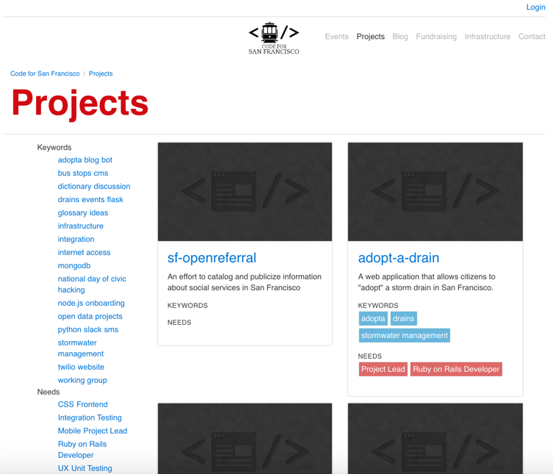
2. Unclear what ‘keywords’ or ‘needs’ mean.
Suggestions: add title ‘refined by’. Use detailed terms (e.g. project keywords and project needs) and add hover over explanation.
Rating: 3
3. Confusing keywords.
Suggestions: use only commonly-known keywords. Categorizing keywords also helps.
Rating: 3
4. Different numbers of keywords per row w/ unclear cutoffs.
Suggestions: keep it one per row, or at least clearly indicate which words belong to the same keyword (e.g. with underline)
Rating: 3
Long project list, unclear which ones are active.
Suggestions: categorize projects (active vs. inactive (Rating: 4)

Slide 4
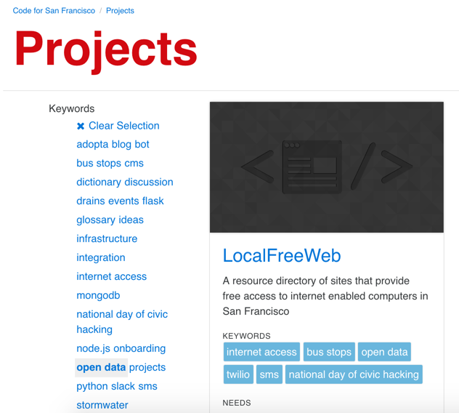
5. Unkown keyword selection vs. project display. (e.g. is LocalFreeWed related to open data? )
Suggestions: add a short description stating ‘x number of projects match keyword y’
Rating: 2
6. Unclear function of clear selection
Suggestions: Clearly tell users that only one keyword can be applied.
Rating: 3
7. Multiple keywords? Keywords + needs?
Suggestions: clearly explain that one keyword or one need per search
Rating: 3
8. Readability: light blue is harder to read
Suggestions: use a darker blue (see amazon)
Rating: 1

Slide 5
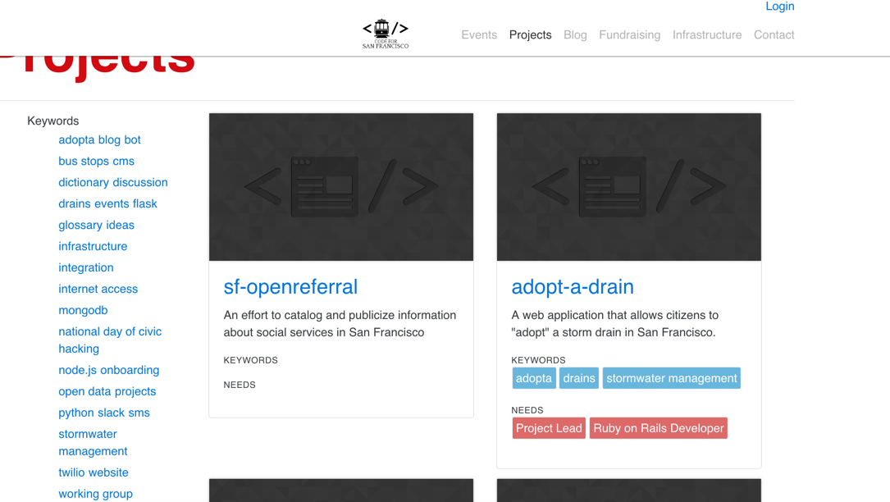
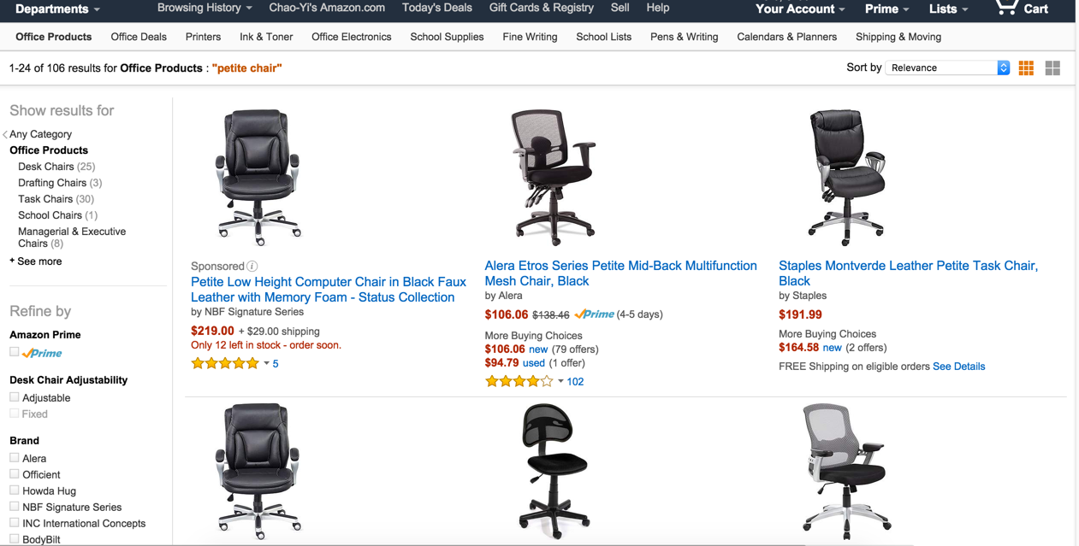
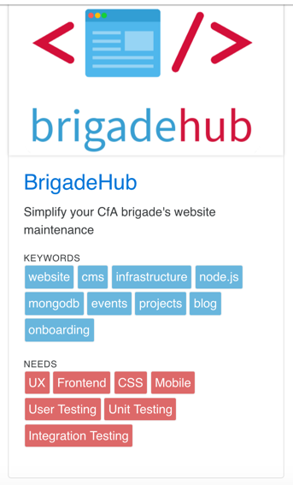
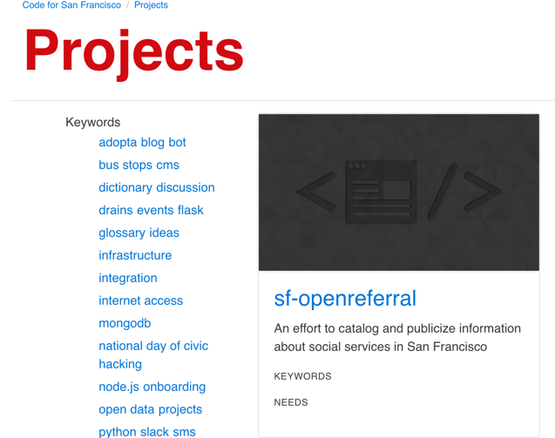
9. Increase scannability
Suggestions: (see amazon for example) smaller images, limit numbers of keywords, better use of space
Rating: 2
10. Limt the number of keywords
Suggestions: limit to 3-5
Rating: 2
11. Add a search bar.
Rating: 4
12. Better navigation
Suggestions: amazon-like filters, categorizing keywords
Rating: 2
13. Add ‘how to start a project’
Rating: 3

Slide 6
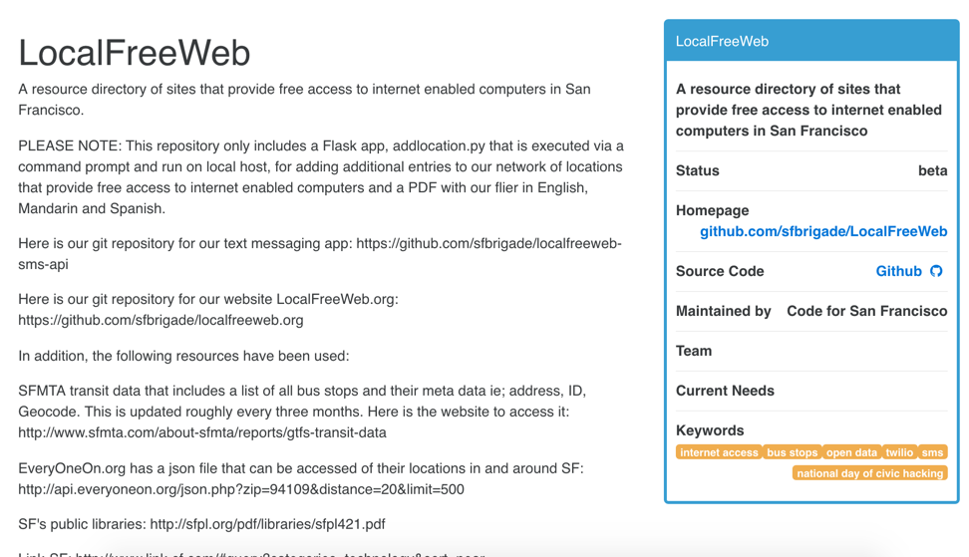
1. Unclear mission statement.
Suggestions: create a section called ‘mission statement’
Rating: 2
Mission
2. No available projects or tasks
Suggestions: create sections for available projects and tasks
Rating: 3
3. In consistent layout among projects
Suggestions: any way to create consistent layout?
Rating: 2
4. No team contact info
Suggestions: Add team contact info
Rating: 2
5. More info, such as (1) status (2) mission (3) contact info (4) tech stacks (5) projects completed/ to-dos (6) team members
Rating: 1

