Slide 1
New member experience project
Methods- Human-centered design approach
Personas
Persona experiences & pain points
Recommendations

Slide 2
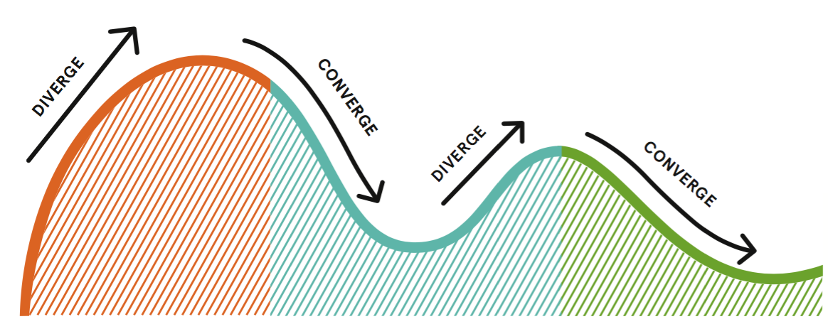
Human- Centered Design
People who face the problem have the key to the solution
Approach:
Notes:
People who face the problem have the key to the solution
Understand the people, come up with innovative solutions that fit people’s needs
Inspiration: problem or opportunity that motivates the search for solutions
Ideation: generate, develop, test ideas
Divergent: stimulating new thinking by exploring and diversifying
Convergent: refining and choosing the best

Slide 3
Methods
Learn about needs
Pain points, beginning to end
Interview
Persona
Journey
map
Pain
Points
Solution
Ideation
Notes:
Interview: Talking with the people we are designing for, goal: to understand their needs and frustrations. To help the group gain insights.
Persona: A way to model and communicate research about target user groups
Goal: to enable the group to empathize and focus on the target groups
Journey Map: a diagram that depicts the experiences new members go through 1st time at c4sf
Goal: for us to improve different touch points of a new member’s journey

Slide 4
Methods
Learn about needs
Pain points, beginning to end
Interview
Persona
Journey
map
Pain
Points
Solutions

Slide 5
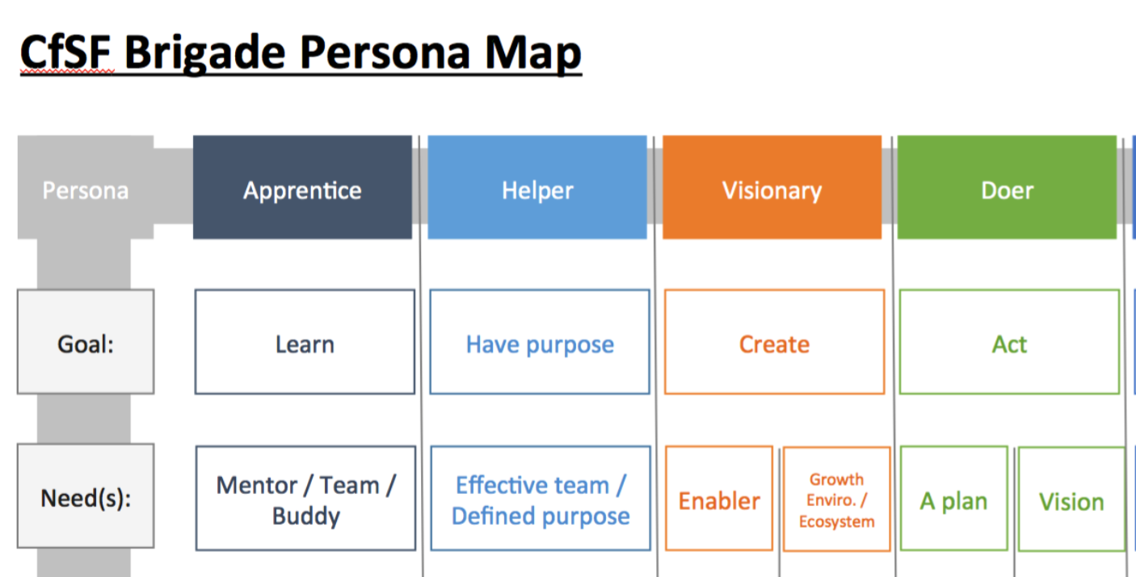
Interviews ->Personas
Apprentice: improve or learn
Helper: help the community
Visionary: solve a specific problem
Doer: work on existing problems

Slide 6
Persona experiences
Journey
map
Pain
Points

Slide 7
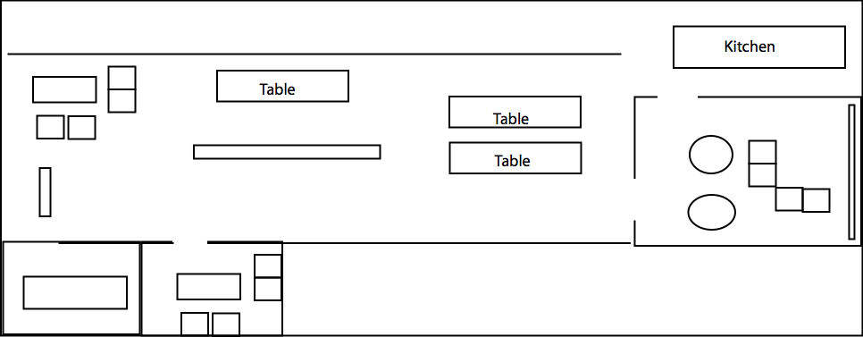
Pain points
Right location?

Slide 8
Pain points
Where is meeting room?
What should I do now?
Who do I talk to?
Do I fit in?

Slide 9
Pain points
Project teams?
Project needs?
Participation level?
Deliverables & Progress?

Slide 10
Pain points
Am I interrupting?
How do I get to know the team?

Slide 11
Pain points (Apprentice)
Apprentice
Accept inexperienced?
Learning opportunities?
Apprentice
Accept inexperienced?
Learning opportunities?

Slide 12
Pain points (Helper)
Helper
How to help & contribute?

Slide 13
Pain points (Doer)
Doers
Available tasks?

Slide 14
Pain points (Visionary)
Visionary
How do I recruit?
Visionary
Appropriate pitch?
How to pitch?

Slide 15
Pain points ->
Converging onto 5 problem domains

Slide 16
3. Team Approaching
4. Learning Opportunities
Am I interrupting?
How to get to know the team?
Apprentice
Accept inexperienced?
Learning opportunities?
5. Team Building
Visionary
How do I recruit?
Visionary
Appropriate pitch? How?
2. Team Details
1. Location & Agenda
Project teams?
Project mission & needs?
Participation level?
Deliverables & Progress?
Right location?
Which direction?
Where is meeting room?
What should I do now?
Who do I talk to?
Do I fit in?
Helper
How to contribute?
Doers
Available tasks?

Slide 17
Five Problem domains ->
ideating solutions & recommendations

Slide 18
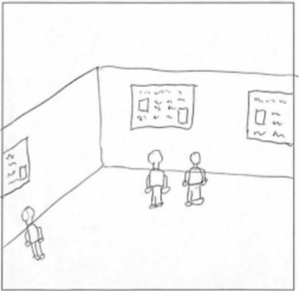
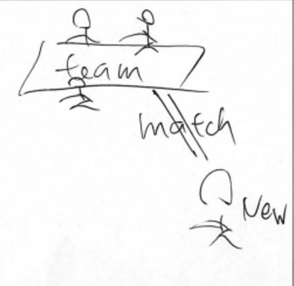
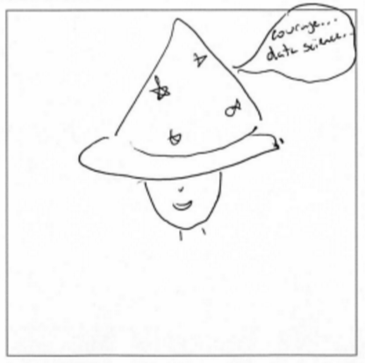
Recommendations- “how might we….”
1. HMW visually describe agenda & location?
Signs, agenda, badge, new member zone, etc
2. HMW provide more team details & connect teams and new members?
Team gallery, matching mechanism,

Slide 19
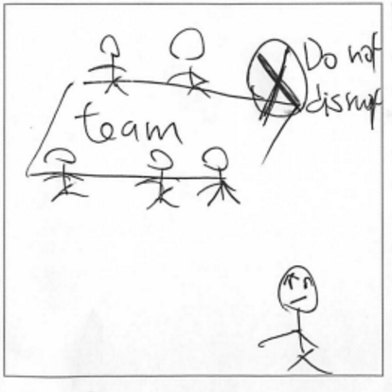
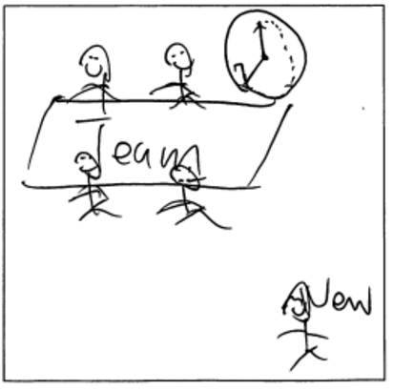
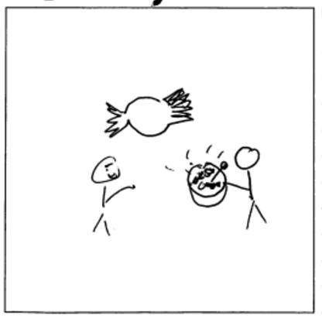
Recommendations- “how might we….”
3. HMW make it easy to approach project teams?
Visual: team greeter badge, no disrupt sign
New member on-boarding
Welcoming atmosphere

Slide 20
Recommendations- “how might we….”
4. HMW create learning opportunities?
Mentorship system
Code- buddy
5. HMW facilitate team building?
More tools (pencils, papers, whiteboards, tables)
Recruitment & matching mechanism

Slide 21
Next steps: prototyping & testing
Better signs (easiest)
large signs that describe hack-night agenda and room/team location
Ambassador program (easiest)
team rep badge & no disturb sign
Team gallery (desirable)
project details & needs
Match-making service (useful)
to connect new members with teams

Slide 22
Acknowledgement
Contributors: Carla, John-Michael, James, Jaoyi, Larry, Jacob, Phoebe, Caitlin, David
Interviewee:
Jesse from Adot-a-Drain, Tom and Aaron from Open Disclosure, Matt from SF in Progress, Jude from Data Science, Joy from San Francisco Government
Thanks to Matt, David, George, Jezmin, Brian, John, Phoebe, and Hailey for sharing their experiences as newcomers at SFBrigade.

