Slide 1
New member experience project
Contributors: Carla, John-Michael, James, Jaoyi, Larry, Jacob, Phoebe, Caitlin, David

Slide 2
What is new member experience project?
Goal: to help improve new member experience at code-for-sf hack night
Approach: user-centered design
- People who face the problem have the key to the
solution

Slide 3
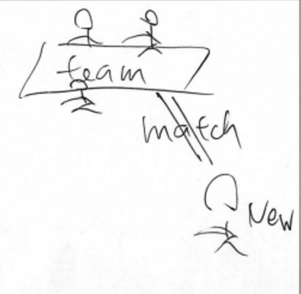
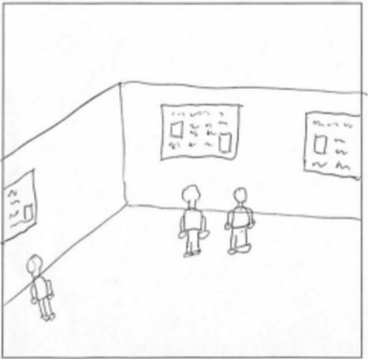
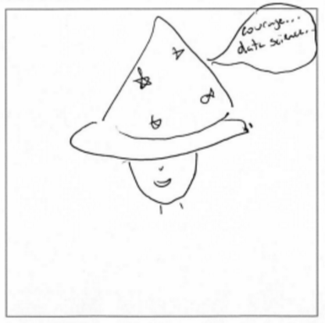
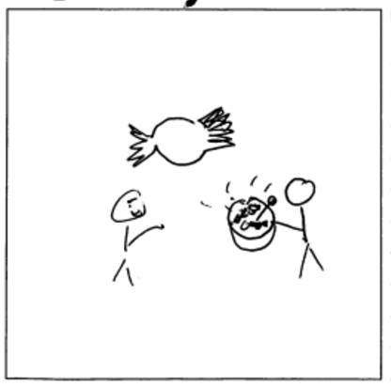
What is the road map of the project?
Interview
Persona
Solution
Ideation
Prototyping
& Testing
Journey
map
Pain Points
Here we are !

Slide 4
What did we find?
Pain Points
Improvement
Opportunities
Solutions

Slide 5
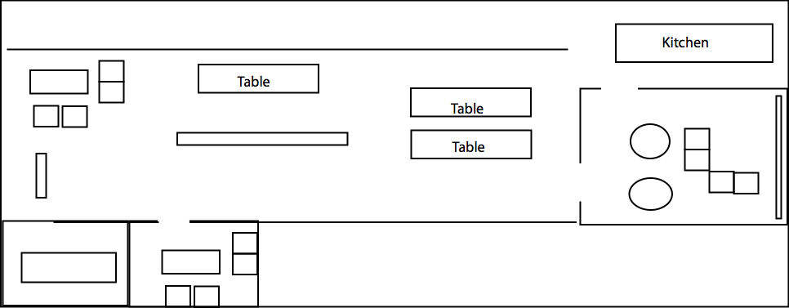
Pain points
Right location?

Slide 6
Pain points
Where is meeting room?
What should I do now?
Who do I talk to?
Do I fit in?

Slide 7
Pain points
Project teams?
Project needs?
Participation level?
Deliverables & Progress?

Slide 8
Pain points
Am I interrupting?
How do I get to know the team?

Slide 9
Improvements & Solutions
Improvement: Easier to approach teams
Solution: ambassador program, etc
Improvement: Better information
Solution: Signage, etc
Improvement: More team details
Solution: team gallery, matching

Slide 10
Next steps: prototyping & testing
Better signs (easiest)
large signs that describe hack-night agenda and room/team location
Ambassador program (easiest)
team rep badge & no disturb sign

Slide 11
Acknowledgement
Jesse from Adot-a-Drain, Tom and Aaron from Open Disclosure, Matt from SF in Progress, Jude from Data Science, Joy from San Francisco Government
Thanks to Matt, David, George, Jezmin, Brian, John, Phoebe, and Hailey for sharing their experiences as newcomers at SFBrigade.

Slide 12
Project team signage
Do-not-disturb-sign
Floor map
Door sign
Agenda
Welcome sign

