Slide 1
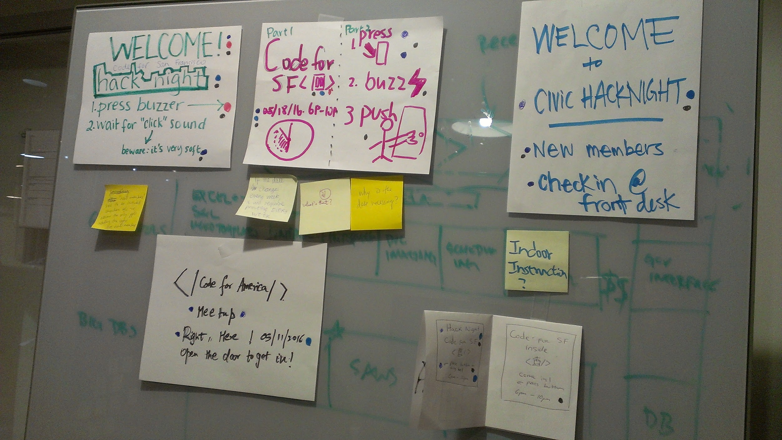
Door sign
Brainstorming summary
Make "meetup names" and "the logo" obvious. Two names i know of are 'Code for SF Civic hack night' and 'Tech for Good'...any other names we use? ( perhaps@jesse would know? ) It would be important to display the names clearly, if only two names, it might be worth trying to display both.
Meetup time is important, possibly also date
BIG arrows clearly showing which button to press on the door
Instruct people to wait for the soft buzz -> then PUSH the door.
'welcome' on top(edited)

Slide 2
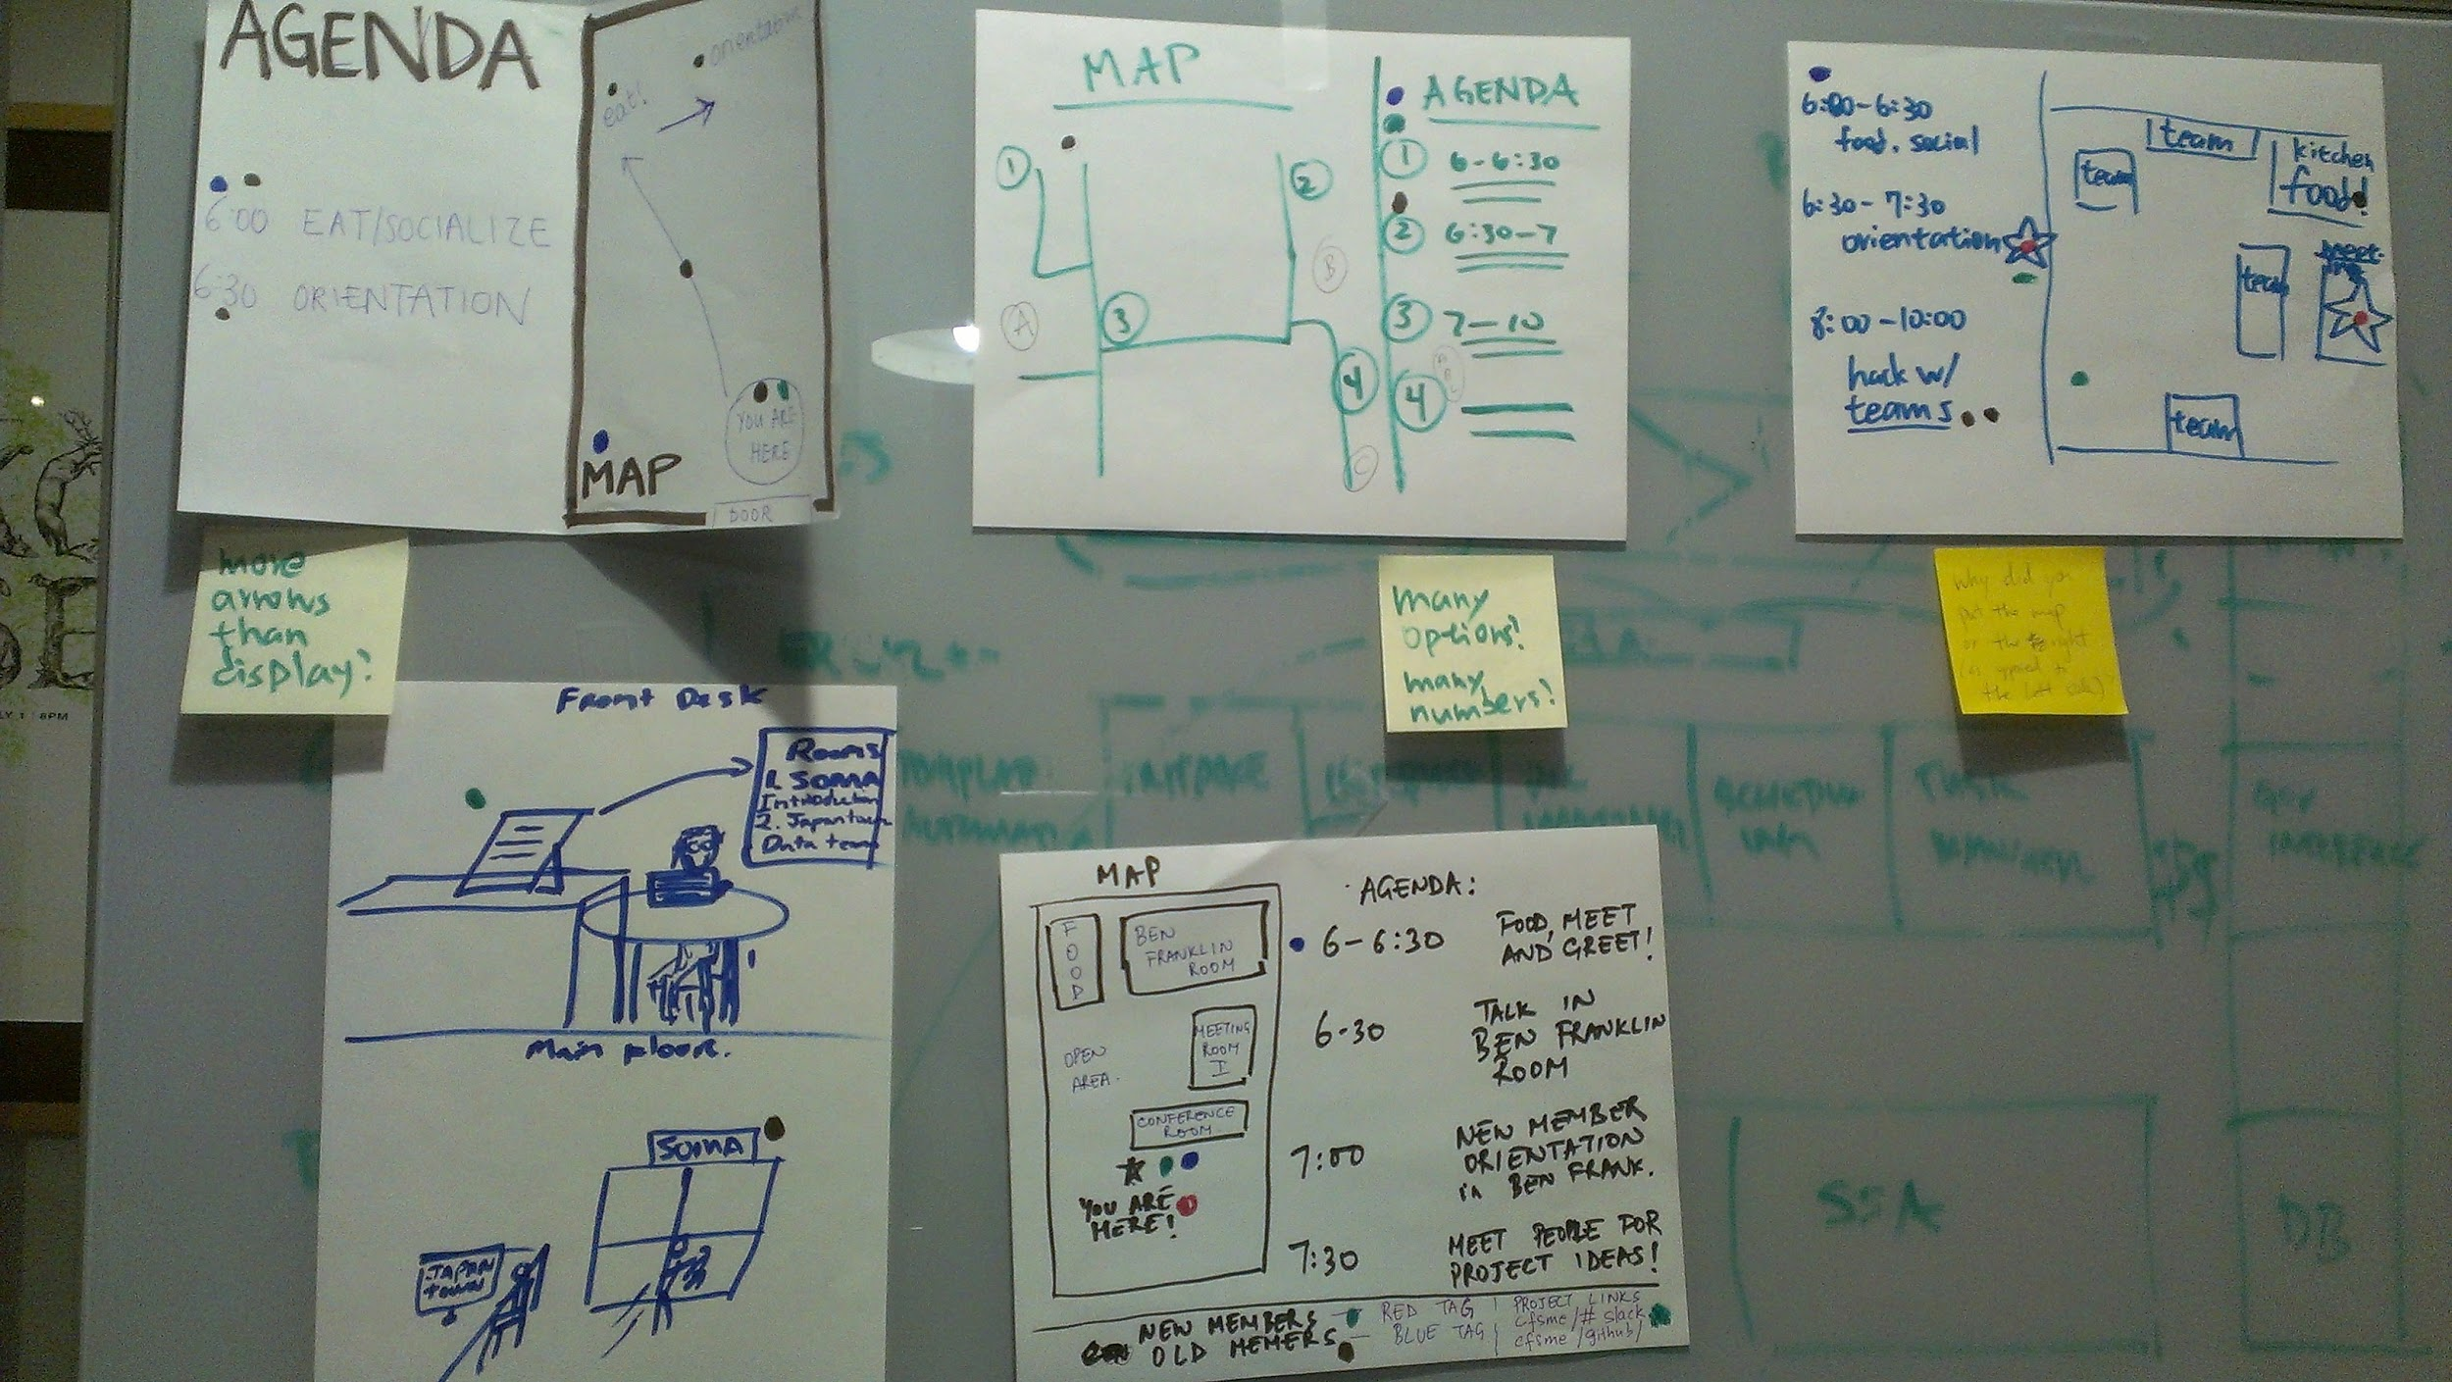
Floor map + agenda sign
Brainstorming summary
Clearly label 'Agenda' and 'Map'
'You are here' on the map
Time table for different events on agenda
'Numbering system' on the map might be better than 'arrow system' or ' text system'...worth experimenting
A sign on the meeting room, corresponding with the name we use for the meeting room on the map (i think just 'meeting room' is good enough for new members)
Links at the bottom. Explanation of different colors of stickers + badges at the bottom. (worth experimenting )(edited)

