Slide 1
Group Wireframing 2016/09/07
Participants: Jaoyi, Kevin Lam,Jeremy Schekett, Tracy Tram

Slide 2
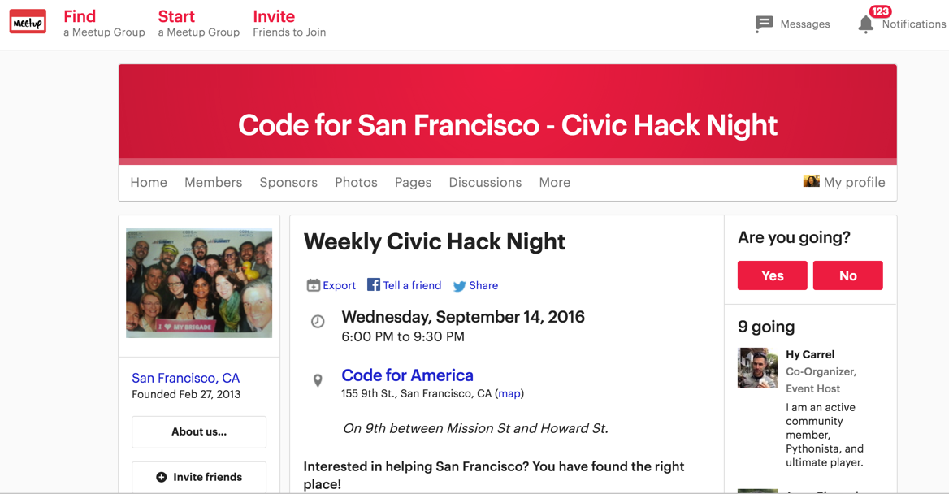
Click to see which project teams match with your interests and skills best ?
Notes:
Meetup- Jaoyi

Slide 3



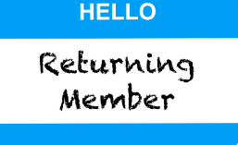
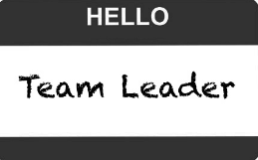
Weekly Civic Hack Night!

Slide 4

Log in/ Sign in
Portfolio
Matching
Matched
Sign in
*Name
*Email
*Password
*required field
Back
Home
Next
Notes:
Log in- Jaoyi

Slide 5
Log in/ Sign in
Portfolio
Matching
Matched
Sign in
* User not found.
*Name
*Email
*Password
*required field
Back
Home
Next
Notes:
Log in User not found- Jaoyi

Slide 6
Login
Portfolio
Matching
Matched!
Name
John Q Public
Email
jqpublic@gmail.com
Interests
Check all that apply….
Skills
Check all that apply….
Goals
Check all that apply….
Back
Home
Next
Notes:
Portfolio_ Jeremy

Slide 7
Login
Portfolio
Matching
Matched!
Goals
Check all that apply….
Your Interests:
Analytics
Software Dev.
Big Data
x
x
x
x
Marketing
x
x
x
Your Skills:
Python
Javascript
Marketing
Your Goals:
x
x
Networking
Build Something Cool
Back
Home
Next

Slide 8

Log in/ Sign in
Portfolio
Matching
Matched
Sit tight! … You are being matched based on your skills...
Fun Fact:
Code for America’s CalFresh app cut the food stamp application process from HOURS to MINUTES.
5,000 More Californians have applied for food stamps thanks to the CalFresh mobile app.
Brigade: Code for America
Site: getcalfresh.org
Back
Home
Next
Notes:
Matching- Fun fact ( Tracy)

Slide 9
Log in/ Sign in
Portfolio
Matching
Matched
Matches
SF Crime Data This application shifts the reporting burdon from police to
Adopt a Drain A web application that allows citizens to adopt a storm drain….
SF Neighborhood Map Universities and colleges have crime reporting requirements…...
Project Description
Project Description
Back
Home
Next
Notes:
Click on project name to get more details

Slide 10
